Slide 1
Minesweeper
Joshua Rand
Kelley Stoll
Michael Santo Jr.

Slide 2
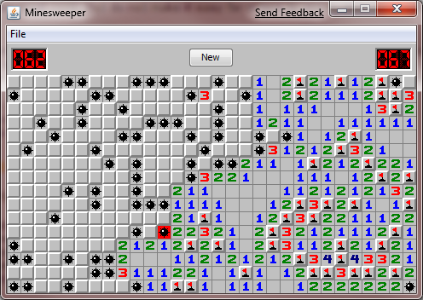
What is Minesweeper?
Logic Game
Number on a space represents the number of mines next to it (1 – 8)
Object of the game
Click all spaces that do not have mines
Score is based on completion time
If you click on a space with a mine, the game is over

Slide 3
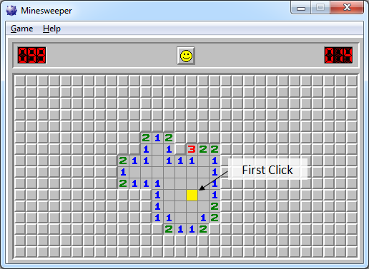
Primary Goals
Construct an algorithm for setting number of bombs around each space
Mine field is generated after the first click
Map randomly generated
First space clicked is never a bomb space
Message box for winning and losing
Draw graphics

Slide 4
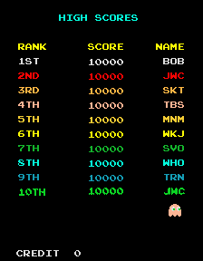

Secondary Goals
Have a high score window after completing the game
Keep track of time
Aesthetically pleasing
Multiple levels
Music
Sound effects

Slide 5


Tools
Microsoft PowerPoint
Microsoft Visual Studio 2013
Adobe Photoshop CS6
Microsoft Paint

Slide 6
Team Roles
Programming manager
Josh
Graphic specialist
Kelley
User Interface
Michael
All collaborative programmers

Slide 7
Schedule/Goals
Week 1 – October 31
Presentation
Week 2 – November 7
Pseudocode, create classes, interface
Week 3 – November 14
Graphics, previous week
Week 4 – November 21
Generate random mine field, numbers correspond with number of adjacent bombs, check for surrounding mines and prevent tiles from being surrounded by mines (if possible)
Week 5 – November 25
Generate random mine field, numbers correspond with number of adjacent bombs, check for surrounding mines and prevent tiles from being surrounded by mines (if possible)
Week 6 – December 5 (Thanksgiving Break)
Win/Lose conditions
Week 7 – December 12
Final debugging/testing

Slide 8

Questions

