Slide 1
Minesweeper
Joshua Rand
Kelley Stoll
Michael Santo Jr.

Slide 2
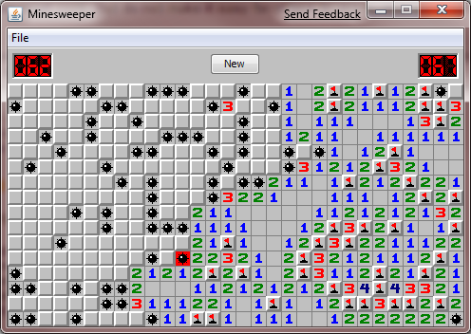
What is Minesweeper?
Logic Game
Number on a space represents the number of mines next to it (1 – 8)
Object of the game
Click all spaces that do not have mines
Score is based on completion time
If you click on a space with a mine, the game is over

Slide 3
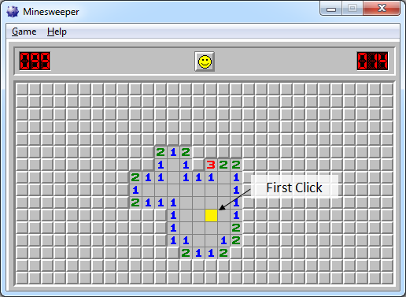
Primary Goals
Construct an algorithm for setting number of bombs around each space
Mine field is generated after the first click
Map randomly generated
First space clicked is never a bomb space
Message box for winning and losing
Draw graphics

Slide 4
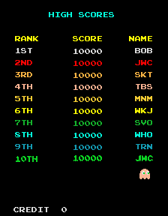

Secondary Goals
Have a high score window after completing the game
Keep track of time
Aesthetically pleasing
Multiple levels
Music
Sound effects

Slide 5
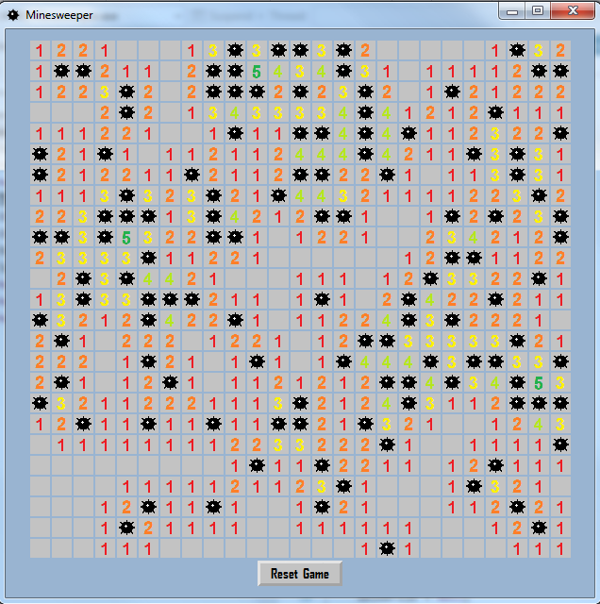
What We Got Done
Construct an algorithm for setting number of bombs around each space
Mine field is generated after the first click
Map randomly generated
First space clicked is never a bomb space
Message box for winning and losing
Draw graphics
Music
Reset Button

Slide 6


Tools
Microsoft PowerPoint
Microsoft Visual Studio 2013
Microsoft Paint
http://www.youtube-mp3.org/

Slide 7
Team Roles
Programming manager
Josh
Graphic specialist
Kelley
User Interface
Michael
All collaborative programmers

Slide 8
Schedule/Goals
Week 1 – October 31
Presentation
Week 2 – November 7
Pseudocode, create classes, interface
Week 3 – November 14
Graphics, previous week
Week 4 – November 21
Generate random mine field, numbers correspond with number of adjacent bombs, check for surrounding mines and prevent tiles from being surrounded by mines (if possible)
Week 5 – November 25
Generate random mine field, numbers correspond with number of adjacent bombs, check for surrounding mines and prevent tiles from being surrounded by mines (if possible)
Week 6 – December 5 (Thanksgiving Break)
Win/Lose conditions
Week 7 – December 12
Final debugging/testing

Slide 9

Questions

