Slide 1
Minesweeper
Josh Rand
Mike Santo Jr.
Kelley Stoll

Slide 2
Where are we now?
Random bomb generator – 120 bombs
Adjacent bombs algorithm
Clickable
Graphics work
Fixed major flickering

Slide 3
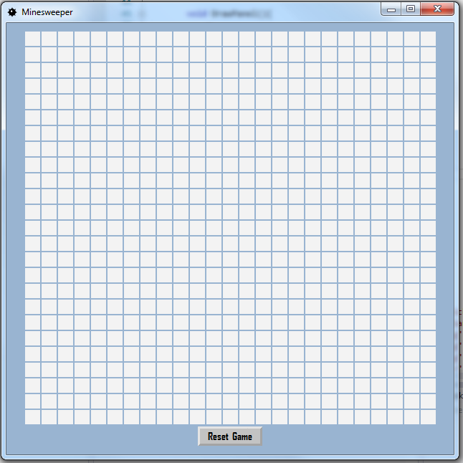
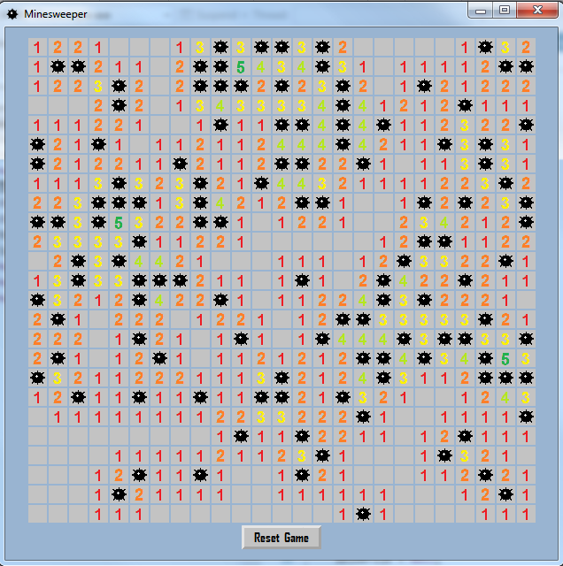
Example

Slide 4
Primary goals
Win/Lose conditions
First click conditions
Flags work

Slide 5
Secondary goals
Time tracker
Aesthetically pleasing

Slide 6
Schedule
Week of 12/1
Win/Lose conditions
First click conditions
Week of 12/8
Testing

Slide 7

Questions?

