Slide 1


Leaf Classifier Showdown!!!
John Randis

Slide 2

The Problem:
Scan a random forest and identify the individual leaf species

Slide 3



The Data:
1584 leaf images
990 for training
594 for testing
Acer Opalis
Quercus Ruba
Liriodendron Tulipifera

Slide 4
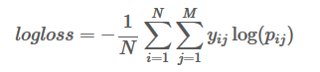
In The Red Corner:
KNeighbors Classifier
In The Blue Corner:
Logistic Regression
The logarithm of the likelihood function for a Bernoulli random distribution.

Slide 5
KNeighbors
Let’s look at the code!
Logarithmic Loss:
.10093
???

Slide 6
Logistic Regression
Let’s look at the code!
Logarithmic Loss:
.03806
???

Slide 7

Winner:
Logistic Regression
https://www.kaggle.com/c/leaf-classification/submissions

