Slide 1
Backup, Replication and Restoration for Agena’s workload
Jyoti Ranjan (Expert Technologist)
27-August-2019

Slide 2
Agenda
Integration with Agena cloud
Scope
Logical architecture
Use cases
Recommendation
Assumption
Evaluation of Veeam
About backup solution
Next steps
Summary
Pros and Cons
Deployment steps

Slide 3
About
To provide complete data protection solution, it requires comprehensive understanding and design thinking on data protection mechanism before concluding any backup, DR or data management solution. The backup, restore and replication is only one aspect of data protection system. The presentation focus only on backup aspects unless stated explicitly otherwise.
The backup solution is highly influenced by customer's source infrastructure and backup requirements to be achieved. The following points greatly influence the design:
Data protection strategy.
Capacity, consumption and design of source infrastructure to be backed up.
Backup and restoration goals.

Slide 4
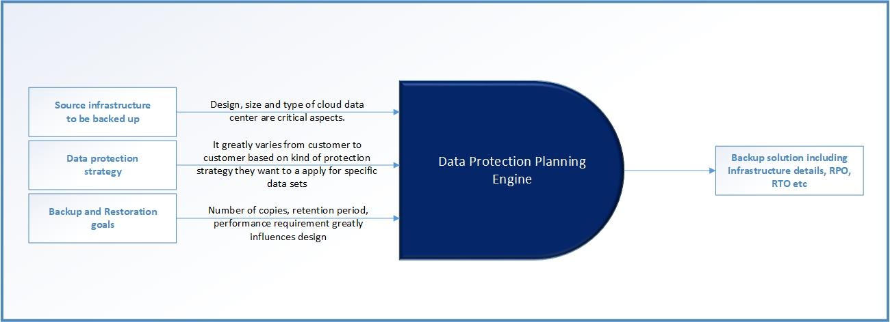
Data protection planning

Slide 5
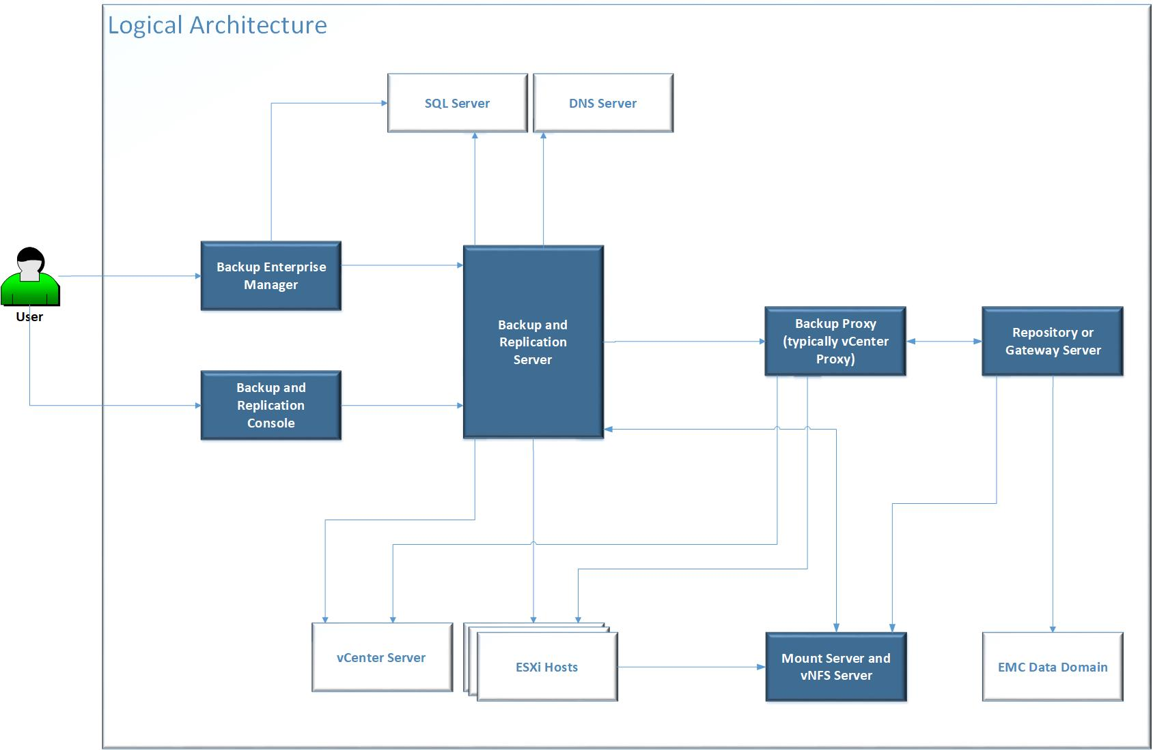
Logical architecture

Slide 6
Use cases (1/2)
VM use cases
Full VM recovery
Recover entire VM to the Original or Different host
Instant VM recovery
Quickly restore to user by starting a VM directly from a backup file on regular backup storage
VM file and virtual disk recovery
Recover individual VM files (such as VMX) and virtual disks (vhd, vhdx or vmdk)
Restore to cloud
File level recovery:
Recovery files from 19 common file systems used by Windows, Linux, Unix, MacOS, Novell, Solaris
Application aware backup (for specific enterprise application)
Microsoft Active Directory, Microsoft Exchange, Microsoft SQL, Microsoft SharePoint
Oracle

Slide 7
Use cases (2/2)
Replication
Image based replication
Replicate image
Use case: high availability or off-site for disaster recovery
Failover and failback
Move production site to disaster recovery site
Mostly used for DR testing
Replication from a backup: Create backup from repositories without affecting workload
Planned failover: Facilitate data-center migration with zero-data loss
1-click failover orchestration
Built-in WAN acceleration
Get replicas offsite up to 50x faster and save bandwidth
Enterprise edition supports built-in WAN acceleration to Veeam Cloud Connect targets only
Enterprise plus edition supports built-in WAN acceleration to any target
Search and restore: User should be able to perform advanced search and restore

Slide 8
Pros and Cons
Pros | Intuitive and self-service portal Rich feature set Very good integration with ESXi and HyperV Supports public cloud integration Good supportability for HPE Storage System like HPE Store Once, HPE Nimble.
Cons | Does not support KVM virtual infrastructure Scale and performance can be eyebrow raising if system has greater than 2000 VMs (to be discovered more) Data optimization during backup and restoration is average. I feel that HPE SimpliVity can lead here significantly.

Slide 9
Scope
What is not in scope?
No complete data protection strategy.
No DR plan.
What is in scope?
Understand backup and restoration solution provided by Veeam
Defining backup and restoration solution for Agena cloud using Veeam
As there is NO customer specific details are available, some assumptions have been made on various aspects. Those assumption greatly influence the architecture, design and configuration of backup and restoration solution. See below.
Focus on following tenets (implicitly if not stated explicitly):
Robustness of backup infrastructure to avoid losing data in case of failure
Scalable along with source infrastructure
Adherence to 3-2-1 rule (if applicable)
Minimal impact on user workload during backup and restore operation.
Low RPO and RTO time
Designed to strive for low cost

Slide 10
Assumption (of backup requirement)
Source infrastructure | Hypervisor = ESXi Maximum number of ESXi hosts = 24 Maximum number of VMs = 2000 Storage media used for VM = Nimble Maximum amount of raw storage = 100 TB
Backup infrastructure | Use Veeam product suite for backup solution Backup storage media = Nimble
Backup and restoration goals | Retention period = 7 days Number of backups per VM = 3 Incremental backup will be taken instead of full backup always to save space Focus is on better performance of restoration than backup. No strict compliance to 3-2-1 rule

Slide 11
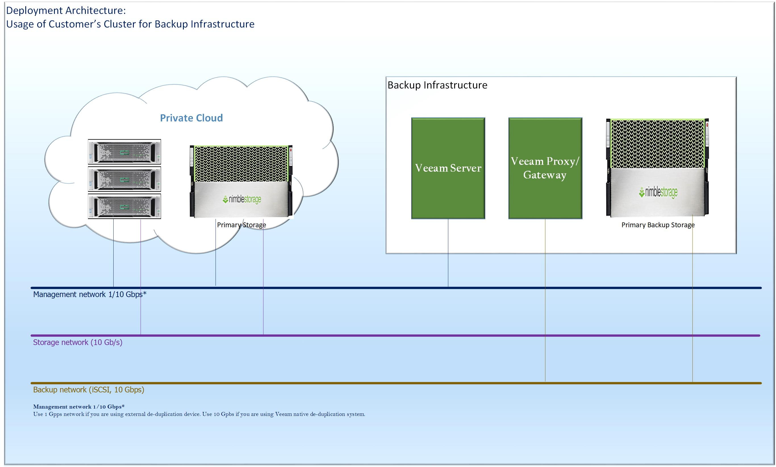
Integration of Veeam with Agena’s cloud

Slide 12
Integration steps
Prepare
Integration with Veam
Create job

Slide 13
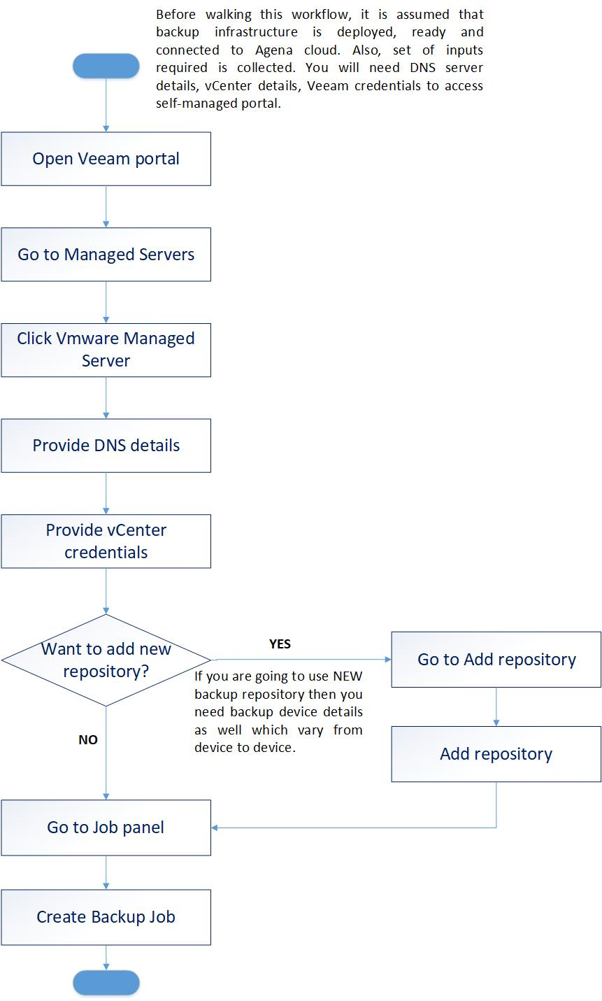
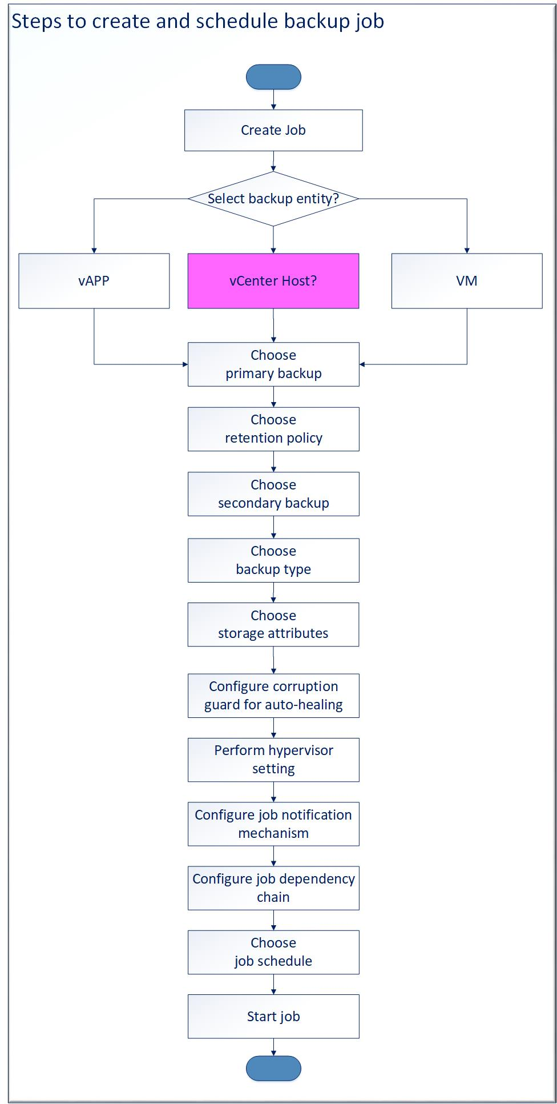
Integration steps

Slide 14
Recommendation
General recommendation
Define your data protection strategy
Category workloads in the terms of medium, high and critical workload
Try to adhere to 3-2-1 rule
Recommendation for Backup infrastructure
Do not deploy backup infrastructure in source cloud infrastructure being backed up
Deploy multiple Backup and Replication server if numbers of VMs are greater than 500
Use independent instance of Microsoft SQL Server
Use Nimble as primary backup storage. It will help to meet better RTO.
[Optional] For critical workload, use primary secondary storage of lower cost.
Backup job configuration
Number of backups
Retention period of 10 days
Choose your backup strategy. It is recommended to go for 'Forever Forward Incremental Backup'
Configure Job backup with following attributes:
[Optional] For backup of secondary backup, use backup copy job in the chain of backup operation.

Slide 15
Next steps (a proposal)
As per author, the story US421 is necessary for but not sufficient for covering all aspects of providing advisory document for GLHC customer for backup and restoration process. There are other activities like PoC, scale and sizing, integration with public cloud (if desired) etc needs to be covered. Effectively, these can be translated into user stories for further work on it if we intend to provide refined document to customer. At this point of time, the following activities have been done:
Evaluation of Veeam product suite
Feature
Logical architecture
Deployment architecture
Define backup and replication architecture for Agena Cloud
Document procedure to integrate Veeam with GLHC
It will be good to carry out more steps like PoC, Detailing scale and sizing aspect, Integration with HPE de-duplication solution HPE StoreOnce, Integration with public cloud (if desired) etc.

Slide 16
Thank You

