Slide 1
Block Storage Evaluation Report for Agena’s VMaaS
Jyoti Ranjan (Expert Technologist)
12 July, 2019

Slide 2
Agenda
Requirements
Evaluation report
Methodology
Recommendation
Recommendation and future guideline
Result
Common observation
Overview
Requirement
Candidates
Feature or parameters

Slide 3
Overview
GreenLake Hybrid Cloud (GLHC) cloud platform is a flagship cloud solution provided by HPE. One of the critical aspect to identify block storage requirement for Agena’s VMaaS platform. The chosen storage system should be able to serve robustness, simplicity, scalability and pay-as-you go model which is fundamental tenets of cloud. It is good to have common storage system for different hypervisor as well as containers if fits well. Otherwise, the focus should be for ESXi based cloud which is going to be first cookie cutter for the customer.
Note:
One of the DESIRED intent of evaluation was to find a common storage system for all environment varying in terms of hypervisor as well as virtualization technology. But, it is not optimal to do so because of varying architectures and other aspects. As greenfield ESXi based VMaaS is first cookie cutter for our customer, the focus is to find best fit storage system for that instead of looking for desired need mentioned above but keeping need of compute and storage to scale in tandem. The supportability of storage system for other use cases mentioned below needs to be looked independently.
Block storage for (Green Lake Cloud Gateway) GLCG
Backup storage system for GLCG
Block storage system for VMaaS platform based on KVM and HyperV
Backup storage system for VMaaS platform
Block storage system for container
Based on experience and available information, the choices can be:
Usage of HPE SimpliVity for HyperV
Usage of PortWorx or Ceph for Container
Usage of HPE Nimble for public cloud portability because of its cloud volume feature set.
Usage of HPE Nimble or HPE Primera or EMC Unity if customer already has storage system as many data center is likely to have.
The above opinion needs to be thoroughly investigated not only on the technical parameter but on other parameters as well like promoting HPE products, supporting more than one storage system as customer might already have many HPE devices but with explicit declaration of reasoning behind it

Slide 4
Requirement
ID | Requirement | Description | Author’s view
1 | Ability to support multiple supervisory | Leverage same storage system for other hypervisor (e.g. KVM, Hyperv) as and when we support it. | Yes, it will be ideal to have same solution for all hyper-visors (e.g. ESXi, KVM, HyperV) but ESXi falls in different bucket because of it's overlay strategy of creating VMFS over native volume presented to ESXi host. The overlay results in dilution of storage capabilities provided by storage system if data stores are not designed properly. In a nutshell, the strategy adopted for ESXi does not fit to other hypervisors (KVM and HyperV) as it is.
2 | Performance requirement | Ability to support differentiate storage offering in terms of feature and IOPS. | Ability to support differentiate storage offering.
3 | iSCSI support | Instances should be able to connect to volume using iSCSI protocol. | Every volume is presented to ESXi instance as SCSI (not iSCSI) unlike KVM or HyperV. In a nutshell, the focus of proposal is on presenting volumes to instances not to hosts. So, iSCSI support in case of ESXi instances is not a true requirement.
4 | Support of enterprise feature | Need supportability of features like replication, de-duplication, compression etc. | In case of ESXi, the ability to present differentiated storage requires careful and thoughtful design of datastore.
5 | Ability to Scale | Ability to scale horizontally, vertically or segmented. | As we know that hypervisor cluster is more towards horizontal and segmented scaling even if storage system offers one or any combination of horizontal, segmented and vertical scaling. The proposal keeps this aspect in mind as it is not wise to see storage scaling separate from hypervisor cluster in most (if not all) cases.

Slide 5
Common observation
Desire to have a same storage system for all use cases is no closer to reality.
Usage of same storage system for all hypervisors might result in compromised storage offering for ESXi hypervisor.
Scalability of storage system along with compute is as important as storage features.
Overlay of VMFS and the concept of datastore warrants design of storage system for ESXi differently than other hypervisors like KVM, HyperV.
Selection of particular storage system greatly influence the realization of advanced features like Remote backup, Disaster recovery.

Slide 6
Evaluated candidates
Vmware VSAN
HPE SimpliVity 380
HPE Nimble
HPE Primera

Slide 7
Evaluated features
Hardware requirement
Specific host hardware requirement
Network requirement
Disk storage requirement
Models
Is hyper-converged storage system?
Hyper-visor supportability
iSCSI supportability to instances
iSCSI supportability to hypervisor host
Maximum raw storage capacity
Maximum usable storage capacity
Maximum effective storage capacity (varies with environment)
Fault tolerance
Availability
Thin provisioning
De-duplication
Compression
Granular control on IOPS for instances to leverage pay based on the quality
Scalability
Ability to work in federated mode
Backup of volume presented to instance
Native application consistency backup
Snapshot of volume presented to instance
Clone of volume presented to instance
Backup of disk volume presented to hypervisor host
Snapshot of disk volume presented to hypervisor host
Clone of disk volume presented to hypervisor host
Ability to support differentiated storage based on volume types
Disaster recovery
Manageability
Maintainability / Operation cost
Telemetry
OpenStack compatibility
Public cloud compatibility

Slide 8
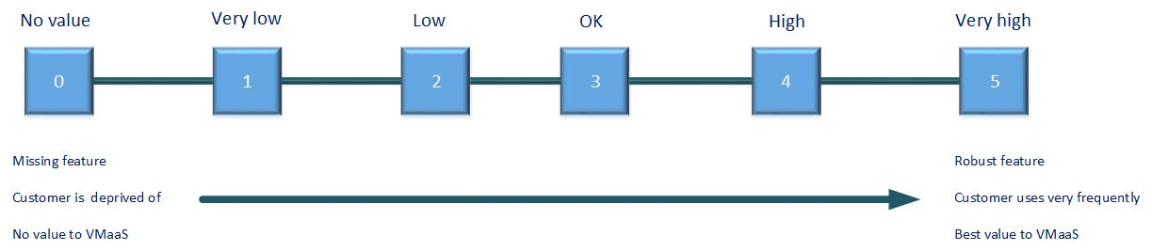
Evaluation mechanism

Slide 9
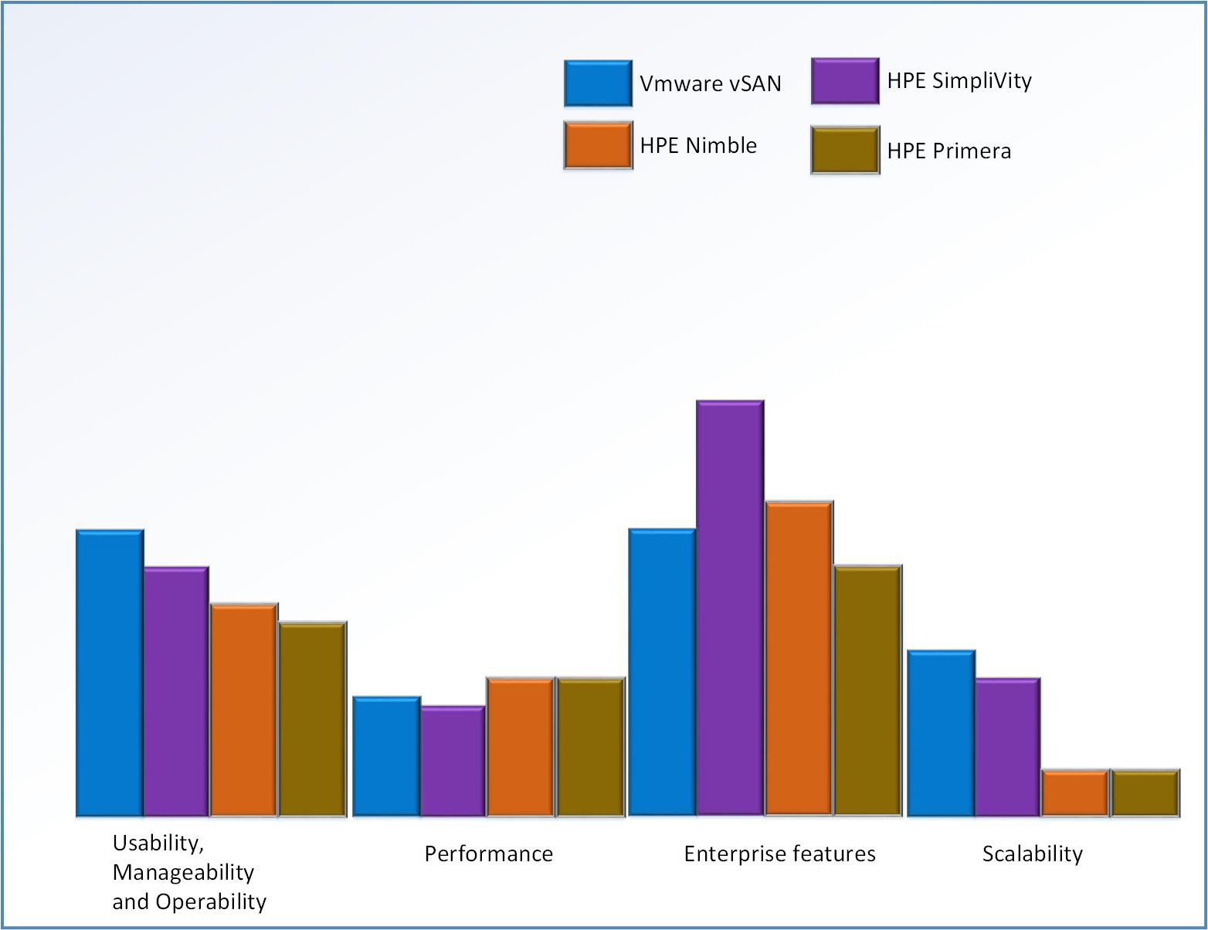
Evaluation report

Slide 10
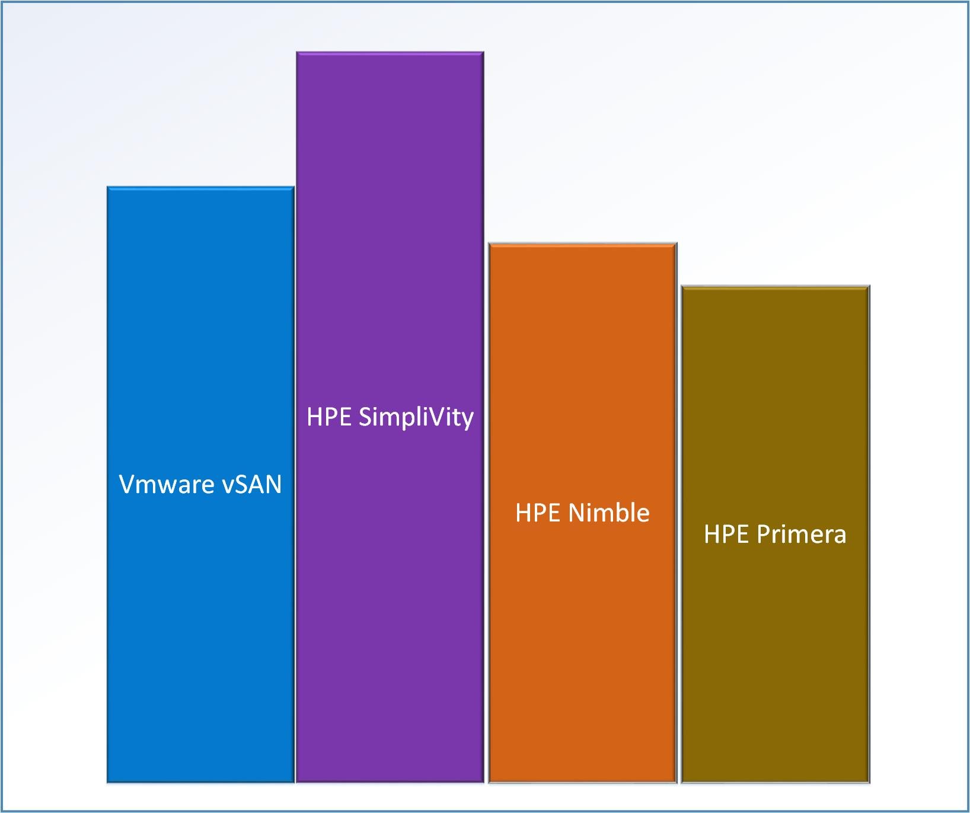
Evaluation report (1/2)

Slide 11
Recommendation
The recommendation is to use HPE SimpliVity as block storage system for Agena's VMaaS solution based on ESXi hypervisor. It wins by a significant margin because of its rich data feature set which is VM centric instead of volume centric, a very critical aspect to be considered when offering VM vending in cloud way. If we ignore that edge of HPE SimpliVity then VMware vSAN fits best bill of using HPE Compute and storage in tandem because of its best fitment with Apollo 4200.
See wiki page for more detail.

Slide 12
Thank You

