Slide 1

Driver Performance Visualization Project
Joey Ashcroft
UCSD Data Science and Visualization

Slide 2
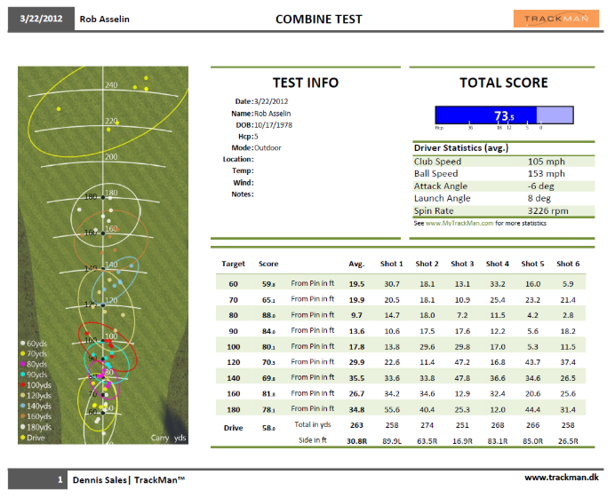
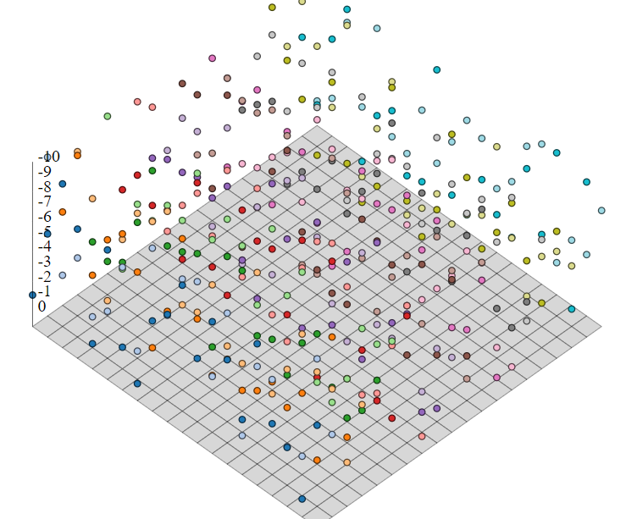
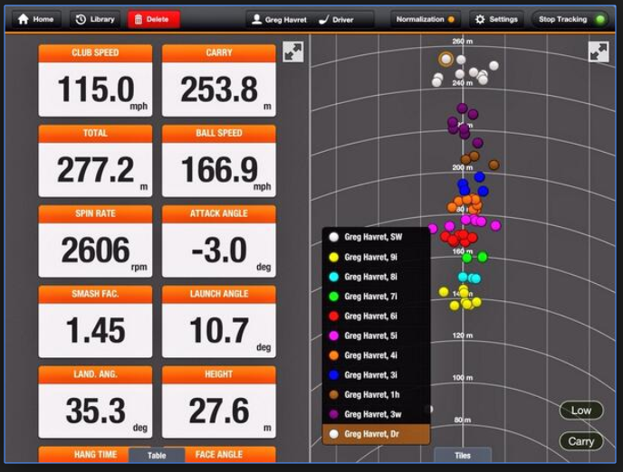
Purpose of Project:
Build a visualization allowing the user to explore golf performance on the PGA tour in many aspects:
→Time/Distance/Accuracy/Player Data/Swing Viz
Inspirational Visualizations:

Slide 3
Procedures:
Build web scraping tool
Scrape PGA tour/Titleist website and push data to MongoDB
Create Flask App to query the data
Format and clean the data in JavaScript
Using D3 and CrossFilter js libraries, build visualization page
Display visualizations with bootstrap/HTML/CSS

Slide 4
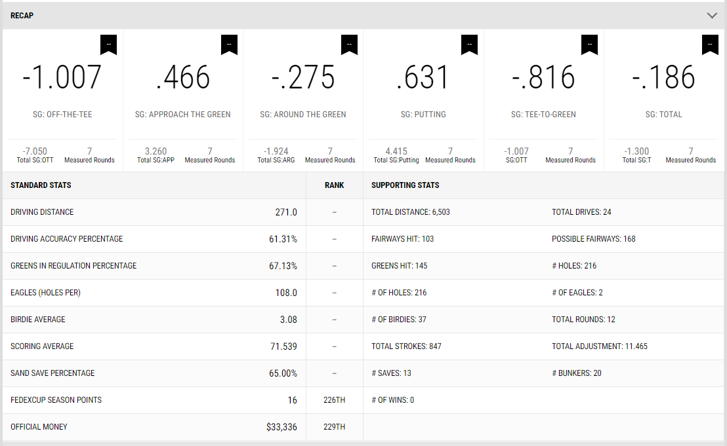
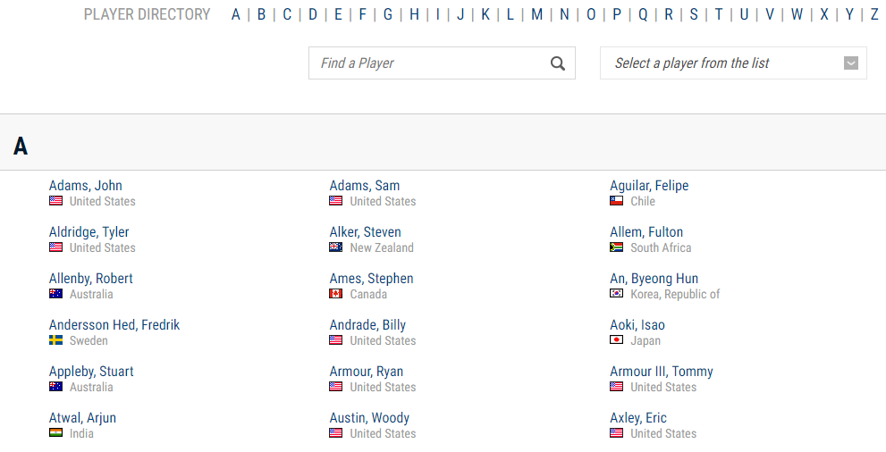
Data Acquisition:
The PGA tour has posted statistics on professional golfers for over 40 years
There are hundreds of categories relating to all aspects of golf for each player
Used splinter to iterate through over 806 players and grab data of interest
https://www.pgatour.com/players.html
https://www.titleist.com/tour/pga

Slide 5
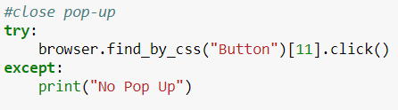
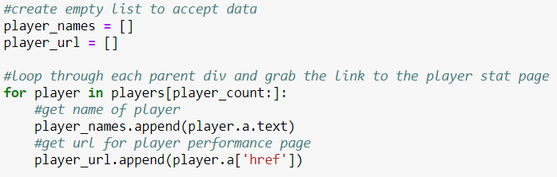
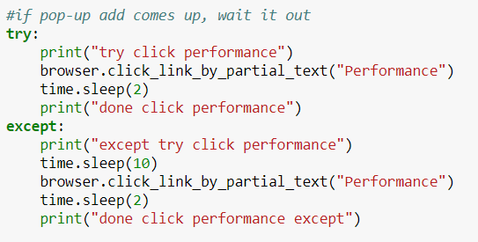
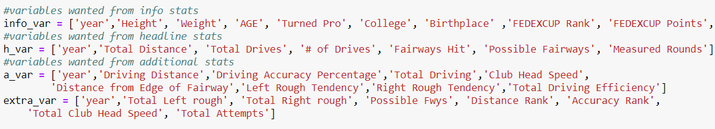
Coding Approach:
2 Different Types of Random Pop-ups
1.) one pop up can be closed by button
2.) Second pop-up must be waited out
Python/Pandas/Splinter/Beautiful Soup
Iterate splinter through all 806 players
Because so many variables are taken from each page (806 players each with on average about 10 years of data) the page will often time out and refuse requests. Because of this, “time.sleep” commands were used often (8 hours to scrape all data)

Slide 6
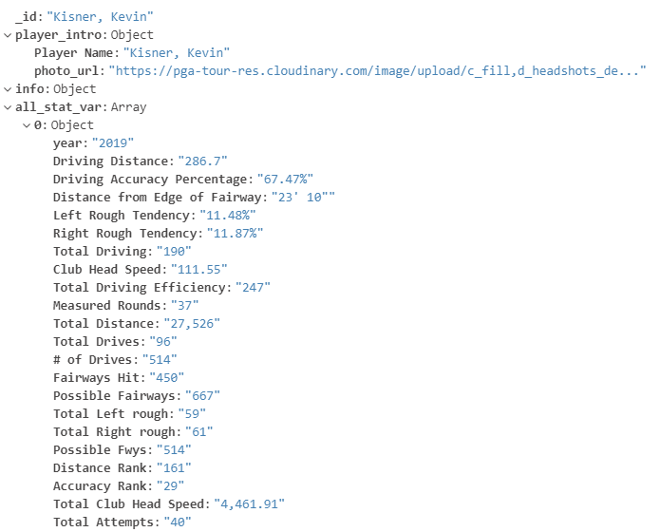
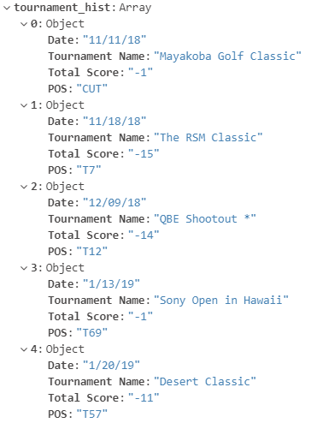
Data Summary:
Each instance stored in MongoDB represents data for 1 player
For each player there are various categories of data stored
Player Intro: Name/Photo
Info: Supplemental Facts such as hometown, height, weight, age, etc
Performance Statistics: Golf Stats
Tournament History: Most recent tournament scores and position
Variables taken for all years player played on tour

Slide 7
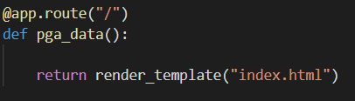
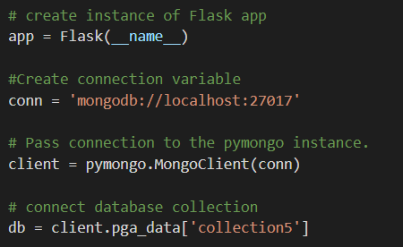
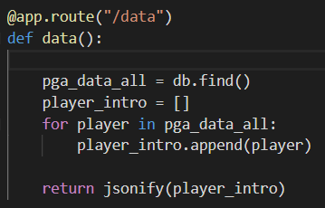
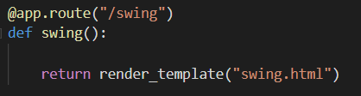
Data Import:
Flask/PyMongo
Python Flask App will collect data from MongoDB and render 2 HTML templates
1.) JSONIFY MongoDB data to be formatted and appended to page via JavaScript
2.) Renders 2 routes to HTML static pages which will be linked to each other
Main page to visualize the scraped data through js CrossFilter library
Supplemental page to create custom D3 interactive swing visualization
Route to render main HTML page
Code Approach:
Call database collection using PyMongo
Route to access data in JavaScript file
Route to render main D3 viz page

Slide 8
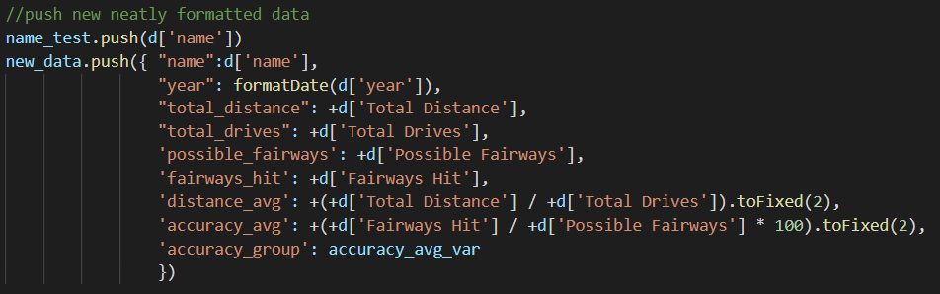
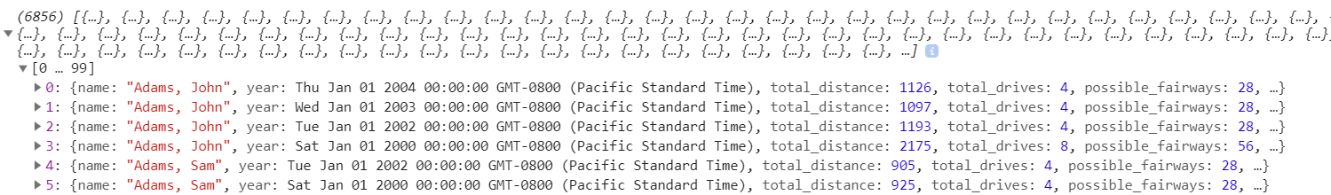
Data Cleaning/Formatting
Because technology has improved over time, the data collected for each player/year varies
Some players have over 20 stats collected which vary year to year, and some none
Because of this, the data needed to be cleaned and filtered for the most common variables
A new object was created for each player consisting of Distance/Accuracy variables only

Slide 9
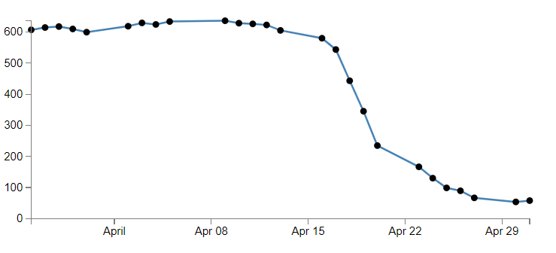
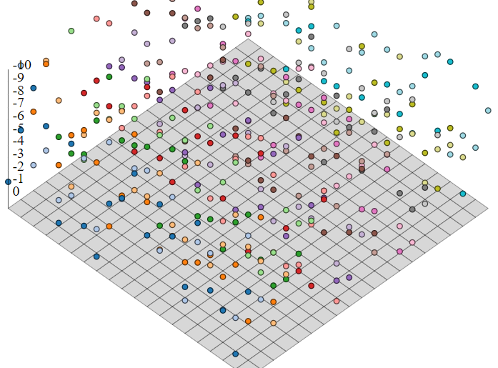
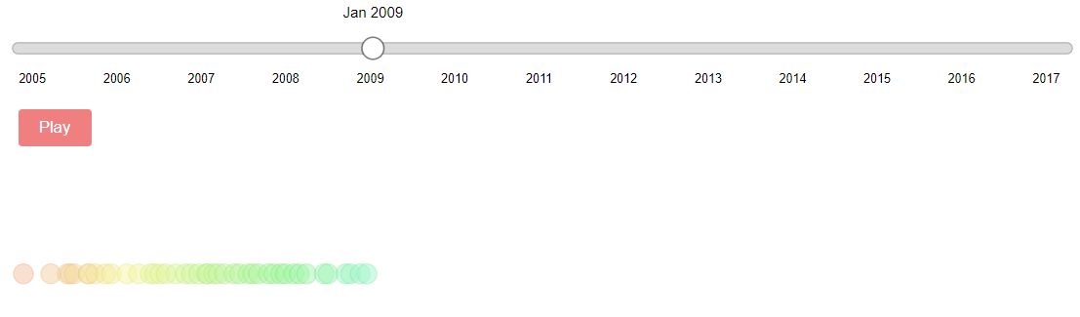
Quick D3 Viz Summary:
Use x/y/z Position data to build an actual 3d interactive golf swing visualization
D3 Features:
Slider Bars: Basic/Range types
3D Scatter plot functions
3D Lines
Inspirational Visuals/code snippets:
D3 Line scatterplot
3D Scatter Plot
Slider Bar Scatter Plot

Slide 10
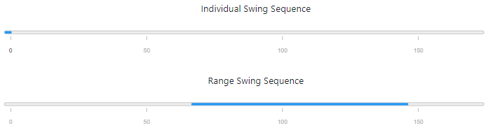
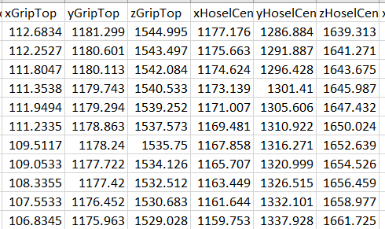
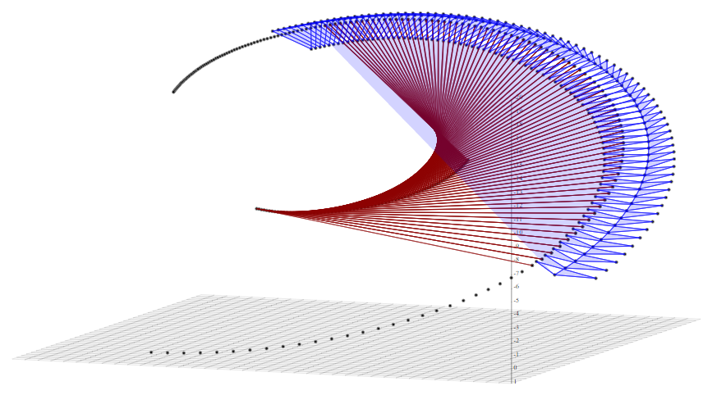
D3 Swing Visualization:
Interactive Swing to visualize how the club is presented throughout the swing
Data collected by me of my own swing
Data:
XYZ Position Data of certain points on the golf club

Slide 11
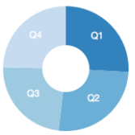
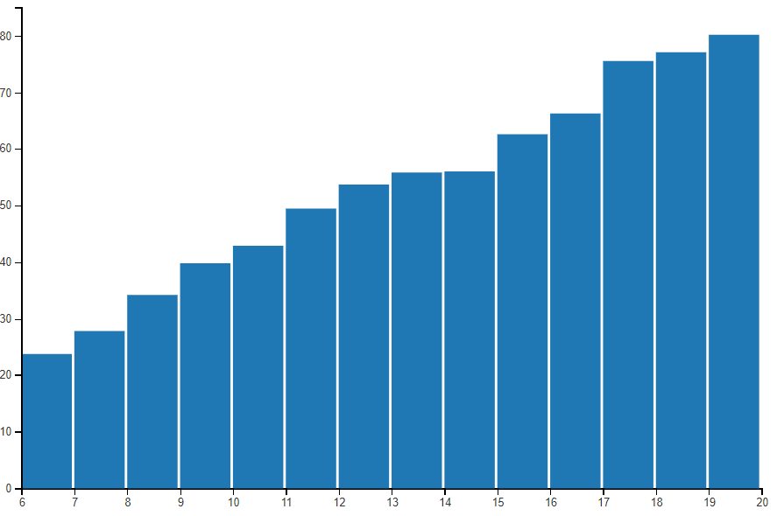

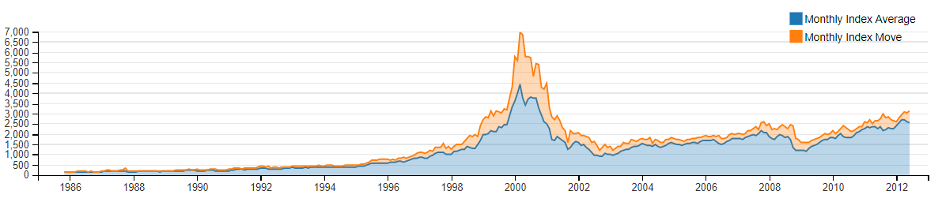
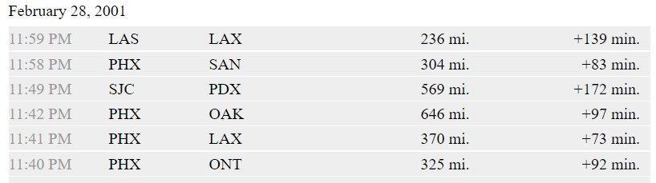
Quick CrossFilter Summary:
I chose the following filters would best summarize my data:
Pie Chart
Bar Chart
Number Display
Composite Line Chart
Table

Slide 12
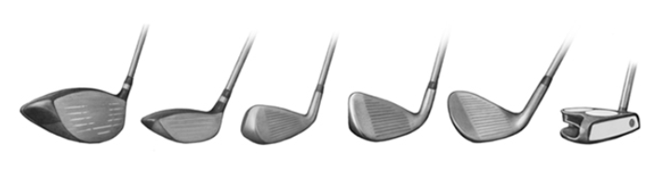
Brief Background for Visualization:
There are many different golf performance statistics but my visualization focuses just on the driver which is the club used to hit the ball 200-300 yards off the tee box
2 parameters can be used to assess driver performance:
1.) Distance (measured in yards from the tee box)
2.) Accuracy (measured by fairways hit)

Slide 13
THE END

