Slide 1
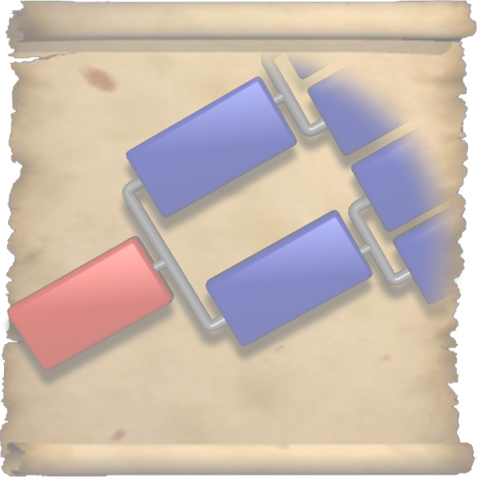
One Page Genealogy

Slide 2

Why One Page Genealogy?
Browse through the records of thousands of ancestors
Visualize complex family relationships
Locate records with questionable or missing data
Find parts of the tree where less research has been done

Slide 3
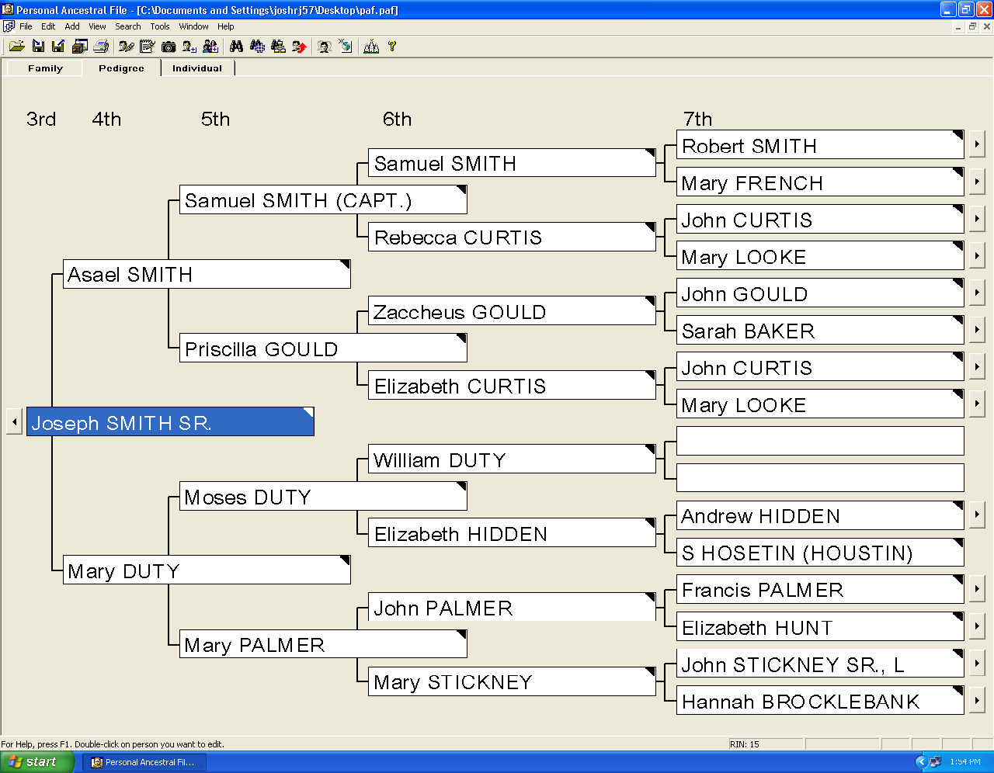
View a piece at a time
Notes:
Several programs exist that allow you to view your family tree on screen, one piece at a time.

Slide 4
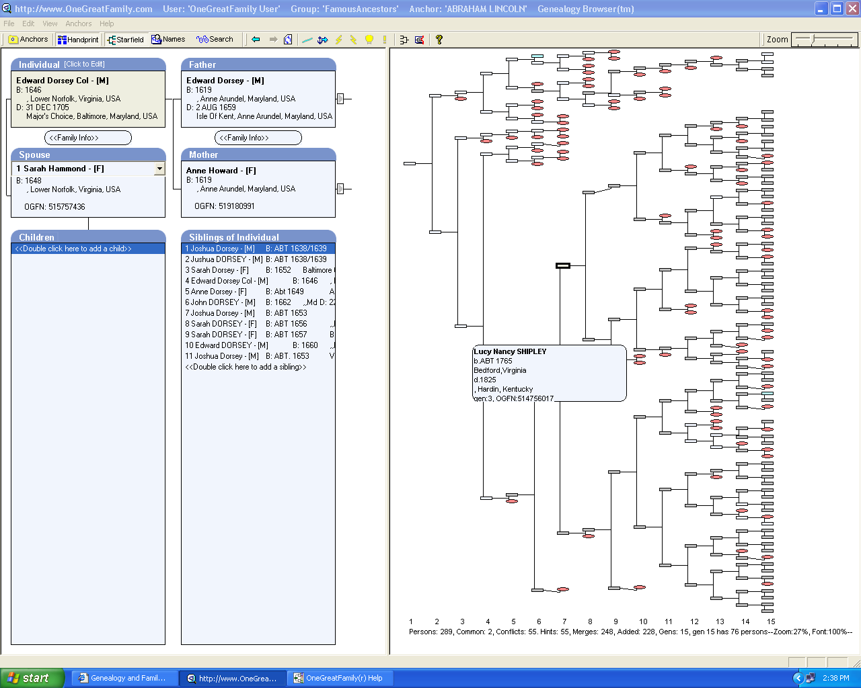
Viewing the entire tree
Notes:
A few programs allow you to view the entire tree. However, it is often desirable to have a printed chart to be able to lay the family tree out on a table, or hang it on a wall.

Slide 5
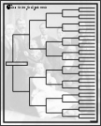
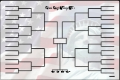
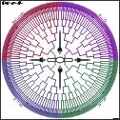
Wall Charts
Usually available in fixed forms.
Layout is already set, user can enter information.
Space is generally limited to about 6 or 7 generations.

Slide 6
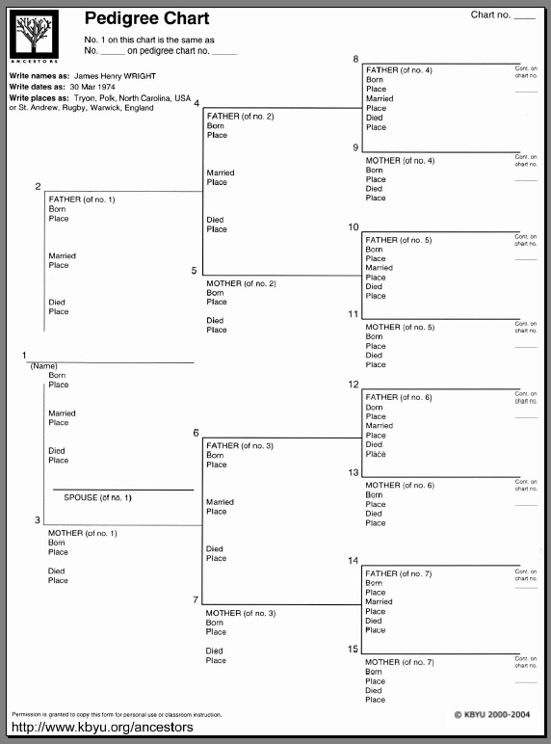
Fixed Form Charts
This 8 ½” x 11” chart displays 4 generations
Can we fit more?

Slide 7
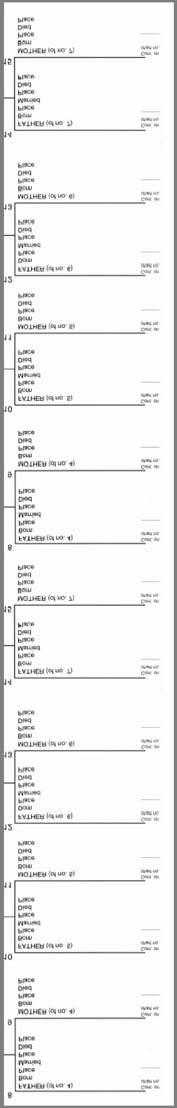
Fixed Form Charts
Page height needs to be doubled for each additional generation.
Paper size grows exponentially.

Slide 8
To give an idea
Suppose we used an 8 point font size
We can fit 9 names per inch
What paper size is necessary to provide space for your family tree?
John
Lucy
Mike
Carol
Dave
Amy
Nick
Kate
Bill

Slide 9
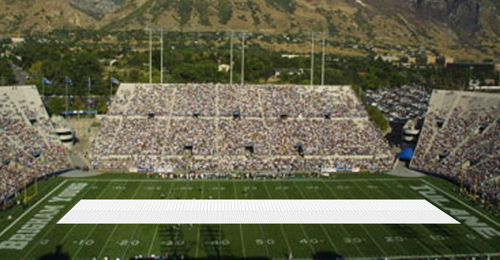
15 Generations
Requires the length of a football field

Slide 10

20 Generations
Requires 1.8 miles:
Almost twice the length
of BYU campus!

Slide 11
A Better Solution?
So what if your family history goes back more than 6 or 7 generations?
One idea: use several smaller charts.

Slide 12
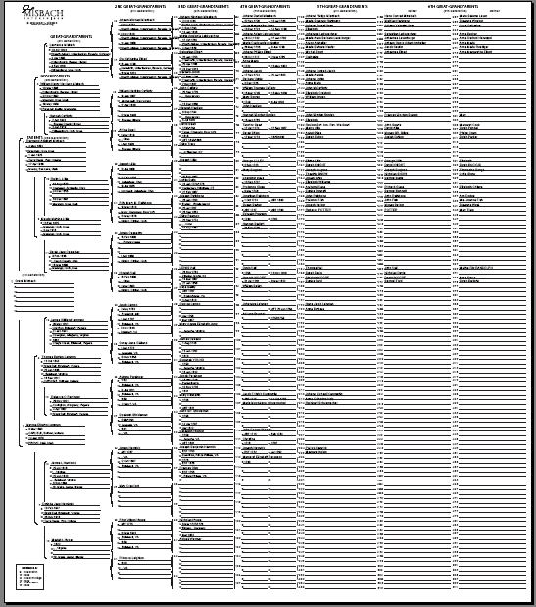
Another Idea
This 2-ft. fixed form displays 9 generations.
Achieved by splitting 9th generation into two columns.
Notes:
Two foot chart able to display 9 generations, but this idea only works once.

Slide 13
Adaptive Chart
Instead of a fixed form, create a custom-fit chart.
The layout is adaptive to the amount of information provided by the user.

Slide 14
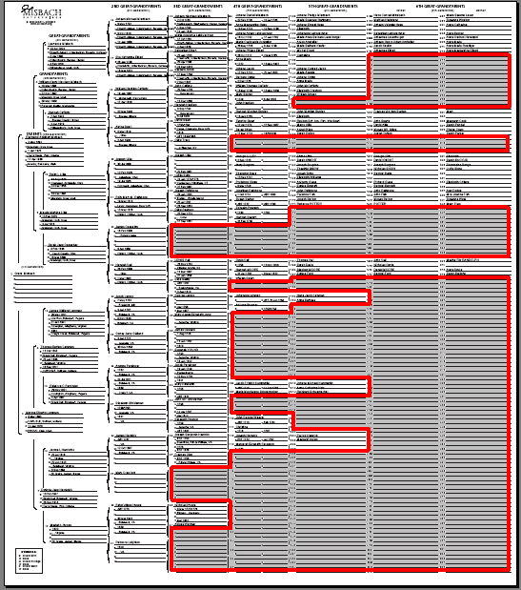
Incomplete Trees
Every researcher has ancestors whose information hasn’t been found yet.
Each ancestor creates space for an entire sub-tree that goes back to the deepest generation.

Slide 15
Incomplete Trees
Reserving room for these blank sub-trees results in large amounts of unused paper space.
Why not take advantage of the unused space?

Slide 16
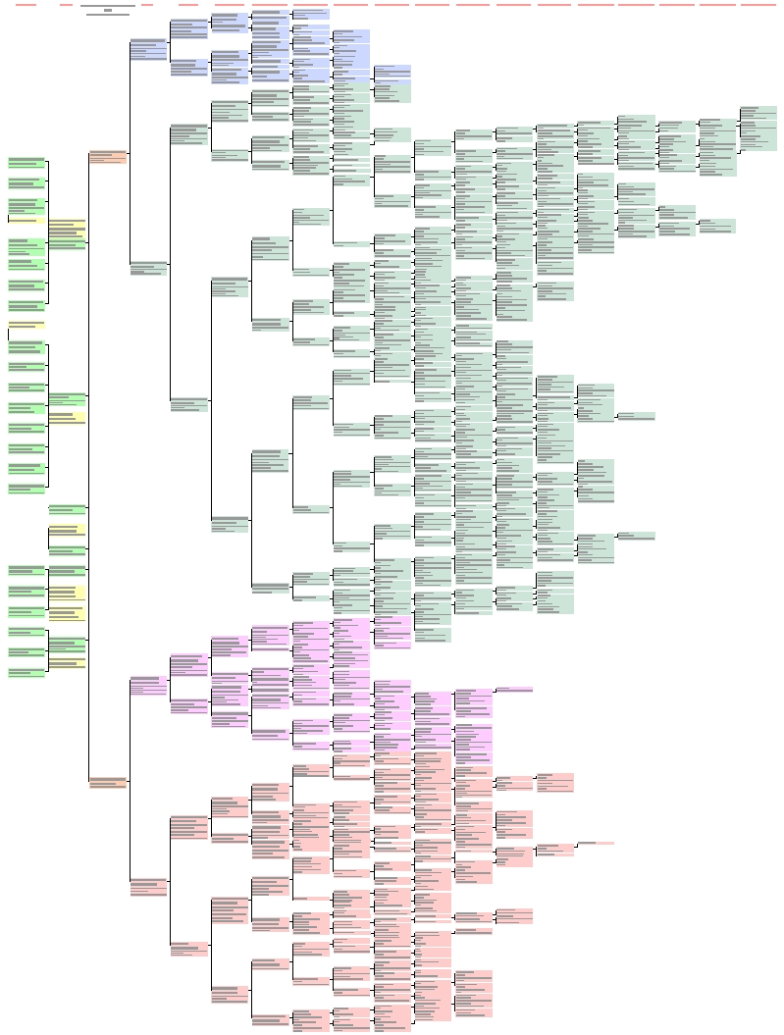
One Page Genealogy
Only uses space for the individuals found in the GEDCOM file.
Fits each pair of sub-trees as close to each other as possible.

Slide 17
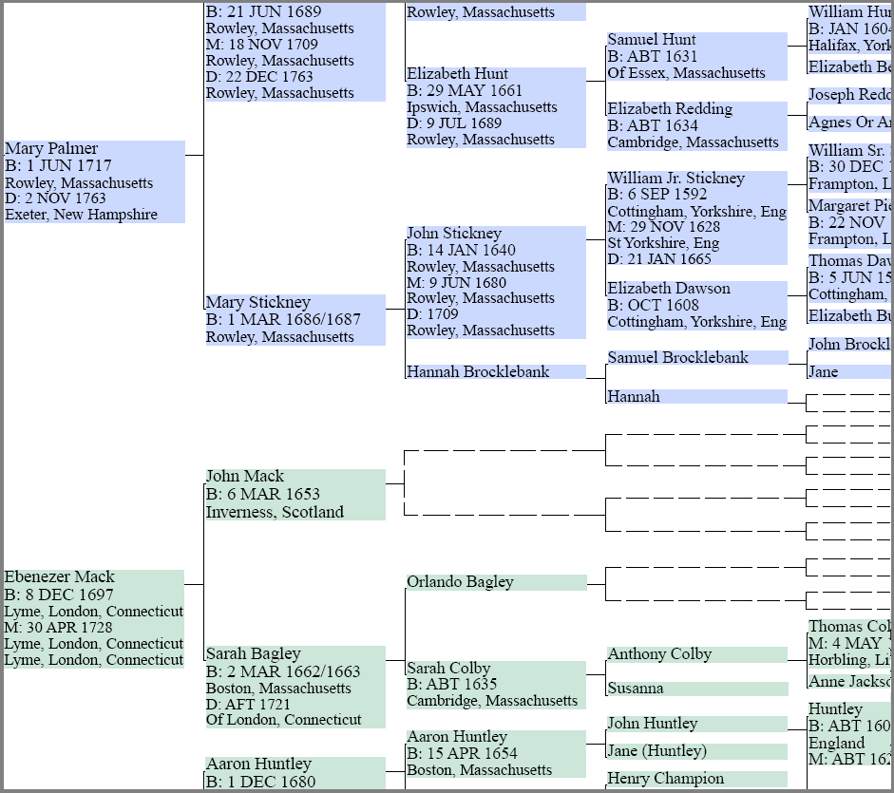
Example
Dotted lines show missing ancestors
Force the two sub-trees as close together as possible

Slide 18
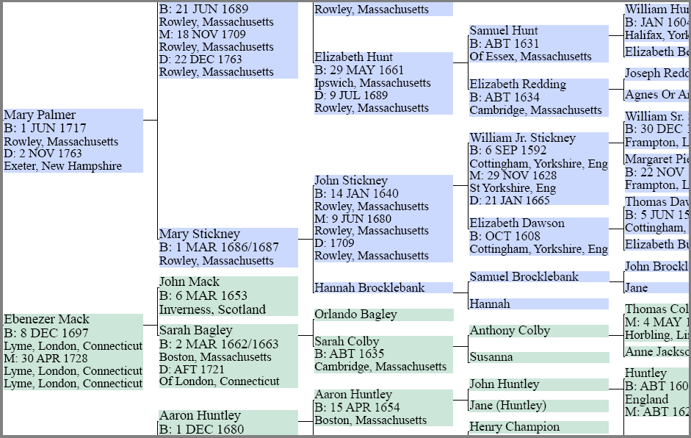
Example

Slide 19
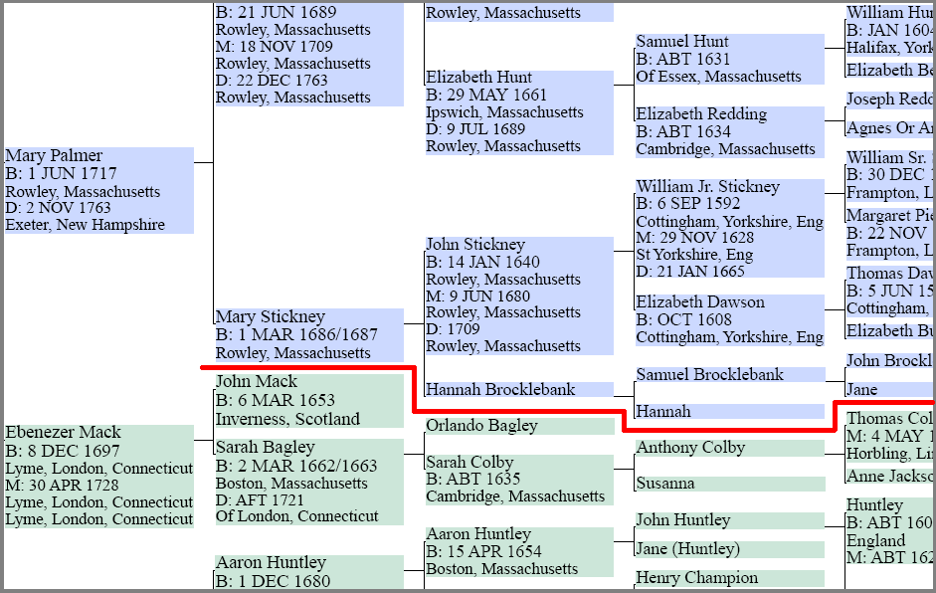
Example
Finds best possible fit

Slide 20
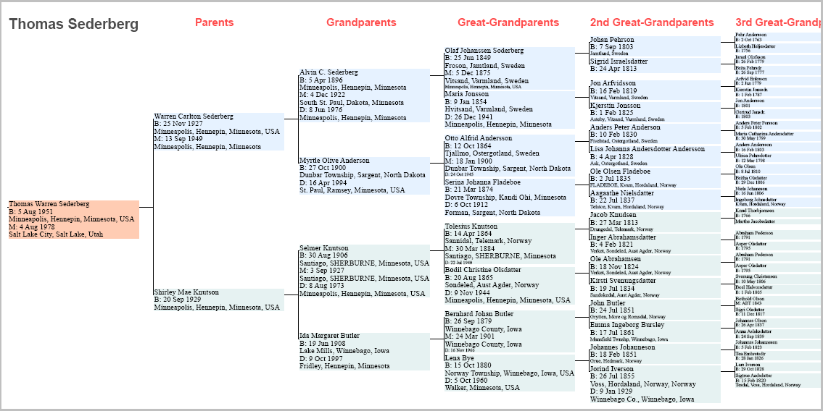
Pedigree Layout
Emphasizes how each individual fits in relation to the others.

Slide 21
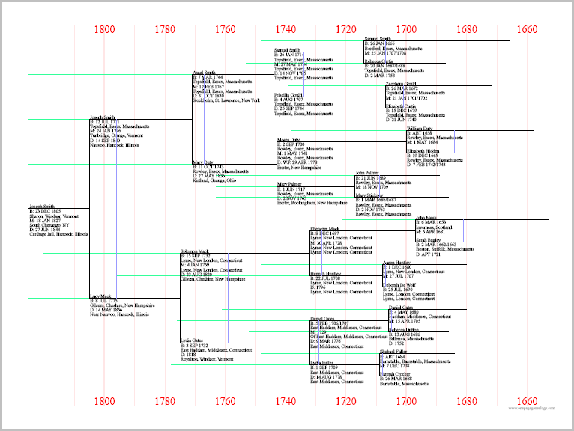
Timeline Layout

Slide 22
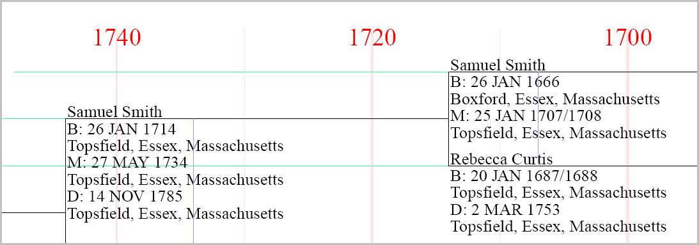
Timeline Layout
Conveys where each individual fits in the context of time

Slide 23
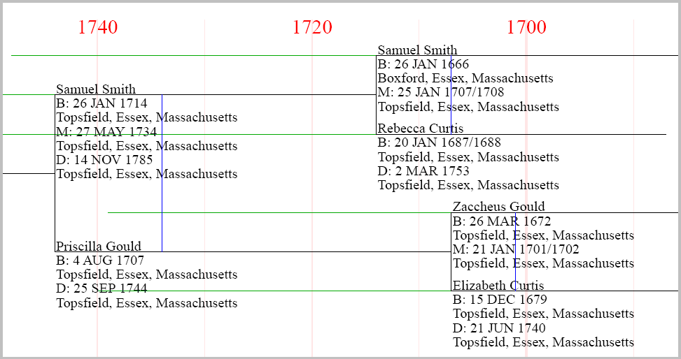
Timeline features
Black lines span from individual’s year of birth to the year a descendant was born.

Slide 24
Timeline features
Green lines continue until the individual’s year of death.

Slide 25
Timeline features
Blue lines show the marriage year of couples.

Slide 26
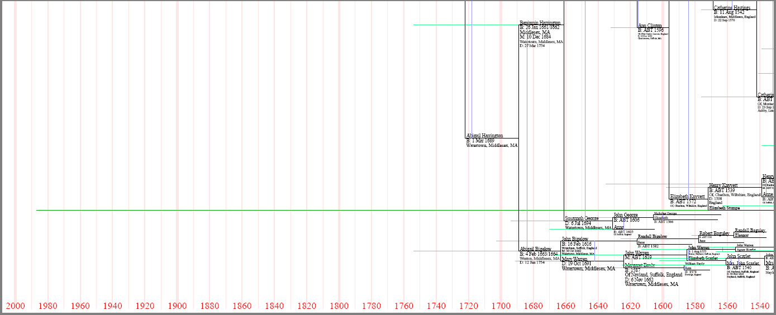
Locate Questionable Data
The Timeline Layout is especially helpful for detecting potentially incorrect dates.

Slide 27
Missing Dates
The program will estimate the year of birth if one is not given for a particular ancestor
Each guess is based on the recorded birth dates of the closest relatives

Slide 28
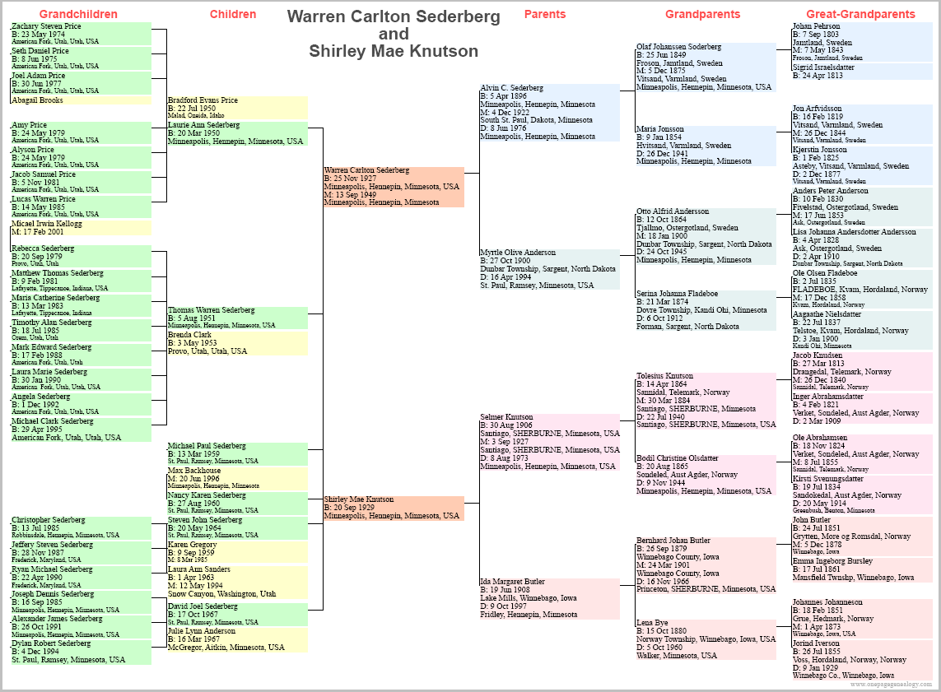
Couples and Descendants

Slide 29
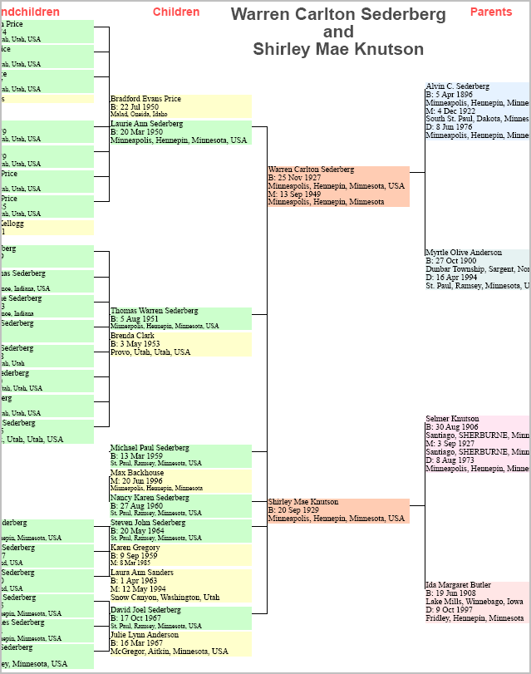
Couples and Descendants
Include the spouse of the root individual
Display the ancestry of both people
Show descendants of that couple

Slide 30
Future Direction
Given a family tree, the program will recommend:
  page dimensions
  font sizes
Optimize layout of sub-trees to fill more paper space and display more information
Use of color to denote:
  lineage
  nationality

