Slide 1
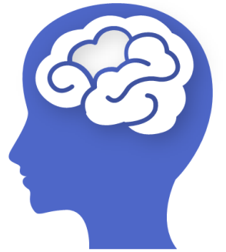
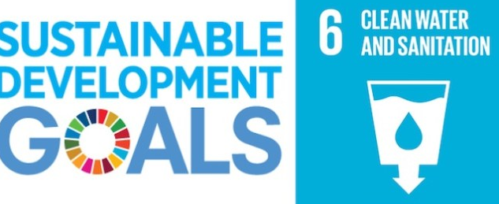
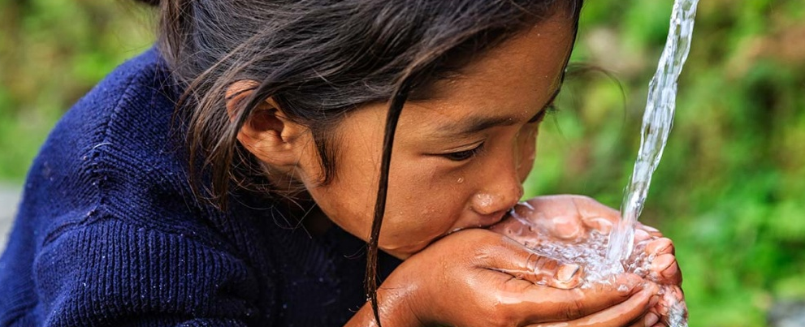
Jal.AI - A MACHINE LEARNING SYSTEM FOR WATER QUALITY ASSESSMENT AND PURIFICATION APPROACH
Team Name – Hackers_ICT, Theme – “Access to Water”
GitHub Link - https://github.com/jrath2001/jal-ai
(Find the full code for Django app and demo video in the ‘Project Upload.rar’ uploaded on Skillenza. It contains all parts of this project)
Contact - +919438912559, che19j.rath@stuiocb.ictmumbai.edu.in

Slide 2
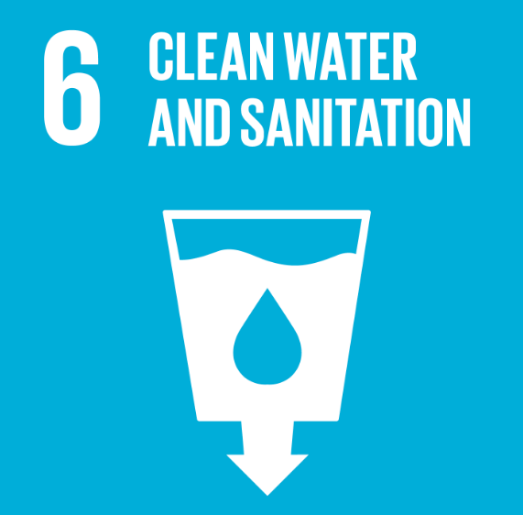
all that glitter isn’t gold… ALL THAT WATER ISN’T PURE !
We all are aware of this fact – Earth’s surface is made of 71% water and 29 % land. But less than 1% of water is available for use .
Water is a ubiquitous need for life. Look at the bigger picture - water is not only required for human consumption but also for specific industrial & manufacturing purposes. A large chunk of world’s population has no access to potable water. The situation is more grim in India.
A lot of studies exist on the assessment & purification of water. Yet, the use of Machine Learning and AI happens to be very less till now.
Jal.AI is a Machine Learning/AI based solution that helps to assess the quality of water and provides recommendation for purification and improvement.
Not able to access clean water is one of the biggest challenges that the humanity is facing for a long time and the solution is yet so far.

Slide 3
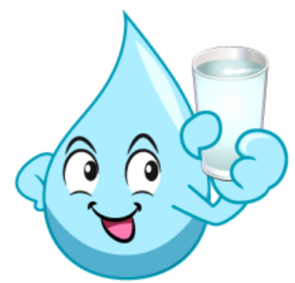
WHAT AND WHY Jal.AI ?
What is Jal.AI ?
We have designed a Machine Learning/AI based system that helps to calculate and predict the purity of water samples. It also recommends strategies for water purification and quality improvement.
The ML model, trained on a dataset by Govt. of India, can accurately predict the WQI (water quality index) using two or three parameters instead of 6 or more parameters used universally.
Why Jal.AI ?
A lot has been said & done on “access to pure & potable water” yet the world struggles to find an apt solution. Jal.AI is an intelligent and easy-to-implement approach. It can accurately help to know what is the purity status of a water sample and also recommend strategies. Without running to a lab for testing and then finding out methods of purification, one can get to know in seconds by saving time and money. The model can keep improving as more and more data and strategies are provided.
What’s unique ? A easy ML model – no neural networks or deep learning used, can run on cloud or integrated into handheld devices at the point of use.

Slide 4
UNLEASHING THE POWER OF MACHINE LEARNING !
Have a look at how we built Jal.AI
Dataset on Water
(available on Govt. of India portal)
Data collected from various locations & stations across India. Parameters include – Temp., pH, Conductivity, Dissolbved Oxygen, BOD, Nitrate/Nitrite/Coliform
1. Data Cleaning & Analysis (EDA)
Machine Learning Model
(A Classification + Regression Model
built on Python)
Algorithms used – Linear Regression, Random Forest (with correlation analysis)
Model Accuracy –
2. Coding and training the ML Model
The Django based app interface serves as our frontend and the Machine Learning model as the backend.
A unique example of how ML models can be put into direct use !
Live Water Purity Assessment Interface Machine Learning Model
(A app built on Django that calculates and predicts the water purity of input sample and enlists strategies for quality improvement.
Check app screenshots and demo video for more details

Slide 5
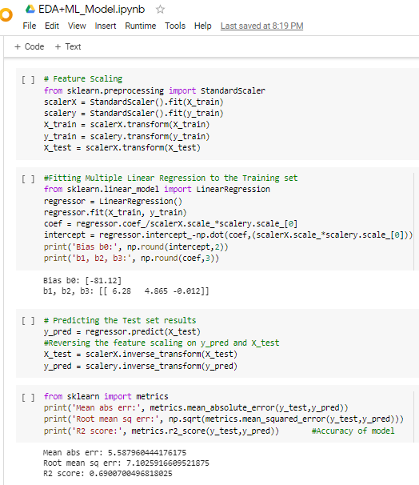
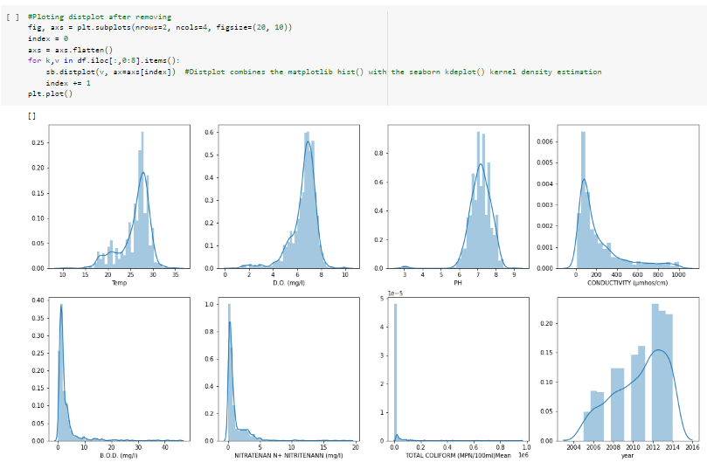
MAKING THE CORE ML MODEL … SOME SNAPSHOTS
(For detailed codes, check GitHub repo and project upload ZIP)
Feature Scaling + Regression Analysis
Data Distribution Plots (after removing outliers)

Slide 6
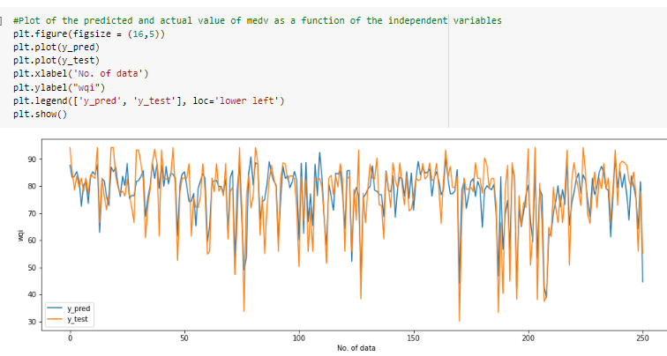
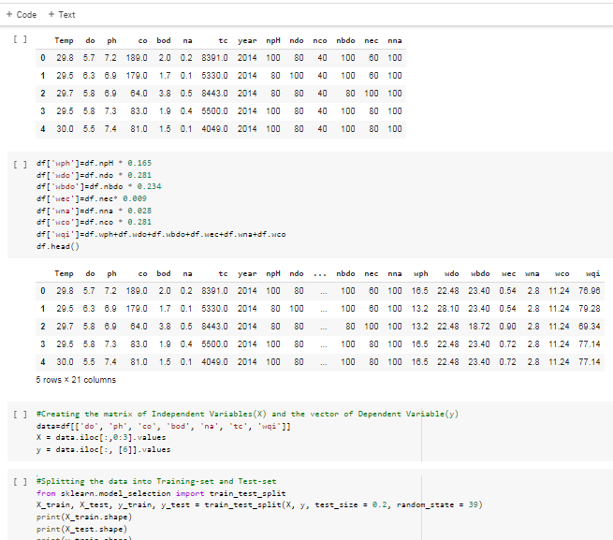
Estimating WQI and checking the model’s accuracy

Slide 7
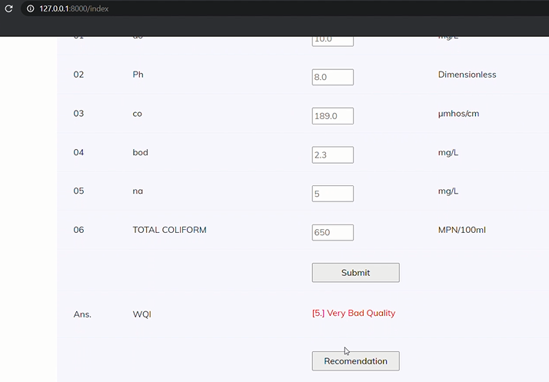
GIVING THE MODEL A LIFE – A LIVE INTERFACE BUILT ON DJANGO
We used Django to build an app based on the machine learning model. The source uses 6 parameters for calculating Water Quality Index (WQI). However, this app can predict the WQI using only 2 or 3 parameters.
Have a look at the demo video and check the full codes on GitHub and ZIP.

Slide 8
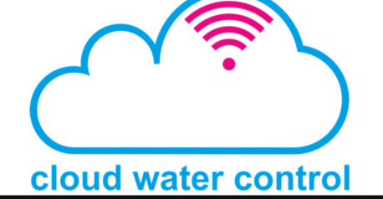
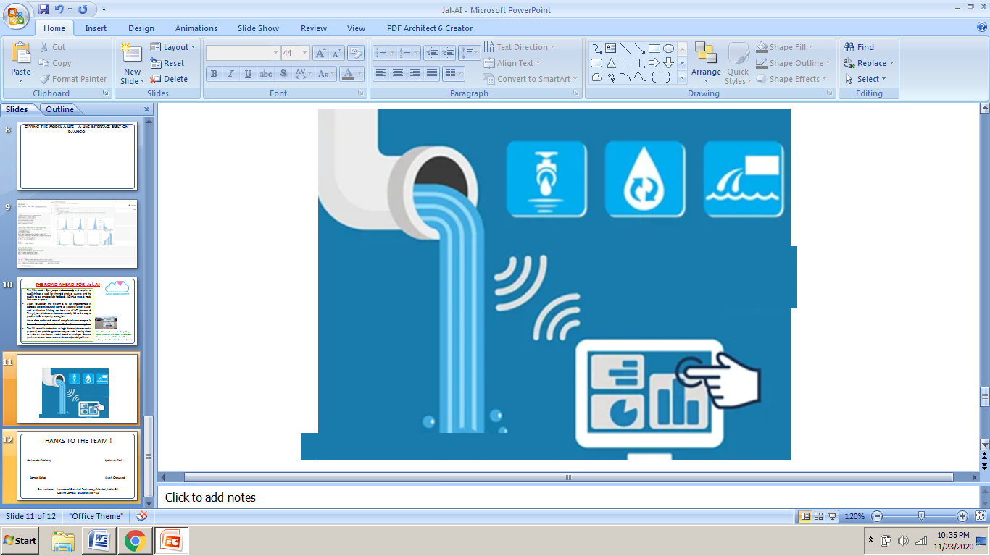
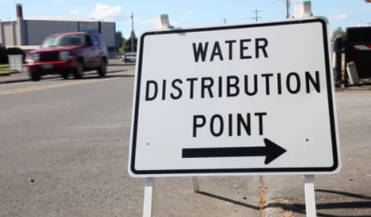
THE ROAD AHEAD FOR Jal.AI …
The ML model + Django app is cloud-ready and we plan to publish it on a web for chemical analysts, experts and the public to use and provide feedback. A GitHub repo. is made for same purpose.
Upon incubation, the system is to be implemented in portable devices to use at points of water collection, supply and purification. Making the best use of IoT (Internet of Things), sample data can be automatically fed to the app to predict WQI and purity strategies.
Saves time and avoids manual analysis of water samples in industries and points of water distribution in our city/state.
The ML model is trained on a single dataset (demonstrative purpose) and provides good accuracy as such. Looking ahead to make an ever better model based on multiple datasets (with numerous parameters and sources) and algorithms.
A public use-case includes getting to know WQI for the water that comes to our home and checking the efficacy of installed water purifiers.

Slide 9
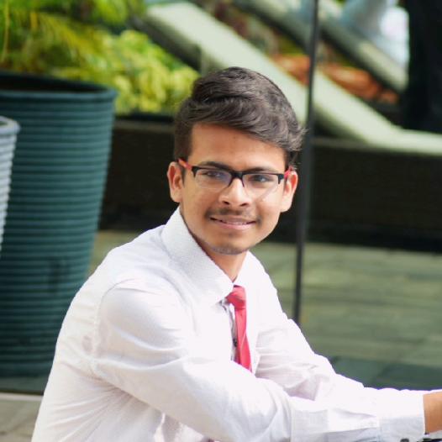
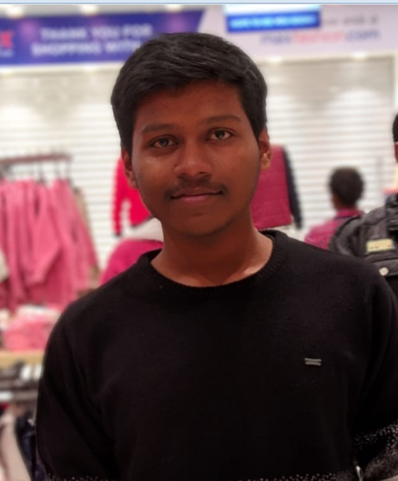
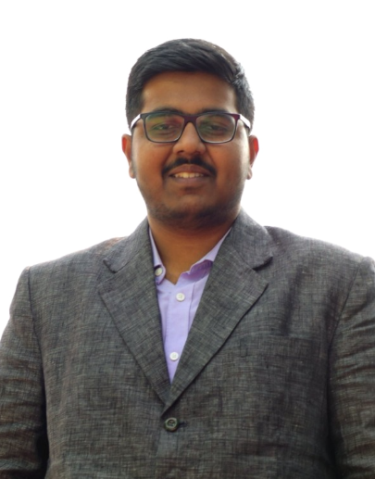
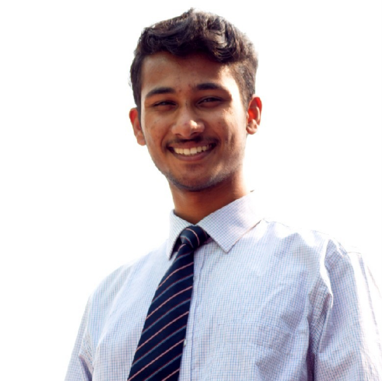
THANKS TO THE TEAM !
We are from Institute of Chemical Technology Mumbai, IndianOil Odisha Campus, Bhubaneswar - 13
<Abhinandan Mohanty/>
<Someet Sahoo/>
<Jyotisman Rath/>
<Ayush Chaturvedi/>

