Slide 1
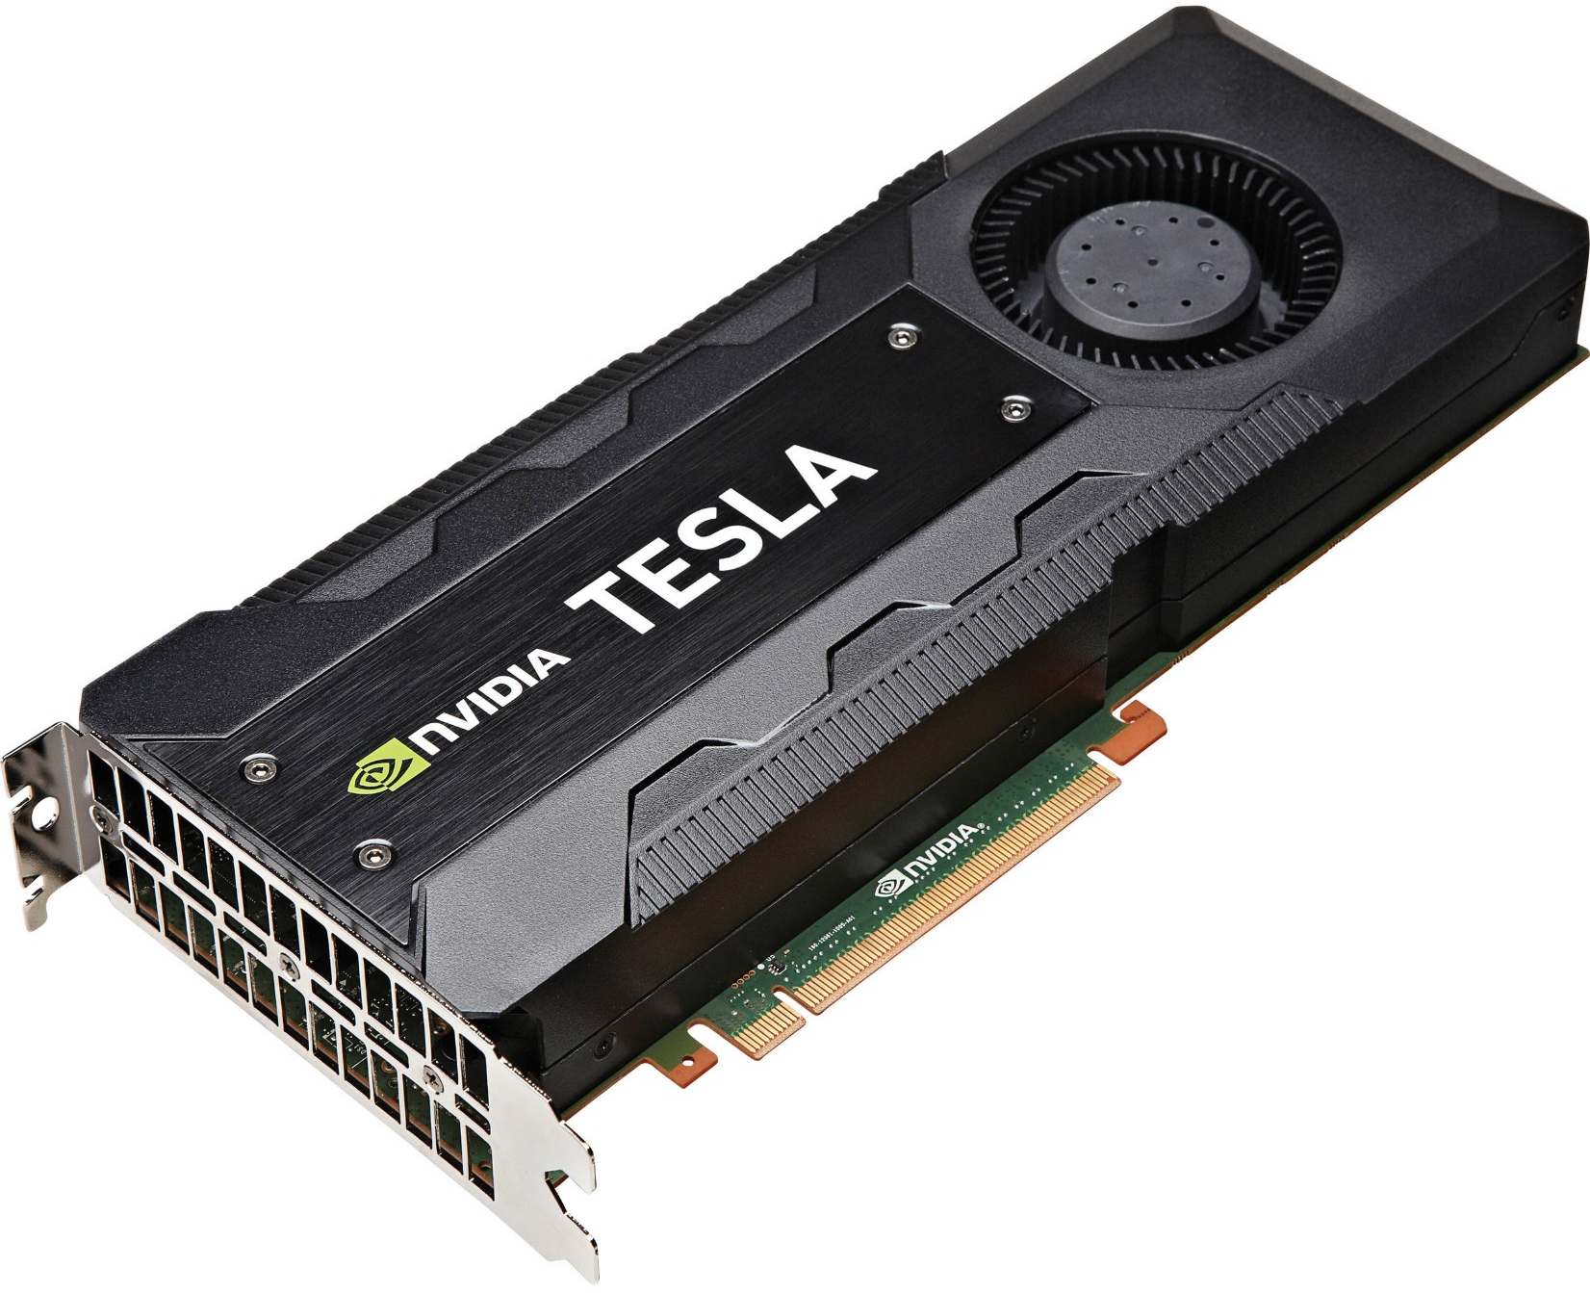
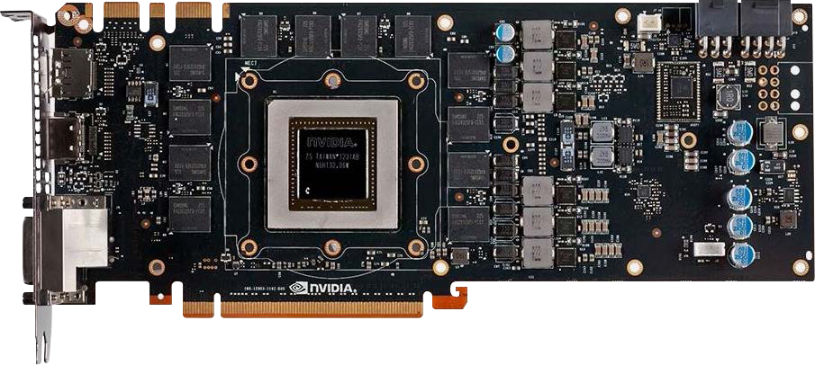

Slide 2



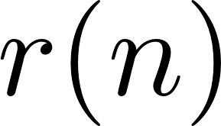

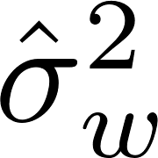



preamble detection
frequency offset estimator
channel
estimator
noise
estimator
apply
equalizer
apply
detection
filter
SxS
detector
compute
equalizer
SM-0
SM-1
SM-M
Threads on CUDA Cores
Threads on CUDA Cores
Threads on CUDA Cores
on GPU chip
Registers
Registers
Registers
PCI Express
Bus
Host Memory
L1
Shared Memory
L1
Shared Memory
L1
Shared Memory
L2
off GPU chip
Global Memory

Slide 3






0
0
Host to
Device
1
1
Host to
Device
time
0
1
2
3
4
5
6
7
0
1
2
3
4
5
6
7
7
7
time
0
1
2
3
4
5
6
7
0
1
2
3
4
5
6
7
Device to Host

Slide 4
Block 0
Block 1
Block 2
Block 3
Block 0
Block 1
Block 2
Block 3
Block 4

Slide 5
Small Memory
Registers
Fast Memory
L1/Shared Memory
L2
Large Memory
Global Memory
Slow Memory

Slide 6
Thread 0
Registers & L1
Fastest Memory
Block 0
Shared
Memory
Block 0
Block M
Block 0
Block M
Shared
Memory
Shared
Memory
Shared
Memory
Shared
Memory
Blocks on CUDA Cores
Blocks on CUDA Cores
Streaming Multiprocessor 0
Streaming Multiprocessor S
L2 & Global Memory
Slowest Memory
GPU 0

Slide 7

12672+
186-1
Conv
12672+
186+21-2
Conv
186+21-1
Conv
12672+
186+21-2
Conv

Slide 8
GPU0
H to D
GPU Kernel
D to H
CPU
CPU
Acquire Data
H to D
D to H
CPU
Synchronize
D to D
GPU Kernel
D to H
D to D
GPU Kernel
D to H
GPU0
Async H to D
Async H to D
CPU
CPU
Acquire Data
Async H to D
CPU
Acquire Data
Async H to D
CPU
Synchronize
CPU
Synchronize

Slide 9
D to D
GPU Kernel
D to H
D to D
GPU Kernel
D to H
GPU0
Async H to D
Async H to D
D to D
D to H
D to H
D to D
GPU Kernel
GPU Kernel
D to D
D to D
GPU Kernel
GPU1
GPU Kernel
D to D
GPU Kernel
D to H
CPU
Acquire Data
D to H
GPU2
D to D
GPU Kernel
CPU
CPU
Acquire Data
Async H to D
CPU
Acquire Data
Async H to D
CPU
Synchronize
CPU
Synchronize

