Slide 1




FFT
Complex
Multiplication
IFFT
Trim & Scalar Multiplication
FFT
Frequency-domain Convolution

Slide 2
FFT
Complex
Multiplication
IFFT
Trim & Scalar Multiplication
FFT
Frequency-domain Convolution

Slide 3





1 Batch
5 Batches

Slide 4
12672 sample Packet or Batch
Preamble
ASM
Data
1 Set of 3104 Batches
Batch 0
Batch 1
Batch 2
Batch 3101
Batch 3102
Batch 3103

Slide 5
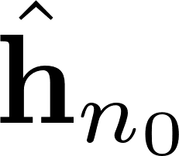


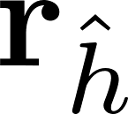




Fill Vector
cuSolverSp
Fill CRS
Matrix
Auto-
correlation
Frequency-domain Convolution

Slide 6


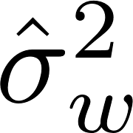

Fill Vector
Solve
Fill CRS
Matrix
Auto-
correlation
Conv
Fill Vector
cuSolverSp
Fill CRS
Matrix
Auto-
correlation
Frequency-domain Convolution

Slide 7
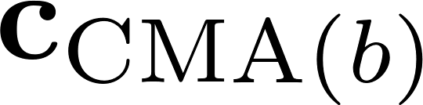


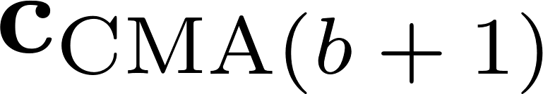


Frequency-domain Convolution
Multiply
Frequency-domain Convolution
Steepest Descent
Conv
Conjugate Time Reversal
Frequency-domain Convolution

Slide 8
FFT
Complex Multiplication & Division
IFFT
Trim and Scale
FFT

Slide 9

FFT
Complex Multiplication & Division
IFFT
Trim and Scale
FFT

