Slide 1



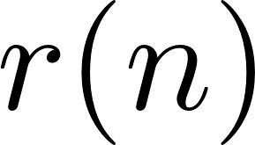

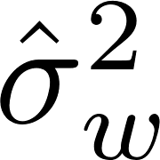



preamble detection
frequency offset estimator
channel
estimator
noise
estimator
apply
equalizer
apply
detection
filter
SxS
detector
compute
equalizer
SM-0
SM-1
SM-N
Registers
Registers
Registers
L1
Shared Memory
L1
Shared Memory
L1
Shared Memory
Host Memory
PCI Express
L2
Global Memory

