Slide 1





1 Batch
5 Batches

Slide 2
12672 sample Packet or Batch
Preamble
ASM
Data
1 Set of 3104 Batches
Batch 0
Batch 1
Batch 2
Batch 3101
Batch 3102
Batch 3103

Slide 3
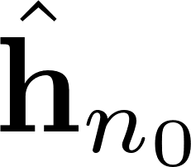

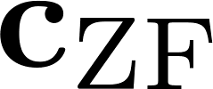
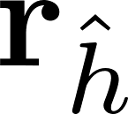




Fill Vector
Solve
Fill CRS
Matrix
Auto-
correlation
Conv

Slide 4


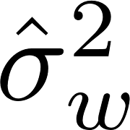
Fill Vector
Solve
Fill CRS
Matrix
Auto-
correlation
Conv

Slide 5
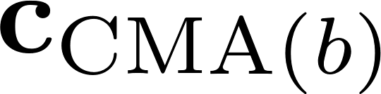



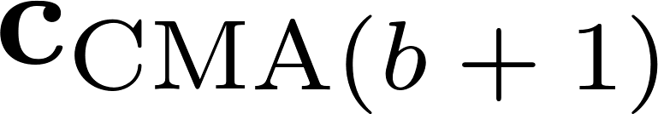


Conv
Multiply
Conv
Steepest Descent
Conjugate Time Reversal
Conv

Slide 6
FFT
Multiply
IFFT
Trim and Scale
FFT

Slide 7

FFT
Multiply
IFFT
Trim and Scale
FFT

