Slide 1
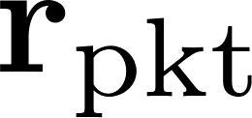


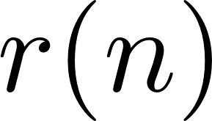

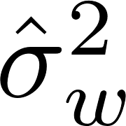



In the GPU I treat everything packet by packet. There is one vector of each term on this page for each packet
r_r is indexed by (n) because we don’t know where the packets are yet.
The preamble detector searches r_r for packet edges.
Confused? Read Andrews thesis
preamble detection
frequency offset estimator
channel
estimator
noise
estimator
apply
equalizer
apply
detection
filter
SxS
detector
compute
equalizer
Most of the time the detection filter is wrapped in as part of the SxS detector.
I don’t do this because I am going to exploit that there are 2 filters in a row…less computation

Slide 2
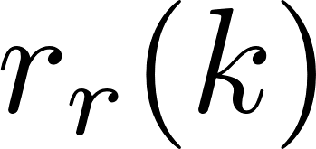
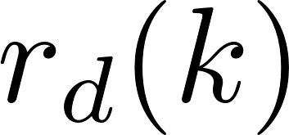
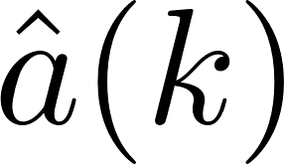
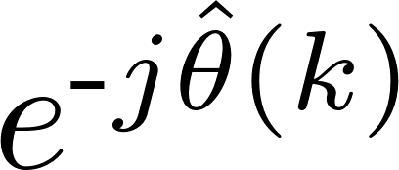
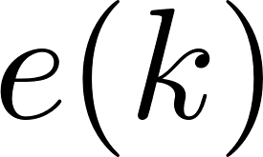

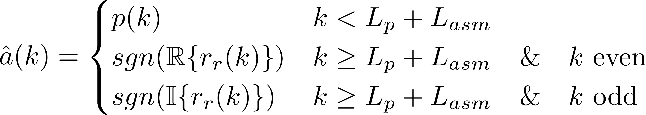
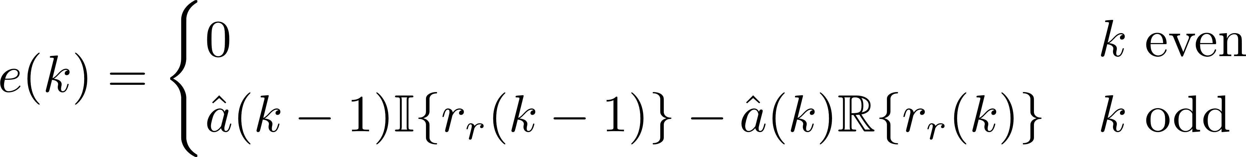
DDS
PED

Slide 3
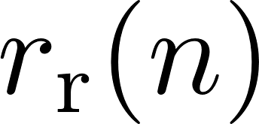
preamble detector
search
algorithm
packetize samples

