Slide 1





1 Batch
5 Batches

Slide 2
12672 sample Packet or Batch
Preamble
ASM
Data
1 Set of 3104 Batches
Batch 0
Batch 1
Batch 2
Batch 3101
Batch 3102
Batch 3103

Slide 3
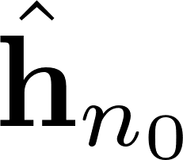


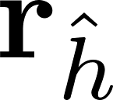




Fill Vector
Solve
Fill CRS
Matrix
Auto-
correlation
FFT
Hadamard
Product
IFFT
Trim and Scale
FFT

Slide 4


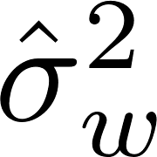
Fill Vector
Solve
Fill CRS
Matrix
Auto-
correlation
FFT
Hadamard
Product
IFFT
Trim and Scale
FFT

Slide 5
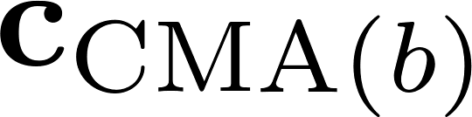

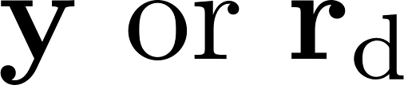





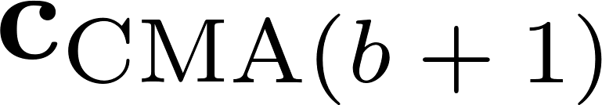

FFT
Hadamard
Product
IFFT
Trim and Scale
FFT
Multiply
FFT
Hadamard
Product
IFFT
Conjugate Time Reversal
FFT
Trim and Scale
Steepest Descent

Slide 6
FFT
Multiply
IFFT
Trim and Scale
FFT

Slide 7

FFT
Multiply
IFFT
Trim and Scale
FFT

