Slide 1
256
samples
128
samples
12288
samples
Preamble
ASM
Data
12672 samples
Data
Preamble
ASM
Data
Preamble
ASM
Data

Slide 2



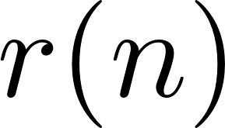

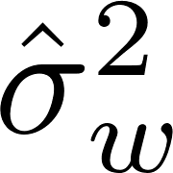



SM-0
SM-1
SM-M
Threads on CUDA Cores
Threads on CUDA Cores
Threads on CUDA Cores
Block 0
Block 1
Block 2
Block 3
Block 0
Block 1
Block 2
Block 3
Block 4
on GPU chip
Registers
Registers
Registers
PCI Express
Bus
Host Memory
L1
Shared Memory
L1
Shared Memory
L1
Shared Memory
L2
Global Memory
Preamble Detection
Offset Estimator
Channel
Estimator
Frequency
Noise
Estimator
Apply
Equalizer
Apply
Detection
Filter
Detector
Compute
Equalizer

Slide 3
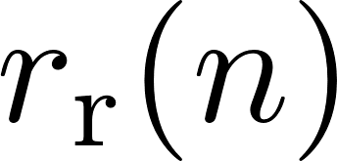
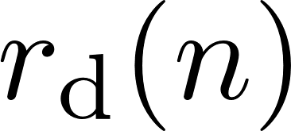
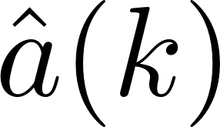
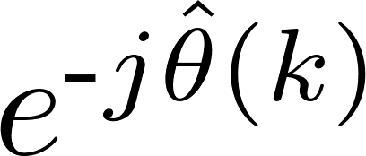
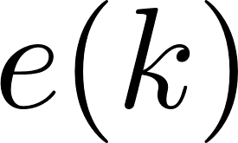

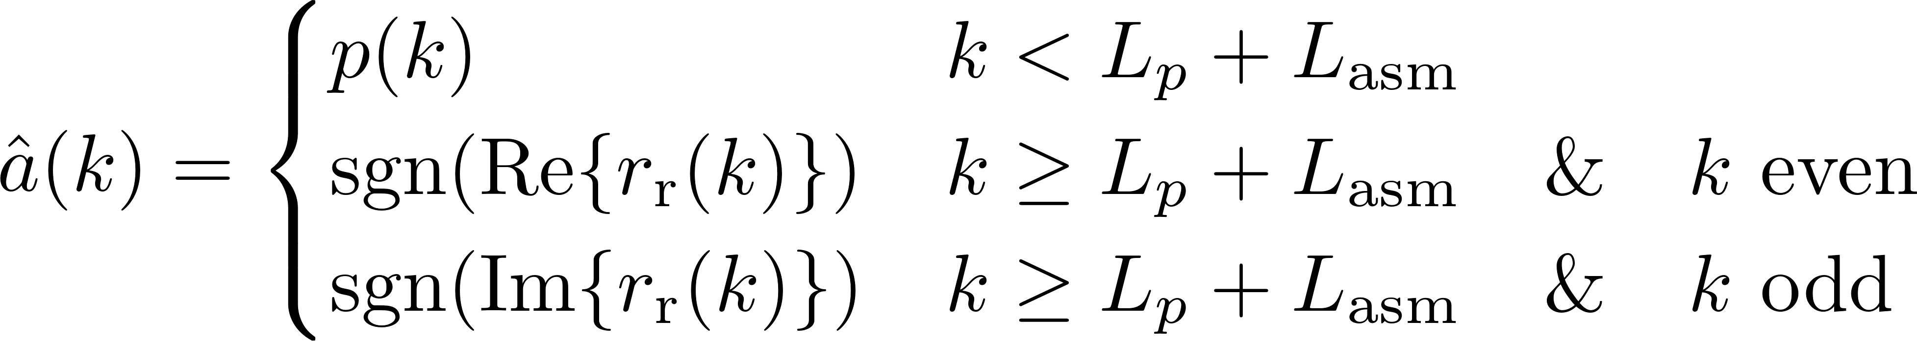
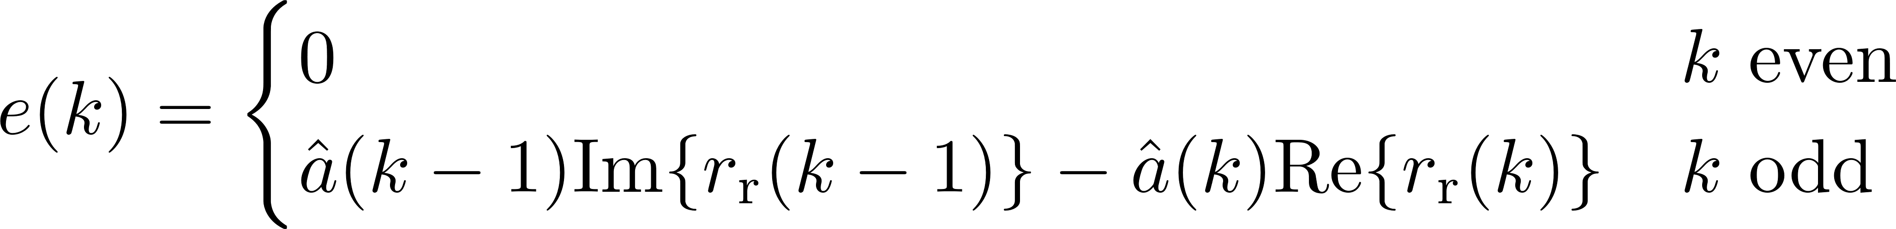
DDS
PED

Slide 4

preamble detector
search
algorithm
packetize samples

