Slide 1
SM-0
SM-1
SM-M
Threads on CUDA Cores
Threads on CUDA Cores
Threads on CUDA Cores
on GPU chip
Registers
Registers
Registers
PCI Express
Bus
Host Memory
L1
Shared Memory
L1
Shared Memory
L1
Shared Memory
L2
off GPU chip
Global Memory

Slide 2
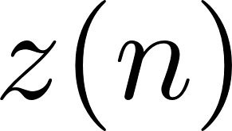

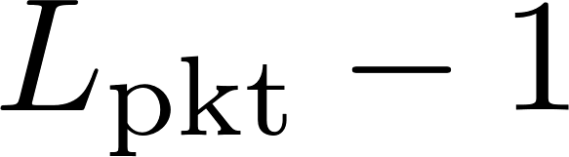

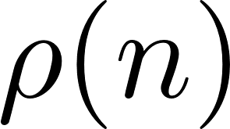
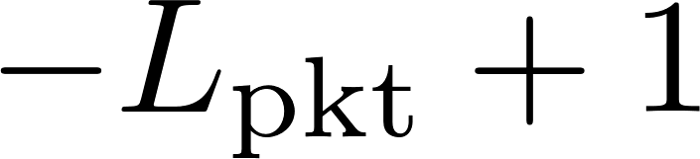
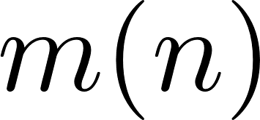
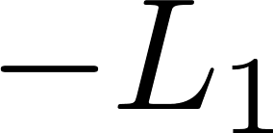
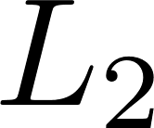

Slide 3
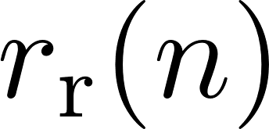
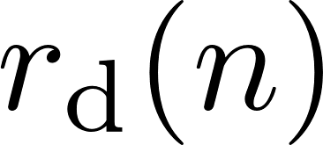
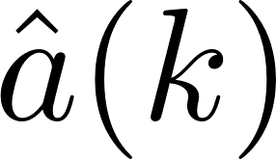
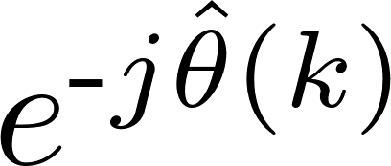
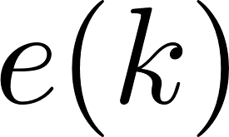

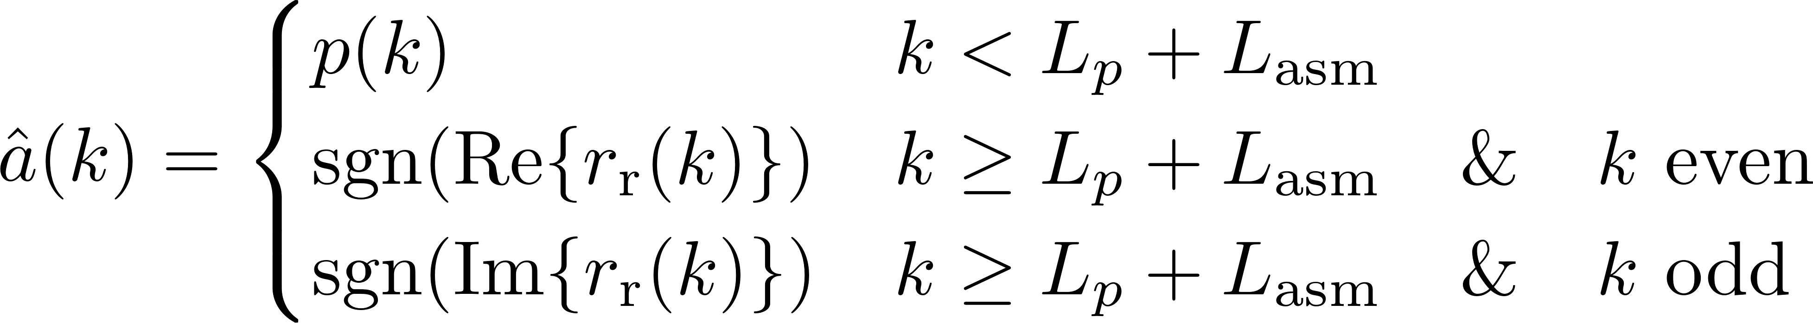
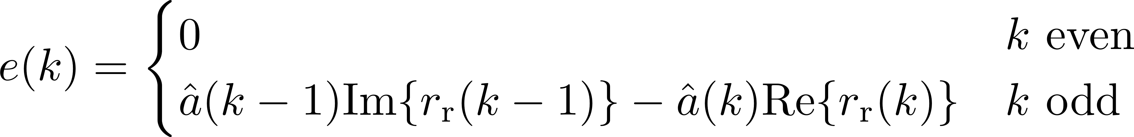
DDS
PED

Slide 4

Preamble
Data
ASM
Data
Preamble
ASM
Data
Cyclic Prefix
Cyclic Prefix
ASM
Data
12672 samples

