Slide 1
Strategic models for integrated land use and transportation
Regional Visioning
Strategic Models
Plans

Slide 2
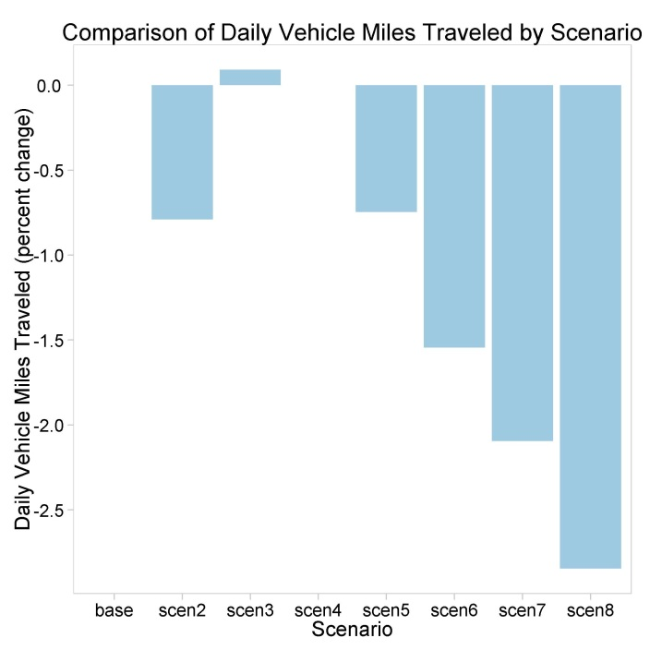
Communicating results
Comparison of Daily Vehicle Mile Traveled by Scenario

Slide 3
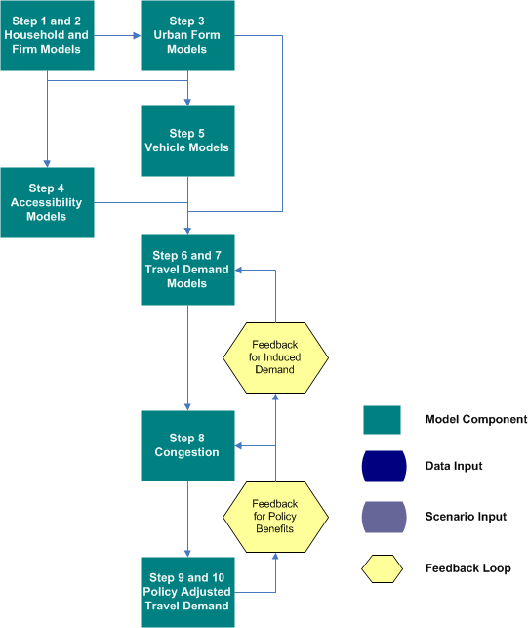
Rapid Policy Assessment Tool Process

Slide 4
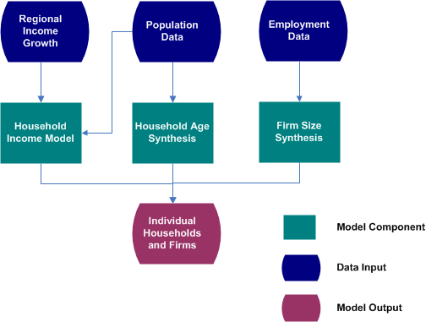
Household and Firm Synthesis

Slide 5
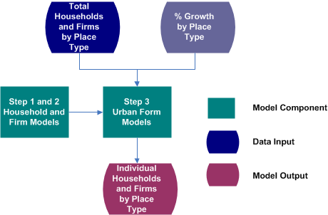
Urban form models

Slide 6
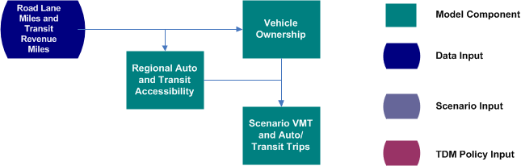
Accessibility

Slide 7
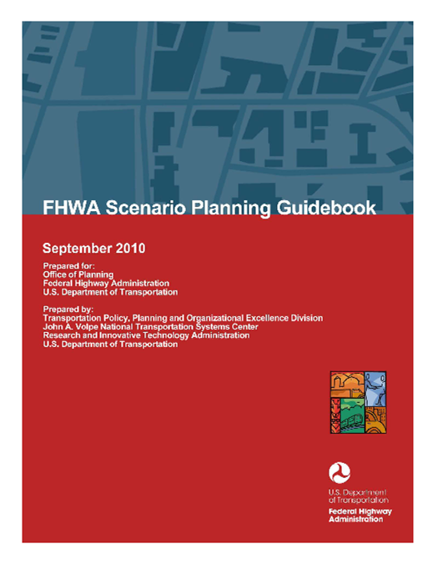
Scenario planning at FHWA / FTA

Slide 8
Needs for a data-driven process
Land Use
Transportation

Slide 9
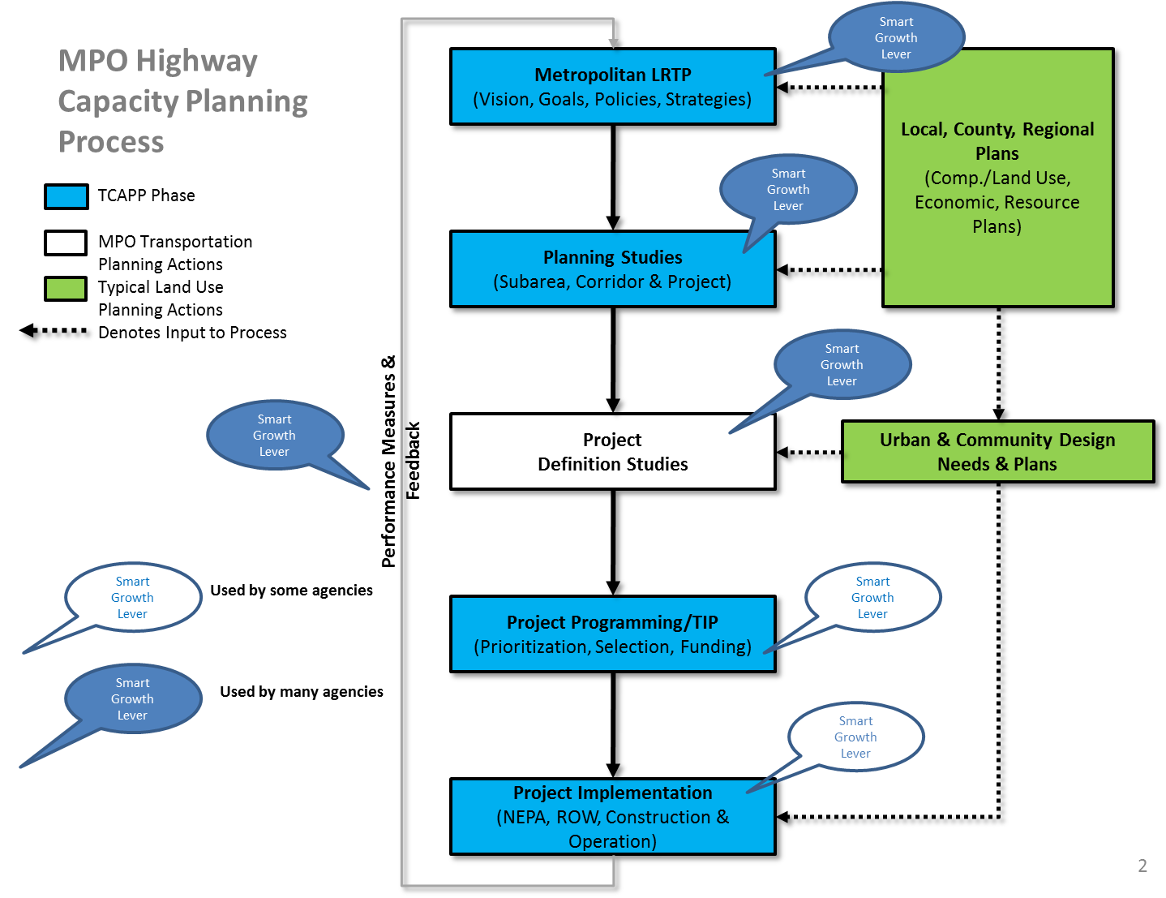
Decision points for smart growth …

Slide 10
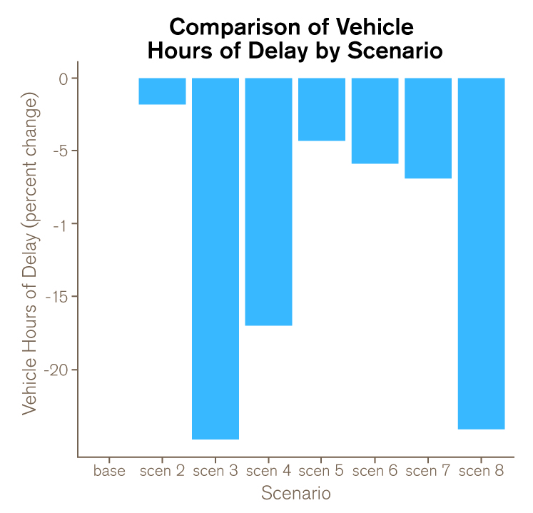
Visualizing performance metrics
Title, including Performance Metric (Vehicle Hours of Delay)
Percent Change in Performance Metric for each Scenario
Axis adjusted for each Performance Metric
Scenarios compared against the Base Scenario

Slide 11
Results screenshots

Slide 12
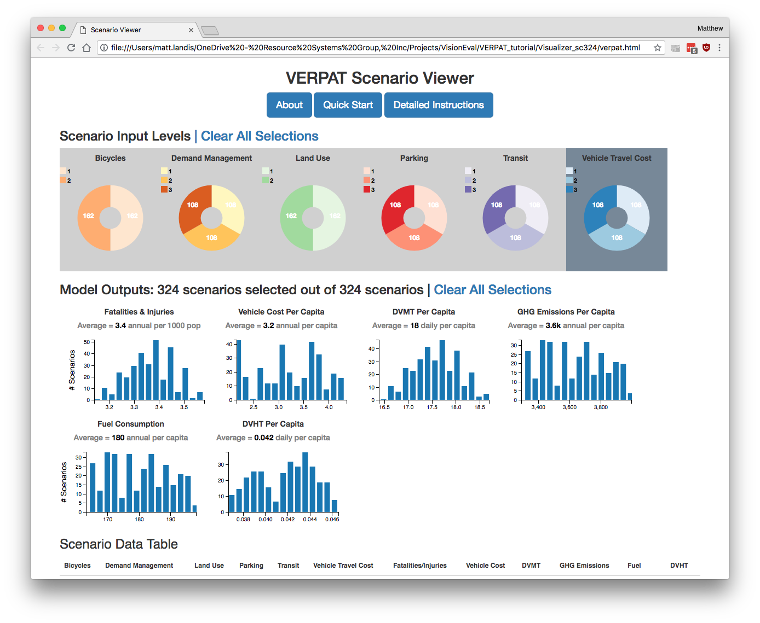

Slide 14
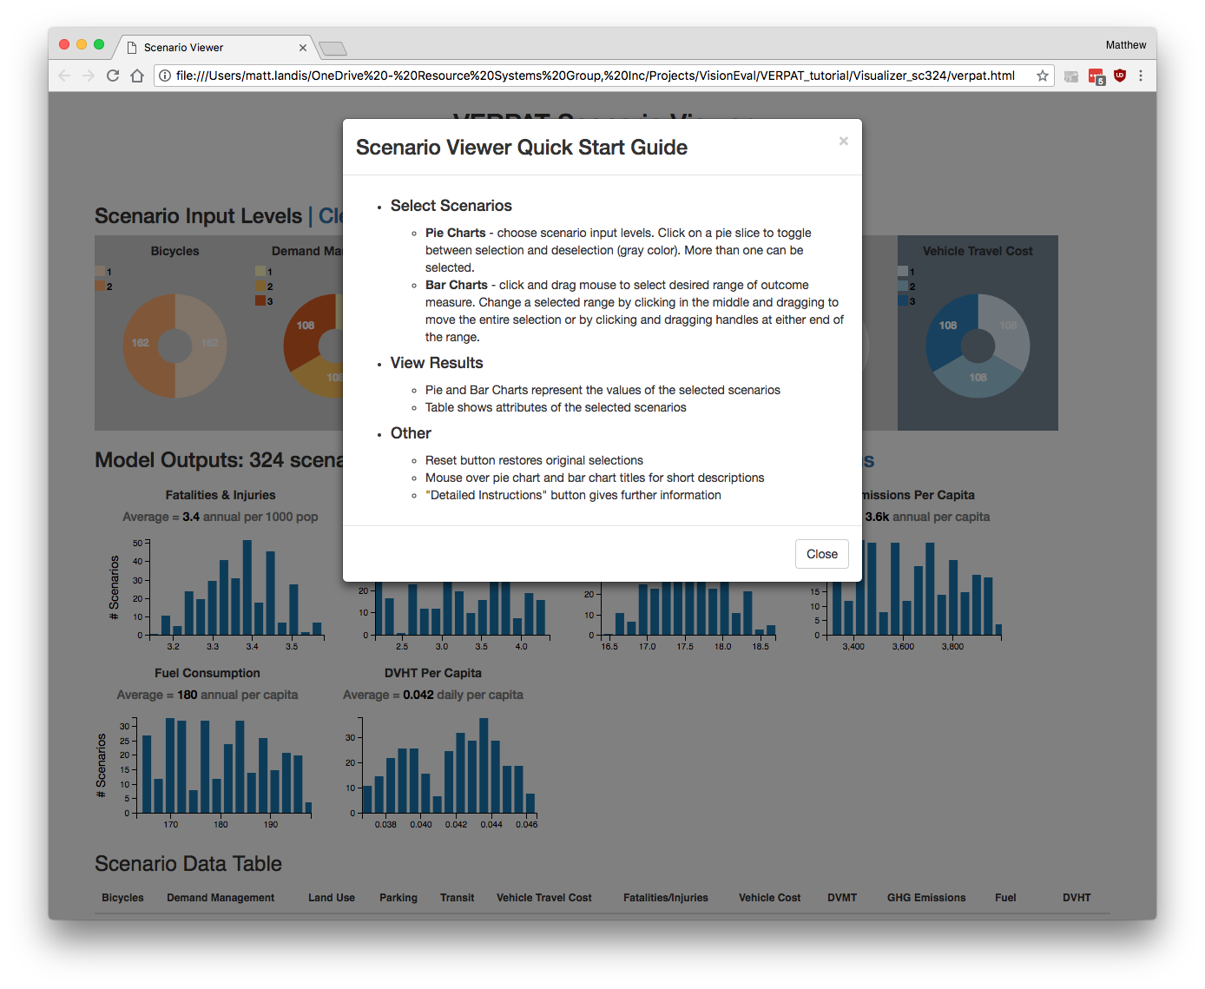

Slide 16
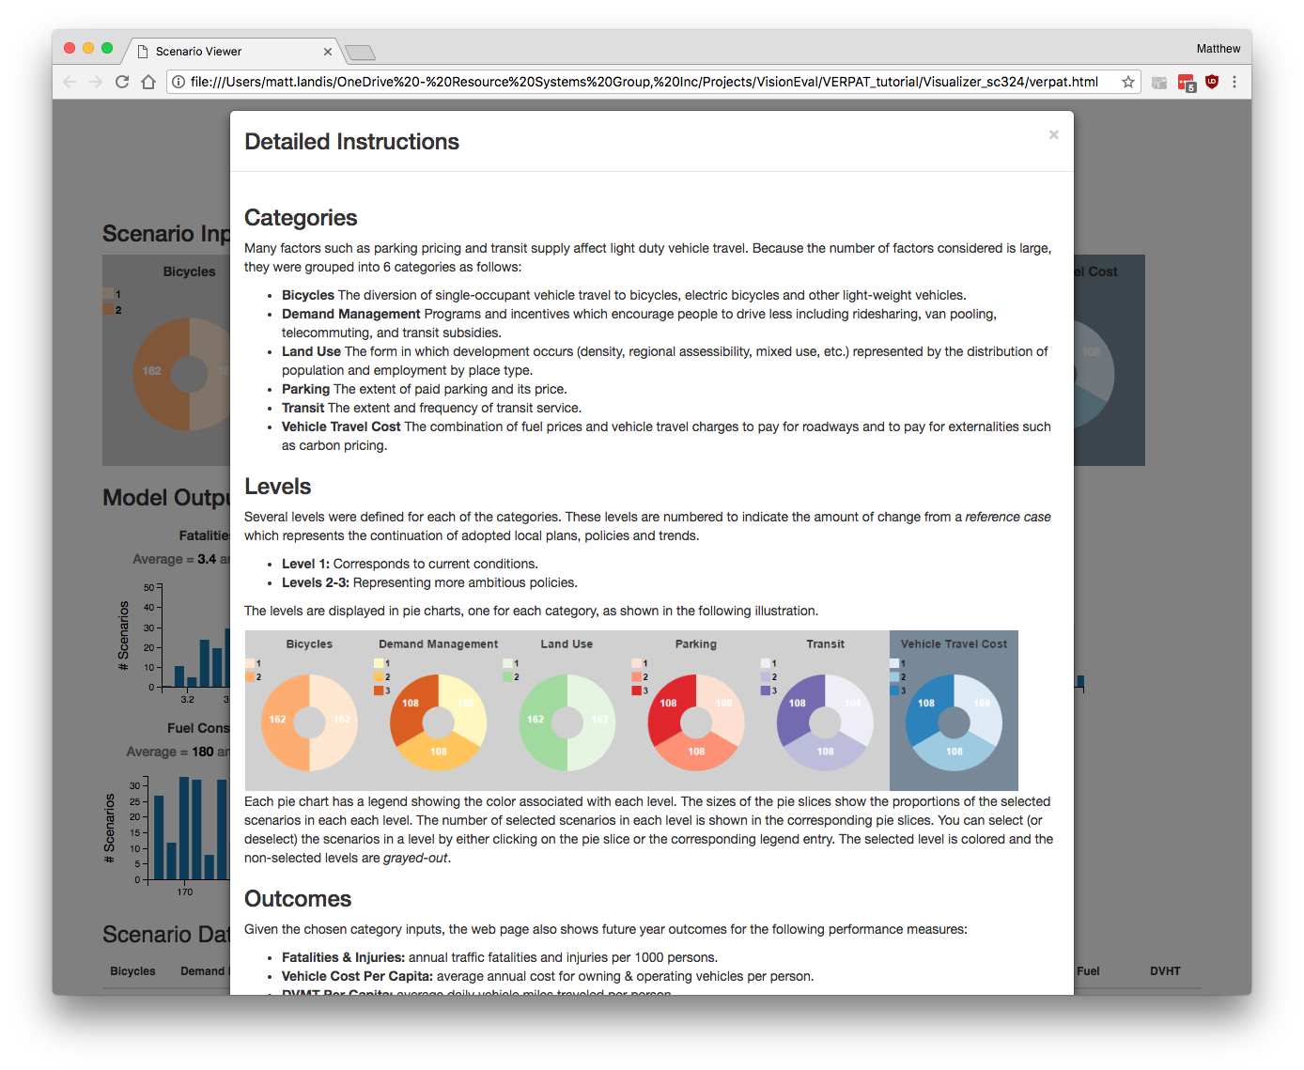

Slide 17
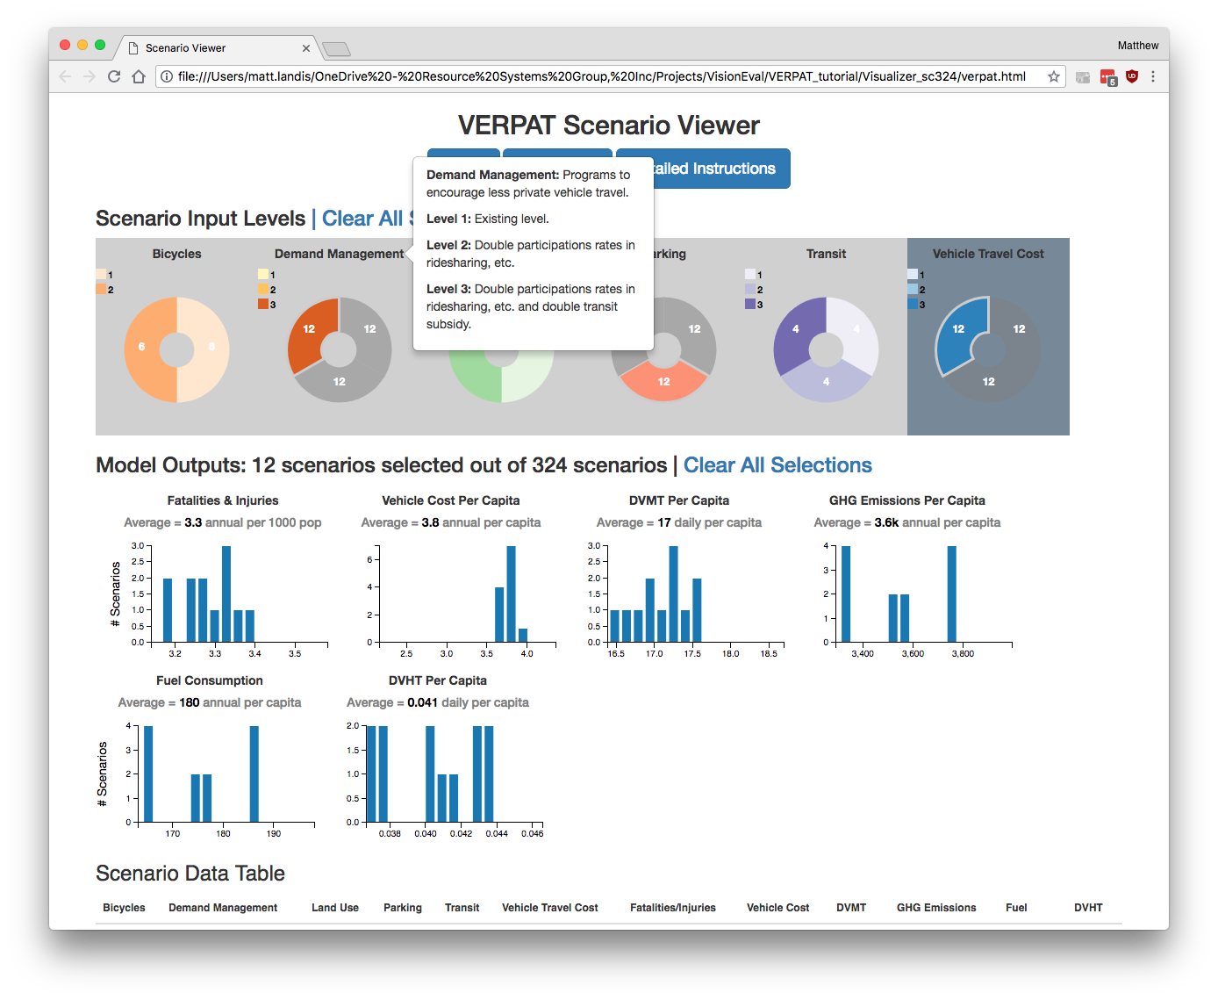

Slide 18
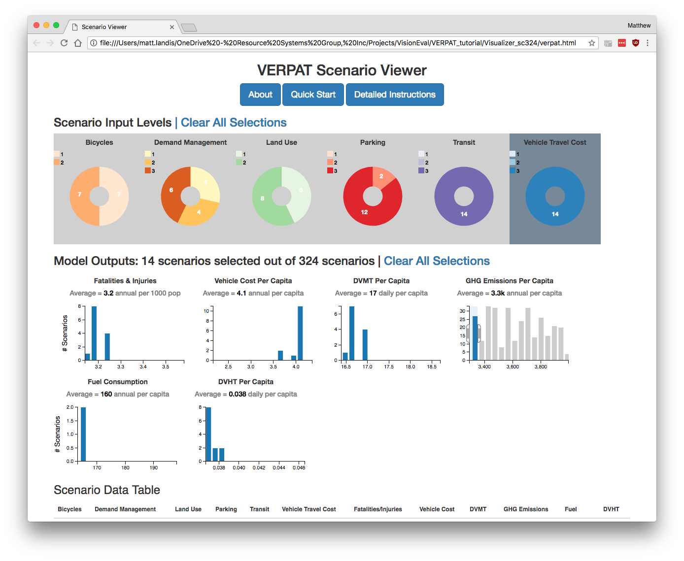

Slide 19
