Slide 1
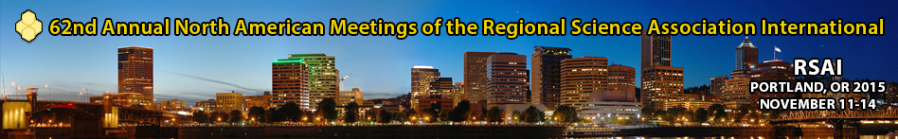
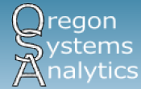


A Programming Framework for the Collaborative Development of Regional Strategic Planning Models
Brian Gregor, Oregon Systems Analytics LLC
Tara Weidner, Oregon Department of Transportation
Jeremy Raw, Federal Highway Administration
November 14, 2015

Slide 2
Outline
The need for Strategic Planning Models
Overview of the GreenSTEP family of models
Benefits of an open-source modeling system
VisionEval modeling system and software framework
Next steps and potential applications outside of transportation planning

Slide 3
The past transportation planning context …
Transportation planning (at least in the United States) proceeded on the assumption of continued increases in ‘automobility’, population, income, and vehicle travel would continue to increase.
Fundamental transportation changes to vehicle technologies and transportation services were not considered.
Focus on traffic congestion and ‘induced demand’ as the principal concerns.
Budget limitations and policy discord often resulted in an largely incremental approach to planning.
Major environmental constraints, other than localized constraints were not considered.
Notes:
Transportation planning is heavily influenced by past trends. Over many decades in the United States, population, incomes and vehicle travel have been rising steadily. Planning was done with the underlying assumption that “automobility” would continue to increase and planning should accommodate the increases.
Until recently, there have been few changes in passenger transportation technologies. Mode choices are the same as they’ve been for decades. Automobiles have become more durable, efficient, and comfortable, but have not changed in any fundamental way. Likewise for public transit.
The focus of transportation planning has been predominantly on traffic congestion and how to alleviate it. The Texas Transportation Institute’s biannual issuance of their Urban Mobility Report and the attention it receives is a prime example. More recently, the effects of roadway expansion on land use and “induced demand” have become more prominent in congestion discussions.
There is a considerable amount of political polarization in the United States and transportation planning is not immune. This has affected transportation budgets and the ability of states and metropolitan areas to develop big plans. As a result, transportation planning has focused on incremental changes.
Although environmental constraints were considered in a localized context (e.g. wetlands, cultural resources, air quality), they were not considered in the broader contexts of global warming, climate change, and sustainability.

Slide 4
… resulted in a model development focus on
Disaggregation
Behavioral model detail
Geographic detail
Land use – transport interactions
Integrated discrete choice framework
Enabled by expanding computer capabilities…
Notes:
The focus of transportation planning on stable trends, traffic congestion, incremental changes, and localized impacts influenced the direction of transportation model development, which emphasized:
Increasing disaggregation: microsimulation of populations, household activities, vehicle movements, time.
Increasing behavioral model detail supported by detailed travel surveys.
Increasing geographic detail: micro-zones and grids.
Land use and transportation interactions and induces demand.
There has been an emphasis on maintaining theoretical consistency across all model components and developing integrated transportation and land use models in a tightly-coupled discrete choice framework (nested models, log-sum feedback, etc.)

Slide 5
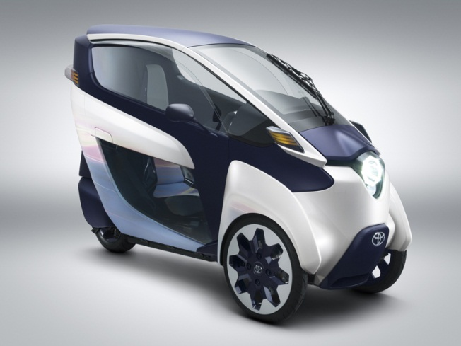


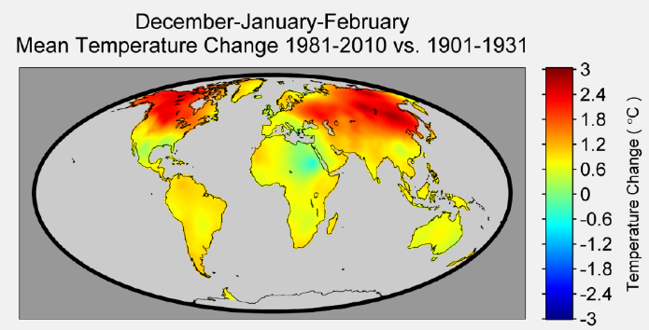

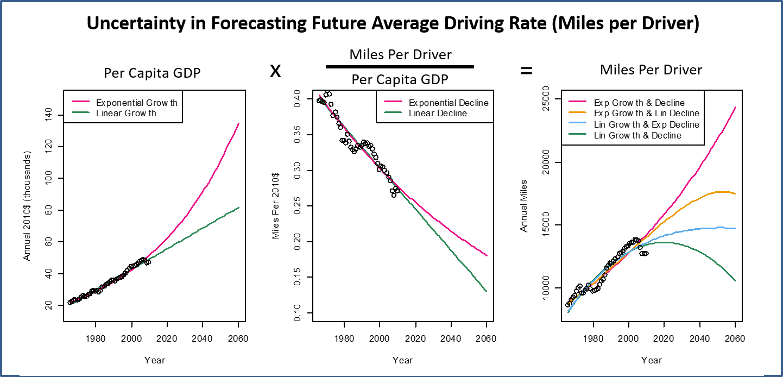
The planning context is changing …
Increasing ‘automobility’ is no longer a foregone conclusion.
Disruptive technologies and services are emerging.
Substantial constraints to the continuation of past trends are apparent.
There are substantial uncertainties.
Notes:
The planning context is changing with the emergence of disruptions to past trends:
Increasing automobility is no longer a foregone conclusion.
Per capita vehicle miles appear to have peaked.
There are indications that Millennials may have some different travel predispositions than their parents.
The baby boom generation is aging.
A number of changes to transportation technology and services are occurring.
Carsharing
Expansion of personal for-hire transportation: Uber, Lyft
Electric cars
Autonomous vehicles
Mobile apps
Electric bicycles and other light-weight electric transportation
Now it has become apparent that there are substantial constraints to the continuation of past trends:
The biggest of these is the need to greatly reduce carbon emissions from the transportation system
Reducing carbon emissions will require much greater fuel economy and ultimately a shift to electric and fuel cell vehicles
This will in turn greatly affect transportation financing and a shift to distance-based fees
Other changes to pricing may also be necessary to address the impacts of transportation: e.g.
There is considerable uncertainty about these and other changes such as fuel prices, income growth, and population shifts
This figure illustrates uncertainty with respect to changes in the rate of driving (vehicle miles traveled or VMT per driver). Over the past 40 years, the dominant components of vehicle travel growth in the United States have been the growth of population and the growth of the driving rate (miles per driver). A simple model can be used to explain past trends in the driving rate and examine the implications of those trends for the future. Miles per driver is the product of per capita GDP and the ratio of miles per driver to per capita GDP. The leftmost graph shows that real per capita GDP in the United States grew almost linearly over the past 40 years, although it is also possible to fit an exponential curve to the trend as well. The middle graph shows that the miles driven per dollar of GDP has been declining almost linearly. In other words we have become more productive with respect to the amount of travel. As with the trend in the previous graph, it is possible to fit an exponential curve to this trend. The rightmost graph shows all of the results of combining these trends. It can be seen that if per capita GDP grows linearly and the ratio of miles per driver to GDP declines linearly, that the U.S. is nearing a peak in the driving rate and the rate will drop in the future. This, perhaps is what we’re now observing in the reported trends. However, if per capita GDP grows exponentially and the ratio of miles per driver to GDP declines at a diminishing rate over time, then the driving rate will grow substantially in the future.

Slide 6
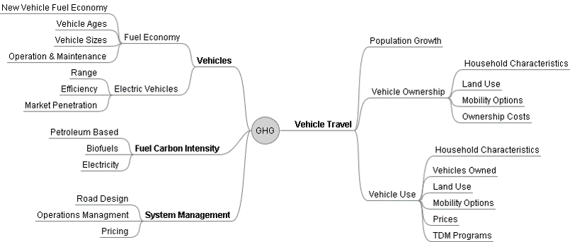

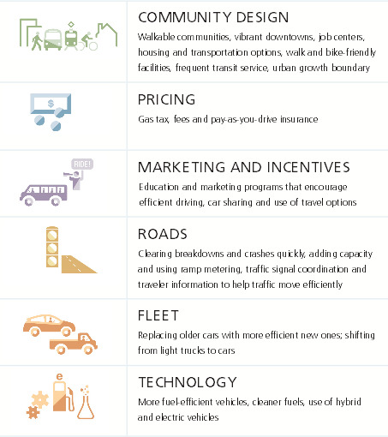
… requiring a strategic planning approach and the use of strategic planning models
Breadth over depth (inputs and outcomes)
Loosely coupled components allow modularity
Lighter model & short runtimes to explore large decision space:
1000s of what-if scenarios of many input combinations
Address resilience to future uncertainties
Communication of uncertainty and tradeoffs: e.g., through visualization, interactive web-based tools
Notes:
Disruptive changes, uncertainty, and the need to address constraints requires a strategic approach to transportation planning, and this requires strategic planning models. These models are different in that:
Large number of dimensions need to be considered. Breadth is more important than depth, both for inputs and outputs:
This figure, for example, shows the large number of factors that affect GHG emissions from passenger transportation: they include characteristics of vehicles, vehicle fuels, the management of the transportation system, and how people travel
These are also a number of outcome considerations, in addition to how congested the roadways are, such as the effects on public health, impacts to the environment, impacts to communities, energy demand, and economic effects.
Model components need to be loosely coupled so that new dimensions can be added easily (without redesigning and reestimating other components).
Exploring a decision space with many dimensions is a combinatorial problem requiring many runs. Model components need to be lightweight so that runtimes are short.
Need an efficient way to manage all of the combinations of dimensions while maintaining reasonable disaggregation of each dimension.
Need to have ways of communicating uncertainty and tradeoffs with the public, planners and decision makers.

Slide 7
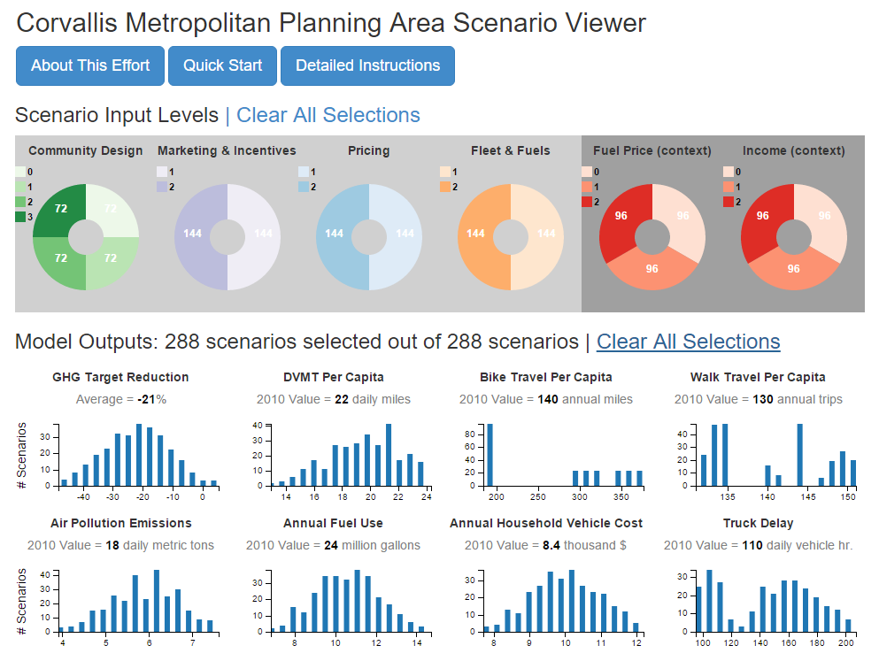
Example of data browser to explore the decision space
Notes:
It is very important that tools be developed to engage the public and decision-maker and to communicate trade-offs. This requires that strategic planning models run quickly so that hundreds or thousands of model runs can be done to explore the decision space, and that accessible interfaces be developed so that more people can interact with the data. Here is one example that has been developed to assist the planning process for a small metropolitan area in Oregon.

Slide 8
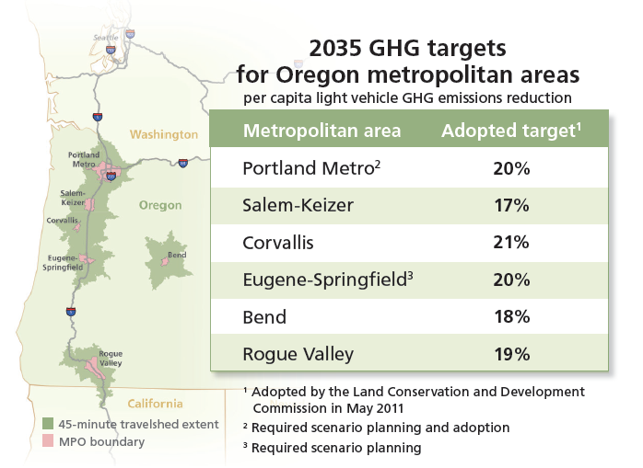
GreenSTEP: the beginning of a new strategic planning model system
Greenhouse Gas Strategic Transportation Energy Planning Model.
Developed to assist planning to meet state goals for reducing transportation sector GHG emissions.
Calculated via interagency effort using GreenSTEP
Notes:
The development of a strategic planning modeling system that this presentation is about, starts with the GreenSTEP model developed by the Oregon Department of Transportation. The GreenSTEP name stands for Greenhouse Gas Strategic Transportation Energy Planning Model. Work on the model started in response to goals adopted in Oregon for reducing greenhouse gas emissions. There is an overall goal in statute to reduce greenhouse gas emissions as a whole 75% from the 1990 level by 2050. There are also targets for reducing greenhouse gas emissions from light duty vehicles in metropolitan areas (beyond what is expected to occur as a result of improvements to fuel economy and reductions in fuel carbon intensity). At the time that work on GreenSTEP began, there were no other models available that would address the variety of factors affect greenhouse gas emissions (as seen in a previous slide).

Slide 9


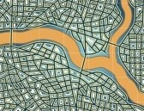
Factors Considered at the Household Level
Household Structure
Number of People
Ages
Income
Location Attributes
Density
Design
Transportation Attributes
Roads
Transit
Other
TDM
Eco-Driving
Parking
Carshare
Prices ...
40 12 8 36
Notes:
GreenSTEP, like many recent travel models, simulates households for a number of reasons:
It is important to evaluate the synergistic and antagonistic interactions between factors. For example increasing fuel economy will reduce the effect of increasing fuel prices and fuel taxes.
Policies and other non-policy changes (e.g. fuel prices) will affect households unequally. For example, as I will show in a following slide, pricing policies tend to affect lower income households more than higher-income households.
When modeling many dimensions, simulating individual households is much more efficient than the alternative of using a high dimensional array. For example, an array that represents 10 factors, each with five levels, would have almost 10 million cells.
Household-level modeling makes it easier to apply the same model to different geographic scales. GreenSTEP was first developed as a statewide model. We could convert it to a metropolitan area model with a reasonable amount of work because of the household-level modeling approach.

Slide 10



Forecasts Made at the Household Level
Vehicle Ownership
Number
Type/Technology
Age
VMT
By vehicle
Daily average
GHG & Energy Use
By vehicle
By fuel/energy type
Health
Walk Trips
Bike Miles
Expenditures

Slide 11
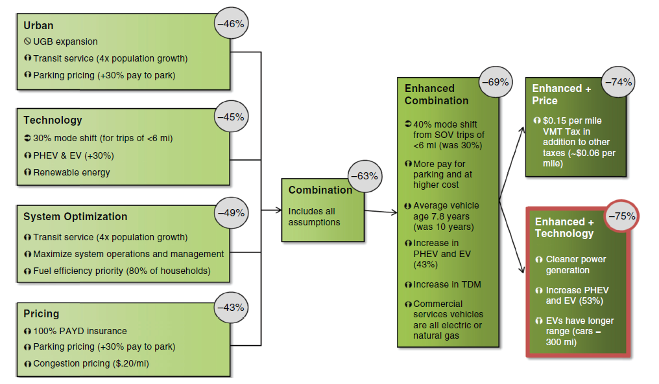
GreenSTEP Example: ODOT’s Statewide Transportation Strategy (STS) for Reducing GHG Emissions
X%
2050 state GHG reduction vs. target of 75%
Notes:
The first major planning application of GreenSTEP was the development of a statewide transportation strategy for reducing greenhouse gas emissions. Oregon’s state legislature adopted a law requiring the Oregon Department of Transportation to develop a strategy to assist in achieving the 2050 goal. This diagram summarizes some of the process for developing the strategy. Starting at the left-hand side, several thematic approaches for reducing emissions were considered. As expected, all were found to be inadequate. These themes were then combined, and when it was found that the combination was still inadequate, enhancements were made to the combination. Finally, two alternative approaches were tried for making the final reductions. The first was to increase prices to a level that would reduce demand sufficiently to meet the goal. The second was to pursue more ambitious improvements to transportation and power technology to reduce emission rates per mile.

Slide 12
Example of ODOT Statewide Transportation Strategy Household Results
Emissions vs. Income
Emissions vs. Density
Higher incomes affected more by technology
Lower incomes affected more by prices
At higher densities, enhanced tech has lower emissions than enhanced price
Notes:
The household-based modeling approach of GreenSTEP enabled us to see how emissions differed with regard to household characteristics. The left-hand figure shows how the emissions of households vary by household income under the four combination scenarios shown in the previous slide: combination, enhanced combination, enhanced combination with greater pricing, and enhanced combination with improved technology. One thing to notice regarding this is that the increased pricing scenario reduces emissions more than the improved technology scenario for lower household incomes, but the opposite is the case for higher income households. The right-hand figure shows that except for households living at the lowest densities, the improved technology scenario reduces emissions more than the increased pricing scenario.

Slide 13
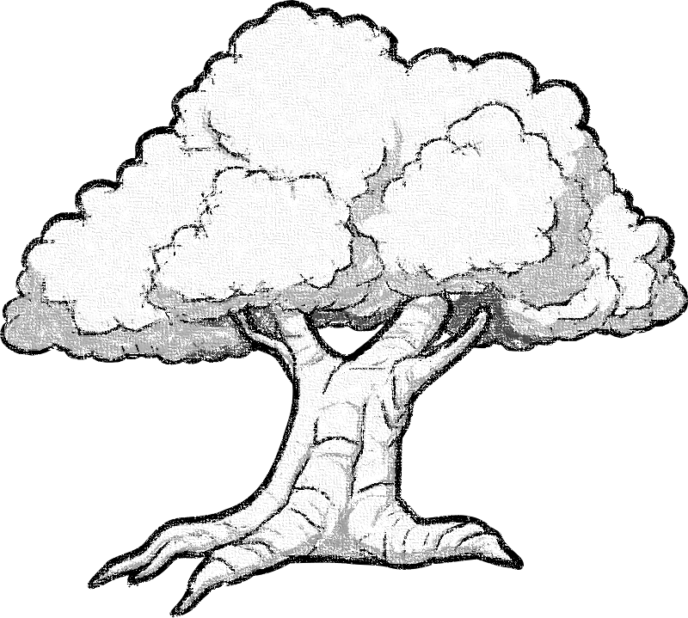
GreenSTEP became the basis of an ad hoc modeling system for strategic planning
Oregon
FHWA
Common modeling approach
Shared implementation code
All model estimation code is open
Model code is modular (mostly)
RSPM
Regional Strategic Planning Model
RPAT
Rapid Policy Assessment Tool (formerly SmartGAP)
EERPAT
Energy and Emissions Reduction Policy Analysis Tool
GreenSTEP
Greenhouse gas Strategic Transportation Energy Planning
Notes:
The GreenSTEP model got the notice of other transportation modelers and planners and several other models were spawned from it. These include the Federal Highway Administration’s Energy and Emissions Reduction Policy Analytic Tool (EERPAT) used for state-level planning, and Rapid Policy Assessment Tool (RPAT) used for metropolitan-level planning. It also includes ODOT’s Regional Strategic Planning Model (RSPM) which is a metropolitan version of GreenSTEP.
The development of new models from GreenSTEP was a consequence of a number of things, in addition to the model design including:
All of the model code was licensed by ODOT under an open-source license,
Component models were all estimated using the R language and all the scripts and data were made available. This made is easier for models to be re-estimated for other locations and uses.
The code was fairly modular so that changes and additions could be made without needing to change substantial portions of the code.

Slide 14
This current ad hoc modeling system…
Advantages:
Sub-models (i.e. modules) estimated independently.
Sub-model functions/procedures don’t directly interact with one-another.
Common design pattern used for calling most modules.
Limitations:
Not fully modular.
Possible to modify and extend, but multiple code changes may be needed.
No standard module interface.
Minimal data checking.
Notes:
Together these models form an ad-hoc modeling system because they share a modeling approach, many model components, and model code. This modeling system has a number of advantages including:
Sub-models are estimated independently
Sub-models are loosely coupled. These two things simplify revising or extending models.
A common design pattern is used for calling most models.
There are, however, several limitation to this ad hoc system.
The model framework is not fully modular. Some important functions are in main scripts and not in independent modules.
It is possible to modify and extend, but since it is not fully modular, multiple code changes may be necessary to modify and extend the model.
Although similar design patterns are used, there is no standardized module interface so custom programming is necessary.
There is minimal data checking. Incorrect input data will only be discovered at run time and the error messages are not particularly helpful in finding the source of the error.

Slide 15
VisionEval common framework is designed to…
Enable modules created by many independent developers to work together in models.
Enable new modules to be shared between different models.
Enable choosing mix of components for different models in a declarative manner, by listing the modules they want to run in the desired order.
Provide full self-documentation of modules including how sub-models were estimated and input requirements.
Open estimation code that it can be replicated and modified.
Provide services for checking all inputs for consistency so that errors are flagged before a model is run.
Notes:
Our goal is to formalize the model system. The objectives are to:
Enable modules created by many independent developers to work together in models.
Enable new modules to be shared between different models.
Enable choosing mix of components for different models in a declarative manner, by listing the modules they want to run in the desired order.
Provide full self-documentation of modules including how sub-models were estimated and input requirements.
Open estimation code that it can be replicated and modified.
Provide services for checking all inputs for consistency so that errors are flagged before a model is run.

Slide 16
VisionEval framework in a nutshell
Modules that meet specifications ‘plug into’ framework services and are run successively.
‘Initializing’ creates a common datastore and checks and loads scenario inputs.
All information is passed to and from the datastore, controlled by the framework services.
‘Loading’ the framework provides controls and services.
Models are specified with a simple declarative script.
library(visioneval)
initialize(“MyScenario”)
run(“CreateHouseholds”)
run(“PredictIncome”)
run(“PredictVehicleOwn”)
…
Load Required Inputs into Datastore
Save Module Outputs to Datastore
Get Required Data from Datastore
Initialize Model Environment
Create Households
Predict Income
Predict Vehicle Ownership
Framework Services
Framework Datastore

Slide 17
Components of Modeling System
Framework
Modules
Models
SERVICES
Initialize model data store
Check that model data dependencies are satisfied
Retrieve data from storage
Write data to storage
Run model modules
Manage errors
Calculate performance measures from data store
…
DATA STORE (HDF5)
Data Groups
Household Characteristics
Vehicle Characteristics
Place Characteristics
Metadata
PACKAGES
MODEL SCRIPT
initializeModel (“HighGasPrice”)
run (“SynthesizeHH”, pkg=“HH”)
run (“PredictWkr”, pkg=“HH”)
run (“PredictInc”, pkg=“HH”)
run (“PredictAuto”, pkg=“Auto”)
run (“PredictVMT”, pkg=“Travel”)
…
Travel
Modules
SythesizeHH
PredictWkr
PredictInc
Documentation
…
Auto
Modules
SythesizeHH
PredictWkr
PredictInc
Documentation
…
HH
Modules
SythesizeHH
PredictWkr
PredictInc
Documentation
…
API for model modules and packages of modules
Common services for running modules
Management of data storage shared by modules
Module developers combine modules into R packages
Compiled code (e.g. Fortran, C++, Java) can be included
Simple declarative script for combining modules into model

Slide 18
Establishing consistency for geography:
Create consistency in how statewide and metropolitan level models define space in order to enable modules to be shared by all models.
Four geographic definitions:
Azone: County or Census Public Use Microsample Area (PUMA) – used for population and economic forecasts, …
Bzone: Census Tract – used for simulating neighborhood characteristics such as population density, …
Czone: Subdivision of Census Tract – used for simulating development characteristics such as mixed use development, …
Marea: Metropolitan Area – used for modeling transportation supply, congestion and urban area expansion, …
Azones for all models correspond to real boundaries, but Bzones and Czones can be either real geographic entities or simulated entities. Mareas can change over time.
Bzones nest in Azones. In metropolitan area models (RSPM) they may represent real boundaries (census tracts). But in statewide models they may be simulated entities.
Metropolitan
Statewide

Slide 19
Development Status
Working with a technical advisory committee to develop the framework code, standards for modules, demonstration modules, module template, documentation.
Follow along on GitHub: https://github.com/gregorbj/VisionEval
Schedule:
2015: Development work completed (demo code/standards)
2016: Migrate existing models to the new framework
Open Source Project multi-agency partnership:
Provide governance and forums for technical & policy makers
to use, extend, and share tool experiences.

Slide 20
Potential applications outside of transportation planning
Several modules used for transportation planning can be used for other purposes as well:
Synthetic households (income, household size, age, land use type) can be the basis for add-on modules like health impacts of active travel.
Extend framework to add new functionality:
Housing type prediction – add affordability, building age, etc.
Travel budget model – add more aspects of household budgets
Household synthesis – add education and job status of households
Other ideas:
Use housing types and household characteristics to model of household energy consumption.
Use household, housing, and neighborhood characteristics to model water consumption

Slide 21
Contacts
https://github.com/gregorbj/VisionEval
Brian Gregor (corresponding author)
Oregon Systems Analytics LLC
gregor@or-analytics.com
Tara Weidner
Oregon Department of Transportation
Tara.J.WEIDNER@odot.state.or.us
Jeremy Raw
Federal Highway Administration
jeremy.raw@dot.gov

