Slide 1

Predicting Multiple Time Series with USA COVID-19 data using ML models
Researcher:
John Ray Martinez johnray.balistoy.martinez@drexel.edu

Slide 2
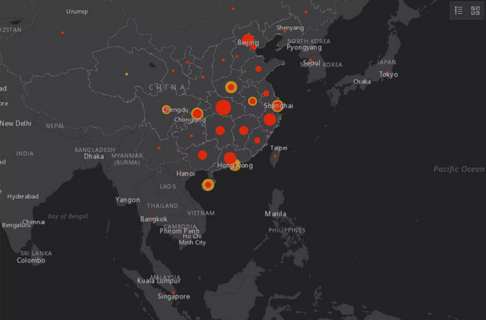
Is it possible to use one Machine Learning model on multiple time series data to project future COVID-19 Confirm Cases

Slide 3

Objectives
Train a single ML model to forecast multiple time series at the same time
Investigate the performance of the following ML models in COVID-19 daily confirmed cases data
Linear Regressor
RandomForest Regressor
Gradient Boost Regressor
XGBoost Regressor
Identify the Machine Learning model with the best performance

Slide 4

The DATASET
11,128 COVID-19 daily confirm cases
7 months (01/22/2020 – 08/22/2020)
1 country
Source of Data: 2019 Novel Coronavirus COVID-19 (2019-nCoV) Data Repository by Johns Hopkins CSSE. https://github.com/CSSEGISandData/COVID-19

Slide 5
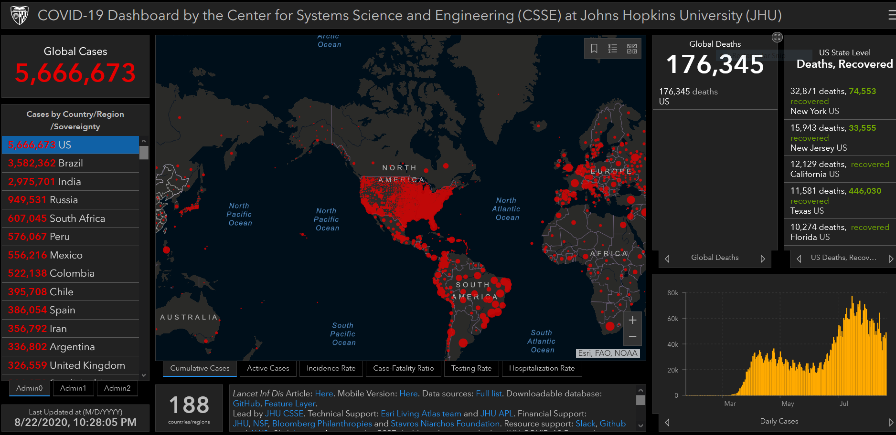
Target variable: Daily Confirmed Cases

Slide 6
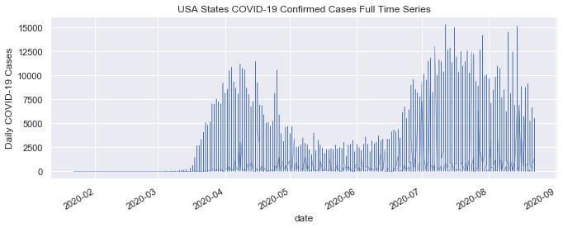
Daily Confirmed Cases vs Outbreak Time
Time series plot of US Daily Confirmed Cases over the study period of time

Slide 7
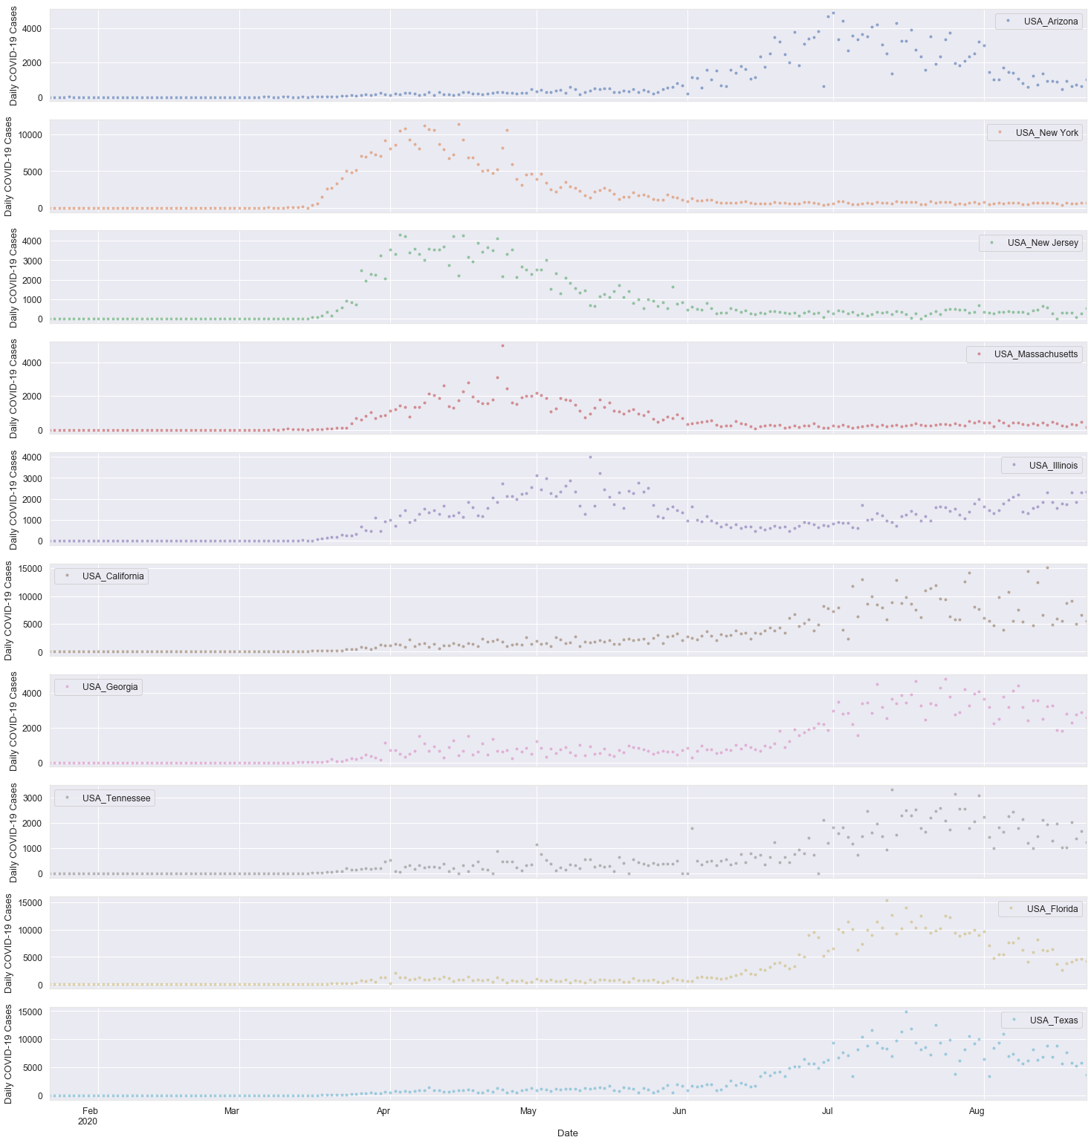
States Time Series Decomposition

Slide 8
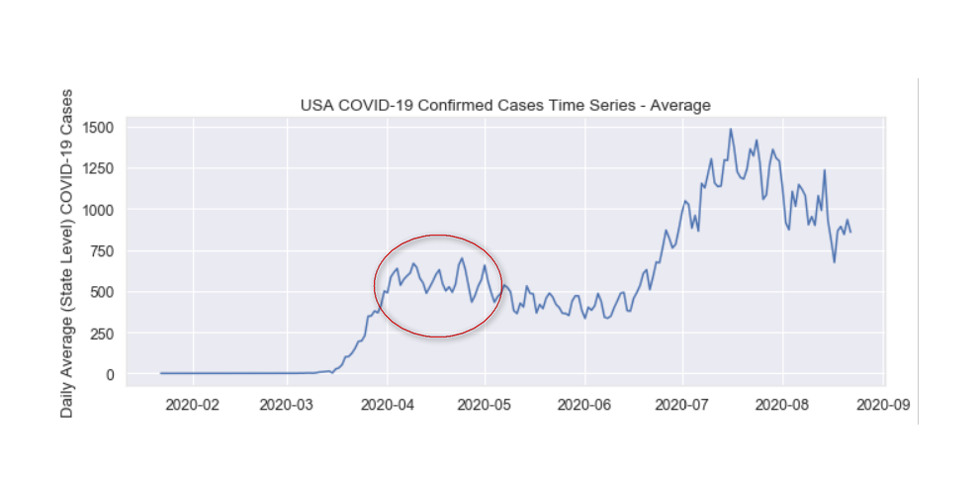
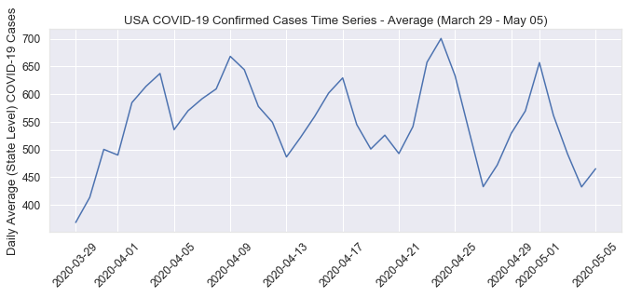
Average Confirmed Daily Cases
Daily confirmed cases were doubled starting late June while tripled after first week of July compared to previous month
Lowest number of daily average confirmed cases Sunday-Tuesday
Highest number of daily average confirmed cases Thursday-Saturday

Slide 9
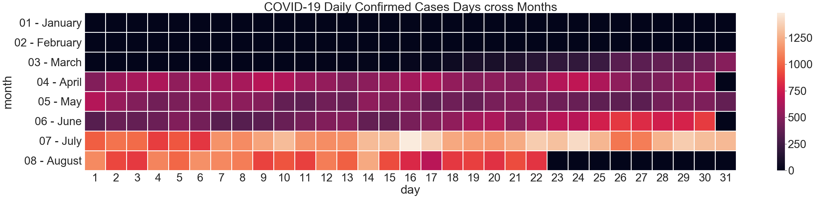
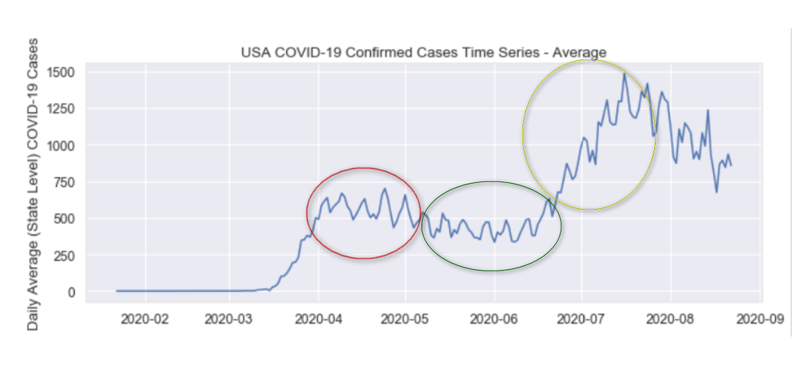
Heatmap of Outbreaks
Earlier peak during month of April and had been on a downward trajectory for months of May and early June, resurgence can be seen starting June 25 when the cases is doubled then spiked starting July 7 when the cases has tripled

Slide 10
Preprocessing
1 Feature engineering (Lag Features)
2 Data Merging (Population, Kalman Filtering)
3 Feature selection (Pearson Correlation)
4 Data transformation (Log, Polynomial)
5 Categorical Encoding (LE, OHE)
6 ML Modeling
OHE of 52 States increases the sparsity of the data

Slide 11
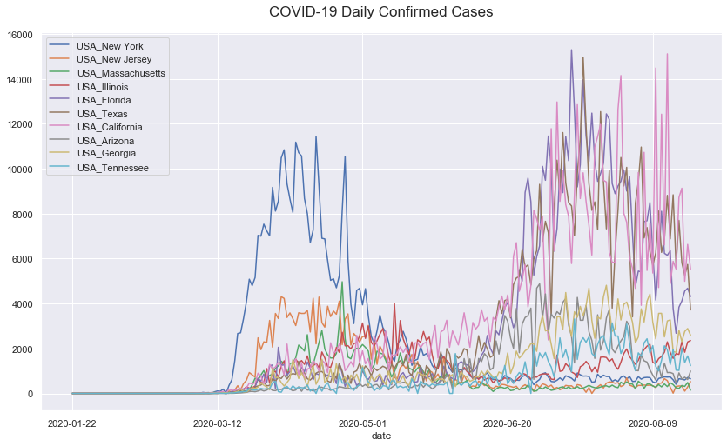
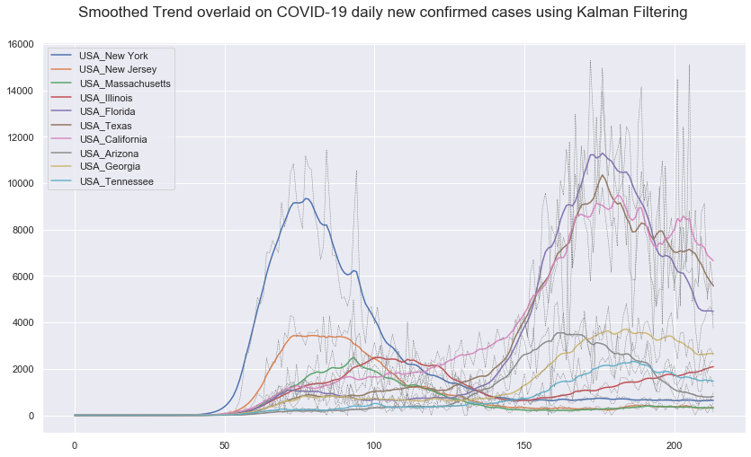
Preprocessing
Kalman Filtering

Slide 12
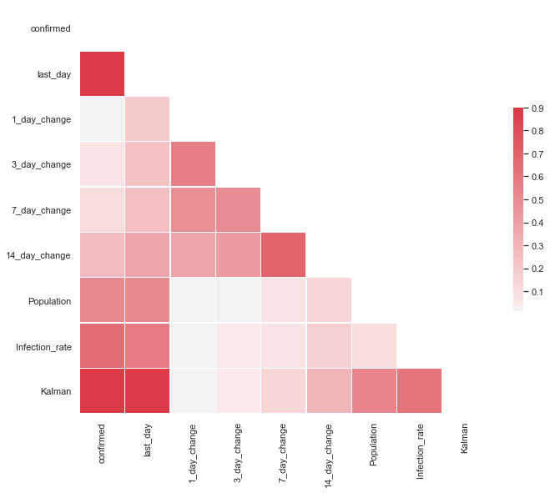
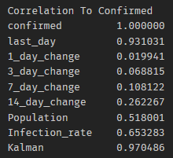
Feature Selection
Selected Features: last_day, Infection_rate, kalman
Multicollinearity Issue: drop Population

Slide 13
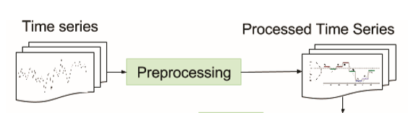
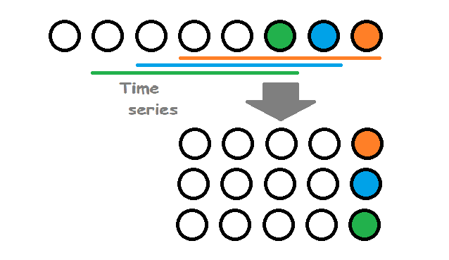
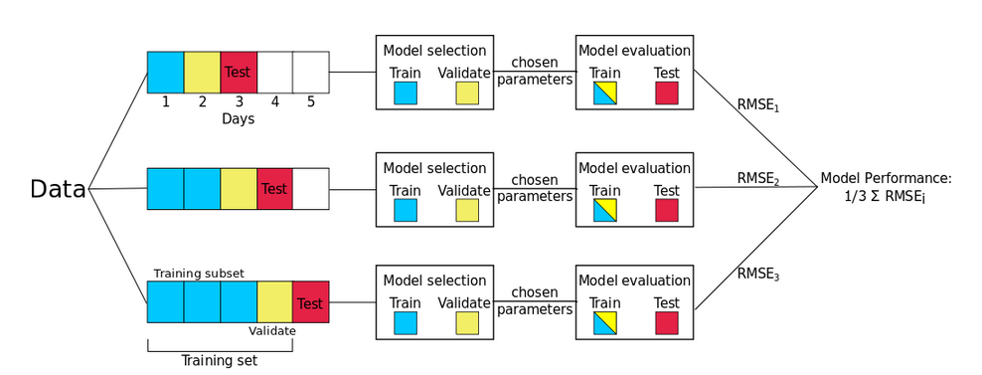
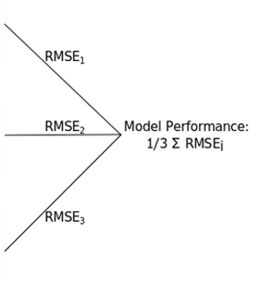
Methodology
Feature Engineering – Lag Features
Data Merging (Population, Kalman)
Feature Selection (Pearson Corr)
Data Transformation (Log, Poly)
Categorical Encoding (LE, OHE)
Time Series Split
Recursive Forecasting

Slide 14
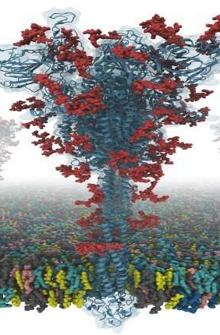
Machine Learning Models
Models
Linear Regressor
Random Forest Regressor
Gradient Boosting Regressor
XGBoost Regressor
Time Series Split Data
Training set - (01/22/2020 – 06/30/2020)
Validation set - (07/01/2020 – 07/31/2020)
Test set - (08/01/2020 – 08/22/2020)
Performance Criteria
R²
Root Mean Square Error (RMSE)
Mean Absolute Error (MAE)

Slide 15
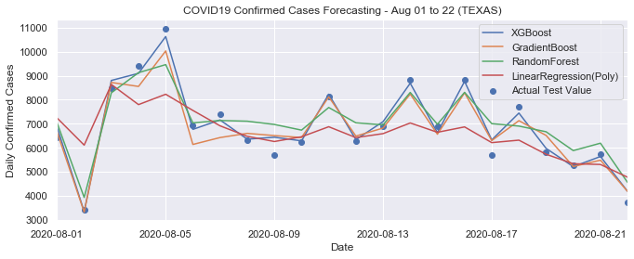
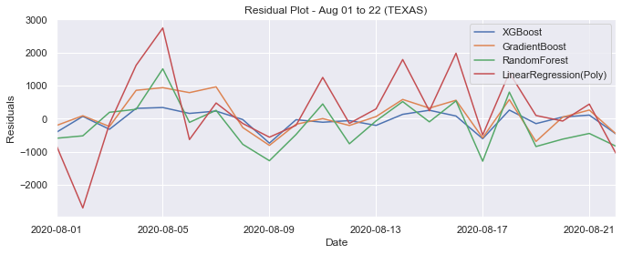
Prediction and Residual Plots over the Test Set (TEXAS)

Slide 16
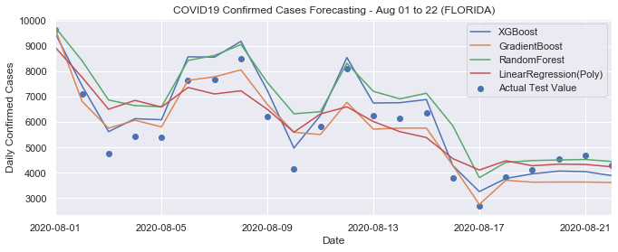
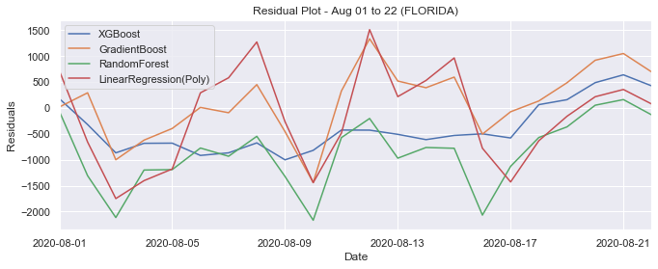
Prediction and Residual Plots over the Test Set (FLORIDA)

Slide 17
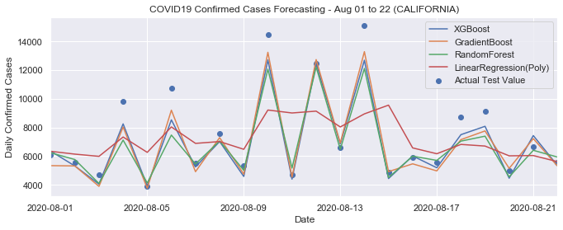
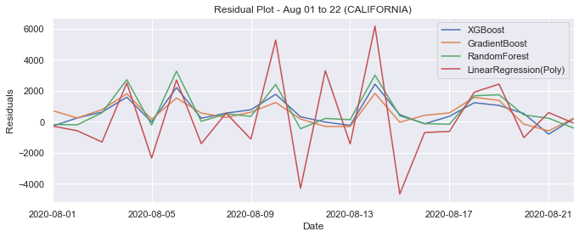
Prediction and Residual Plots over the Test Set (CALIFORNIA)

Slide 18
Statistics for prediction of COVID-19 daily confirmed cases
Parameter | Model | Data | Criterion |  |  | Elapsed Time
 |  |  | R² | RMSE | MAE
 | Baseline | Train | 0.867 | 720 | 304 | 89ms
default | Linear Regressor | Train | 0.395 | 1709 | 712 | 2.40s
 |  | Test | 0.548 | 1106 | 526
default | Linear Regressor (Polynomial=2) | Train | 0.955 | 430 | 186 | 1.31s
 |  | Test | 0.922 | 457 | 172
n_estimators=3000, max_depth=None, min_samples_leaf=1, min_samples_split=2 | Random Forest Regressor | Train | 0.966 | 356 | 140 | 28m 33s
 |  | Test | 0.967 | 295 | 123
n_estimators=3000, learning_rate=0.05, max_depth=3, min_samples_leaf=1, min_samples_split=2 | Gradient Boosting Regressor | Train | 0.986 | 227 | 97 | 10m 13s
 |  | Test | 0.985 | 200 | 94
n_estimators=3000, learning_rate=0.1, max_depth=6, min_child_weight=1 | XGBoost Regressor | Train | 0.978 | 265 | 99 | 7m 37s
 |  | Test | 0.986 | 188 | 77

Slide 19
Summary and Future Work
Estimated values of COVID19 daily confirmed cases were in good agreement with their related observed values and the used Machine Learning models, especially the ensemble method – Boosting models, could be used to forecast daily confirmed cases.
Results are very worthwhile for the decision-making bodies or public health experts given that the decision is urgent
Merge more domain-related data like temperature, lockdown periods, etc, that have significant impacts in variation of number of COVID19 cases
Explore the direct forecasting approach
Machine learning strategies for multi-step-ahead time series forecasting
by Souhaib Ben Taieb PhD thesis, University of Mons, Belgium
Source: http://souhaib-bentaieb.com/pdf/2014_phd.pdf

Slide 20


Thank You
Researcher:
John Ray Martinez, jbm332@drexel.edu

