Slide 1
numpy/mp Exercises

Slide 2
Session Outline
Session materials
https://github.com/jrb28/BUAD5042NumpyNumbaMP
3 exercises
Breakouts
Think of alternatives (5 min)
Discussion
Code (10-15 min)
Discussion

Slide 3
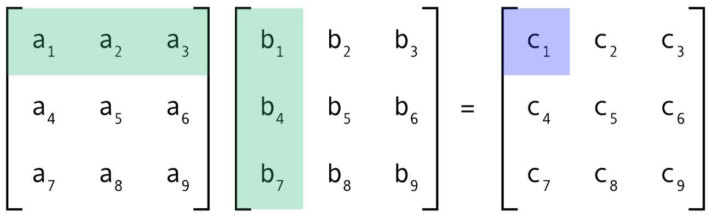
Ex. 1: Matrix Multiplication
Code with numpy and mp in matmul.py
Image source: https://medium.com/ai%C2%B3-theory-practice-business/fastai-partii-lesson08-notes-fddcdb6526bb

Slide 4
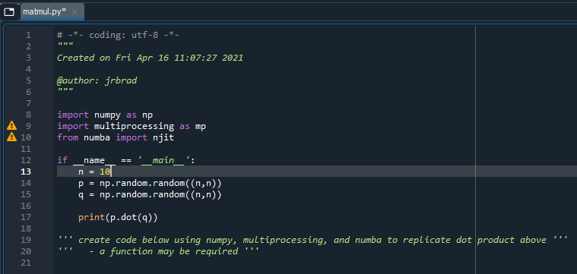
Ex. 1: Matrix Multiplication

Slide 5
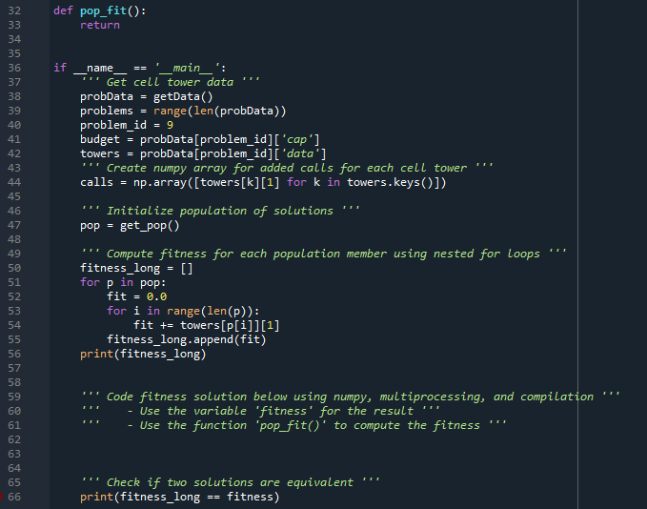
Ex. 2: Population Fitness
Fitness for Cell Tower Problem GA: fitness.py

Slide 6
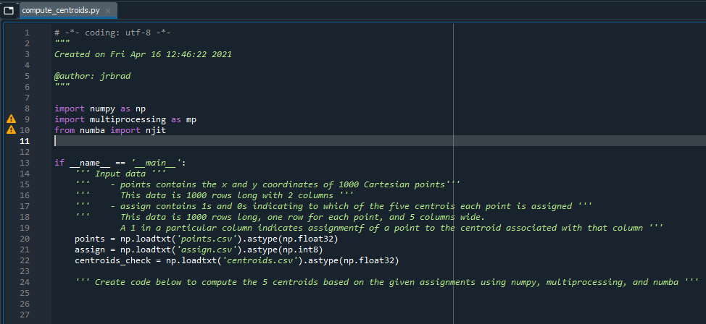
Ex. 3: Computing Centroids
compute_centroids.py

