Slide 1
Python in Two Hours
James R. Bradley

Slide 2
Python in Two Hours
Impossible to be a Python expert in 2 hours
Need to know basic Python, plus packages like numpy and pandas
Main goals
Give you a solid basis
Excite you about Python
Give you ideas on what it can do
What we’re going to do
Cover a lot of the basics (not comprehensive)
Show interesting projects
Most of the code will have been explained

Slide 3
What is Programming?
Sequence of instructions, which the computer executes
A Python engine interprets statements for the CPU
Requirements for a program:
Can be interpreted by the Python engine (proper syntax)
The code does what we want it to do

Slide 4
Why Python?
Because it’s widely used in analytics
Trend from SAS toward R and Python

Slide 5
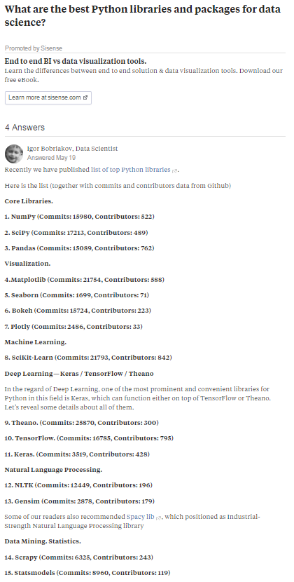
Web page for popular Python packages

Slide 6
Content
See Jupyter notebook: Python101.ipynb

Slide 7
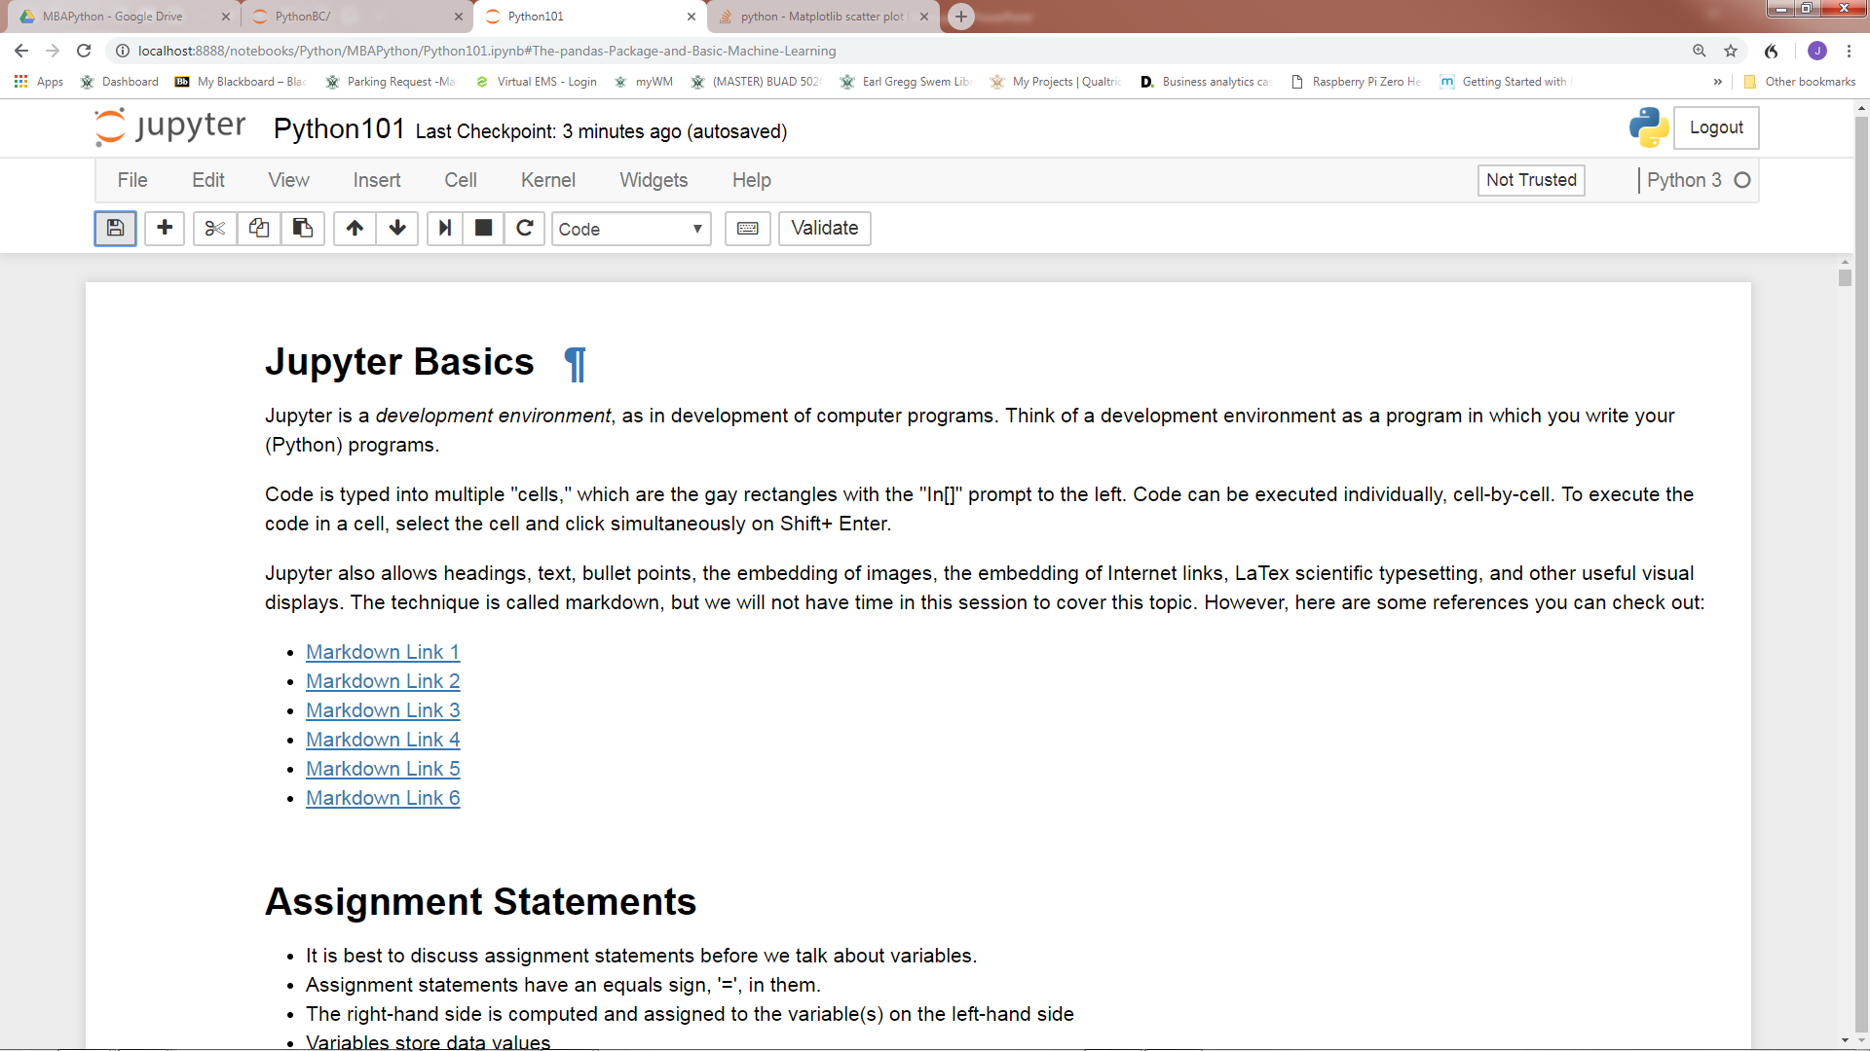
Jupyter

Slide 8
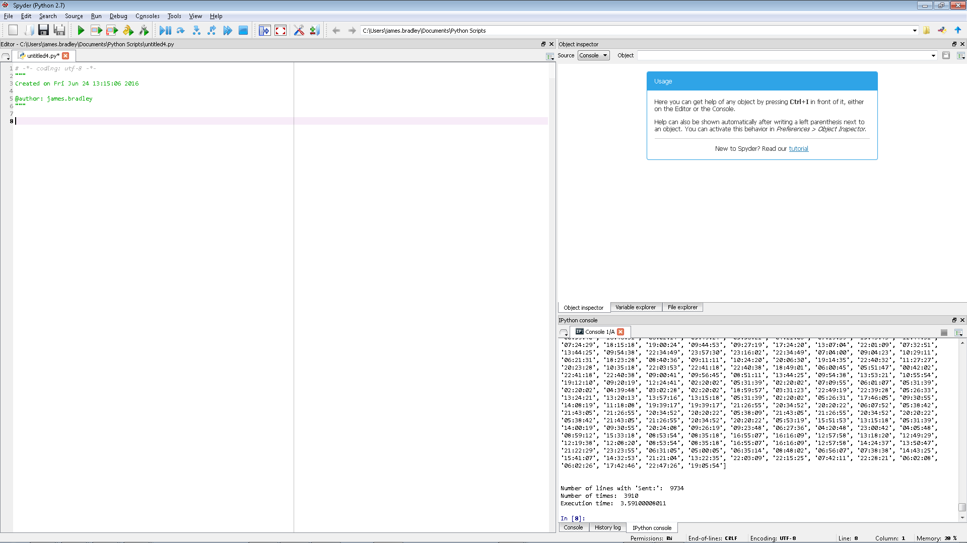
Spyder
Object Explorer
Script Editor
Write many lines of code for sequential execution here
Console
Run 1 or a few lines of code here

Slide 9
To Learn Further
Future: MSBA Python course offered to MBAs
Severance courses on Coursera
https://www.coursera.org/learn/python
https://www.coursera.org/learn/python-data
https://www.coursera.org/specializations/python
Specialization
Udemy.com pandas course
https://www.udemy.com/data-analysis-with-pandas/
Software APIs on MSBA page
https://mason.wm.edu/current/mymsba/software_installation/index.php

Slide 10
To Learn Further
TeamTreehouse.com courses, workshops, & practice
Disclaimer: I have not tried
Python Basics
Introducing Lists
Practice Python While Loops
Practice Creating and Indexing Lists
Practice comparisons in Python
Practice Writing loops in Python
Practice Basic Math Calculations
Practice Using Strings and Lists…
Introduction to Anaconda
Jupyter Notebooks
Introduction to Data Visualization
Introduction to numpy
CSV and JSON in Python
Python File I/O
Python Comprehensions
Using databases in Python
Regular Expressions in Python
Object oriented Programming
Python for File systems
Functional Python

