Slide 1
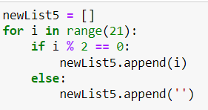
[
]
What to append in if-else format
For Iterator

