Slide 1
Regular Expressions (Regex)
James R. Bradley

Slide 2
Regular Expressions
Purposes
Finding patterns of characters
Text analysis
For processing text, strings
Validating data entry:
Email addresses, phone numbers, social security numbers
Replacement, substitution
Cleaning text
Removing characters
Stripping whitespace characters, punctuation
Parsing text
Splitting strings into a list of words at occurrence of particular characters

Slide 3
Regular Expressions
Specific applications
Webscraping
Specifying tag attribute values
Filtering text
Finding relevant filenames in hard drive folders
Finding relevant email messages based on content or distribution
Finding relevant database records
Searching for comments in Python files
Finding code or markdown cells in Jupyter files

Slide 4
Put Regex on Your Resume
Take a course
Lynda.com
Free, “Regular Expressions Training and Tutorials,” Kevin Skoglund
Go through the Swem Library web site
https://www.lynda.com/Regular-Expressions-training-tutorials/1066-0.html
Comprehensive, many examples at the end
datacamp.com
https://www.datacamp.com/courses/regular-expressions-in-python
Post a project on Github

Slide 5
Training Tasks
Multiple iterations of…
Exposure to various Regex syntax examples
Applying those examples to different tasks
Using regexr.com
Other similar environments mentioned in references
Complete a programming task
Using Python
Find all email address in file of email messages

Slide 6
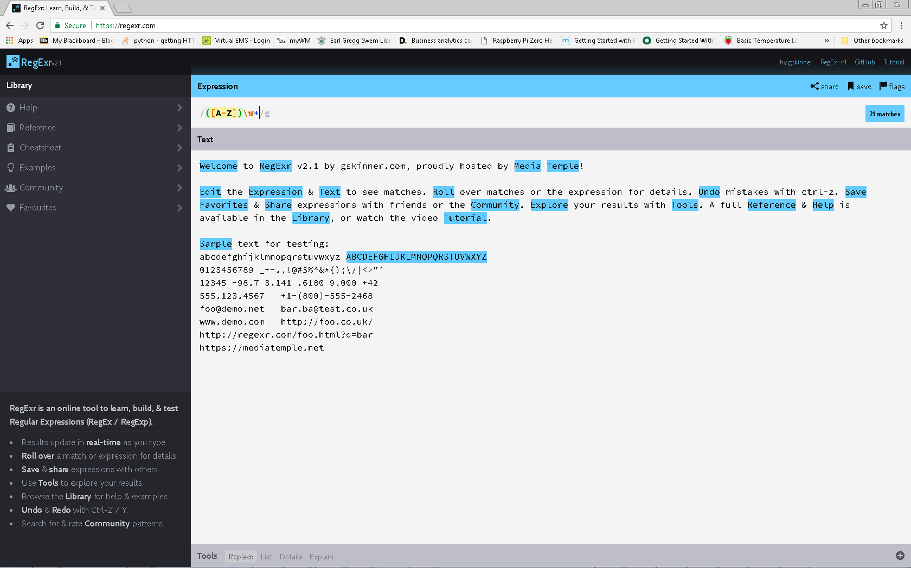
Regular Expressions

Slide 7
Syntax Instance 0
Insert Text into regexr.com
Matches that contiguous pattern of letters
Matches in regexr.com are indicated by highlighting
(T|t)ext
Matched “text” with either upper or lower case t
The pipe (|) performs logical or
The parentheses group the upper/lower cases of the t together
[Tt]ext
Brackets indicate that any of the characters contained therein can be matched
Examples (to try in regexr.com)
[abc]
[d-g]
[4-7]

Slide 8
Exercise 0
Search for Roll
Search for either reg or Reg
Find all instances of these two sequences of letters: in or on

Slide 9
Syntax Instance 1
\d: or [0-9]: numeric digits
\D: characters that are not numeric digits
Append these to the right of \d or \D:
{n}: find n contiguous instances
{m,n}: append to right end of one of the above to find at least m instances and at most n instances contiguously
Examples (to try in regexr.com)
\d
\d{3}
\D
\D{2}
\d{2-4}

Slide 10
Exercise 1
Match any sequence of 2 digits
Search for patterns of 1 to 3 consecutive digits
Match any sequence of 3 or 4 digits preceded by a dash
Find sequences of digits, any length, followed by a decimal point

Slide 11
Syntax Instance #2
\w:
Any character that could be used in a word, plus digits and the underscore
Any character from a-z, A-Z, 0-9, including _ (underscore)
Also could be written [a-zA-Z0-9_]
The [] syntax permits matching any one of the characters within the brackets
\W: characters that are not numeric digits
Examples (to try in regexr.com)
\w
\w{3}
\W
\W{2}

Slide 12
Exercise 2
Match all words and numbers that have three characters, and without and decimal points or periods
e.g., 123, abc, 1c5
Search for between 3 and 5 contiguous word characters

Slide 13
Syntax Instance 3
\b
Detects “word breaks” which consist of white space, newlines, symbols, etc.
Examples:
\b\w{3}
\b\w{4}\b

Slide 14
Exercise 3
Detect patterns of 3 contiguous digits with word breaks before and after

Slide 15
Syntax Instance 4
.
Matches any character except a newline character
\.
Matches a period or decimal point
\ is an escape character: says that you aren’t using . as a wildcard

Slide 16
Example 4
Find all periods on regexr.com

Slide 17
Syntax Instance 5
?
Find 0 or 1 of a character
*
Find 0 or more of a character
+
Find 1 or more of a character
Examples
\w+
[0-9]+
[0-9]+\.?
[0-9]*\.?[0-9]+

Slide 18
Exercise 5
Find patterns with:
Any number of numeric digits,
Followed by either a decimal point or a comma,
Followed by three numeric digits,
Followed by a word break

Slide 19
Syntax Instance 6
[^w]
Within brackets the caret, ^, means “not one of these characters”. Here “not w”
Examples
[^\d]
[^abcdr]

Slide 20
Exercise 6
Find all characters that are not one of these: ‘, “, >, <, -

Slide 21
Syntax Instance 7
Grouping: ()
Most often used for contiguous, repeated sequences
Examples
(\d{3}\.)+
(\w+\.)+
([a-zA-Z]+\.)+
([a-zA-Z]{2,}\.)+

Slide 22
Syntax Instance 8
Search beginning of a string: ^
Search end of a string: $
Behavior on regexr.com and in Python will be different
Let’s discuss
Examples
^Welcome
net$

Slide 23
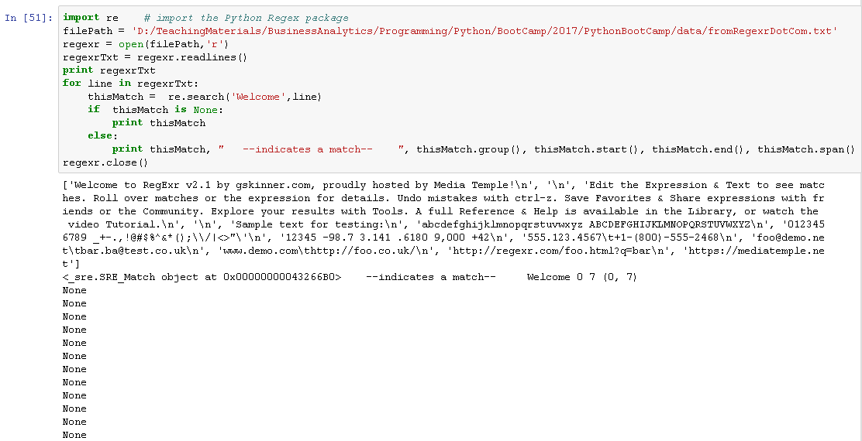
Putting Regex into Python
Files
fromRegexrDotCom.txt
Regex.ipynb

Slide 24
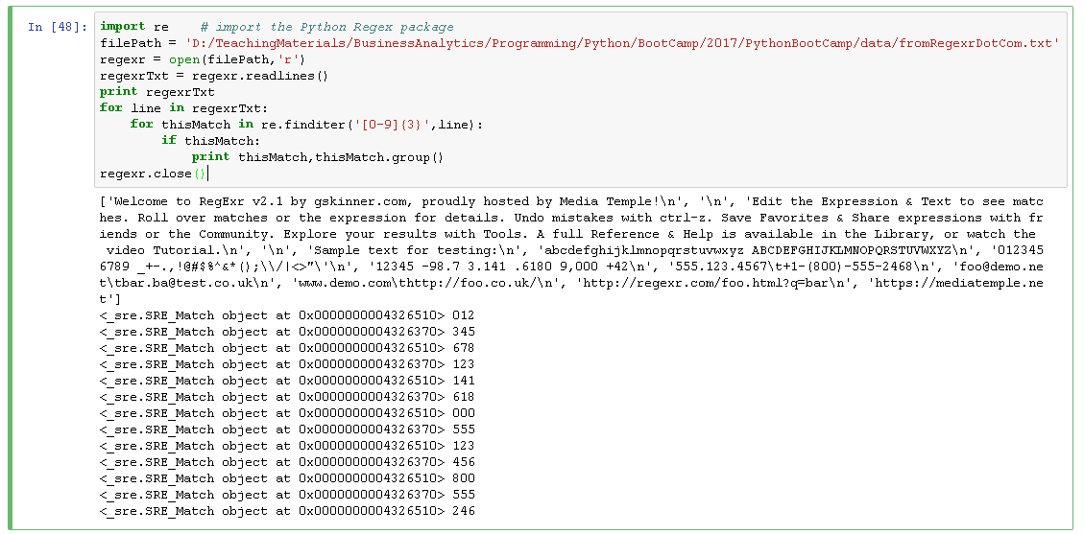
Putting Regex into Python
re.finditer()

Slide 25
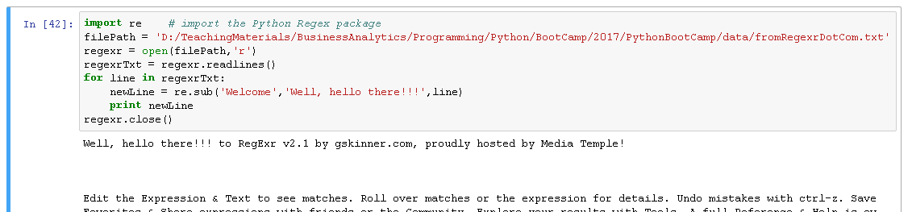
Putting Regex into Python
re.sub()

Slide 26
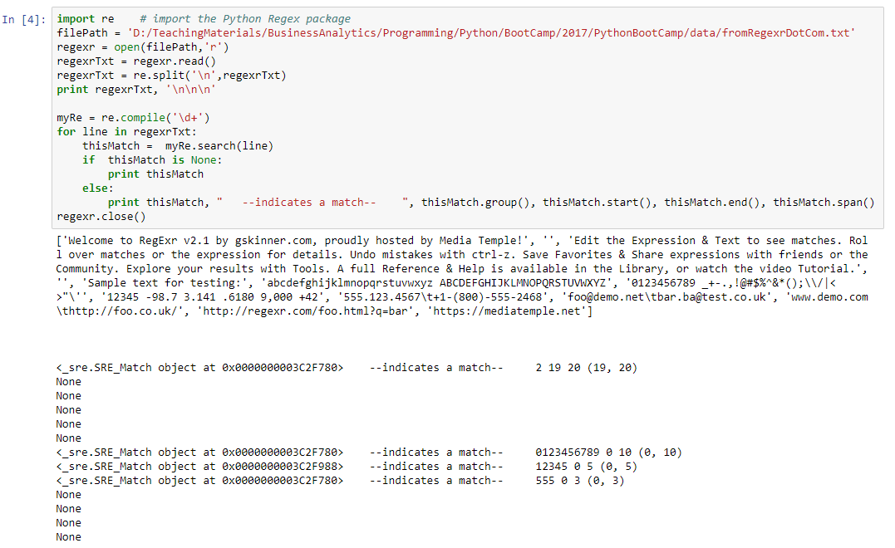
Putting Regex into Python
re.split()
re.compile()

Slide 27
Regular Expressions
Frequently used methods
re.search('text_2_find','text_2_search')
Finds text_2_find
Within the string text_2_search
Will find only the first match
If text_2_search is found then returns a Match object
<_sre.SRE_Match at 0x3912b28>
Otherwise, returns a result of the NoneType
re.match('text_2_find','text_2_search')
Same as re.search() but looks at the beginning of the string for a match

Slide 28
Regular Expressions
Frequently used methods
re.finditer(regex, string2search)
Return an iterable object that can be used in a for loop
Each iteration of the loop returns data of the match data type, if a match is found
The loop will iterate through all matches in a string
re.sub(regex,sub_text,string2search)
Substitute this text: sub_text
For this text: string2search
re.findall(regex, string2search)
Find this pattern: regex
In string2search
Return all instances of string2search in a list

Slide 29
Regular Expressions
Frequently used methods
re.split(regex, string2split)
Splits a string string2split at the pattern regex
re.compile(regex)
Creates a regular expressions object that uses the pattern regex that can be used multiple times with the foregoing methods
For example, x = re.compile(′\n′) creates a regex object that can be used to search for line breaks
x.search(string2search)
Note that the regex pattern is omitted from the parameters
x.split(string2split)
Note that the regex pattern is omitted from the parameters

Slide 30
Regular Expressions
Match data type properties
match.group()
Get the string that matched the Regex pattern
match.start()
String index of the start of the matched string
match.end()
String index of the end of the matched string
match.span()
Returns a tuple with the start and end string index of the matched string

Slide 31
In-Class Exercise 1
Write a Regex expression to find numbers in any of these formats
1234, 12.34, .1234, 1234.
… with any number of digits before and after a possible decimal point
Experiment, prototype with regexr.com

Slide 32
In-Class Exercise 2
Find text of President Trump’s tweets that satisfy these criteria:
From May or June 2019
Next, if time:
Search text of tweets to find text containing a particular word
Steps
Inspect date field
Develop regex strategy
Prototype, and iteratively improve your strategy at regexr.com
Then put into a Python program
Data (abridged version of source)
realdonaldtrump_abridged.ndjson
Source: https://dataverse.harvard.edu/dataset.xhtml?persistentId=doi%3A10.7910%2FDVN%2FKJEBIL

Slide 33
In-Class Exercise 3
Find email addresses in Hillary Clinton’s email
With whom did she correspond?
Create frequency histogram in a dictionary
Keys are email addresses, values are frequencies
First step is Regex to find email addresses
Steps
Prototype, and iteratively improve your Regex at regexr.com
Then put into a Python program
This process is an iterative, trial and error
Files
hillary-clinton-emails-august-31-release_djvu.txt
Regex.ipynb

Slide 34
Regular Expressions
Python Regex References
https://docs.python.org/2/library/re.html
https://docs.python.org/2/howto/regex.html
Online Regex editors
regexr.com
regexpal.com
regex101.com

