Slide 1
Radio Meteor Tracker
RTL-SDR FM forward-scatter meteor detection | Seattle, WA
Design, status, and roadmap
Release v1.2 - GUI, Classification & Reporting
Detect meteors by the radio echoes their ionized trails reflect from a
distant FM transmitter that is normally below the horizon.
Radio Meteor Tracker · Code & Versions
code v1.5 · 2026-07-13 · 1/18

Slide 2
What is radio meteor forward-scatter?
- A meteor entering the atmosphere (~80-120 km) leaves a brief trail of
. ionized gas that reflects VHF radio like a mirror.
- Point the receiver at a powerful transmitter far beyond the horizon.
. Normally you hear nothing (the signal passes overhead).
. When a trail forms in the common volume, it reflects the signal down
. to you as a brief 'ping' (a few ms to ~1 s).
- Works day and night, in any weather - a key advantage over visual.
- Count / time-stamp pings to measure meteor activity and shower peaks.
Radio Meteor Tracker · Code & Versions
code v1.5 · 2026-07-13 · 2/18

Slide 3
Choosing the frequency: 104.3 MHz
- Europe has dedicated beacons (GRAVES 143.05 MHz); North America does not.
- -> Use FM broadcast forward-scatter: a channel VACANT locally but carrying
. a high-power station a few hundred km away.
- Measured the Seattle FM band with the dongle (fm_vacancy.py):
. 104.3 MHz sits ~12 dB below the noise floor - locally empty.
- Distant co-channel stations on 104.3 (beyond the horizon):
. KAWO, Boise ID - 52 kW - ~650 km (ideal geometry)
. KSOP-FM, Salt Lake City UT - 25 kW - ~1100 km (bonus reflector)
Radio Meteor Tracker · Code & Versions
code v1.5 · 2026-07-13 · 3/18

Slide 4
Inputs: Hardware
- RTL-SDR dongle:
. RTL2832U demodulator + Rafael Micro R820T tuner (USB 0BDA:2838)
. Delivers raw IQ samples over USB; tunable ~24-1766 MHz
- Antenna:
. Small whip (used for bring-up). Weak-signal work wants better:
. horizontal dipole or 3-el Yagi aimed ~SE toward Boise
- Host PC: Windows 11, USB 2.0+
- Driver: WinUSB bound to dongle Interface 0 via Zadig
. (Interface 1 stays unbound - normal; RTL-SDR uses Interface 0 only)
Radio Meteor Tracker · Code & Versions
code v1.5 · 2026-07-13 · 4/18

Slide 5
Inputs: Software stack
- Python 3.14 (64-bit)
- pyrtlsdr 0.4.0 -> librtlsdr (rtl-sdr-blog v1.3.6 DLLs, bundled)
. Patched to bind a few optional functions as no-ops (DLL lacks them)
- numpy - FFT / band-power / detection math
- matplotlib - spectrogram & waterfall rendering (Agg for files, TkAgg live)
- python-pptx - this deck
- rtl_sdr_env.py registers the bundled DLL folder so no PATH edits are needed.
- Config-driven: all parameters live in config.py (frozen dataclass).
Radio Meteor Tracker · Code & Versions
code v1.5 · 2026-07-13 · 5/18

Slide 6
How the detector works (pipeline)
- 1. Tune 250 kHz below 104.3 -> whole 180 kHz channel sits at +250 kHz,
. clear of the RTL-SDR DC spike.
- 2. Read IQ continuously at 1.024 Msps; FFT each ~4 ms block.
- 3. Channel power = sum of FFT power in the +-90 kHz detection band.
- 4. Baseline = slow EMA of channel power while quiet (the noise floor).
- 5. Ping = power rises >= threshold above baseline; ends via hysteresis.
. Keep only min_ping_ms .. max_ping_ms duration events.
- 6. Log to CSV; (v1.1) save a high-resolution snapshot of the moment.
Radio Meteor Tracker · Code & Versions
code v1.5 · 2026-07-13 · 6/18

Slide 7
Key assumptions
- 104.3 stays locally vacant (no new Seattle station appears on-channel).
- A distant 104.3 carrier (Boise/SLC) is present and stable to reflect.
- Meteor pings are brief (tens of ms to ~1 s) and localized to the channel.
- Events > 2 s are NOT meteors (aircraft scatter, tropo, sporadic-E) -> rejected.
- Fixed gain gives a stable baseline; AGC does not (see next slide).
- The host keeps up with 1.024 Msps USB streaming without dropping samples.
- Single process owns the dongle at a time.
Radio Meteor Tracker · Code & Versions
code v1.5 · 2026-07-13 · 7/18

Slide 8
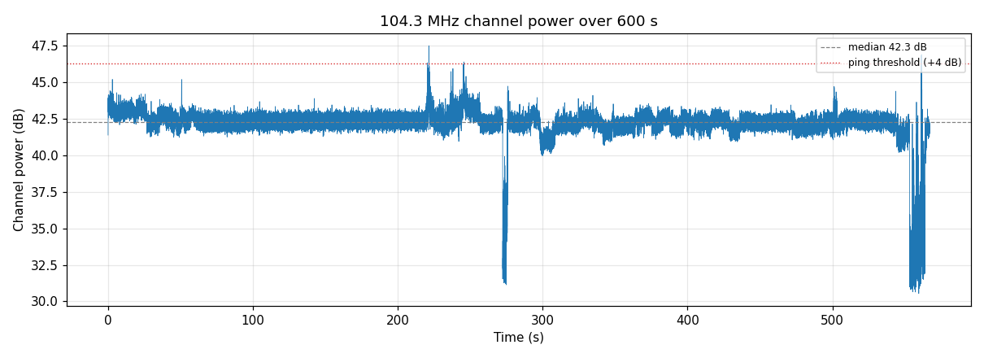
Bring-up lesson: fixed gain, not AGC
- First 10-min run used gain='auto'. The AGC hunted:
. startup ramp, mid-run band-wide dips, erratic tail.
. 6 'pings' logged - all AGC artifacts, 0 real.
- Fixes folded into the baseline config:
. FIXED gain 40.2 dB (stable baseline ~0.7 dB sigma)
. warmup_skip_s = 20 s (ignore settling)
. max_ping_ms = 2000 (reject aircraft/tropo)
. threshold 6 -> 4 dB (still ~6 sigma)
- Re-run baseline is flat (see plot) -> trustworthy detection.
Radio Meteor Tracker · Code & Versions
code v1.5 · 2026-07-13 · 8/18

Slide 9
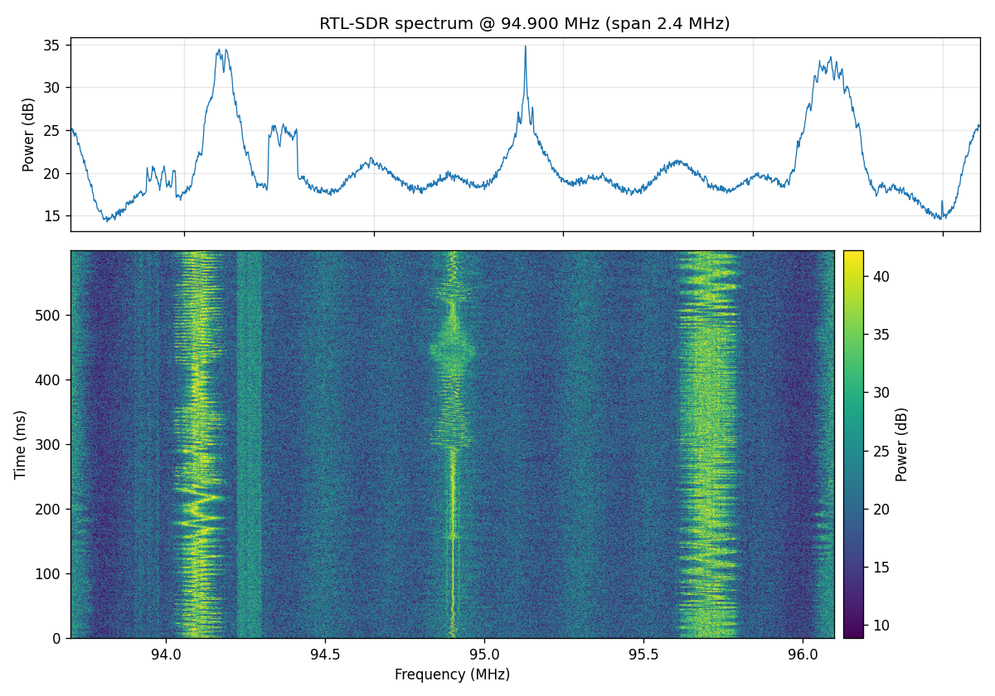
Proof: real RF off the antenna
- Spectrograph of live FM capture confirms the full chain works:
. antenna -> dongle -> WinUSB -> Python -> image.
- Bright vertical bands = local FM stations at exact channel freqs.
- Flickering texture = live audio modulation (proves it is real signal,
. not an artifact).
- The vacancy scan then found 104.3 clear for meteor scatter.
Radio Meteor Tracker · Code & Versions
code v1.5 · 2026-07-13 · 9/18

Slide 10
v1.1: Trigger snapshots
- Problem: a ping COUNT cannot tell meteor from aircraft or interference.
- Solution: keep a rolling IQ buffer; on each ping, render a zoomed
. spectrogram (pre-roll + event + post-roll) marked with the channel.
- New: snapshot.py (IQRingBuffer + save_snapshot).
- Changed: Ping carries sample indices; detector records them; main() saves
. a PNG per ping under snapshots/. Snapshot errors never stop capture.
- Reading a snapshot:
. Meteor -> brief streak LOCALIZED at 104.3 (maybe a Doppler tail)
. Aircraft -> a carrier line SWEEPING in frequency over seconds
. Interference -> broadband smear across the whole window
Radio Meteor Tracker · Code & Versions
code v1.5 · 2026-07-13 · 10/18

Slide 11
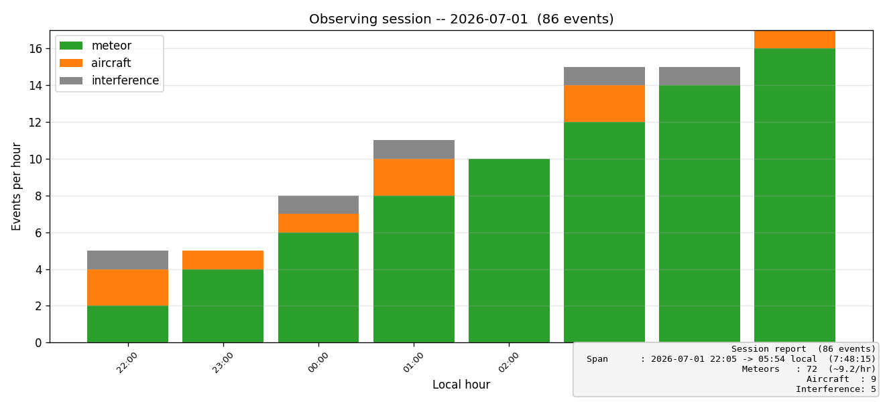
v1.2: GUI, classification & reporting
- Threaded capture engine (capture_engine.py) keeps the UI responsive.
- Tkinter GUI (gui_app.py): live waterfall, Start/Stop, live freq/gain/
. threshold, ping counter, per-class tally, and a snapshot GALLERY
. with class-colored thumbnails (click to enlarge).
- Auto classification (classify.py) of every ping:
. meteor / aircraft / interference, from spectral concentration,
. frequency drift, and duration. Written to CSV, filename & GUI.
- Session report (session_report.py): pings-per-hour stacked by class,
. plus a text summary (example at right).
Radio Meteor Tracker · Code & Versions
code v1.5 · 2026-07-13 · 11/18

Slide 12
v1.3: Tabbed UI + surviving a long run
- GUI split into a ttk.Notebook: Live tab (waterfall + side gallery) and
. Gallery tab (big image viewer, Prev/Next, full event list).
- Problem: an overnight run could not be trusted to finish.
- Auto-reconnect (reconnect.py -> ReconnectingReader): a USB/read error no longer
. ends the run -- close -> exponential backoff -> reopen -> resume.
- Async snapshots (snapshot.py -> SnapshotWorker): matplotlib rendering moved to a
. background thread, so it never stalls the capture read and drops USB samples.
. If the worker falls behind, extra RENDERS are dropped -- events still logged.
- Shared by CLI, GUI and the Pi service. CLI prints a 5-minute heartbeat.
Radio Meteor Tracker · Code & Versions
code v1.5 · 2026-07-13 · 12/18

Slide 13
v1.4: Fitting a 1 GB Raspberry Pi (this release)
- The insight: memory is dominated by SNAPSHOTS, not detection.
. One second of IQ at 1.024 Msps = 8.2 MB. A queued snapshot job holds a whole
. event window: ~4 MB (brief meteor) to ~25 MB (2 s event).
. v1.3's 32-JOB queue bound was really a ~790 MB bound -> OOM on a Pi during an
. aircraft burst, which is exactly when the queue fills.
- Fixes (all shared by CLI / GUI / Pi):
. Queue bounded by BYTES. dsp.py: chunked float32 FFT (numpy upcasts to complex128,
. so the old one-shot FFT spiked ~150-200 MB PER EVENT). Ring buffer is now
. preallocated + circular (was re-allocating ~33 MB four times a second).
. snapshot_mode = png | npz | off. On the Pi, matplotlib is never imported (~90 MB)
. -- events are saved as compact .npz and rendered on a PC (render_snapshots.py).
- Measured: ~104 MB peak RSS on the 'pi' profile vs ~450-490 MB on the defaults.
Radio Meteor Tracker · Code & Versions
code v1.5 · 2026-07-13 · 13/18

Slide 14
v1.5: Measuring exposure (this release)
- Every rate is counts / EXPOSURE -- so exposure has to be MEASURED.
- The trap it removes:
. diurnal.py used to INFER exposure from the span of logged events
. ('the receiver was on whenever anything was logged').
. Observe only 22:00-06:00 for a week and that span covers the daytime
. hours you never watched -- so they look observed-but-empty, their rate
. collapses, and you get a textbook diurnal curve (peak ~06h, trough ~18h)
. manufactured entirely by your own schedule. It looks like SUCCESS.
- The fix: uptime.py writes sessions.csv (append-only on/beat/off).
. Exposure EXCLUDES warm-up and USB reconnect gaps.
. A crash costs one beat interval (60 s), not the session -- and never
. counts the dead hours as observed.
. diurnal.py integrates it; with no log it still runs but stamps the plot
. 'EXPOSURE GUESSED' so a bad curve cannot travel quietly.
- Verified: with a FLAT synthetic rate, the old method invents the curve;
. the new one recovers flat and leaves unobserved hours BLANK.
Radio Meteor Tracker · Code & Versions
code v1.5 · 2026-07-13 · 14/18

Slide 15
Version roadmap
- v1.0 - Baseline detector
. Band-power + EMA baseline + threshold/hysteresis -> CSV log & count.
. Hardened: fixed gain, warm-up skip, duration bounds.
- v1.1 - Trigger snapshots
. Rolling IQ buffer; per-ping high-res spectrogram.
- v1.2 - GUI, classification & reporting
. Threaded engine; live waterfall + counter + snapshot gallery.
. Heuristic meteor/aircraft/interference classifier; session reports.
- v1.3 - Tabbed UI + long-run robustness
. Live/Gallery tabs; auto-reconnect; async snapshots off the capture thread.
- v1.4 - Low-memory profile
. Fits the 1 GB Pi 3B+: byte-bounded queue, chunked FFT, circular ring,
. npz snapshot mode + PC-side rendering. config.py PROFILES['pi'].
- v1.5 - Measured exposure (CURRENT)
. sessions.csv uptime log; diurnal rates divide by REAL observing hours.
- Next
. Real-hardware validation on a Pi; trained classifier; dark theme; .exe packaging.
Radio Meteor Tracker · Code & Versions
code v1.5 · 2026-07-13 · 15/18

Slide 16
An observing session: a meteor shower night
- Example: Perseids peak, night of Aug 12-13 (also Delta Aquariids late Jul).
- Before: python fm_vacancy.py to confirm 104.3 still clear; check gain fixed.
- Run: python meteor_detector.py continuously, e.g. 22:00 -> 06:00 local.
. Snapshots ON; CSV logging the whole night.
- Expect: ping rate RISES after local midnight toward dawn (Earth's leading
. side faces the meteor stream), and higher near the peak date.
- Watch out: summer sporadic-E can mimic activity - real pings are brief;
. E-skip openings last minutes and show in snapshots as sustained signal.
- After: review snapshots, classify, plot pings-per-hour vs time & vs sporadic rate.
Radio Meteor Tracker · Code & Versions
code v1.5 · 2026-07-13 · 16/18

Slide 17
Next steps
- Antenna upgrade (biggest sensitivity gain): dipole/Yagi aimed SE to Boise.
- Real-hardware validation of v1.3/v1.4 -- all of it is so far verified HEADLESSLY
. on Windows against synthetic sources; the Pi run is still pending.
- Frequency calibration: rtl_test -p to set freq_correction_ppm.
- Longer unattended runs (overnight) to gather real event statistics, then
. tune classifier thresholds against confirmed events. Target: Perseids Aug 12-13.
- Later: trained classifier; dark theme + MHz axis polish; package as an .exe.
- Optional: second reference channel (e.g., 104.5 Spokane) for cross-checking.
- Optional: contribute counts to citizen-science meteor networks.
Radio Meteor Tracker · Code & Versions
code v1.5 · 2026-07-13 · 17/18

Slide 18
Caveats & limitations
- Small whip antenna limits sensitivity -> expect low ping rates for now.
- Summer sporadic-E (Jun-Aug) can cause false pings; distinguish by duration.
- RTL-SDR frequency drift until warmed up / ppm-calibrated.
- Only one process may hold the dongle at a time.
- pyrtlsdr patch lives in site-packages; a reinstall reverts it.
- Classification (v1.2+) is HEURISTIC, not trained -- treat labels as triage, and
. expect to tune the thresholds in config.py against confirmed events.
- Under heavy load a SNAPSHOT may be dropped (v1.3/v1.4 governors) -- the EVENT is
. always still classified and logged, so the counts never suffer.
Radio Meteor Tracker · Code & Versions
code v1.5 · 2026-07-13 · 18/18

