Slide 1
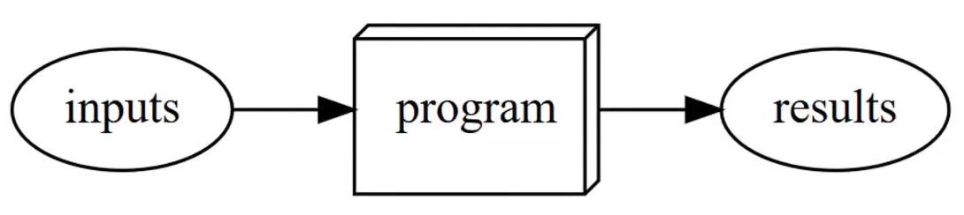
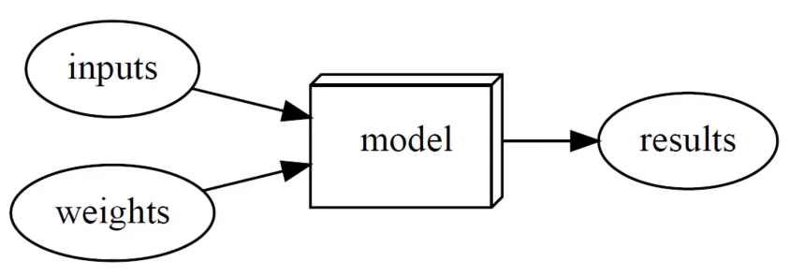
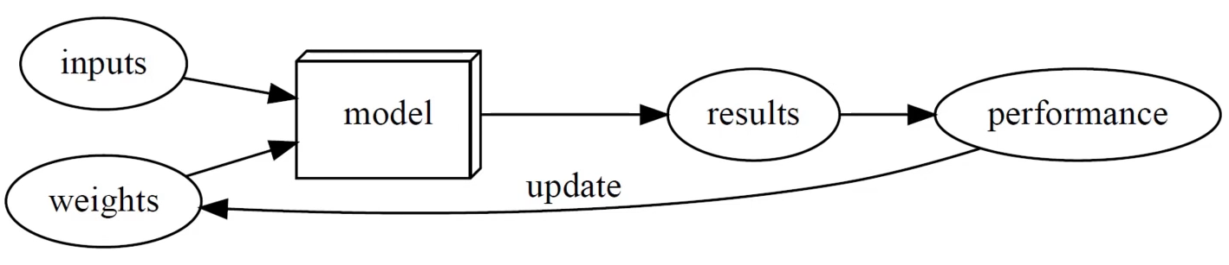
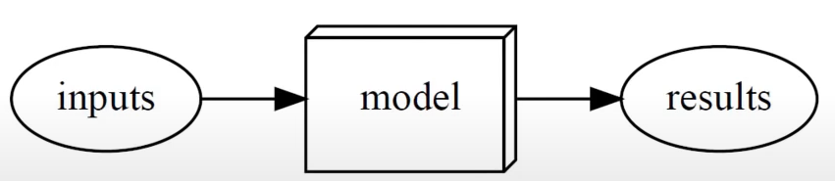
Aprendizaje
Automático

Slide 2
Universal Approximation Theorem
Y = F(X)
F es una función de mapeo,
X is a set of variables (parameters)
Existe una función F suficientemente flexible para modelar, ajustar, separar cualquier distribución existente (regresión/clasificación) a la precisión deseada en teoría ! → Una red neuronal artificial
- poco # de capas y de neuronas
- tiempo limitado de entrenamiento
- capacidad computacional limitada
- limited datasets and size
- errors in datasets
X
(x1,x2,x3, ,xi)
F(X) es la red neuronal o modelo
Y

Slide 3
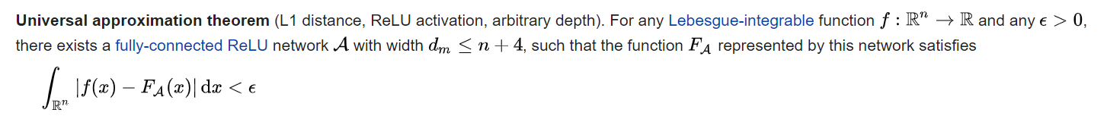
Universal Approximation Theorem
Concern the approximation capabilities of the feedforward architecture of continuous functions between two Euclidean or Non Euclidian spaces, in respect to the compact convergence topology.
Approximation capabilities of neural networks with an arbitrary number of artificial neurons and or an arbitrary number of hidden layers.
Imply that neural networks can represent a wide variety of interesting functions when given appropriate weights.
Does not provide a construction for the weights, but merely state that such a construction is possible.
proved by George Cybenko in 1989 and then by Kurt Hornik in 1991

Slide 4
Gradient Descent (stochastic)
Minimizes the cost function, to obtain the best parameters (coefficients)
Initial coefficients are zero or random
Cost Function
Cost(x1,x2,x3)
A learning rate must be specified, it controls how much the coefficients can change on each update.
coefficient = coefficient – (Lr * delta)
This continues until cost function is zero or close to zero
Best sets of parameters
Min of Cost Function, cost function zero or close to zero

Slide 5
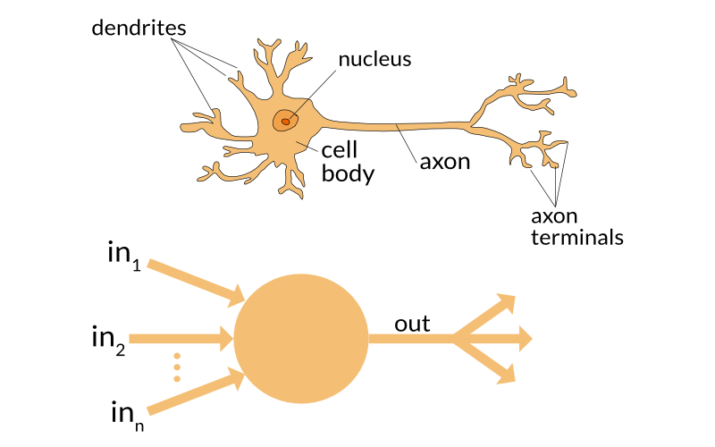
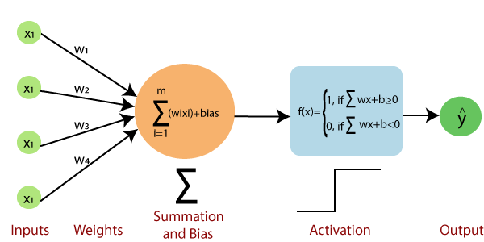
A Perceptron
(Rosenblatt, 1959)

Slide 6
Pocas dependencias, pocas versiones
Mas liviano y eficientado
Pocos involucrados en desarrollo
Centrado en la experimentación
Automatizado de model performance
Automatizado Data Augmentation
Automatizado de uso de arquitecturas
Automatizado de Data Split: Train/Validation
Automatizado de Lrate, LR Plot, Differential Layer Trainning (unfreezing)
Faster
More Modern
Keras
Fastai
TensorFlow
PyTorch
Google
Andrew NG y muchos Otros
Facebook
Jeremmy Howard, Yan Lecunn y Otros

