Slide 1
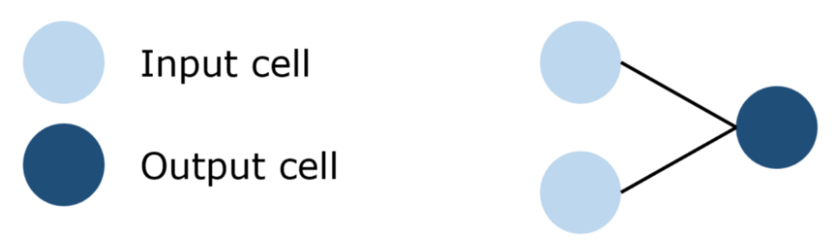
Essential Neural Network Architectures Standard, Recurrent, Convolutional, Autoencoder, & GANs
Standard
1-Perceptron

Slide 2
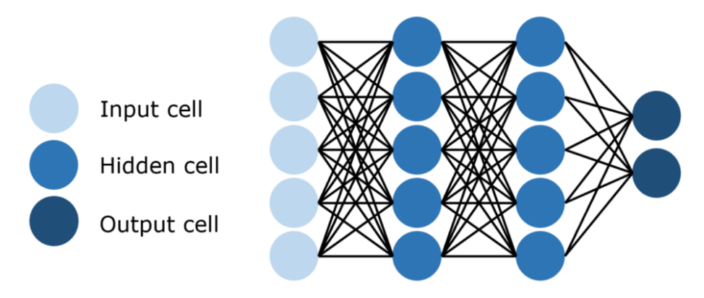
2-The Feed-Forward Network
Feed-forward networks use backpropagation to iteratively update the parameters until it achieves a desirable performance.

Slide 3
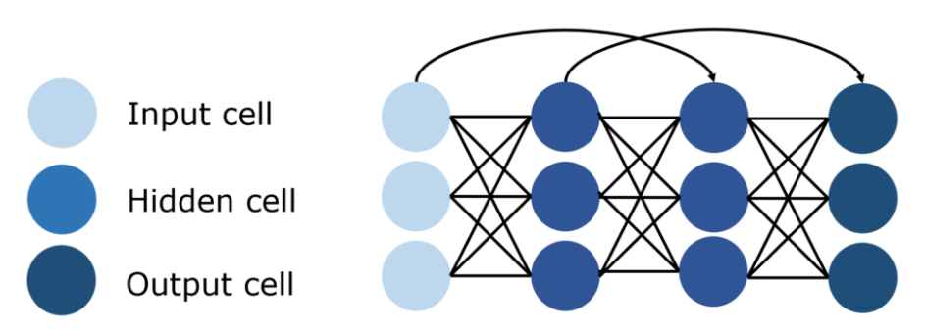
3-Residual Networks (ResNet)
One issue with deep feed-forward neural networks is called the vanishing gradient problem, which is when networks are too long for useful information to be backpropagated throughout the network. As the signal that updates the parameters travels through the network, it gradually diminishes until weights at the front of the network are not changed or utilized at all.
ResNet employs skip connections, which propagate signals across a ‘jumped’ layer. This reduces the vanishing gradient problem by employing connections that are less vulnerable to it. Over time, the network learns to restore skipped layers as it learns the feature space, but is more efficient in training as it is less vulnerable to vanishing gradients and needs to explore less of the feature space.

Slide 4
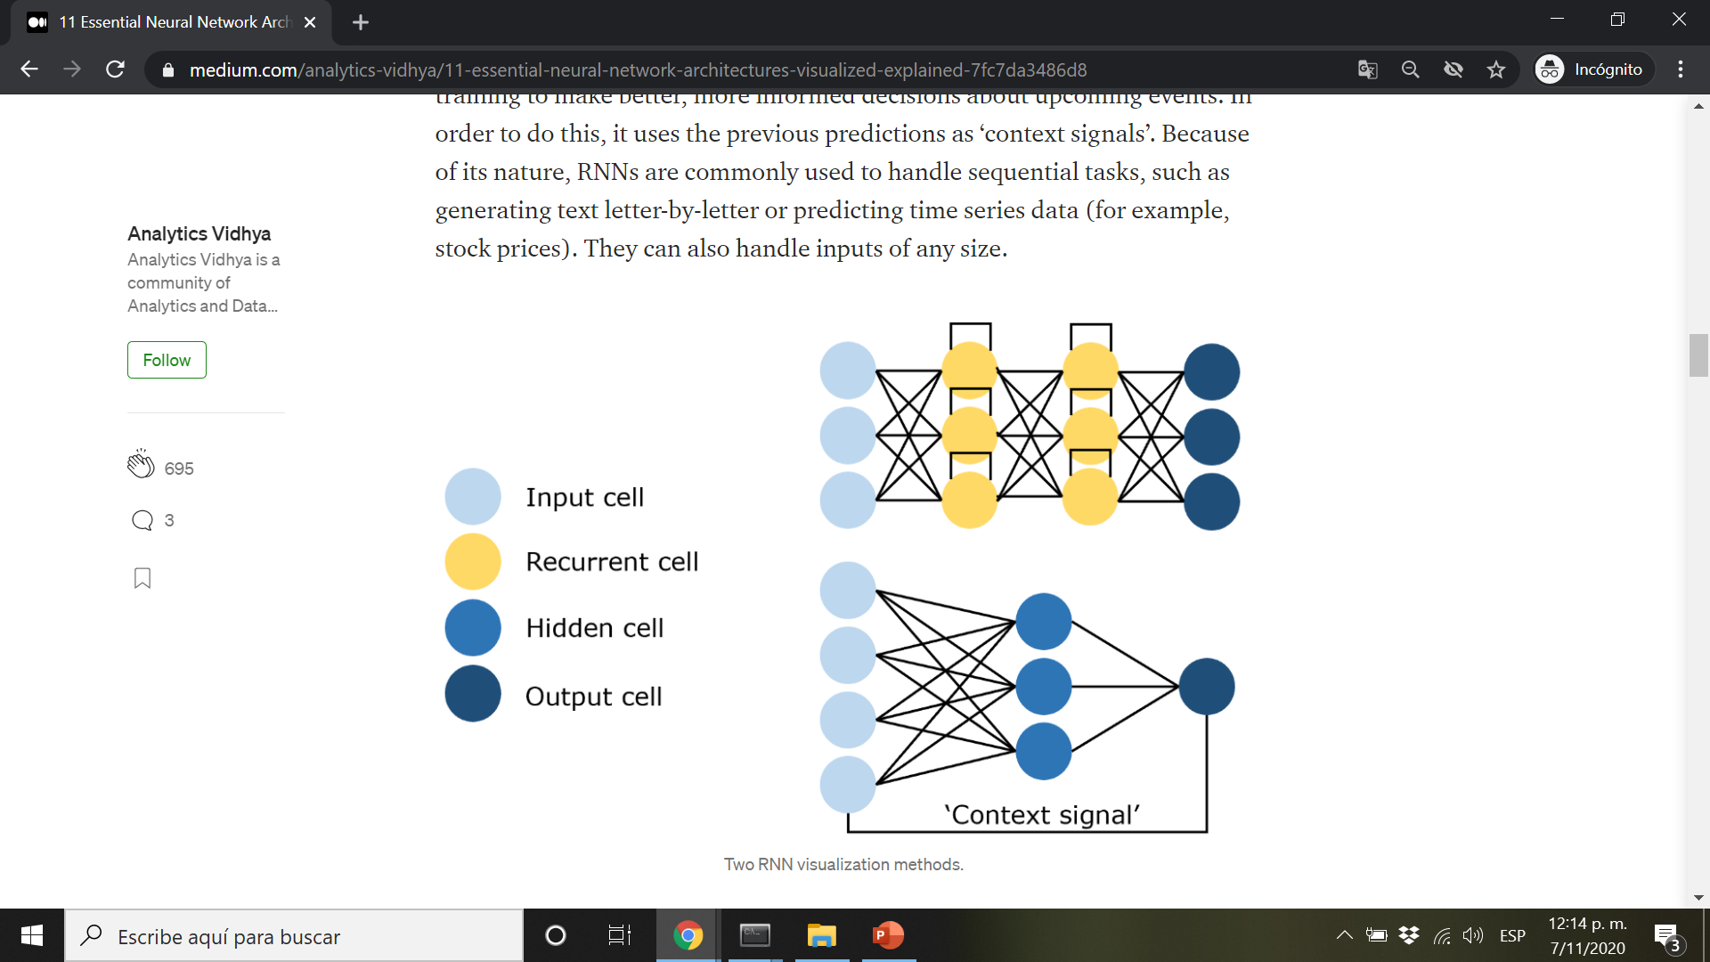
The Recurrent Networks
4- The Recurrent Neural Network (RNN)
A type of network that contains loops, and recurs over itself. Allowing for information to be stored in the network, RNNs use reasoning from previous training to make better, more informed decisions about upcoming events. In order to do this, it uses the previous predictions as ‘context signals’. Because of its nature, RNNs are commonly used to handle sequential tasks, such as generating text letter-by-letter or predicting time series data (for example, stock prices). They can also handle inputs of any size.

Slide 5
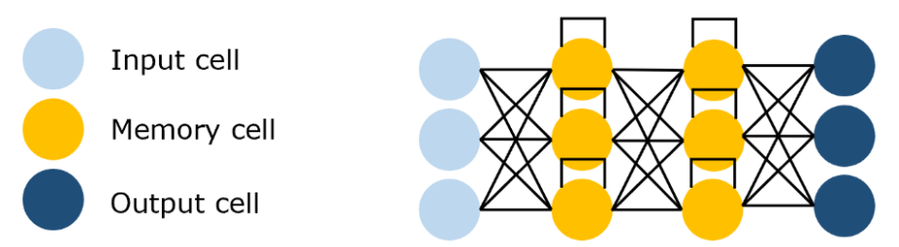
5- The Long Short Term Memory Network (LSTM)
RNNs are problematic in that the range of contextual information is, in practice, very limited. The influence (backpropagated error) of a given input on an input on the hidden layer (and hence on the network’s output) either blows up exponentially or decays into nothing as it is cycled around the network’s connections. The solution to this vanishing gradient problem is a Long Short-Term Memory Network, or an LSTM.
This RNN architecture is specifically designed to address the vanishing gradient problem, fitting the structure with memory blocks. These blocks can be thought of as memory chips in a computer — each one contains several recurrently connected memory cells and three gates (input, output, and forget, equivalents of write, read, and reset). The network can only interact with cells through each gate, and hence the gates learn to open and close intelligently to prevent exploding or vanishing gradients but also propagate useful information through “constant error carousels”, as well as discarding irrelevant memory content.

Slide 6
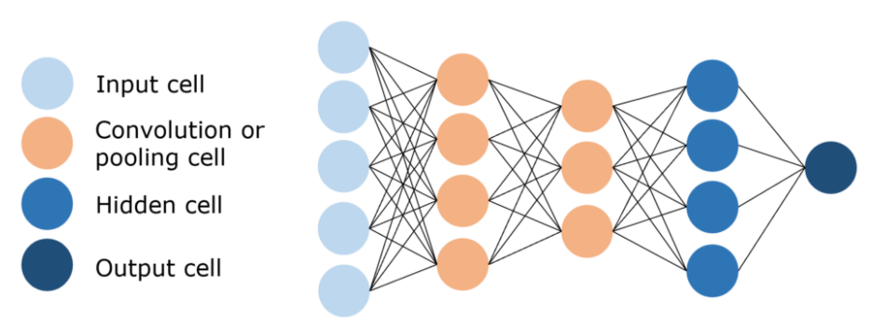
The Convolutional Networks
6- The Convolutional Neural Network (CNN)
Images have a very high dimensionality, and hence training a standard feed-forward network to recognize images would require hundreds of thousands of input neurons, which, besides a blatantly high computational bill, can cause many problems associated with the Curse of Dimensionality in neural networks. They provide a solution to this by utilizing convolutional and pooling layers to help reduce the dimensionality of an image. As convolutional layers are trainable but have significantly less parameters than a standard hidden layer, it is able to highlight important parts of the image and pass each of them forward. Traditionally in CNNs, the last few layers are hidden layers, which process the ‘condensed image information’.

Slide 7
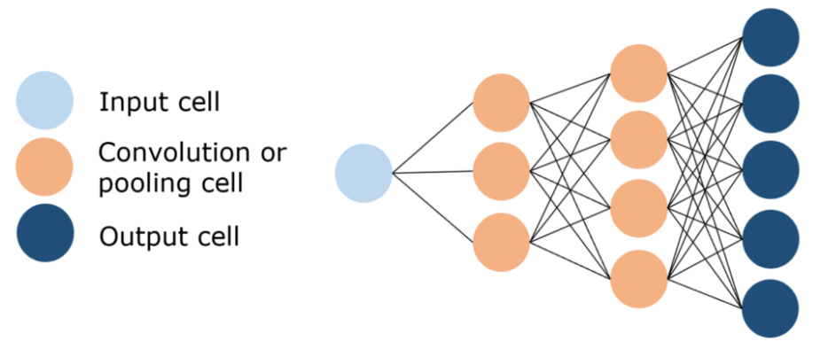
7- The Deconvolutional Neural Network (DNN)
Performs the opposite of a CNN. Instead of performing convolutions to reduce the dimensionality of an image, a DNN utilizes deconvolutions to create an image, usually from noise. This is an inherently difficult task; consider a CNN’s task to write a three-sentence summary of the complete book of Orwell’s 1984 while a DNN’s task is to write the complete book from a three-sentence structure.

Slide 8
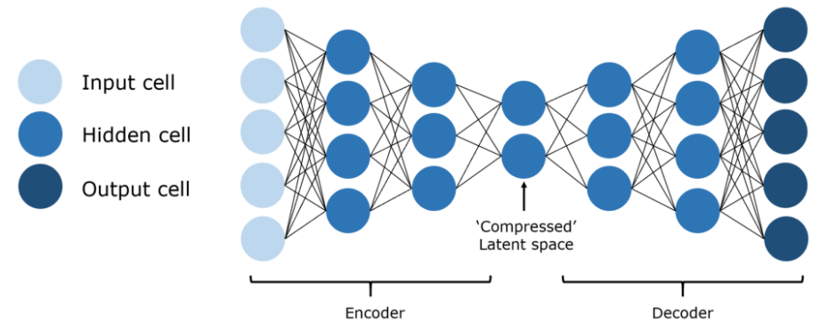
The Auto-Encoders
8- The Auto Encoder (AE) - UNET
The idea of an autoencoder is to take in original, high-dimensionality data, ‘compress it’ into a highly informational and low-dimensional data, and then to project the compressed form into a new space. There are many applications of autoencoders, including dimensionality reduction, image compression, denoising data, feature extraction, image generation, and recommendation systems. It can be purposed as both an unsupervised or a supervised method, can be very insightful as to the nature of the data.

Slide 9
Generative Adversarial Network (GAN)
A specialized type of network designed specifically to generate images, and is composed of two networks — a discriminator and a generator. The discriminator’s task is to discriminate between whether an image is pulled from the dataset or if it has been generated by the generator, and the generator’s task is to generate images convincing enough such that the discriminator cannot distinguish whether it is real or not.
Over time, with careful regulation, these two adversaries compete with each other, each’s drive to succeed improving the other. The end result is a well-trained generator that can spit out a realistic-looking image. The discriminator is a convolutional neural network whose goal is to maximize its accuracy in identifying real/fake images, whereas the generator is a deconvolutional neural network whose goal is to minimize the discriminator’s performance.

Slide 10
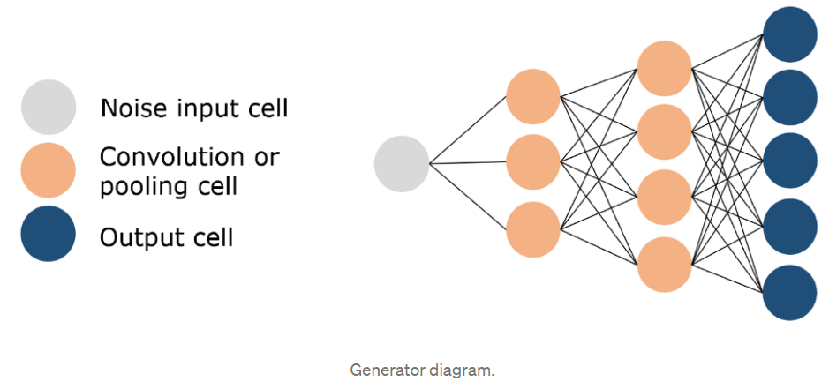
9- Conditional GAN (cGANs)
When a chosen percentage of the images are passed by the discriminator
10- Cycle GAN
When 2 gans compete to generate images using unpaired training data.

Slide 11
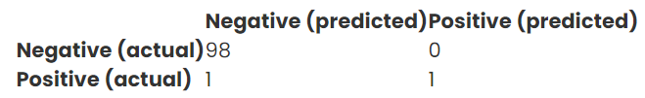
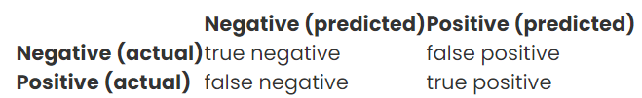
Evaluation Metrics for Neural Networks Accuracy, Precision, Recall, and F1
How to evaluate the model’s performance?
Confusion Matrix
The predicted vs. actual classification can be charted in a table called a confusion matrix, it describes an output of negative vs. positive. These two outcomes are the “classes” of each examples. Overall, how our model classify?

Slide 12
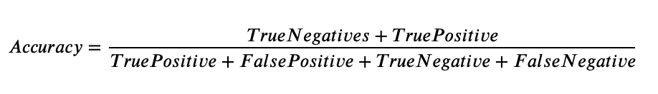
Accuracy exactitud
how often is our model correct?
As a heuristic, or rule of thumb, accuracy can tell us immediately whether a model is being trained correctly and how it may perform generally. However, it does not give detailed information regarding its application to the problem.
The problem with using accuracy as your main performance metric is that it does not do well when you have a severe class imbalance.
Application: fraud detection, spam

Slide 13

Precision
When the model predicts positive, how often is it correct?
Precision helps when the costs of false positives are high. So let’s assume the problem involves the detection of skin cancer. If we have a model that has very low precision, then many patients will be told that they have melanoma, and that will include some misdiagnoses.
Application: medical diagnoses

Slide 14

Recall
Recall helps when the cost of false negatives is high.
What if we need to detect incoming nuclear missiles? A false negative has devastating consequences. Get it wrong and we all die. When false negatives are frequent, you get hit by the thing you want to avoid. A false negative is when you decide to ignore the sound of a twig breaking in a dark forest, and you get eaten by a bear. (A false positive is staying up all night sleepless in your tent in a cold sweat listening to every shuffle in the forest, only to realize the next morning that those sounds were made by a chipmunk. Not fun.)

Slide 15

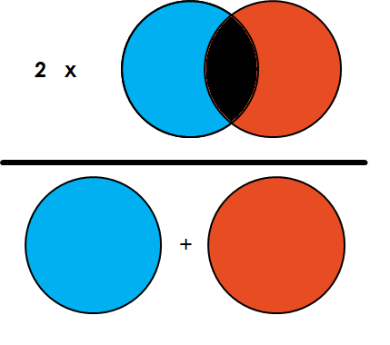
F1 Score Dice Coefficient
A good F1 score means that you have low false positives and low false negatives, so you’re correctly identifying real threats and you are not disturbed by false alarms.
All models will generate some false negatives, some false positives, you often face a tradeoff, You’ll need to optimize for the performance metrics that are most useful for your specific problem.

Slide 16
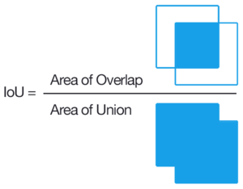
Intersection-Over-Union (IoU, Jaccard Index)
The most commonly used metrics in semantic segmentation because it is extremely effective. Simply put, the IoU is the area of overlap between the predicted segmentation and the ground truth divided by the area of union between the predicted segmentation and the ground truth.
Ranges from 0–1 (0–100%):
0: no overlap and
1: signifying perfectly overlapping segmentation.
For binary (two classes) or multi-class segmentation, the mean IoU of the image is calculated by taking the IoU of each class and averaging them.
Mean IoU = (Ships + Background)/2 = (0%+95%)/2 = 47.5%

Slide 17
F1 Score Vs IoU
Both are very similar and positively correlated, meaning if one says model A is better than model B at segmenting an image, then the other will say the same. Like the IoU, they both range from 0 to 1, with 1 signifying the greatest similarity between predicted and truth.
The IoU metric tends to penalize single instances of bad classification more than the F score quantitatively even when they can both agree that this one instance is bad.
The IoU metric tends to have a "squaring" effect on the errors relative to the F score. So the F score tends to measure something closer to average performance, while the IoU score measures something closer to the worst case performance.
Read more in: https://stats.stackexchange.com/questions/273537/f1-dice-score-vs-iou/276144#276144

Slide 18
AUC ROC
Do your search on these !
We are pinballs bouncing between false positives and false negatives in search of truth !
Keras is limited to performance evaluation, use Scikitlearn API

