Slide 1
Layterms
Notes:
Ryan- implementation for Layterms

Slide 2
Project Goals
Converting arbitrary units to more relatable units (ex. Weight in terms of a car)
Accomplish this goal with units that measure area, volume, length, and mass
Write a function that accepts a string with a measurement and a unit
This function must then separate the the measurement and unit in order to find the appropriate new unit.
Then output the conversion

Slide 3
Problems encountered
Separating the string
Going beyond just meeting the goals
Accepting different forms of syntax for units -- m^3 vs m3 vs m-cubed

Slide 4
Algorithm - Layterms
Needs to take in a string and separate the measurement from the units.
Validate unit -- make sure it is supported
Then pass the unit and measurement to the appropriate subfunction

Slide 5
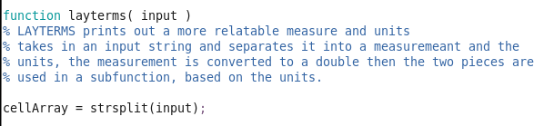
Implementation - Layterms
We used strsplit() to separate the measurement and unit

Slide 6
Implementation - Layterms
Unfortunately, this means our code doesn’t generalize as well (but we have a solution to this...you’ll see a bit later)
Possible Bugs:
layterms(‘100 US tons’) -- a string with more than one space
layterms(‘ m’) -- a string with a space and unit, but no measurement
layterms(‘100 ‘) -- a string with a measurement and space, but no unit
layterms(‘ ‘) -- a string with a space, but no unit or measurement

Slide 7
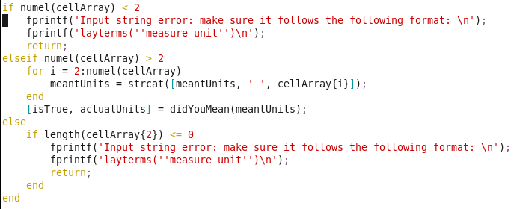
Bug Fixes - Too Many Spaces
strsplit() returns a cell array of the elements
We checked how many elements were in the cell array

Slide 8
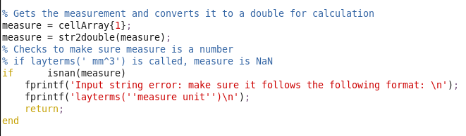
Bug Fixes - No Measurement
An input string like this: ‘ m^3’ would make the first element in the cell array empty. Beyond that, once we changed it to a double it would became a NaN, so we checked for that:
Notes:
First element of cell array is empty when turned to a double it becomes a nan

Slide 9
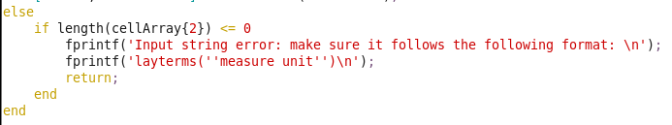
Bug Fixes - No units
A string like this: ‘500 ‘ would cause this bug. Zooming in on a previous if-statement, we checked for the length of the second element in the cell array:
This is only checked if the number of elements is exactly 2.

Slide 10
Bug Fixes - Just a Space
‘ ‘ -- This input is caught by the previous check, checking for the length of the second element in the cell array.

Slide 11
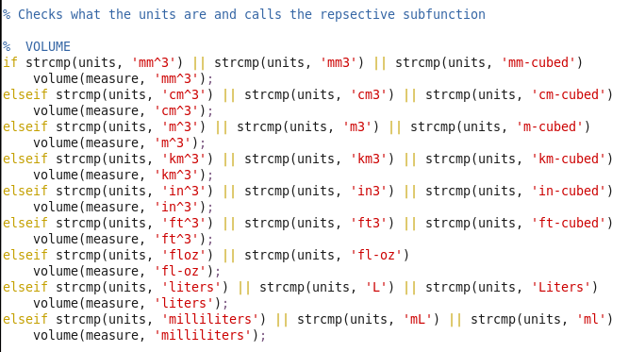
Implementation - Layterms
Finally, we check what the units are….

Slide 12
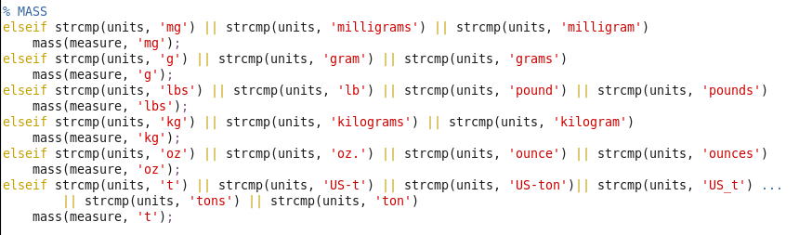
Notice that we don’t check for every possibility, just a few of the most common

Slide 13
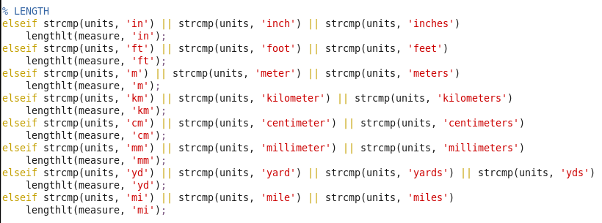

Slide 14
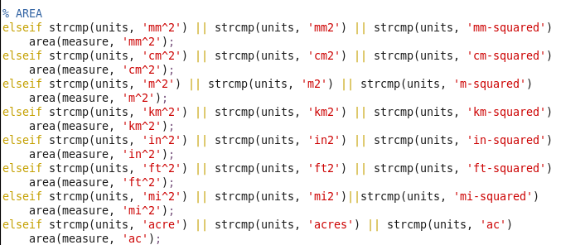

Slide 15

...And Finally
If units fails to match any of those, we print this:
And layterms is done.

Slide 16
Algorithm - Subfunctions
We used four subfunctions
These subfunctions would convert length, mass, area, and volume to more relatable things, such as phones, computers, cars, etc.
Each subfunction would take in a measure and a unit from layterms().
The subfunctions would have two local variables -- printMeasure and printUnits these would serve as our converted measure and units.
Then, based on how big the conversion is, suggest using larger units and convert using larger units to make it as relatable as possible.

Slide 17

Implementation - Subfunctions
Start by initializing printMeasure and printUnits

Slide 18
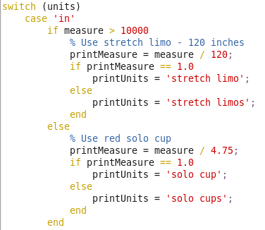
Implementation - Subfunctions
switch statement to check each case that is called in layterms()

Slide 19
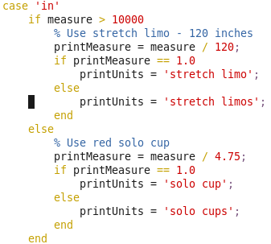
Implementation - Subfunctions
Focusing on the if-statement...

Slide 20
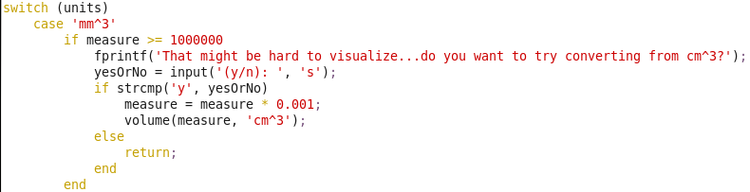
Implementation - Subfunctions
switch statement to suggest larger units if conversion is hard to visualize

Slide 21
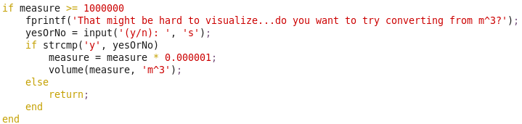
Implementation - Subfunctions
This block of code asks for input about whether the user wants to convert using larger units to better visualize the measure and units entered into layterms()

Slide 22
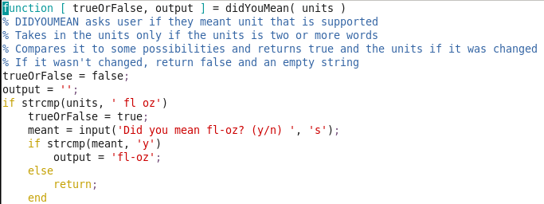
Did You Mean…?
In order to make our code more robust, we added another function -- didYouMean().

Slide 23
Algorithm - Did You Mean…?
The goal of this code is to suggest a supported unit based on some incorrect input by the user.
This function takes in the units (after being concatenated together in Layterms) and checks against what we considered would be common mistakes in spelling, etc.
Then asks the user if they actually meant our suggestion -- if there is no suggestion, it prints a message saying so
This function returns a bool, whether it changed the units or not -- trueOrFalse and the units itself -- output
If no change was made, it returns false and an empty string.

Slide 24

Implementation - Did You Mean…?
In layterms(), elements 2 through the end of the cell array are concatenated together with a space in between each element.
You can see at the end here, the method returns a boolean and a string

Slide 25
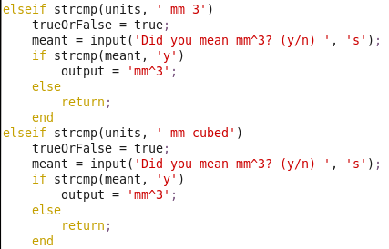
Implementation - Did You Mean…?
Many if-statements of many of the possible mistakes that could have been made:

Slide 26
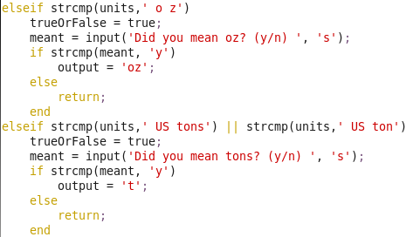
Plus many more...

Slide 27

If no suggestions are found...

Slide 28
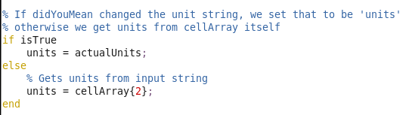
Implementation - Did You Mean…?
In layterms, an if-statement checks if didYouMean() changed the units and if so, assigns the string returned by didYouMean() into ‘units’. Otherwise it gets the units from the second element in the cell array:

Slide 29
Demonstration

Slide 30
Questions?

