Slide 1
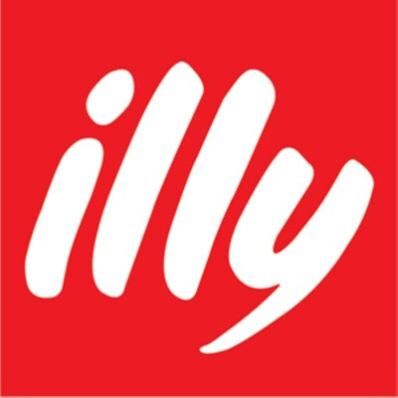
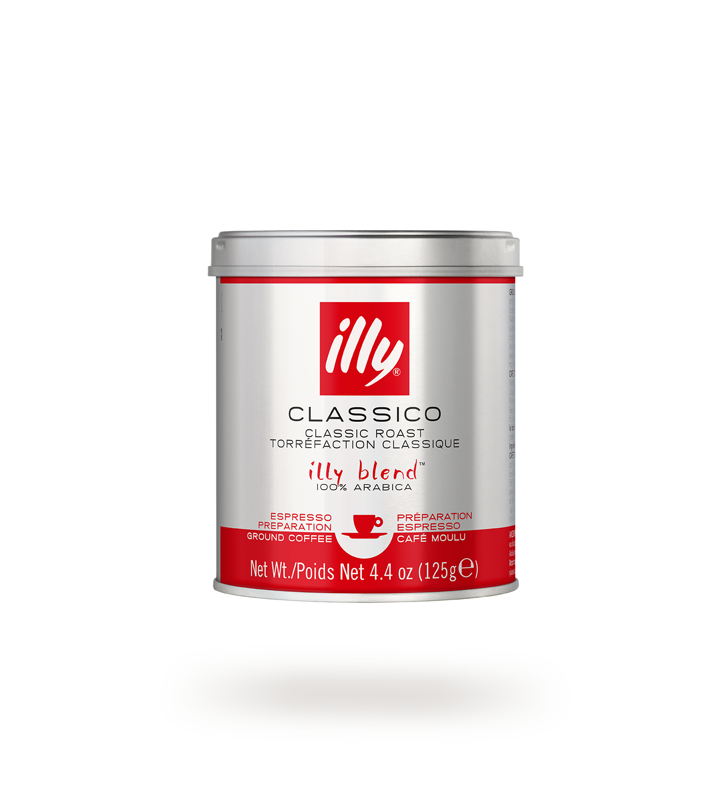
BRAND CASE STUDY
illycaffè
Strategic Anatomy & Omnichannel Evolution
Premium Coffee · FY2025 Financials · Brand Architecture · HoReCa · US GTM · Lessons for Orfeu
Prepared for Orfeu US Market Research · June 2026 · Confidential

Slide 2
CONTENTS
01
Brand Heritage & Strategic Timeline
02
Financial Architecture FY2024–2025
03
Brand DNA & Core Positioning
04
Brand Positioning Framework
05
HoReCa Strategy & Own Café Network
06
Product Portfolio — Formats & Range
07
US Market GTM Strategy
08
Key Activations & Campaigns
09
Digital, Social & E-commerce
10
Sustainability as Commercial Moat
11
Results Scorecard
12
Key Articles & Sources
13
Lessons for Orfeu

Slide 3
01
Brand Heritage & Strategic Timeline
From Trieste 1933 to €700M global leader

Slide 4
01 · BRAND HERITAGE & STRATEGIC TIMELINE
1933
Founded in Trieste, Italy by Francesco Illy. Roots in Central-European café culture — Italian coffee as a cultural institution, not a commodity.
1934
Pressurization patent: nitrogen/CO₂ replaces oxygen in tins → tin becomes active aging vessel → transoceanic export of fresh roasts becomes viable.
1935
"Illetta" proto-espresso machine separates pressure from temperature → hardware-and-coffee dual DNA begins.
1991
Direct Trade model: bypass commodity brokers → premium financial incentives for quality yields → supply chain control + ESG foundation.
1999
Università del Caffè: institutionalised B2B training across 25 countries → ensures perfect extraction at every HoReCa touchpoint.
2021
B Corp Certification → formalized ESG credentials justify super-premium pricing vs. mass market.
2024
B Corp recertification: score 90.4 (+9.7 pts). Rhône Capital 20% stake → funds aggressive US market rollout.
2025
Acquires 80% Capitani (home machines) + 100% Thalwil Ag (Swiss B2B distribution). FY revenue €700M. 4th consecutive year of growth.

Slide 5
02
Financial Architecture
FY2024–2025 · Revenue growth vs. margin compression

Slide 6
02 · FINANCIAL ARCHITECTURE FY2024–2025
€700M
€90M
€20M
+20.1%
FY2025 Revenue
EBITDA
Net Profit
US Revenue Growth
+11.1% YoY
–18.1% YoY
–39.3% YoY
const. FX 2025
Revenue by Channel
Geographic Mix
Out-of-Home (HoReCa)
53.1%
€372M
EMEA (ex-Italy)
38.4%
~€269M
+8.2% — US, ES, IT, DE premium accounts
Home (DTC/E-comm/Retail)
46.9%
€328M
Italy (Home Market)
31.6%
~€221M
Amazon, D2C subscriptions, premium grocery
Americas ★ Priority
22.0%
€154M
Asia / Rest of World
8.0%
~€56M
⚠ Margin compression driven by Arabica price inflation (+70% 2023–25). EBITDA/profit decline reflects strategic US investment period — prioritising market share and brand equity over short-term profitability.

Slide 7
03
Brand DNA & Core Positioning
Single blend · Five pillars · Art Collection

Slide 8
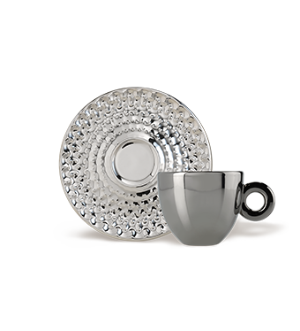
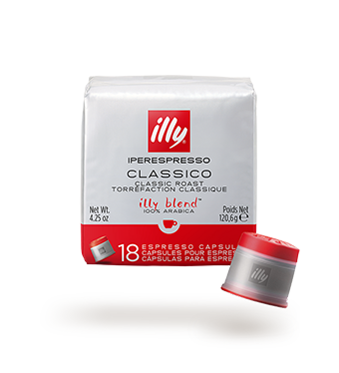
03 · BRAND DNA & CORE POSITIONING
"The authentic Italian coffee lifestyle, delivered without compromise — at scale."
SELECTION
BLENDING
ROASTING
PRESSURIZATION
SIP
9 origins
100% Arabica
Top 1% beans
Direct Trade
Single proprietary
blend since 1933
Consistent across
all SKUs globally
Precision roasting
protocol. No SKU
diversification
dilutes brand
1934 patent:
N₂ seal actively
ages + preserves
essential oils
'Why We Make It'
narrative. Experience
over transaction.
Craft story
Iconic red tin — single blend globally
Art Collection — 30-yr artist collab
iperEspresso capsules — home format
Red circle — 90yr brand equity

Slide 9
04
Brand Positioning Framework
Positioning statement · Creative idea · Benefits · RTBs · Values · Target

Slide 10
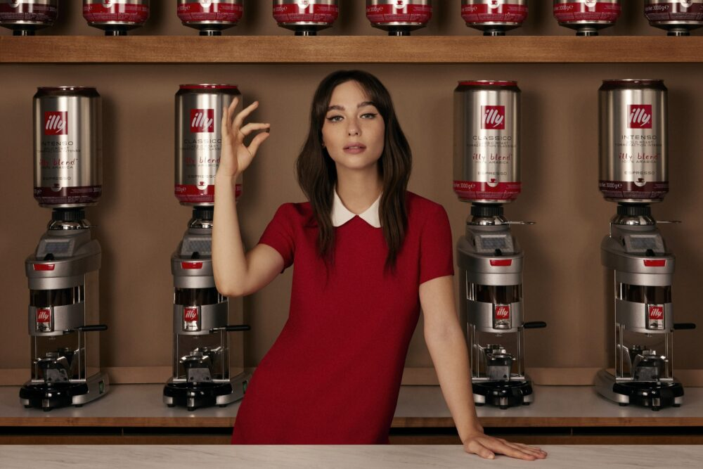
04 · BRAND POSITIONING FRAMEWORK
BRAND POSITIONING STATEMENT
For discerning coffee lovers who seek authentic Italian mastery, illy is the only super-premium espresso brand that guarantees perfection in every cup — because uncompromising quality in every step, from farm to extraction, is the only way we know.
CORE CREATIVE IDEA
"Quality Loves Details" — Perfection is the accumulation of a thousand uncompromising choices.
PRODUCT BENEFITS & CLAIMS
BRAND VALUES
• 100% select Arabica — no Robusta, ever
• Single global blend: 9 origins, consistent across 40+ markets
• Pressurized tin: sealed with inert gas → preserves aroma & essential oils
• Precision roasting protocol → consistent extraction every time
• iperEspresso: patented two-phase capsule for crema-perfect espresso at home
• Excellence: the relentless pursuit of perfection in every detail
• Authenticity: Italian heritage expressed without nostalgia or irony
• Responsibility: Direct Trade, B Corp, Climate Transition Plan
• Beauty: Art Collection, cinematic advertising, design-forward packaging
• Knowledge: Università del Caffè — sharing mastery, not keeping secrets
EMOTIONAL BENEFITS & CLAIMS
TARGET CONSUMER
• "I chose the best" — signals taste sophistication and discernment
• Italian lifestyle aspiration — la dolce vita in a cup
• Ritual and pause: coffee as moment of beauty, not caffeine delivery
• Pride of serving: for HoReCa, illy on the counter signals curation
• "Coffee people" identity: belonging to a global community of craft
• Primary: affluent urban professional, 30–55, frequent traveller
• Coffee-literate: knows the difference between third-wave and mass market
• Motivated by provenance, craft, and brand integrity — not price
• US: Amazon Prime household, premium airline passenger, Whole Foods shopper
• HoReCa: decision-makers at 4-5★ hotels, Michelin-adjacent restaurants, design cafés
REASONS TO BELIEVE
Direct Trade 1991 · B Corp 90.4 · Università del Caffè 25 countries · Ernesto Illy Award (top 27 global producers) · 90+ years single blend · 1,000+ premium HoReCa

Slide 11
05
HoReCa Strategy & Own Café Network
53.1% of revenue · Partner selection · Università del Caffè · illy caffè branded stores

Slide 12
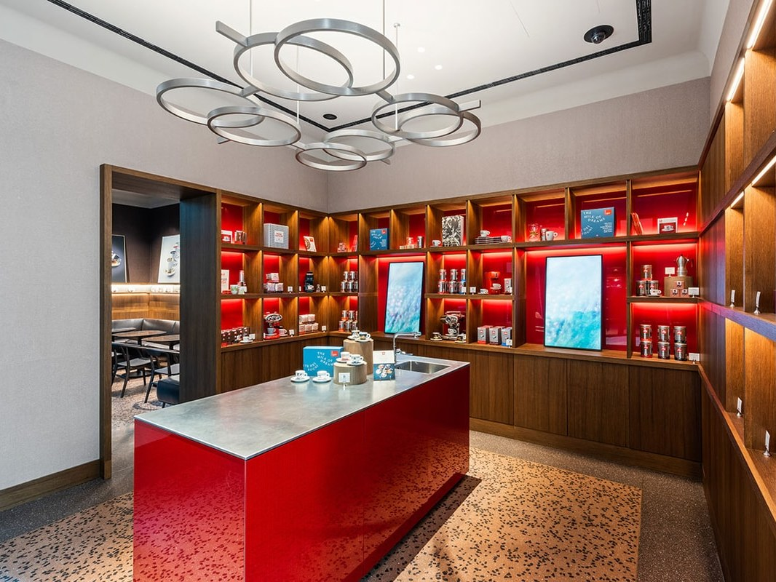
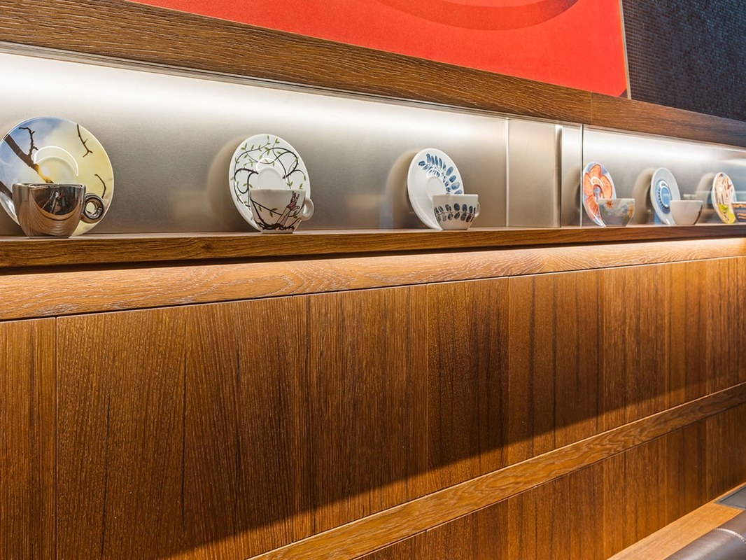
05 · HoReCa STRATEGY & OWN CAFÉ NETWORK
HoReCa = 53.1% of total revenue · €372M · +8.2% growth 2025 · Largest single revenue driver · New premium accounts: US, ES, IT, DE
HORECA CHANNEL STRATEGY
BRANDED CAFÉ NETWORK — illy caffè
• Strictly premium partner selection — illy does NOT distribute to mass-market cafés or QSR
• 4-star+ hotels, Michelin-adjacent fine dining, specialty/independent cafés, premium airline galleys
• HoReCa contributes brand equity as much as revenue — every cup served is a brand experience
• Università del Caffè: B2B training platform across 25 countries → reduces partner churn, ensures consistent quality at point of consumption
• Francis Francis espresso machines: sold/leased to partners → hardware lock-in, margin + brand presence
• Professional Co. machine range (high-volume HoReCa): positioned for 4-5★ environments
• 2025 M&A: 80% Capitani acquisition internalises the home + professional machine ecosystem
• 2025 M&A: 100% Thalwil Ag (Switzerland) internalises B2B distribution infrastructure
• illy operates a branded café format under the 'illy caffè' name in select global markets
• Locations: flagship stores in Trieste (HQ), Milan, Rome + international franchise model
• Function: brand showcasing, consumer education, premium sampling — P&L secondary to brand-building role
• Flagship stores serve as 'concept stores': art exhibitions, barista masterclasses, product launches
• Each café carries illy Art Collection as permanent décor — reinforces art/coffee positioning
• Not a scaled café chain — strategic footprint only (unlike Lavazza, which has ~300+ branded bars)
• illy deliberately limits own-retail expansion to protect HoReCa partner relationships and brand scarcity
Entrada — Via Monte Napoleone

Slide 13
06
Product Portfolio — Formats & Range
Primary: whole bean · capsule · RTD · Secondary: ESE pods · Nespresso · machines · Art Collection

Slide 14
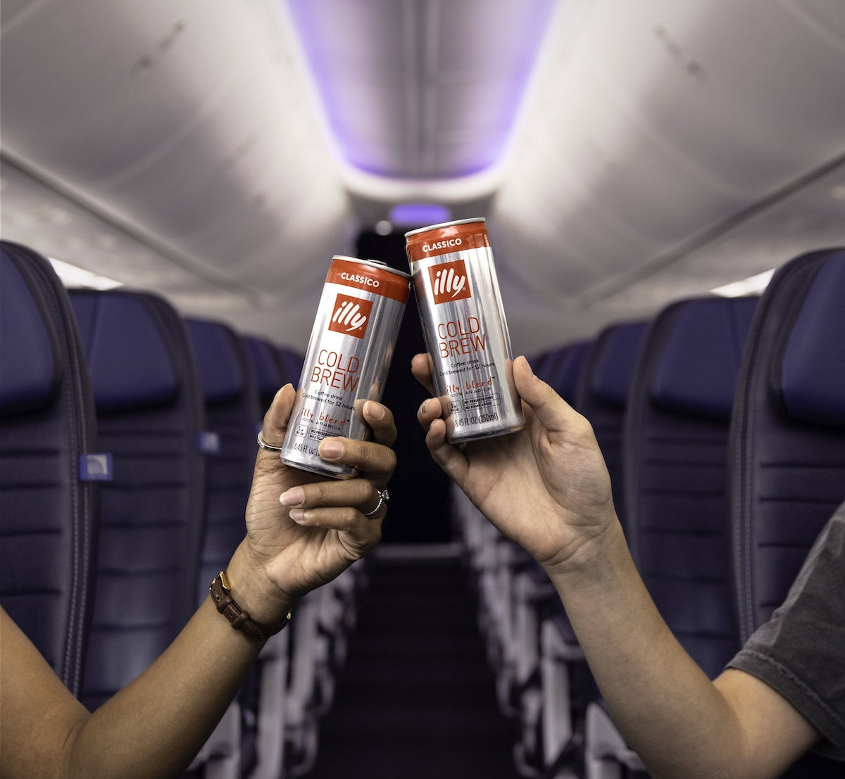
06a · PRODUCT PORTFOLIO — PRIMARY FORMATS
All products share ONE roast philosophy: single 100% Arabica blend, 9 origins. Differentiation by FORMAT + use occasion — never by origin or roast variety.
Whole Bean & Ground Coffee
iperEspresso Capsules
RTD — Ready to Drink
Primary / Hero SKU
Primary / Premium Home
Primary / Growth Format
• Whole bean (250g, 500g)
• Ground for moka, filter, drip
• Fine ground for espresso
CHANNELS: Grocery premium, DTC, HoReCa
"The pure illy experience — nothing between the bean and your cup"
• Single capsule (illy-exclusive system)
• Compatible: illy X7.1, Y3.3 machines
• Available: Classico, Intenso, Lungo, Decaf
CHANNELS: DTC, Amazon, illy.com, specialty retail
"Barista-quality crema in a closed premium ecosystem"
• issimo Cold Brew cans (8.45oz)
• Cold Brew + Oat Milk
• Cappuccino RTD (shelf stable)
CHANNELS: United Airlines cabins, premium retail, Amazon, convenience premium
"illy coffee without equipment — same quality standard in a can"

Slide 15
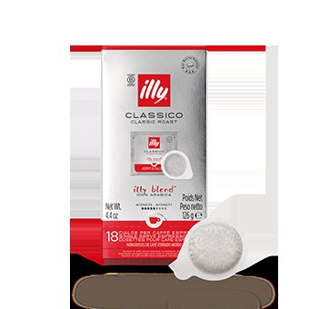
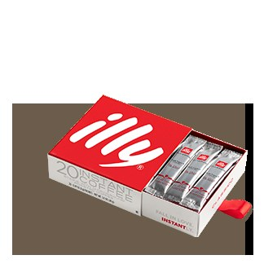
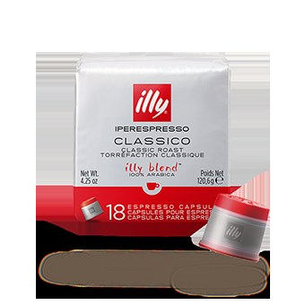
06b · PRODUCT PORTFOLIO — SECONDARY FORMATS & MACHINES
Classico
Stick Pack
Classico
Cold Brew Concentrate
iperEspresso + moagem
Blend 100% Arábica
Compatível ESE 44mm
125g · 18 cápsulas
250ml · Alta concentração
Serve 4–6 drinques por lata
PVP: ~€ 349
Ideal: home top-tier & gifting
ESE Paper Pods
Nespresso-Compatible Capsules
Easy Serving Espresso
illy for Nespresso®
• 44mm industry-standard pod format
• Aluminium capsule — illy blend in Nespresso machines
• Compatible with all ESE machines globally
• Classico, Intenso, Lungo formats
Instant Coffee — ilyissimo
Machines — illy Y3.3 / X7.1
Emerging / Test Format
Hardware Ecosystem
• Freeze-dried instant — premium tier positioning
• Y3.3: iperEspresso capsule machine — home flagship
• Targets: travel, office, emerging markets
• X7.1: premium home espresso machine — semi-professional
Art Collection Products
Cold Brew Concentrate
Brand / Cultural / Gift
HoReCa / Foodservice
• Artist-designed espresso cups, mugs, accessories
• Professional-grade cold brew for HoReCa behind-bar use
• Annual artist collaborations since 1992 (30+ year programme)
• Allows coffee cocktail, over-ice, and café menu flexibility
Portfolio principle: BREADTH by format (whole bean → capsule → RTD → pod → machine), UNITY by blend (single Arabica always). No flavoured coffees. No origin sub-brands. Consistency = pricing power.

Slide 16
07
US Market GTM Strategy
Priority market · 4× growth · €154M Americas 2025

Slide 17
07 · US MARKET GTM STRATEGY
US = Priority Expansion Market · Rhône Capital 20% stake · Cristian Arcangeli VP Marketing/Digital US · €154M Americas 2025 · +20.1% US growth (constant FX) · 4× category growth rate
01
Amazon Retail Media Networks
E-COMMERCE
02
United Airlines RTD Cold Brew
SAMPLING
Prime Video as upper-funnel storytelling → targets affluent demographics. Seamlessly connects brand awareness to DTC purchase. Agency: Tinuiti.
★ Amazon Ads Partner Award (Seasonal Sales, Americas) · +35% Q4 revenue · +21% conversions
Jul 2024: RTD Cold Brew served complimentary in premium cabins = subsidised high-income sampling.
Only major US airline with premium cold brew on most flights. Captive audience of high-NPS frequent flyers pre-qualified by income.
03
Social — "Coffee Break" Series
SOCIAL
04
illy Cube — Hudson Yards
EXPERIENTIAL
Agency: Inspira Marketing Group (Instagram + TikTok AOR).
'Coffee Break' series bridges European heritage with US coffee culture.
Target: 25–40 urban professionals defining identity through provenance and taste.
NYC immersive pop-up at Hudson Yards. Manifested global 'Why We Make It' campaign physically.
5 stations: Selection → Blending → Roasting → Pressurization → Sip. Premium sampling, brand education, earned media, trade press coverage.

Slide 18
08
Key Activations & Campaigns
Venice Biennale · Hudson Yards · United Airlines · Quality Loves Details

Slide 19
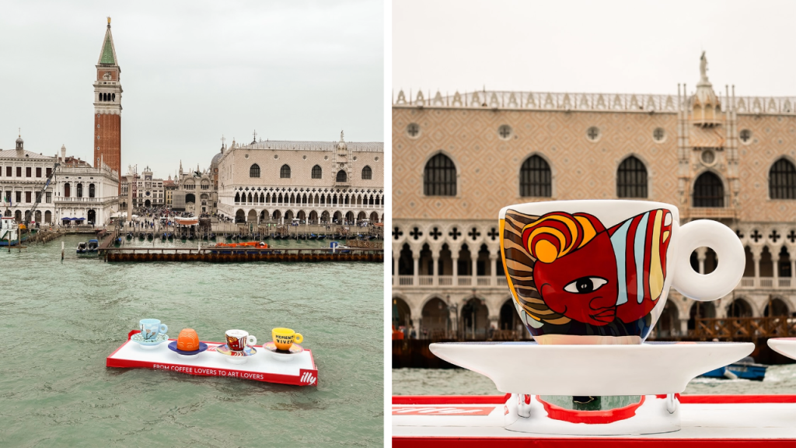
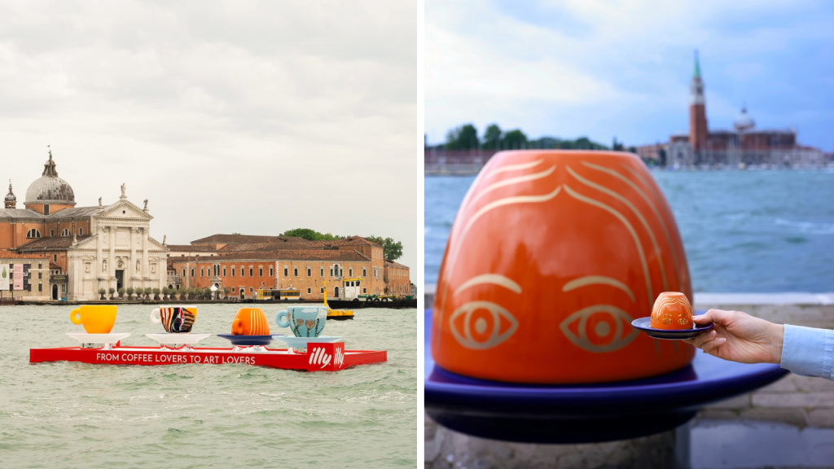
08a · KEY ACTIVATION — VENICE BIENNALE 2026
illy at Venice Biennale Arte 2026 — "In Minor Keys"
• Sponsor of 'In Minor Keys' exhibition, curated by Koyo Kouoh — 61st Venice Biennale (2026)
• Disrupted digital FOOH trend by PHYSICALLY fabricating giant oversized espresso cups floated on the Venetian waters at Riva Ca' di Dio
• Classic illy cup transformed into monumental public art → massive earned media coverage globally
• Aligns with Cannes Lions: 'Market Disruption' (E08) + 'Cultural Engagement' (E09)
• US debut of Art Collection 'In Minor Keys' at Frieze New York immediately preceded

Slide 20
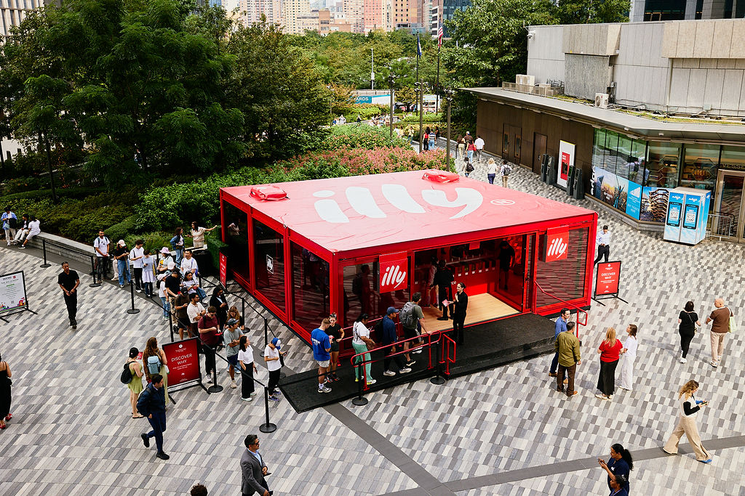
08b · KEY ACTIVATION — HUDSON YARDS CUBE + UNITED AIRLINES
illy Cube — Hudson Yards
United Airlines Partnership
• NYC Hudson Yards pop-up — high-traffic immersive brand experience
• Manifested 'Why We Make It' campaign in physical form
• 5 stations: Selection / Blending / Roasting / Pressurization / Sip
• Premium tastings + brand education + earned media + trade press
• Target: affluent NYC consumers + F&B media + hospitality buyers
• Jul 2024: RTD Cold Brew in United premium cabins
• Subsidized sampling reaching highest-income frequent travellers
• Only major US airline serving premium cold brew on most flights
• Builds HoReCa credibility in an aspirational captive context
• Complements Amazon digital funnel with physical trial trigger

Slide 21
09
Digital, Social & Campaign Excellence
Amazon · Prime Video · TikTok/Instagram · Cinematic storytelling

Slide 22
09 · DIGITAL, SOCIAL & CAMPAIGN EXCELLENCE
"Quality Loves Details" — Global Master Campaign
Brand Ambassador
Matilda De Angelis — Italian actress, international recognition
Director
Martin Aamund — Cannes Lions, Epica & Clio award winner → cinematic luxury standard
Message
Supreme Arabica quality emerges from obsessive attention to every detail of the process
Distribution
TV, digital, owned social, HoReCa B2B materials across 40+ markets
Tone
Aspirational Italian lifestyle — neither nostalgic nor aggressively modern
Amazon & Digital Strategy
• Prime Video upper-funnel storytelling → brand awareness → DTC checkout in one ecosystem
• Tinuiti as performance agency → Amazon Ads Partner Award (Seasonal Sales Strategy, Americas 2025)
• Q4 campaign: +35% revenue · +21% conversions — validated full-funnel commerce media model
• Instagram + TikTok: Inspira Marketing Group AOR → 'Coffee Break' series targeting 25–40 urban professionals
• Content strategy: bridge Italian heritage with US third-wave coffee culture via local creators + brand education

Slide 23
10
Sustainability as Commercial Moat
B Corp · Direct Trade · EIICA · Climate Transition Plan

Slide 24
10 · SUSTAINABILITY AS COMMERCIAL MOAT
Direct Trade Model (since 1991)
B Corp Certification
Bypasses commodity brokers. Premium prices direct to farmers for quality yields. Secures top 1% Arabica supply with multi-decade farmer loyalty. ESG credential that defends pricing.
Originally certified 2021. Recertified 2024: score 90.4 (+9.7 pts). Structural ESG commitment — required for premium US grocery (WFM) and elite HoReCa gatekeepers.
Ernesto Illy Int'l Coffee Award
Climate Transition Plan 2025
10th anniversary 2025. Evaluates top 27 producers globally. B2B loyalty lock + regenerative agriculture promotion → climate resilience in the supply chain.
Published July 2025. Scope 1-3 emissions roadmap. Ahead of EU CSRD mandates. Reduces regulatory risk and differentiates in ESG-screened procurement and investment decisions.
In super-premium: ESG is NOT CSR — it is a commercial requirement. B Corp + Direct Trade + award programs prevent greenwashing accusations, protect pricing power, and are table stakes for elite HoReCa gatekeepers.

Slide 25
11
Results Scorecard
Financial + Brand + Supply + M&A metrics

Slide 26
11 · RESULTS SCORECARD
AREA
METRIC
RESULT / DATA
FINANCIAL
FY2025 Revenue
€700M (+11.1% YoY)
✅
EBITDA
€90M (–18% — margin squeeze vs. raw material inflation)
⚠
Net Profit
€20M (–39% — strategic investment period)
⚠
US MARKET
Americas Revenue
€154M · +20.1% growth (constant FX)
✅
Amazon Q4 Campaign
+35% revenue / +21% conversions (Tinuiti)
✅
US growth vs. category
4× category average under premium discipline
✅
BRAND
B Corp Score
90.4 (2024 recertification, +9.7 pts)
✅
Cannes Lions alignment
Venice Biennale FOOH disruption + Matilda campaign director
✅
Award recognition
Amazon Ads Partner Award — Americas Seasonal Sales
✅
SUPPLY
Direct Trade farmers
Top 1% Arabica across 9 origins · 30+ year relationships
✅
EIICA (2025, 10th yr)
Top 27 producers evaluated globally · regenerative ag
✅
M&A
Capitani acquisition
80% stake — internalises home + professional machine hardware
✅
Thalwil Ag acquisition
100% — internalises Swiss B2B distribution infrastructure
✅

Slide 27
12
Key Articles & Sources
12 primary sources cited

Slide 28
12 · KEY ARTICLES & SOURCES
Annual Report 2025
4th Straight Year of Growth
illy.com — illy_Annual Report 2025_EN.pdf
gcrmag.com — Global Coffee Report
Primary financial source: channel split, geographic data, revenue growth.
EBITDA/profit compression, M&A (Capitani + Thalwil Ag), Rhône Capital.
Quality Loves Details Launch
How Illy Grew 4× by Owning Premium
PR Newswire — Matilda De Angelis campaign
YouTube — Cristian Arcangeli VP Marketing US
Campaign strategy, director credentials, Università del Caffè stats.
4× growth methodology, Amazon strategy, premium positioning discipline.
United Airlines RTD Cold Brew
Inspira Marketing Group AOR
worldcoffeeportal.com — Jul 2024
inspiramarketing.com — 2024
In-flight sampling strategy, premium cabin targeting, only major US airline.
Instagram + TikTok AOR, 'Coffee Break' series, US social strategy.
illy Cube Hudson Yards
Tinuiti Wrapped 2025
PR Newswire — 2025
tinuiti.com — Amazon Ads Partner Award
'Why We Make It' experiential, 5 manufacturing pillars, NYC activation.
+35% Q4 revenue, +21% conversions — commerce media result validated.
Venice Biennale Floating Cups
Art Collection 'In Minor Keys' Frieze
famouscampaigns.com — May 2026
PR Newswire — May 2026
Physical FOOH disruption, earned media, Cannes Lions Brand Experience.
US debut, Koyo Kouoh curation, Frieze New York luxury art context.
Ernesto Illy Award 2025
Climate Transition Plan
PR Newswire — 10th Anniversary
illy.com — CTP ENG July 2025
Top 27 producers, regenerative agriculture, B2B supply chain loyalty.
Scope 1-3 roadmap, CSRD preparation, ESG as commercial differentiator.

Slide 29
13
Lessons for Orfeu
5 strategic implications for US market entry

Slide 30
13 · LESSONS FOR ORFEU
Premium Discipline Prevents Commoditization
L1
illy held 100% Arabica, single blend, no grocery discounting — even when it constrained volume. Result: 4× US growth rate vs. category. Orfeu: US entry price could be fixed high and defended. Channel selection IS the pricing decision.
Subsidized Sampling in the Right Context
L2
United Airlines = free cold brew to high-income travelers = highest-quality sampling money can buy. Orfeu: prioritize occasions that pre-qualify affluence and taste-sophistication (premium airline lounges, specialty food festivals, Whole Foods sampling events).
Art + Culture as Brand Moat
L3
30-year Art Collection + Venice Biennale = brand equity advertising cannot replicate. Orfeu: Brazilian craft narrative (terroir, specialty process, origin story) could be the equivalent cultural moat. Embed in US press + specialty coffee trade from day one. Will be able to compete globally with Illy in Art?
Amazon is Brand-Building, Not Just Sales
L4
Prime Video storytelling + performance commerce = full funnel. +35% Q4 / +21% conversions. Orfeu: Amazon entry must include brand content investment. Budget for Retail Media Network spend from launch — product listing alone will not build premium positioning. Attention to the US cost of acquisition,
ESG Credentials are US Market Access Requirements
L5
B Corp 90.4 + Direct Trade + regenerative agriculture = required credentials for Whole Foods buyers, premium HoReCa, and US media. Orfeu: Brazilian origin traceability + sustainability story is a key US retail conversation.
Template reusable for: Lavazza · Nespresso · Intelligentsia · Blue Bottle · Stumptown · Counter Culture · Brazilian specialty brands

