Slide 1
Agent Based Implementation of a Neural Network
-By Joe Brenner

Slide 2
Neural Network
A network that is used to make predictions or classify data
Trained on a set of sample data representing the population of interest
Used for machine learning applications including image recognition stock market prediction, and language processing

Slide 3
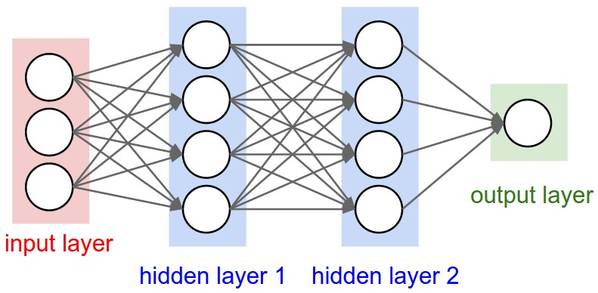
Neural Network with 3 inputs, 1 output, and 2 layers of 3 neurons
Source: https://www.google.com/search?q=neural+net&client=firefox-b-1-ab&source=lnms&tbm=isch&sa=X&ved=0ahUKEwiAjeK2nqbaAhXJsVQKHflQDCYQ_AUICigB&biw=1282&bih=858&dpr=1#imgrc=EXoHkcJRnWRI3M:

Slide 4
How it Works
Forward Propagation
Input neurons are set
Each neuron sums up the output of the previous layers neurons times their connection weights
These inputs are put into a sigmoid function to determine output
Back Propagation
The error of output neurons are determined
Total contribution to the error by hidden neurons is calculated
Connection weights are updated to minimize error

Slide 5
W = .2
1
W = .5
W = .7
W = -.1
W = .4
W = .6
W = -.9
W = -.9
W = .8
0
W = -.3
W = .3
W = .1

Slide 6
∑=.5
Out = .62
W = .2
1
W = .5
W = .7
W = -.1
W = .4
W = 0
∑=0
Out = .5
W = -.9
W = -.9
W = .8
0
W = -.3
W = .3
∑=-.3
Out = .43
W = .1

Slide 7
∑=.5
Out = .62
W = .2
∑= .367
Out = .59
1
W = .5
W = .7
W = -.1
W = .4
W = 0
∑= 0
Out = .5
W = -.9
W = -.9
W = .8
0
∑= -.47
Out = .38
W = -.3
W = .3
∑=-.3
Out = .43
W = .1

Slide 8
∑=.5
Out = .62
W = .3
∑= .367
Out = .59
1
W = .5
W = .7
W = 0
W = .5
W = 0
∑= 0
Out = .5
W = -.9
W = -.7
W = .6
0
∑= -.47
Out = .38
W = -.3
W = .3
∑=-.3
Out = .43
W = .3

Slide 9
∑=.5
Out = .62
W = .3
∑= .367
Out = .59
1
W = .35
W = .9
W = 0
W = .5
W = .05
∑= 0
Out = .5
W = -.95
W = -.7
W = .6
0
∑= -.47
Out = .38
W = -.4
W = .1
∑=-.3
Out = .43
W = .3

Slide 10
My Implementation

Slide 11
Agents
Member Variables
Summed_input
Output
Error
Connections
Weight
Functions
Activate
Sum_inputs
Calc_error
Update_weights
All handled through NetworkX

Slide 12
What happens in one cycle
Forward Prop
Agents get their summed inputs and calculate their new outputs
Agents are updated Asynchronously, starting with first hidden layer
Back Prop
Errors are calculated based on ideal output
Errors are propagated backwards on the network
Connection weights are updated synchronously

Slide 13
Testing and Validation

Slide 14
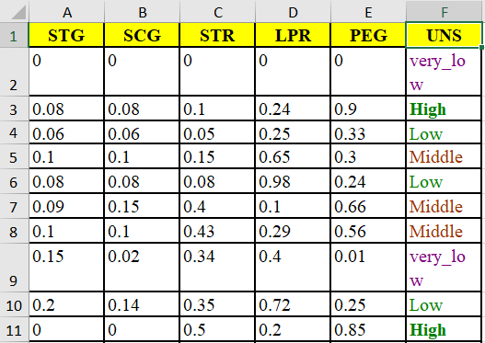
Data Set
This should be multipurpose, applicable to any data set
Found a data set for classifying knowledge level based off of input values
5 criteria, 4 possible categories
259 Training instances
146 Testing Instances

Slide 15
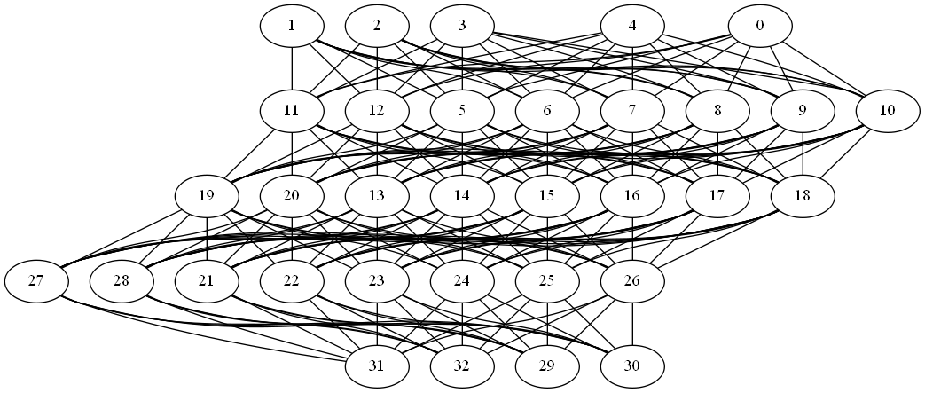

Slide 16
0
0
0
0
0
1
0
0
0

Slide 17
Parameters of Interest
Layers: 1 - 5
Nodes in Layer: 2, 4, 6, 8, 10
Learning Rate: .1, .25, .5, .75, 1
Number of Epochs

Slide 18
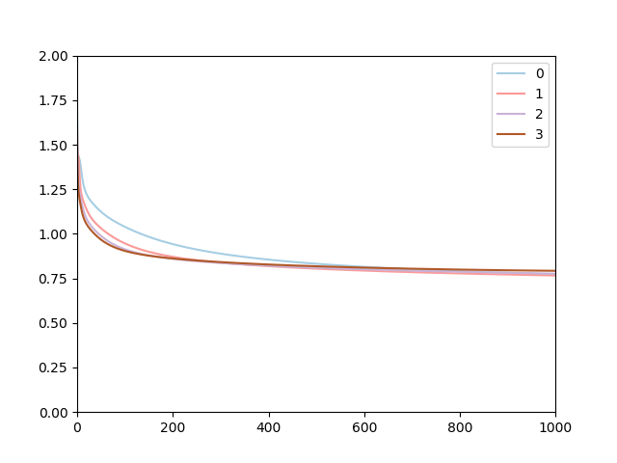
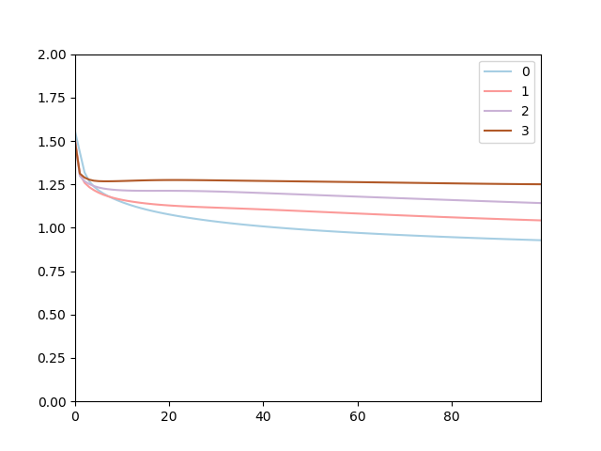
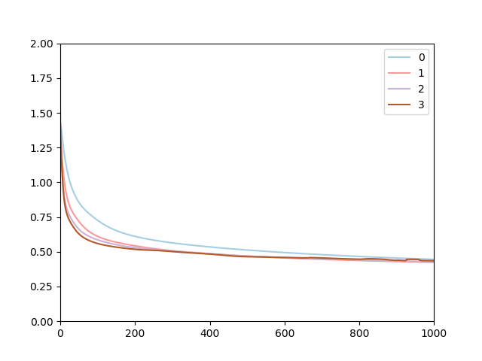
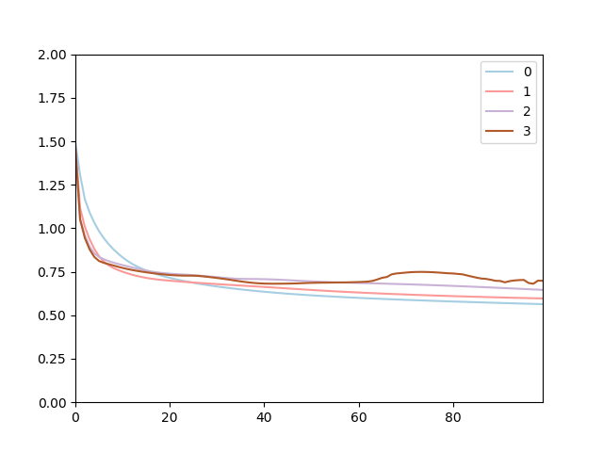
1x2 Training
1x2 Testing
1x10 Training
1x10 Testing

Slide 19
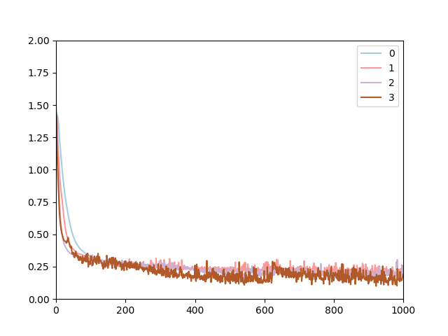
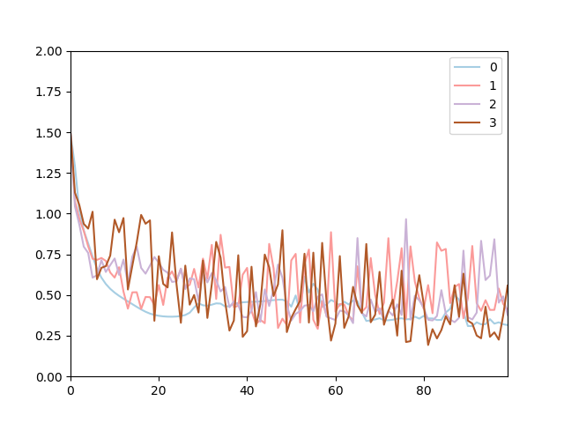
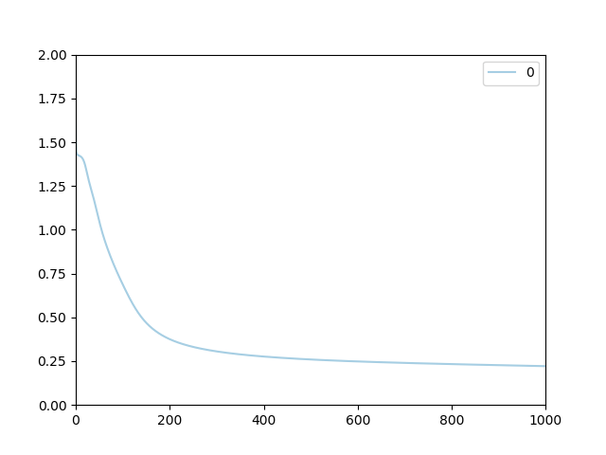
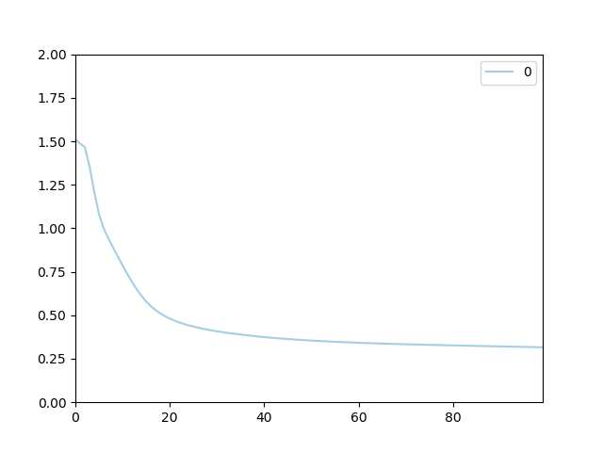
2x10 Training
2x10 Testing
2x10.1 Training
2x10.1 Testing

Slide 20
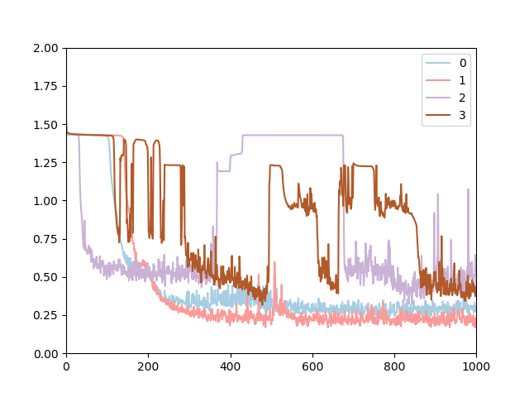
4x4 Training

Slide 21
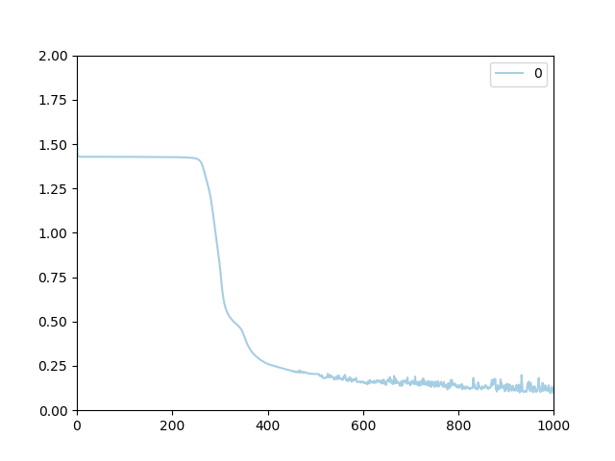
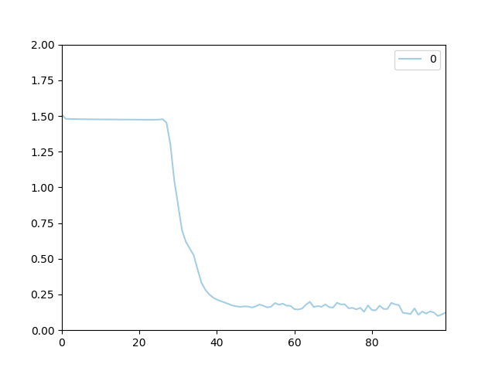
5x10.1 Training
5x10.1 Testing

Slide 22
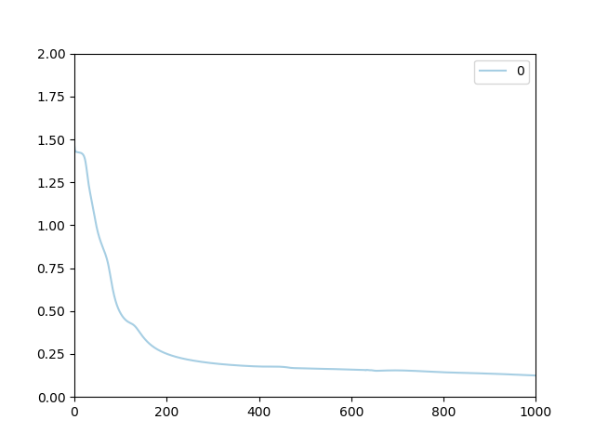
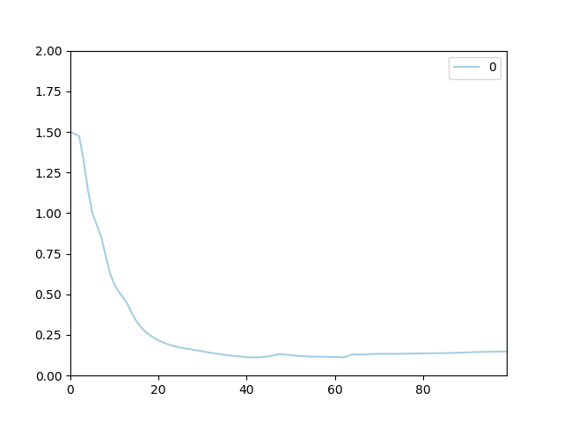
Best Performance
3x10.1 Training
3x10.1 Testing

Slide 23
Conclusions
There is a sweet spot for number of layers and total Neurons
Increasing number of neurons increases effect of learning rate
Lower learning rate performs better
Possibility of Overtraining

Slide 24
Next Steps
Explore adding more neurons in layer
Run Monte Carlo to confirm initial conclusions
Test on other Data sets
Clean up my code for reusability

Slide 25
References
https://mattmazur.com/2015/03/17/a-step-by-step-backpropagation-example/
http://neuralnetworksanddeeplearning.com/chap2.html
https://machinelearningmastery.com/implement-backpropagation-algorithm-scratch-python/

Slide 26
Math

Slide 27
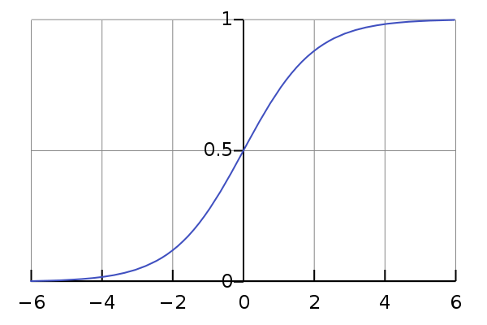

Sigmoid Function
Maps values between 0 and 1
Used to determine output of neuron
$\frac{1}{1+e^{−x}}$
x = summed input to neuron

Slide 28

Delta Calculation
Output Neuron
Partial Derivative of Etot with respect to w5
Derivative of error
Derivative of output
Derivative of connection’s input
(actual – ideal) * (output * (1 – output)) * (input)

Slide 29


Delta Calculation
Hidden Neuron
Partial Derivative of Etot with respect to w1
Derivative of contribution to total error
Derivative of output
Derivative of connection’s input
∑($connection_weight_{i}$*$delta_{i}$) * (output * (1 – output)) * (input)

Slide 30

Calculating New Weight
$weight=weight_{i} −rate ∗delta$

