Slide 1


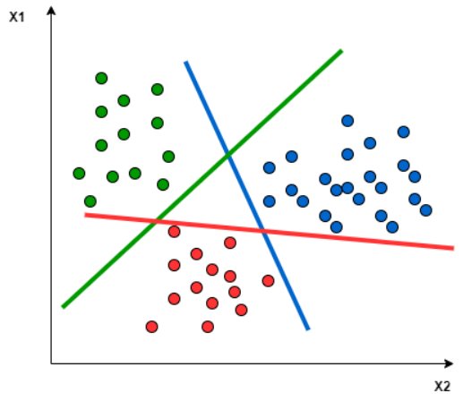
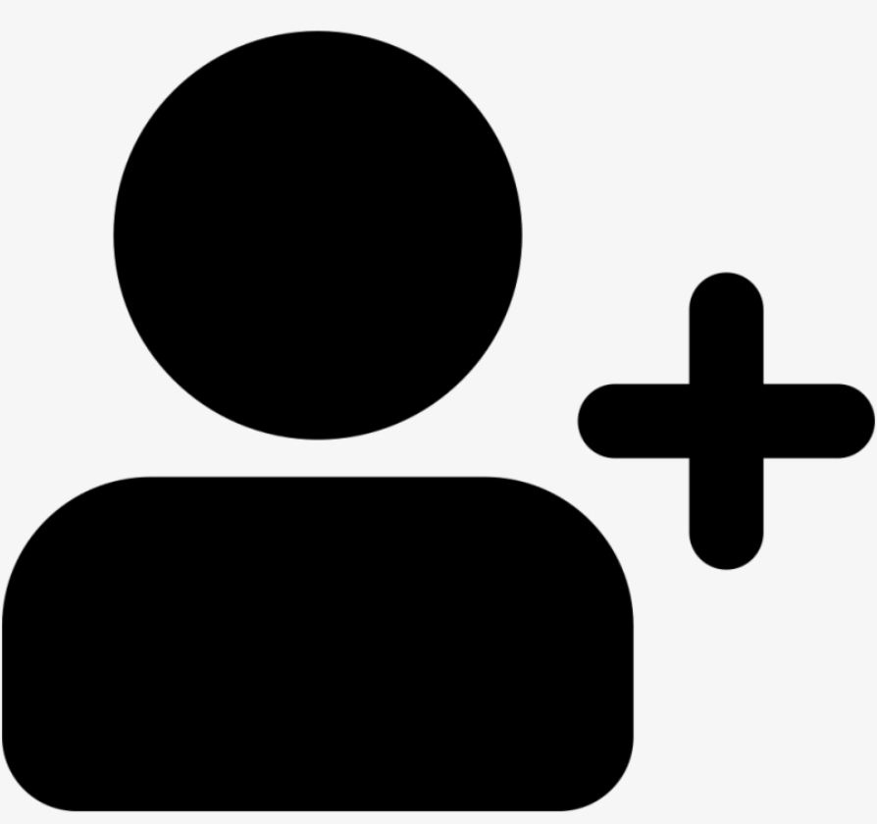

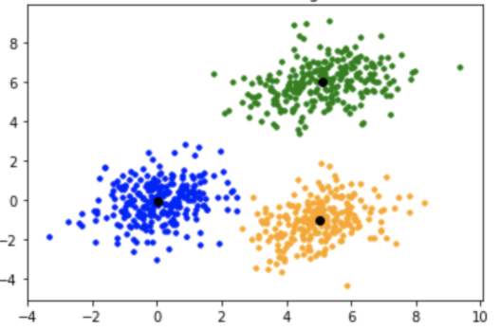
Technical Workflow
Linear Support Vector to Categorize Videos
Further Processing
To Build Video Space
Video Data
Pull Video Transcripts via YouTube API
Preprocess Data using NLP
Recommender based on K-Means clustering of video data. User video history analysis to find vidoes to recommend
Patient Data
Preprocess Data
Input: Patient vector
Recommendation

Slide 2

Feature Engineering
Video Data:
The video data was rather sparse – not all the information was populated for each video (primary category, description, tags, etc.). For this reason transcripts were pulled off YouTube using YouTube API.
NLP techniques (tokenize, remove stop words, stem, etc.) used to pre-process text data and then CountVectorization used to populate word count / video dataframe
Linear SVM used in conjunction with populated data to use supervised learning to populate videos primary categories
Patient Data:
Patient data well populated but EDA showed few distinguishing features
Watch events pulled from video data and added to features for patients
Attempted to recommend based on user-user collaborative filtering but few new videos were recommended

Slide 3
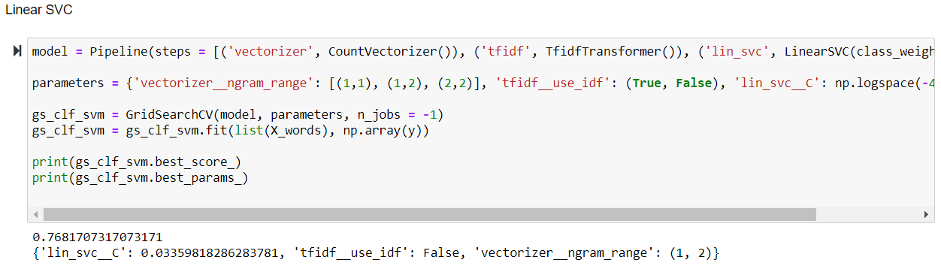
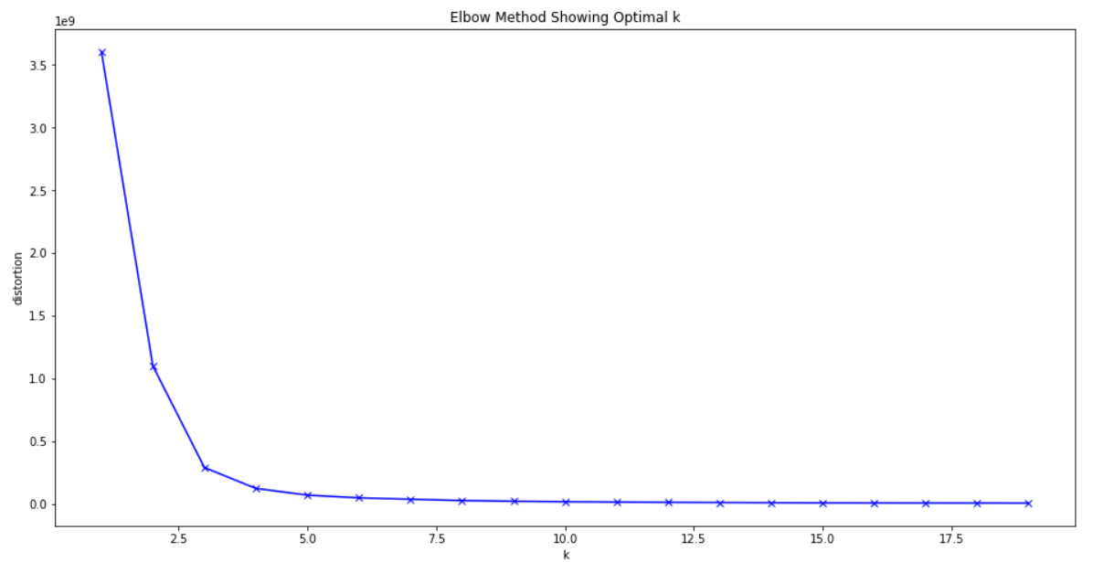
Models
Primary Category Population
Linear support vector classifier used to populate primary category based on transcripts, notes, description, and tags
Model and parameters chosen based on GridSearchCV:
Video Recommendation
Unsupervised model using k-means to find videos in cluster of videos that patient has already watched
Distortion of different k values ploted to ensure we weren’t above an elbow
k values picked based on trial and error and review of clustering data

Slide 4

Testing and Results
Video categorization
Score tested using cross validation (scored using multi train/test splits) with average of roughly 77%
On final model accuracy, precision, recall and F1 were all calculated
Recommendation:
Filtered on patients that watched more than 6 videos (ignoring cold start)
Removed two videos from patient watch list
Recommend 10 videos that try to predict those two videos held out
Results:
Manually inspected data show recommendation consistent on a categorical level but low prediction percentage on the 2 videos with held
Cosine similarity predicted roughly 3%
Kmeans predicted roughly 8%

Slide 5
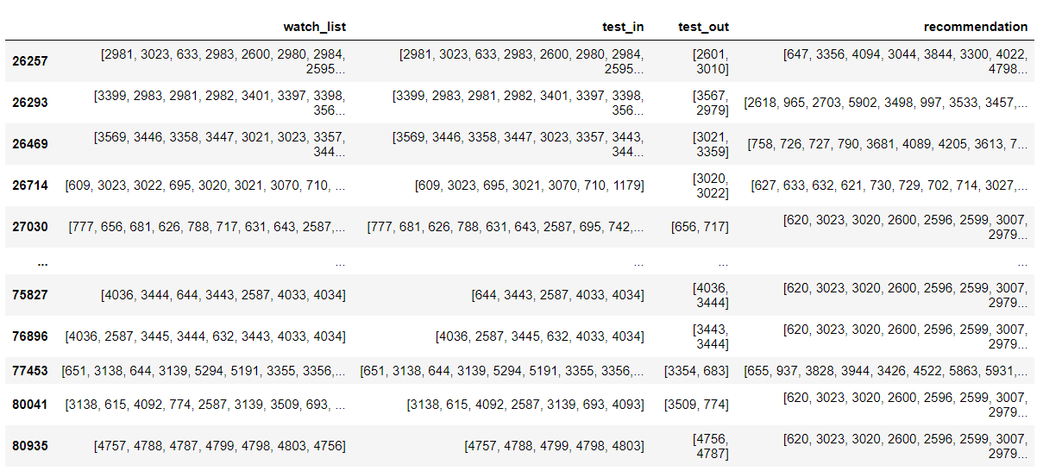
Discussion
Summary
Model used patient watch history to recommend similar videos
Similar videos found using K-Means clustering on roughly 20 clusters
Model tried to predict / recommend videos pulled from the patients watch history but did so with low accuracy (roughly 8%)
Many reason this could be so low
Manual review of some recommendation showed videos recommended were similar to watch history
Future Improvements
Patient data / user-user collaborative filter could be expored to find videos watched by similar patient
Video popularity could have be levereaged to recommend videos that were watched more times by more patients
Cold start was not address in this model
Limited feature engineering for final recommender model so this could be tuned and explored more
There wasn’t much data to build models so pulling more data on videos or recording more data on patients upfront could help
cosine similarity and K-means were the only similarity algorithms used so exploring new machine learning algorithms could yield improve results.
Getting real life feedback from patients based on recommendations could be fead back into a model to improve future recommendations

