Slide 1
Clinical Interviewing with the SCID-5
Julianna Calabrese
October 16th, 2019

Slide 2
Structured Clinical Interview for DSM-5 Disorders (Research Version)

Slide 3
What is the SCID-5?
A (semi-)structured interview guide to make major DSM-5 diagnoses
Can be conducted on any sample (clinical or community)
Covers current and past disorders
Most appropriate for adults (18 or older)
The Kiddie Schedule for Affective Disorders and Schizophrenia (KSADS) is a similar interview for children and adolescents
Research Version is more customizable than Clinician or Clinical Trial Versions
SAND-21 will use some (not all) of the SCID modules
Interviewers must be trained on SCID practices
Takes about an hour (hopefully)

Slide 4
SCID Overview
SCID scoring
1 = Absent
2 = Sub-Threshold
3 = Present
Questions about symptoms are asked in the context of a time period, e.g.:
After the age of 18
Within the last 6 months
A 2-week period in the last year when symptoms were most severe
Do the symptoms cause clinically significant distress or impairment in social, occupational, or other important areas of functioning?
Are the symptoms explained by another disorder (mental or physical), substance, or side effect of substance?

Slide 5
SAND-21 SCID Modules
Module A: Depression
Without specifiers
Without Premenstrual Dysphoric Disorder
Module BC Screen: Psychotic
Module D: Differential Diagnosis
Not conducted during actual interview
Module E: Substance
Module F: Anxiety
Module G: OCD
Module I: Eating/Feeding
Module K: Externalizing
Only ADHD and Intermittent Explosive Disorder
Module L: Trauma

Slide 6
Module versus Screen
Each major DSM-5 diagnosis gets a module to assess severity and specific symptoms
A screener is much shorter and determines the presence or absence of the disorder
The Psychotic Screener “assesses only the lifetime presence of delusions and hallucinations, and is generally used for the purpose of screening out from a study cases with a lifetime history of psychotic symptoms”

Slide 7
Some disorders may invalidate the SCID
“Some individuals with severe cognitive impairment, agitation, or severe psychotic symptoms cannot be interviewed using the SCID‐5”
No modules for autism, developmental disorders, or intellectual disability
Symptoms of autism or ID may appear in other modules
SAND-21 will not include any personality disorder modules

Slide 8
Some factors to consider
All participants will be from the FFCWS sample
75% were born to unmarried mothers in urban areas
70% Black/African-American
Exposure to community violence and early-life adversity
Poverty, material hardship
No one older than 25 years old
Measured by KSADS at age 15, participants were pretty healthy
Most common among children
ADHD, depression, panic attacks, social phobia
Most common among PCGs
Social phobia, specific phobia, depression, panic attacks
Notes:
Because of this, the homework cases at the back of the SCID-5 manual aren’t super helpful. We won’t be interviewing anyone above the age of 25.

Slide 9
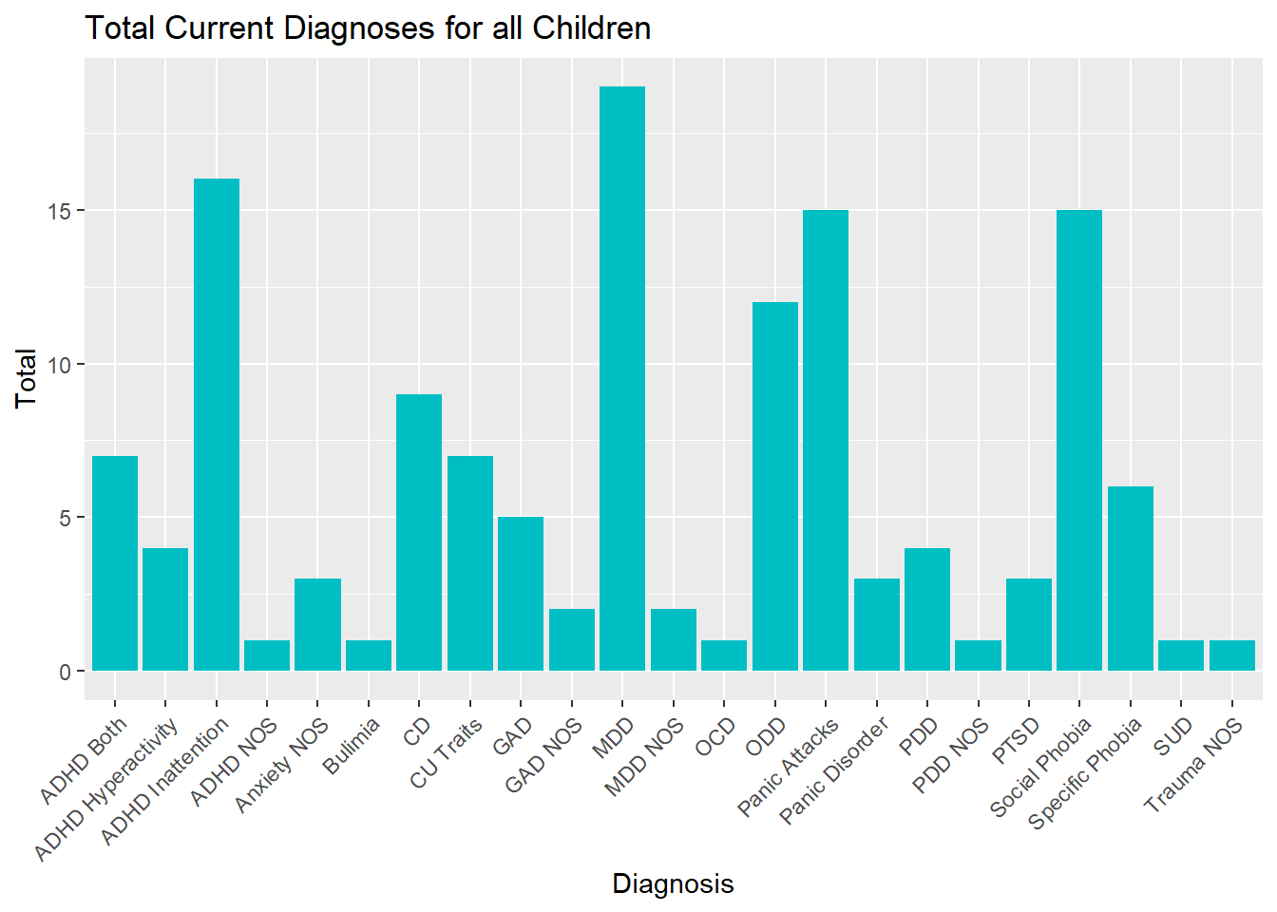

Slide 10
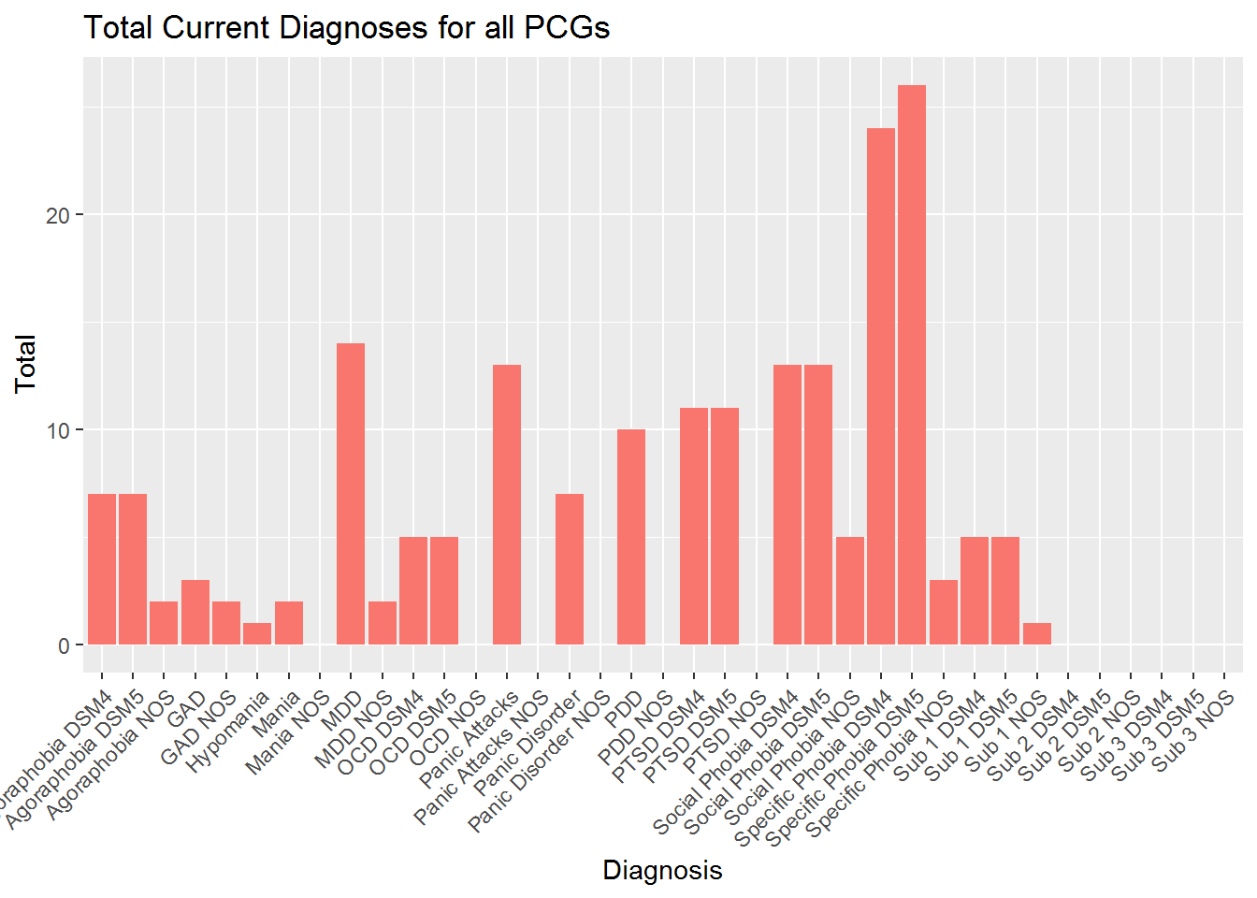

Slide 11
Modules & Disorders
Module A: Major Depressive Episode
Mood Episodes
Cyclothymic Disorder
Persistent Depressive Disorder
Module BC: Psychosis
Delusions
Hallucinations
Module D: Differential Diagnosis
Bipolar I & II
Major Depressive Disorder
Module E: Substance
Alcohol & non-alcohol use disorders
Module F: Anxiety
Panic Disorder
Generalized Anxiety Disorder
Agoraphobia
Social Anxiety Disorder
Specific Phobia
Module G: OCD
Obsessions
Compulsions
Module I: Eating/Feeding
Anorexia Nervosa
Bulimia Nervosa
Binge-Eating Disorders

Slide 12
Modules & Disorders
Module K: Externalizing
ADHD Inattention
ADHD Hyperactivity/Impulsivity
Intermittent Explosive Disorder
Module L: Trauma
Trauma History
Acute Stress Disorder
PTSD
Adjustment Disorder

Slide 13
SAND-21 SCID Modules

Slide 14
Module A: Major Depressive Episode
Mood Episodes
Depressed mood most of the day, nearly every day
Markedly diminished interest or pleasure in activities
Weight loss or gain
Insomnia or hypersomnia
Psychomotor agitation or retardation
Fatigue or loss of energy
Worthless, excessive/inappropriate guilt
Diminished ability to think/concentrate or indecision
Recurrent thoughts of death
Cyclothymic Disorder
Periods of hypomanic symptoms that don’t meet criteria for hypomanic episodes
Persistent Depressive Disorder
Depressed mood most of the day, nearly every day, for at least 2 years
Two or more of the following:
Poor appetite/overeating
Insomnia /hypersomnia
Low energy or fatigue
Low self-esteem
Poor concentration or indecision
Hopelessness

Slide 15
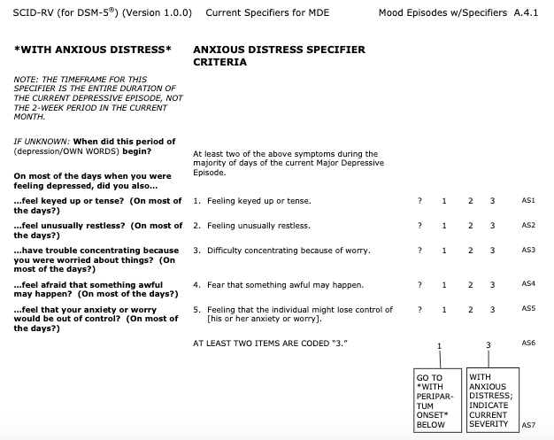
MDE Specifiers
Anxious distress
Peripartum onset
Mixed features
Catatonia
Melancholic features
Atypical features
SAND-21 will not use MDE specifiers

Slide 16
Module BC Screen: Psychotic
Delusions
Delusion of reference: Events, objects, or people have unusual significance to them
Persecutory delusion: Someone is attacking, cheating, or conspiring against them
Grandiose delusion: They have special powers, knowledge, or a relationship with a famous person or deity
Somatic delusion: Something is wrong with their body that cannot be medically explained
Delusion of guilt: A small error will lead to a disaster, or that they should be punished because they committed a terrible crime
Jealous delusion: Their partner is unfaithful
Erotomanic delusion: A usually-famous person is in love with them
Religious delusion: A higher power directly communicates with them
Delusions of being controlled: Someone else is controlling their thoughts or actions
Thought delusions: Someone else inserts or removes thoughts in their head, or they believe that others can read their own thoughts

Slide 17
Module BC Screen: Psychotic
Hallucinations
Auditory
Visual
Tactile
Somatic
Gustatory
Olfactory

Slide 18
Module D: Differential Diagnosis
Bipolar I
Has had at least 1 manic episode
Bipolar II
Has had at least 1 major depressive episode and 1 hypomanic episode
Major Depressive Disorder
Has had at least 1 major depressive episode
Differential Specifiers
Rapid cycling
Seasonal pattern
This module will be completed outside of the interview
We can add up symptoms from other modules to determine if they meet criteria for any of these disorders

Slide 19
Module E: Substance
Substance Symptoms
Problematic pattern of use
Consumed in larger amounts OR over a longer period of time than intended
Persistent desire or unsuccessful attempts to limit use
Spends a lot of time to use, obtain, or recover from substance
Strong desire to use
Use leads to inability to fulfill obligations (school, employment)
Consistent use despite interpersonal problems
Gives up activities due to use
Recurrent use in dangerous situations (e.g. drunk driving)
Continues to use despite knowledge that they have a problem
Develops tolerance, needs more substance to become intoxicated
Develops withdrawal symptoms within several hours to a few days of ceased use

Slide 20

Module E: Substance
Substance Use Disorders
Alcohol
Sedative, Hypnotic, or Anxiolytic
Cannabis
Stimulant
Opioid
Inhalant
PCP
Hallucinogen
Other or Unknown Substance
Interviewers must go through all symptoms for every substance endorsed
Scoring is different from other modules
This module can take a long time if the interviewee endorses multiple substances

Slide 21
Module F: Anxiety
Panic Disorder
Heart racing
Sweating
Shaking
Shortness of breath
Feelings of choking
Chest pain
Nausea, stomachache
Dizziness, lightheadedness
Dizziness, lightheadedness
Chills or heat sensations
Numbness or tingling
Feelings of unreality or being detached from oneself
Feelings of “going crazy”
Fear of dying
Recurrent panic attacks

Slide 22
Module F: Anxiety
Generalized Anxiety Disorder (GAD)
Excessive anxiety and worry
Difficult to control the worry
Anxiety is associated with at least three:
Restlessness
Being easily fatigued
Difficulty concentrating, mind going blank
Irritability
Muscle tension
Sleep problems

Slide 23
Module F: Anxiety
Criteria in Agoraphobia, Social Anxiety Disorder, and Specific Phobia:
Marked fear or anxiety of a:
Situation
Social interaction or performance
Specific object, creature, situation, or phenomenon
Fears being unable to escape situations, negatively judged, etc.
Situation/object always causes fear or anxiety
They avoid situations/objects or endures them with intense anxiety
Their fear/anxiety is unrealistic or out of proportional of its actual danger

Slide 24
Module F: Anxiety
Agoraphobia
Public transportation
Open spaces
Enclosed spaces
Being in a line or crowd
Being outside of home alone
Social Anxiety Disorder (SAD)
Social situations
Being observed
Performing in front of others
Specific Phobia
Animal (spiders, insects)
Natural environment (heights, storms)
Blood-injection-injury (needles, invasive medical procedures)
Situational (airplanes, elevators, enclosed places)
Other type (situations that might lead to choking or vomiting)

Slide 25
Module G: OCD
Obsessions
Intrusive thoughts, urges or images
Tries to ignore, suppress, or neutralize intrusions
Compulsions
Repetitive behaviors or mental acts
Cleaning, Washing
Doubting, Checking
Ordering, Straightening, Rearranging
Hoarding
Done to prevent or reduce anxiety, or to prevent a dreaded event
Time-consuming

Slide 26
Module I: Eating/Feeding
Anorexia Nervosa
Restriction of energy intake, leads to low body weight
Intense fear of gaining weight
Disturbance in how they experience their weight or shape
Bulimia Nervosa
Recurrent episodes of binge eating
Feelings of lack of control over eating during the episode
Eating an unproportional amount of food during a discrete period (e.g. with a 2-hour period)
Inappropriate behavior to prevent weight gain (e.g. vomiting, laxatives)
Severity on 4-point scale, based on BMI
Two subtypes: Restricting or Binge-Eating/Purging

Slide 27
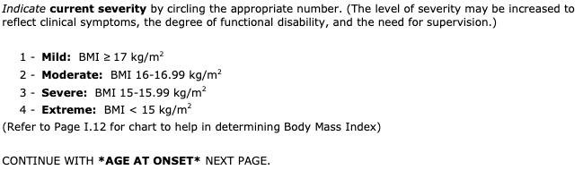
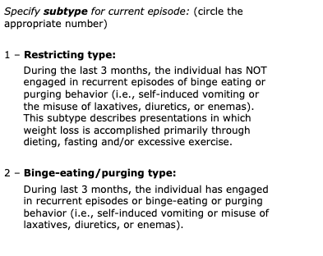
Module I: Eating/Feeding

Slide 28
Module I: Eating/Feeding
Binge-Eating Disorder
Episodes are associated with at least 3:
Eating more rapidly than normal
Eating until feeling uncomfortably full
Eating large amounts of food when not hungry
Eating alone because of embarrassment at how much they are eating
Feeling disgusted, depressed, or guilty after eating

Slide 29
Module K: Externalizing Disorders
ADHD
At least 5 Inattention symptoms:
Fails to keep close attention, makes careless mistakes
Hard to sustain attention
Doesn’t listen when spoken to directly
Doesn’t follow through on instructions, starts but fails to finish tasks
Difficulty in organizing tasks
Avoids tasks that require sustained mental effort
Loses things
Easily distracted
Forgetful

Slide 30
Module K: Externalizing Disorders
ADHD
At least 5 Hyperactivity/Impulsivity symptoms:
Fidgets, squirms in seat
Leaves seat in situations where they should stayed seated
Runs or climbs in inappropriate situations
Unable to play quietly
“On the go” or “driven by a motor”
Talks excessively
Blurts out answers
Difficulty in waiting for their turn
Interrupts others

Slide 31
Module K: Externalizing Disorders
Intermittent Explosive Disorder (IED)
Recurrent outbursts, fails to control aggressive impulses
Verbal or physical aggression towards property, people, or animals
Outbursts are out of proportion to situation
Outbursts are not planned and are not done to achieve a goal

Slide 32
Module L: Trauma
Trauma History
Traumatic Experience:
Death
Serious injury
Sexual violence
Mode of exposure:
Directly experienced
Witnessed happening to others in person
Learning about trauma happening to family or friend
Repeated exposure to averse details

Slide 33
Module L: Trauma
Acute Stress Disorder
Exposure to death, serious injury, or sexual violence
Distressing memories/dreams
Dissociative reactions, flashbacks
Distress and physiological reactions when reminded of trauma
Can’t experience positive emotion
Altered sense of reality
Can’t remember some of traumatic event
Tries to avoids memories, feelings, or physical reminders about traumatic event
Sleep problems
Irritability, angry outbursts
Hypervigilance
Poor concentration
Easily startled
Lasts less than 1 month

Slide 34
Module L: Trauma
Posttraumatic stress disorder
Exposure to death, serious injury, or sexual violence
Distressing memories/dreams
Dissociative reactions, flashbacks
Distress and physiological reactions when reminded of trauma
Tries to avoids memories, feelings, or physical reminders about traumatic event
Can’t remember some of traumatic event
Negative belief about self or others (e.g. “I’m bad”, “Others can’t be trusted”)
Blaming cause of traumatic event on self or others
Persistent negative emotional state
Uninterested in activities
Feelings of detachment
Can’t experience positive emotion
Irritability, angry outbursts
Reckless behavior
Hypervigilance
Easily startled
Can’t concentrate
Sleep problems
Dissociation or derealization
Panic attacks
Lasts more than 1 month

Slide 35
Module L: Trauma
Adjustment Disorder
Develops behavioral or emotional symptoms after a stressful life event within 3 months after the event occurred
Distress out of portion to the stressful life event
Types:
Depressed mood: low mood, tearfulness, hopelessness
Anxiety: nervousness, worry, separation anxiety
Mixed anxiety and depressed mood: both of above
Disturbance of conduct: violation of rights of others, norms, or rules
Mixed disturbance of emotions and conduct: all of above
Unspecified: none of the above (e.g. physical complaints, social withdrawal)

Slide 36
Depression
Depressed mood
Loss of interest or pleasure
Psychosis
Delusions
Hallucination
Differential
Depressive episode
Manic episode
Hypomanic episode
Substance
Large amounts
Cravings
Failed obligations
Tolerance, withdrawal
Anxiety
Panic or worry
Fear of a situation, object, or phenomenon
Out of proportion fear
OCD
Obsessions
Compulsions
Eating/Feeding
Restricted intake
Disturbed body image
Binging
Externalizing
Inattention
Hyperactivity/Impulsivity
Recurrent outbursts
Trauma
Traumatic exposure
Flashbacks
Negative emotion
Hypervigilance

Slide 37
Case Studies

Slide 38
Case Study #1: Lisa (source)
Lisa was the oldest of three children, in a family that she described as “highly dysfunctional”. When Lisa was in her infancy, her parents moved to a farm in Vermont, seeking a hippie lifestyle (e.g., building their own house, eating microbiotically, not working, and schooling the children at home). Lisa’s father drank heavily and was physically abusive toward her mother. Although Lisa reports that she never saw the spousal abuse directly (she had only heard about it from her younger sister), she saw its effects when her mother appeared battered and with stitches. She described her father as very stoical and withdrawn, and suffering from anxieties and phobias. For example, he experienced great anxiety about making left turns when driving and avoided them whenever possible.
When Lisa was nine years old, her parents —who were never actually married— separated, at the time her mother was pregnant with Lisa’s younger brother. Lisa and her siblings continued to live with her mother. Lisa took on the dual roles of confidant and caretaker to her mother and younger brother. Lisa’s mother was severely depressed, unable to work, and spent three years crying almost constantly. Lisa had the job of organizing the household, as well as trying to soothe and care for her mother.
Lisa left home at 16, following a boyfriend to California where she decided to stay, and with permission from her mother, finished high school while working as a nanny. After high school, she went to college where she majored in environmental studies. Her performance in college was erratic. She had many bouts of depression and sought therapy on a number of occasions. She met her boyfriend, Albert, while in college. Though she found him to be a stabilizing influence, she described him as consistently detached and distant. After college, she moved back into the house where she had worked as a nanny, living in an adjacent cottage, and providing housework in partial exchange for rent. Soon thereafter, Albert, who holds a responsible and successful position in the computer industry, moved in with her, sharing the small rent. She described him as steady, slightly withdrawn, unemotional, and for the most part, withholding.

Slide 39
Case Study #1: Lisa (source)
At the time that she presented for treatment, Lisa was an attractive 23 year old recent college graduate, who was seeking therapy for help with feelings of depression. Lisa reported sleep problems, poor appetite, feeling down, trouble concentrating, feeling fidgety, having slow thoughts, and decreased interests in things she enjoyed. She also reported confusion over her career plans and her current relationship with her boyfriend. When she began therapy, she was living with her boyfriend and working as a laborer in a conservation project (as a way to repay her education debts) and as a part-time administrative assistant at a non-profit agency related to environmental issues.
She had been using Zoloft to control her depression but she was still feeling depressed. Her main problems as she described them early in treatment, included a tendency to panic in stressful situations, a phobia or excessive worrying about global warming, feeling overly responsible for and tied to her mother, feeling unnaturally “clingy” and dependent on boyfriends and friends, feeling awkward and ineffective at work and unsure of her future plans, and feeling somewhat dissatisfied with her boyfriend, Albert. She also said she was feeling confused about her sexuality, as she had recently been experiencing feelings of sexual attraction towards her female friend, Jessica.

Slide 40
Case Study #1: Results
Major Depressive Disorder, Recurrent, Mild
Anxiety Disorder NOS

Slide 41
Interview Evaluation

Slide 42
What makes a good interview?
Interviewing Style
Established rapport
Explained purpose of interview
Handled questions well
Recognized and handled participant’s emotional responses (e.g. anger, tearfulness)

Slide 43
What makes a good interview?
Obtaining Information
Elicited enough information in the Overview
Elicited treatment history in the Overview
Followed SCID structure
Got participant to describe symptoms in their own words
Obtained enough information to make sound judgments
Used language that was clear to participant
Took already-obtained information into account when asking questions
Took already-obtained information into account when asking questions
Resolved contradictions in participant’s story
Followed skip instructions
Skipped sections when appropriate
Questions were focused on appropriate time periods
Clearly distinguished easily-confused symptoms
Helped participant not ramble on or get off-topic
Completed interview within 60-90 minutes

