Slide 1
How to Apply to Graduate School in Psychology
Julianna Calabrese
February 12th, 2020

Slide 2
Overview
Psychology Programs
GRE
Choosing a School
Finding a Mentor
Letters of Recommendation
Personal Statements
Other parts of application
Interview Weekend

Slide 3
Types of Psychology Programs, Part I
PhD Programs
Clinical
Counseling
School
Developmental
Social
Neuroscience
Health
Behavioral
Experimental
Personality
Cognitive
Industrial-Organizational (I/O)
Quantitative
Forensic

Slide 4
Types of Psychology Programs, Part II
Master’s Programs
Master’s in Psychology
Applied Behavior Analysis
Marriage & Family Therapy
LMHC/LPC
Non-Psychology Options
MSW (Social Work)
PhD in Neuroscience
PhD in Statistics & Data Science
Nursing School (RN → NP)
Medical School (MD)
Physician Assistant (PA)

Slide 5
Things to know about graduate programs
Master’s: 2-4 years
PhD: 4-7+ years
Some programs require a 1-year internship before graduation
You don’t need to get a Master’s before a PhD
Should be considered by those who didn't major in psychology or have a below-average GPA
Many PhD programs will offer some tuition remission
Stipend and other funding sources vary
Master’s and professional programs (e.g. PsyD) may not offer tuition remission
Notes:
A good Master’s GPA won’t completely overwrite your undergrad GPA, though. Even if you do perfectly in your Master’s, some schools will still look at and consider your Bachelor’s GPA. For an example of this, look at Fordham’s FAQ (it’s the last few sentences under the question “What are the minimum requirements for GPA and GRE scores?”) → https://www.fordham.edu/info/21663/phd_in_clinical_psychology/3732/faq

Slide 6
What are graduate schools looking for?
**Research experience**
E.g. volunteering in labs, internships, senior thesis
Clinical experience (if applicable)
Relevant coursework
Statistics!
Competitive GPA/GRE
Some schools use minimum cut-off scores
Some focus more on psychology GPA than total GPA
Some focus on the last two years/60 credits of all courses
Notes:
A more-than-slight downward trend in GPA over the course of college semesters can sometimes worry admission committees. Don’t let senioritis get you down! On the flip side, an upward trend in GPA can really help you out if you didn’t too so well in your first year.

Slide 7

Taking the GRE, Part I
GRE General Test: 3 hours and 45 minutes, 100 questions, 2 essays
Three components: Analytical Writing, Verbal, Quantitative
AWA: 0 to 6
Verbal & Quant: 130 to 170
Total: 260 to 340
1 - 2 months of studying (recommended)
Suggested path
Study → Spring Semester/Summer
Take test → Summer/Fall Semester
Retest if needed → October/Early November
General Test costs $205
Notes:
Between 2013-2016, the mean GRE score of a psychology major was V152/Q149/AWA3.9 (according to ETS)
UMass Amherst’s average scores for their clinical program from their last cohort: V165/Q160/AWA4.8

Slide 8

Taking the GRE, Part II
Studying options
Free
YouTube & Khan Academy
Prep books (via interlibrary loan)
2 free practice tests from ETS
Favorite brands
ETS (book), Manhattan (book), Magoosh (website)
General Test is offered year-round

Slide 9
Taking the GRE, Part III
Psychology GRE Subject Test (205 questions)
6 Parts: Biological, Cognitive, Social, Developmental, Clinical, & Measurements/Methodology
Many schools recommend it, but few require it
Usually required for non-psychology majors or for applications to specific programs (e.g. clinical)
Offered exclusively in April, September, and October
Subject tests cost $150

Slide 10



Choosing a School
Program specifics & specializations
Location -- Doesn’t have to be in the US!*
Tuition remission, stipend, fellowships/assistantships
Typical length of program
Competitiveness
“Student Admissions, Outcomes, and Other Data”
**Fit with Professor!**

Slide 11
Finding a Mentor, Part I
When you apply, you must select a mentor that you want to work with
People often call their prospective mentor their “PI” or “POI” (“Person of Interest”)
How do I find a mentor?
Researchers who appear in papers you read
Look up your research interests on PsycInfo/PubMed
Schools in good locations with unique characteristics
Scan a school’s faculty list for mentors who share your interests

Slide 12

Finding a Mentor, Part II
Is this professor taking students?
Check school website/faculty page
Check personal lab website
Email them
When you find a potential mentor, email them before applying
Sometime between June and November
Even if you know they’re taking students, introduce yourself via email

Slide 13
How many schools should I apply to?
Don’t bother applying to a school you would never want to go to!
Remember that psychology graduate programs are some of the most competitive programs to get into
Many clinical applicants apply to 12 - 20 schools

Slide 14
Pre-Application Checklist
Must be very certain that you want to go to grad school!
Must have taken or are about to take the GRE
Must have some kind of research experience
Must have a list of schools with 1-3 professors at each school that you want to work with (that you’ve already emailed too!)
Now you can start the application process!

Slide 15
Letters of Recommendation
Who to ask?
Professor
Academic advisor
Lab director
Internship supervisor
Employer
If possible, ask in-person
Give letter-writer sufficient time to write and submit
E.g. Summer, start of fall semester
Technical issues will probably happen

Slide 16
Writing Personal Statements, Part I
Also called: statement of purpose, statement of intent, statement of goals
Word limits range from 500 to 1500
Statements may ask for any of the following:
Research experience
Specific research interests
Relevant skills (e.g. RStudio, working with kids)
Why psychology
Why this specific school
Career goals
Clinical experience (if applicable)
**Will always ask you which faculty members you want to work with**

Slide 17
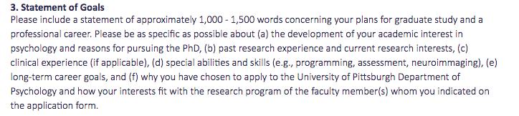
Example 1 (University of Pittsburgh)

Slide 18
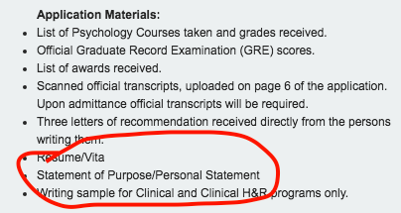
Example 2 (University of Kansas)
Notes:
That’s it!

Slide 19
Writing Personal Statements, Part II
What to do
Differentiate yourself
Balance personal and professional
Emphasize your strengths
Be clear and concise
**Discuss your match with the school and chosen faculty members**
Ask multiple people to review it, including your major advisor and an advisor at a writing center
Rewrite, rewrite, rewrite!

Slide 20
Writing Personal Statements, Part III
What NOT to do
Be too personal
References to yours or a loved one’s mental health
Overly altruistic statements
Excessive self-disclosure*
Other professionally inappropriate topics
Be too poetic/fluffy/clichéd
Repeat your CV
Send a school the wrong statement
From a paper called “Kisses of Death in the Graduate School Application Process”
Notes:
If you have a blip in your record (e.g. a semester that you did really poorly in due to a family emergency or personal illness), you have the option of explaining yourself in your personal statement. Be brief and concise! Don’t talk about the specifics of your emergency/illness/etc. Explain yourself clearly and quickly and say that is not indicative of your overall academic experience. But be careful: if you talk about it, you’re pointing this blip for everyone to see (people may have not totally noticed it beforehand), and you use up valuable space in your statement that you could’ve talked about your interests, strength, match, etc. Talk about this with your academic advisor before you do this.

Slide 21
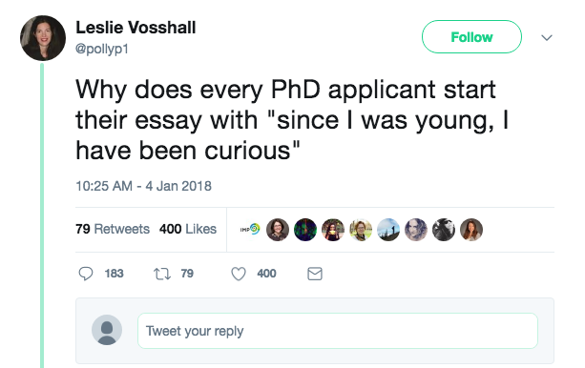
From Leslie Vosshall, neurobiologist and professor at Rockefeller University

Slide 22
Other Parts of Application
Resume vs. CV
Resume: 1 page long, just the important things
CV: Much longer, includes everything relevant
High school is not relevant
Personal history statement
Writing sample
Preferably a research paper
Preliminary interview
After your application is submitted, professors may ask to interview you over Skype/phone before inviting you to interview weekend

Slide 23
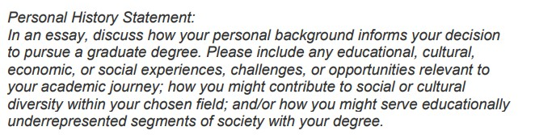
Personal History Statement (UC Berkeley)
Notes:
A personal history statement may be its own separate essay (like with UC Berkeley) or a textbox in the application portal. Some schools’ personal history statements may be optional but schools may encourage applicants to submit them in order to qualify for specific fellowships.

Slide 24
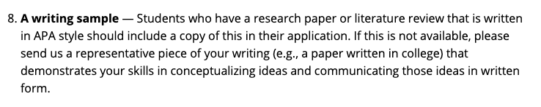
Writing Sample (South Florida)
Notes:
https://www.usf.edu/education/areas-of-study/school-psychology/programs/admission-requirements.aspx

Slide 25

For Clinical, Counseling, & School Applicants
Highly consider NOT studying abroad
Study in the country where you want to practice
Exception: US & Canada (but it’s complicated)
APA accreditation
APA vs. PCSAS
APPIC internship, EPPP, state licensure
Training models
Scientist-practitioner (Boulder model)
Clinical scientist
Other kinds of licensure
Notes:
APA stopped accrediting Canadian universities in 2015, but the APA and CPA have mutual recognition. So supposedly you should be able to go to grad school/do internships/take EPPP/practice in both countries as long as you do all of those things in US or Canada (after being licensed by the local state/province licensing board) BUT this might be harder in practice and it’s hard to say what will happen since the change is so recent.
http://www.apa.org/ed/accreditation/newsletter/2013/12/accreditation-canada.aspx
https://www.cpa.ca/accreditation/FAQ/
Note: you can’t practice in Quebec unless you have a few years of post-secondary French education.
https://psychology-canada.ca/how-to-become-a-psychologist-in-quebec/
Also fun fact: you can get licensed as a IO psychologist!
https://www.siop.org/Membership/Licensure-Policy-by-State
Only some states accept PCSAS accreditation as equal to APA: Delaware, Illinois, Missouri, California, New York, and New Mexico.
https://www.pcsas.org/redesign/wp-content/uploads/2019/09/PCSAS-POPP-Manual-rev-Sept-2019.pdf

Slide 26
Difference Between a Clinical PhD and a PsyD
PhD
Doctorate of Philosophy in Psychology
Older
Focused on research
APA accreditation
89% receive tuition remission
Selective (~7% avg acceptance)
PsyD
Doctorate of Psychology
Newer (1970s)
Focused on clinical work
APA accreditation
17% receive tuition remission
Less selective (~50% avg acceptance)
Notes:
http://www.apa.org/gradpsych/2010/09/freestanding.aspx

Slide 27

Submitting the Application
There are many things to remember and be aware of…
Most schools only offer fall admission
Deadline: December 1st (give or take)
Application fee can be between $35 and $105 per school
May use third-party sites like Interfolio for LORs ($48 subscription)
May require an official copy of transcript sent by the Registrar
May require proof of residency (e.g. scan of passport)
You must send each school your GRE scores using the ETS website
The first four schools are free (at testing center), but after that, it costs $27 per school

Slide 28
Interview Weekend, Part I
Occurs between January and March during spring semester
Sometimes not actually on a weekend
Usually a full day event
You’re interviewing them as much as they’re interviewing you!
Professional attire
Formality depends on school and program
The norm for clinical programs is a suit
Options to attend
Fly there and stay with a current graduate student
Skype/phone call
Reimbursement for travel varies by program (uncommon for clinical)

Slide 29
Interview Weekend, Part II
Designed to assess a mysterious concept known as “fit”
Applicants are interviewed by their prospective mentor(s), other faculty members, and current graduate students
Do your research on your mentor and other people who are interviewing you
Bring a few copies of your CV
Example questions:
“Tell me about yourself.”
“Tell me about [this project/experience on your CV].”
“If you had the funds to design any experiment, what would it be?”
“What do you plan to do after graduate school?

Slide 30
What to do if you’re a firstyear/sophomore
**Get involved with research**
Summer internships
Focus on coursework
Discover your interests
Participate in psychology-related extracurriculars
Psi Chi / Nu Rho Psi
Mental health-related volunteer work

Slide 31
What to do if you’re a junior
**Keep doing research**
Summer internships
Start studying for the GRE!
Take a practice test just to see where you’re at
Narrow your research interests
Consider who should write your letters of recommendation
Consider taking a gap year

Slide 32
What to do if you’re a senior
Consider which cycle you want to apply
What to do during a gap year
**Postbacc position in a lab**
Working in a clinic or hospital
Volunteering & shadowing

Slide 33
Getting a postbacc before graduate school
Postbacc positions are usually 2-year commitments
Look at graduate schools you are interested in, search that school’s job website for postbacc positions, apply to any available
Hospitals, medical centers, and the National Institute of Health also have postbacc positions in psychology/psychiatry/neuroscience
You should get clinical experience if you are especially interested in clinical/professional programs

Slide 34
Getting a Master’s before PhD
Many types of Master’s programs
Research versus clinical/professional
Psychology
Master’s of Arts/Science in Psychology (General)
Specializations: Clinical, counseling, experimental, etc.
Master’s in Applied Behavior Analysis (ABA)
Master’s in Marriage and Family Therapy (MFT)
** Note that Master’s programs can’t be APA-accredited
Psychology-adjacent
Master’s in Public Health
Master’s in Social Work

Slide 35
Other Resources
Mitch’s Uncensored Advice for Applying to Graduate School in Clinical Psychology
A Student’s Perspective on Applying to Graduate School in (Clinical) Psychology: A Step-by-Step Guide
Temple University’s Basic Guide to Graduate School in Psychology
Insider's Guide to Graduate Programs in Clinical and Counseling Psychology
The Definitive ‘what do I ask/look for’ in a PhD Advisor Guide
Kisses of Death in the Graduate School Application Process
Salaries, Student Debt, and Employment Opportunities in Psychology
2 free GRE practice tests from ETS

