Slide 1
Exploring Trophy Hunting and Recreational Hunting Tourism: an Analysis from a Bibliometric Perspective (1971-2024)
Caro-Barrera, J.R.; Pérez Priego, M.; García-Moreno García, M. B.
University of Córdoba (Córdoba), Spain
June, 18th-20th, 2025

Slide 2



AUTHORS
José Rafael Caro-Barrera
Area of Applied Economics
University of Córdoba (Córdoba), Spain
Manuel Pérez Priego
Area of Business Organization
University of Córdoba (Córdoba), Spain
María de los Baños García-Moreno García
Area of Statistics, Econometrics and Operational Research
University of Córdoba (Córdoba), Spain

Slide 3
Outline
Introduction
Literature Review
Methodology
Results
Conclusions

Slide 4
Introduction
1.1 Hunting Tourism Definition
1.2 Sport & Trophy Hunting Development and Its Economic Impact
1.3 Research Objectives

Slide 5
1.1 Hunting Tourism Definition
“A set of activities carried out by individuals who go to a specific place,
attracted by the hunting resource, to capture a game sustainably,
using different techniques and means.” (Rengifo Gallego, 2008).
“Any hunting of a non-human animal in which part of the animal is kept
for personal display and souvenir purposes." (Bichel and Hart, 2023).

Slide 6
1.2 Sport and Trophy Hunting Development and Its Economic Impact
- Early practices throughout human history.
Emergence of sport hunting, trophy hunting and hunting tourism in the 20th century.
Relationship between leisure time and rural tourism expansion.
Important economic activities around the world, particularly in regions with abundant wildlife resources.
Dates back to colonial times, has evolved into a complex industry affecting conservation, rural development and sustainable tourism.

Slide 7
Trophy hunting generated gross revenues of $201 million per year in 23 sub-Saharan African countries covering an area of 1.4 million km². (Lindsey et al. , 2006).
In South Africa alone, trophy hunting generated an economic impact of $137 million in 2013. (Di Minin et al., 2016).
The International Union for Conservation of Nature (2016) report reveals that trophy hunting programmes provide economic incentives in several African countries, with annual revenues ranging from US$1.1 million to US$12.2 million, depending on the country.
In other regions: North America, Europe, and Central Asia, it also generates significant economic value. (Sharp and Wollscheid, 2009) although the specific figures vary depending on the region and the analysis methodology employed.

Slide 8
1.3 Research Objectives
Analyse the main documents, journals and authors in the field of trophy hunting and hunting and recreational tourism.
Identify documents with the highest academic impact through citation analysis.
Evaluate thematic lines and emerging trends for future studies through keyword co-occurrence analysis and longitudinal analysis
Identify documents that have contributed significantly to the theoretical foundations through co-citation analysis.

Slide 9
2. Literature Review
2.1 Evolution of Trophy Hunting Research
2.2 Bibliometric Context of Trophy Hunting

Slide 10
2.1 Evolution of Trophy Hunting Research
1
Early conservationist approaches
Conservation efforts from the 1930s to the 1960s focused on protecting species and habitats, laying the foundations for modern practices.
2
Economic valuation studies
From the 1970s to 1990s, the economic impacts of conservation were assessed, integrating financial incentives into preservation strategies.
3
Sustainability debates
The 1990s to 2000s witnessed intense debates around sustainability, promoting discussions on balancing ecological and economic needs.
4
Integrated socio-ecological approaches
Since 2000, there has been a shift towards integrating socio-ecological frameworks that emphasise the interconnectedness of human and ecological systems.

Slide 11
2.2 Bibliometric Context of Trophy Hunting
The analysis of research on trophy hunting or hunting, or recreational tourism has been partial:
  Wildlife biology,
  Tourism studies,
  Conservation and sustainability science,
  Rural economics,
This specific field has been tangentially analised by Kanta et al. (2021) or Parket et al., (2023).
Lack of bibliometric studies focusing specifically on trophy hunting, recreational hunting or hunting tourism.
This deficit justifies the present work in order to identify patterns, and present and future trends, in trophy hunting and hunting and recreational tourism research at a more global level.

Slide 12
3. Methodology
3.1 A dual approach using SLR and BNA for analysis
3.2 Data Collection Process

Slide 13
3.1 A dual approach using SLR and BNA for analysis
Comprehensive
Analysis
Dual Methodology
01
02
The combination of SLR and BNA provides a comprehensive analysis of secondary data in trophy hunting research, uncovering key insights.
This study employs a dual
methodology combining Systematic Literature Review (SLR) and Bibliographic Network Analysis (BNA)for a thorough analysis.
04
03
Secondary Data Focus
Patterns and Trends
By focusing on secondary data, the study leverages existing research to derive valuable conclusions in trophy hunitng tourism.
This methodology reveals significant patterns and trends in trophy hunting tourism, enhancing our understanding of this field.

Slide 14
3.2 Data Collection Process
Identified records
Web of Science
(n=1506)
Identified records
Scopus
(n=864)
Records after filtering
Web of Science
(n=1361)
Registers
Excluded
(n=145)
Records after filtering
Scopus
(n=707)
Registers
Excluded
(n=157)
Records before merging and deleting duplicates
(n=2068)
Records after merging and deleting duplicates
(n=1559)
Registers
Excluded
(n=509)

Slide 15
4. Results
4.1 Overview of Tourism Hunting and Trophy Hunting Results
4.2 Performance and Citation Analysis: Main Authors
4.3 Performance and Citation Analysis: Main Journals
4.4 Top Ten Papers by Citations
4.5 Network and Keyword Analysis

Slide 16
4.1 Overview of Trophy and Recreational Hunting Results
656 sources
Diverse Sources
The analysis is based on 656 sources covering a wide range of publications relevant to trophy hunting tourism.
1559 documents
Extensive Literature
A total of 1559 documents were evaluated, providing a comprehensive overview of the topic.
2.14%
growth
Steady Growth
The annual growth rate of 2.14% indicates a consistent increase in research activities related to hunting tourism.
22.94 citations
Citations per Document
On average, each document received 22.94 citations, reflecting the significance of these findings in the academic community.
4184 authors
Collaborative Efforts
The research involves contributions from 4184 authors, highlighting the collaborative nature of studies in this field.

Slide 17
4.2 Performance and Citation Analysis: Insights from Top 3 Authors
Top h-index
20
Lindsey, P. leads with an h-index of 20, indicating significant scholarly impact
Total Citations
1924
Lindsey, P. has amassed a total of 1924 citations, showcasing the influence of their work.
Second h-index
19
MacDonald, D. follows closely with an h-index of 19, highlighting their substantial contributions.
Citations Count
1519
MacDonald, D. has garnered 1519 citations, reflecting their research's relevance.
Third h-index
18
Loveridge, A. holds an h-index of 18, indicating notable academic recognition.
Citation Total
1360
Loveridge, A. has achieved 1360 citations, underscoring the impact of their publications.

Slide 18
4.3 Performance and Citation Analysis: Main Journals
Nº | Sources | h index | g index | m index | TC | NP | PY start
1 | Biological Conservation | 28 | 54 | 0,528 | 2998 | 55 | 1973
2 | Journal of Wildlife Management | 25 | 41 | 0,568 | 1686 | 42 | 1982
3 | Conservation Biology | 20 | 29 | 0,588 | 2306 | 29 | 1992
4 | PLoS One | 20 | 45 | 1,111 | 2125 | 45 | 2008
5 | Oryx - The Internat. Journal of Conservation | 19 | 30 | 0,655 | 1047 | 30 | 1997
6 | Wildlife Society Bulletin | 15 | 27 | 0,5 | 741 | 30 | 1996
7 | Journal Of Sustainable Tourism | 13 | 20 | 0,448 | 618 | 20 | 1997
8 | Animal Conservation | 11 | 14 | 0,55 | 464 | 14 | 2006
9 | Human Dimensions Of Wildlife | 11 | 17 | 0,393 | 319 | 23 | 1998
10 | Journal of Applied Ecology | 11 | 16 | 0,55 | 935 | 16 | 2006

Slide 19
4.4 Top Ten Papers by Citations
# | Article | Total Quotes
1. | (Martín-López, et al., 2012), Uncovering Ecosystem Service Bundles through Social Preferences. PLoS One. | 792
2. | (Coltman et al., 2003), Undesirable evolutionary consequences of trophy hunting. Nature | 609
3. | (Massei et al., 2015), Wild boar populations up, numbers of hunters down? A review of trends and implications for Europe. Pest Management Science. | 586
4. | (Boxall et al., 1996), A comparison of stated preference methods for environmental valuation, Ecological Economics | 483
5. | (Lindsey et al., 2007), Economic and conservation significance of the trophy hunting industry in sub-Saharan Africa, Biological Conservation. | 346
6. | ( Köndgen et al., 2008 ), Pandemic Human Viruses Cause Decline of Endangered Great Apes, Current Biology. | 328
7. | (Milner, J.M. et al., 2007), Demographic Side Effects of Selective Hunting in Ungulates and Carnivores, Conservation Biology. | 323
8. | ( Kuvlesky Jr., W.P. et al.,2007 ), Wind Energy Development and Wildlife Conservation: Challenges and Opportunities, The Journal of Wildlife Management. | 314
9. | (Milner et al., 2006), Temporal and spatial development of red deer harvesting in Europe: biological and cultural factors, Journal of Applied Ecology. | 286
10. | (García Nieto, et al., 2013), Mapping forest ecosystem services: From providing units to beneficiaries. | 261

Slide 20
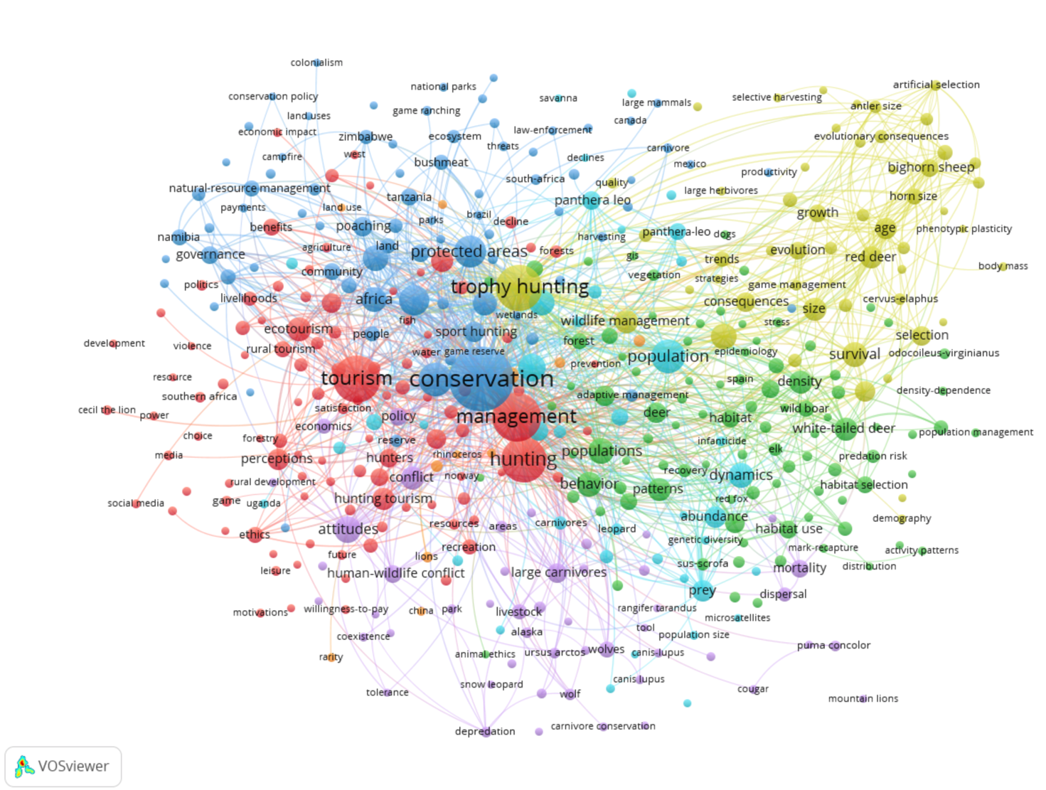
4.5 Network and Keywords Analysis
Relevant research topics: Blue cluster relates work related to "conservation of protected areas”
Red cluster to "hunting tourism"
Yellow cluster to "trophy hunting and wildlife management".
Less relevant:
Green and light blue clusters
relate to "species behaviour in different habitats"
Purple cluster to research on "ethical conflicts in trophy and recreational hunting".

Slide 21
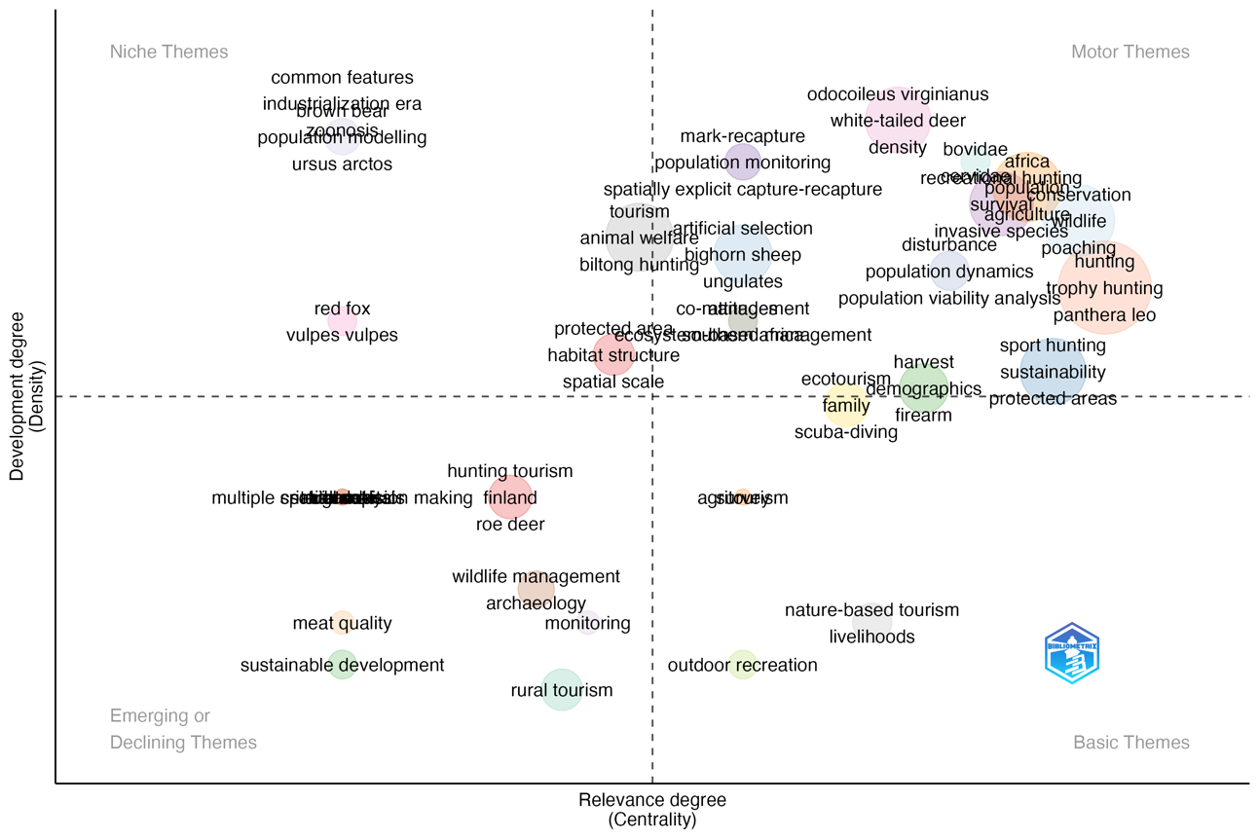
Driving themes: highlight the importance of managing hunting activities.
- Wildlife
- Conservation
- Population
Niche themes: ecological concepts and species.
- Habitat structure
- Spatial scale
- Population monitoring
Basic topics: hunting and tourism concepts.
- Hunting
- Tourism
- Outdoor recreation
- Nature-based tourism
Emerging/Declining topics: areas of research that are emerging or declining in importance
Rural Tourism
- Sustainable development
- Monitoring

Slide 22
5. Conclusions
5.1 Key Insights and Main Contribution of the Work
5.2 Future Directions in Hunting Tourism Research

Slide 23
5.1 Key Insights and Main Contribution of the Work
Rising interest in trophy hunting
There is a growing body of literature exploring the impact of trophy hunting on conservation efforts and economic benefits.
Key trends in hunting tourism
This analysis reveals significant trends within the field, highlighting influential studies that shape the understanding of recreational hunting.
Importance of responsible management
Effective management practices are essential to ensure that ecological and economic advantages are maximised while mitigating negative impacts.
Influential works identified
The bibliometric study underscores key publications that have significantly contributed to the discourse on trophy hunting and its implications.
Notes:
* As the global discourse on sustainable tourism and conservation intensifies, the role of trophy hunting, recreational hunting and hunting tourism within the broader framework of ecotourism is the subject of much controversy and academic research.
* A growing body of research suggests that hunting in general, whether as a sport or leisure activity, when managed responsibly, can bring both ecological and socio-economic benefits
* This bibliometric analysis of the body of articles published between 1971 and 2024, both quantitatively and qualitatively, on trophy and recreational hunting and hunting tourism shows a growing interest as a response to major societal challenges and changes in the last sixty years.

Slide 24
The contribution of this paper to the literature is to offer a data-driven analysis of different fields, providing an initial baseline for researchers, practitioners and policy makers to navigate the complex landscape of trophy and recreational hunting research and practice. In doing so, we have provided an overview of the research landscape on this topic by identifying key trends, influential work and research niches.

Slide 25
5.2 Future Directions in Hunting Tourism Research
Economic analysis of impacts
Biodiversity conservation integration
Sustainable trophy hunting policies
Ethical implications of hunting
This research will assess the economic consequences of hunting tourism on local communities and ecosystems, focusing on financial benefits and drawbacks.
Investigating how biodiversity conservation can be effectively integrated with hunting practices to enhance environmental sustainability and wildlife protection.
The formulation of
policies aimed at promoting sustainable trophy hunting practices, ensuring ethical standards and ecological balance in wildlife management.
A comprehensive study of the ethical considerations surrounding hunting tourism, examining moral questions and societal perceptions related to hunting.

Slide 26
THANK YOU
José Rafael Caro-Barrera
z52cabaj@uco.es
Manuel Pérez Priego
mppriego@uco.es
María de los Baños García-Moreno García
d52gagam@uco.es

