Slide 1
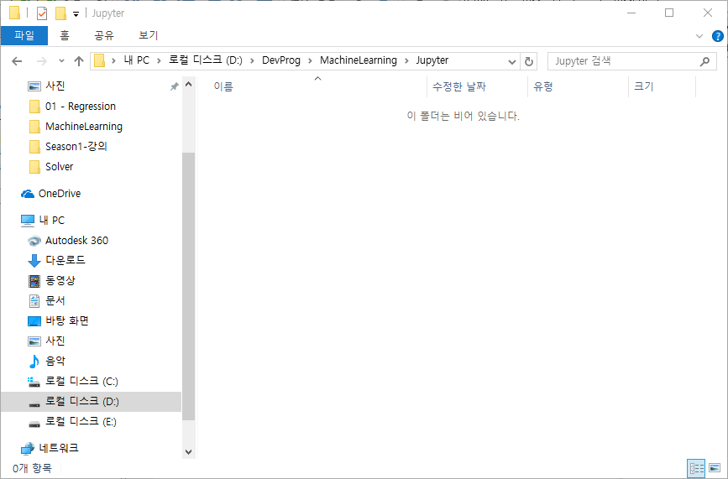
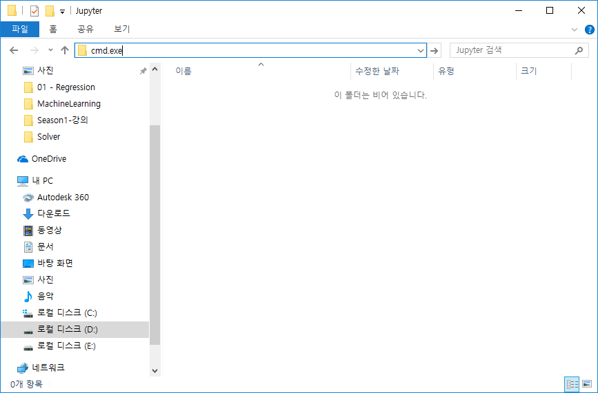
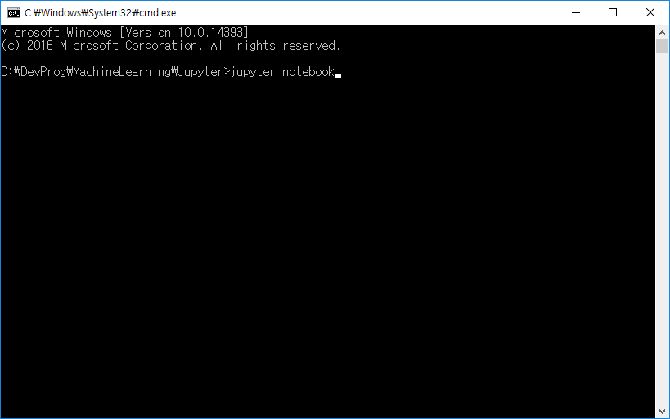
1
사용하고자하는 폴더에서
2
cmd.exe로 쉘을 띄운다
3
jupyter notebook입력

Slide 2
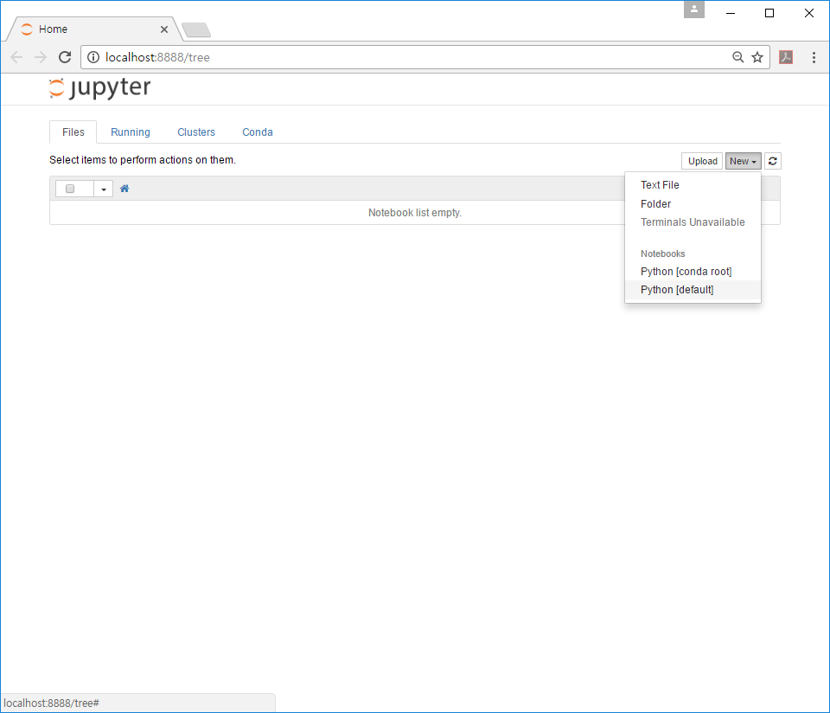
1
새로운 노트 생성

Slide 3
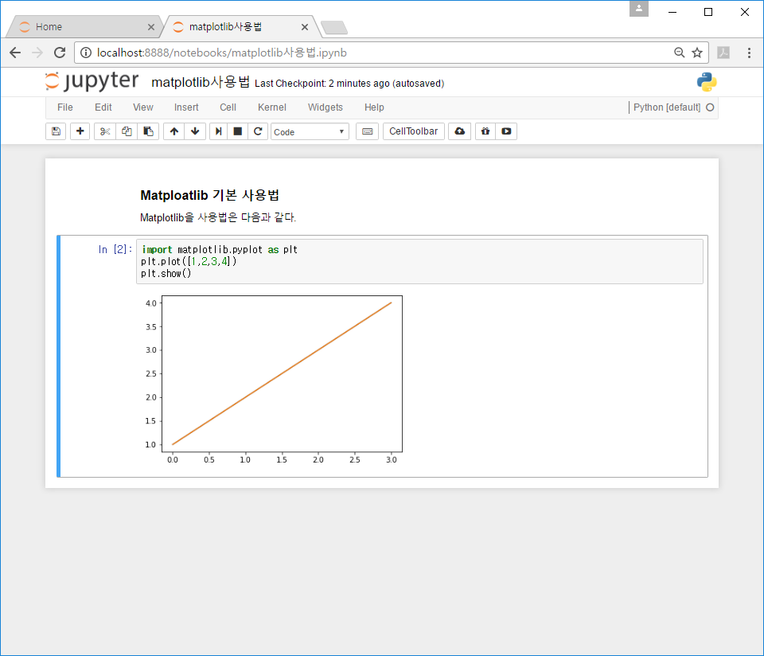
1
문서제목입력
2
Markdown이나
Python 코드
입력 및 실행

Slide 4
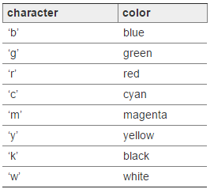
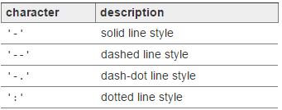
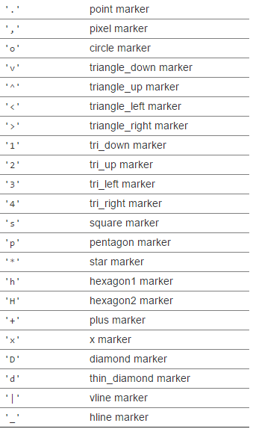
Color
Marker
LineStyle

Slide 5
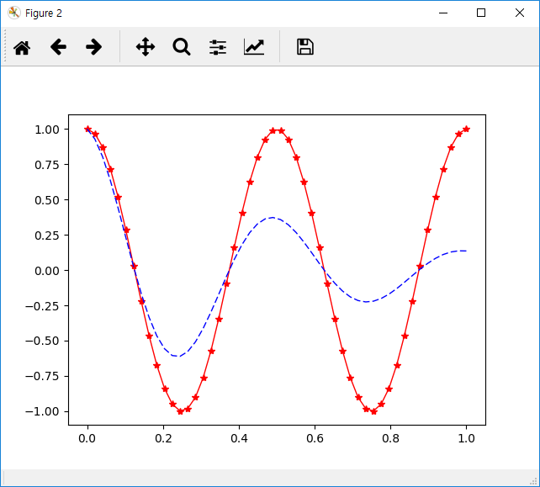
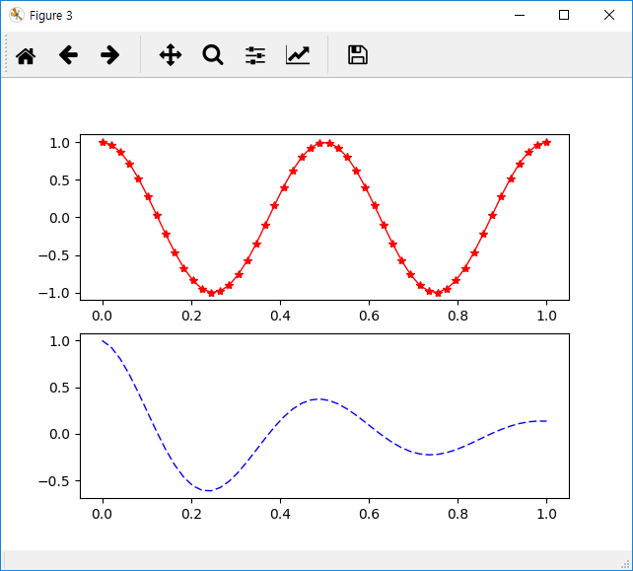
Figure
Figure
Axis
Axes
Axes
Line2D
Axes
Axis

Slide 6
x1 (hour) | x2 (attendance) | y (score)
10 | 5 | 90
9 | 5 | 80
3 | 2 | 50
2 | 4 | 60
11 | 1 | 40
x1 (hour) | x2 (attendance) | y (pass/fail)
10 | 5 | 1
9 | 5 | 1
3 | 2 | 0
2 | 4 | 0
11 | 1 | 0
x1 (hour) | x2 (attendance) | y (grade)
10 | 5 | A
9 | 5 | B
3 | 2 | D
2 | 4 | C
11 | 1 | E
Regression
Classification
→ Logistic regression/Neural Network 등으로 해결

Slide 7
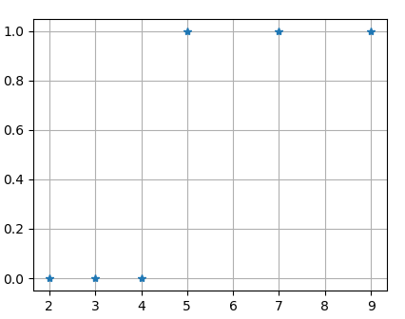
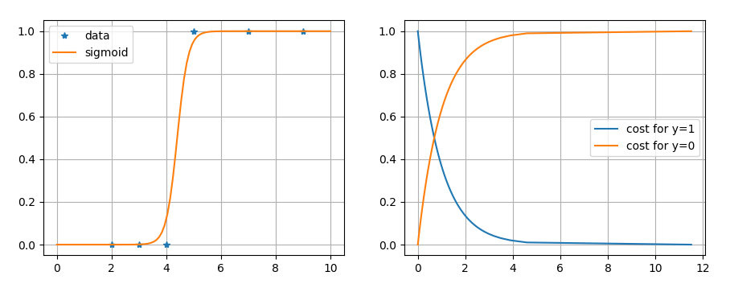





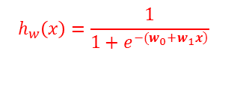
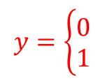
Data
$$h_{w}\left(x\right)=\frac{1}{1+e^{\left.−(w_{0}+w_{1}x\right)}}$$
x | y
2 | 0
3 | 0
4 | 0
5 | 1
7 | 1
9 | 1
$$h_{θ}\left(x\right)=w_{0}+w_{1}x$$
Fail
Pass
Fail
Pass
(a)
(b)
(c)
$$z$$
$$y=\left\{\begin{matrix}0 \\ 1\end{matrix}\right.$$
$$x$$
$$w$$
$$s$$

