Slide 1
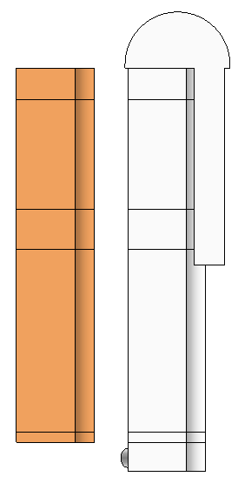

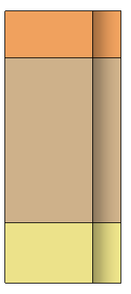
Dome Shape
Unit Brick
Combustion
Chamber
Shape
Sectional
Configurations
Stage
Configurations
Combusted Gas
Gas Waste
Branch
Shape
Cold blast (Air + O₂)

Slide 2
Start
Dome Shape
Unit Brick
Combustion
Simulation
(optional)
Combustion
Chamber
Shape
Ambient
Conditions
Sectional
Configurations
Combusted
Gas
Insulation
Bricks
Shape
Stage
Configurations
Cold blast
(Air + O₂)
Gas Waste
Branch
Shape
End

Slide 3
line black
line gary
line black
Combustion
Simulation
(optional)
Combustion
Simulation
(optional)
Combustion
Simulation
(optional)
Sectional
Configurations
Sectional
Configurations
Combusted
Gas
Combusted
Gas
Combusted
Gas
Sectional
Configurations
Cold blast
(Air + O₂)
Cold blast
(Air + O₂)
Cold blast
(Air + O₂)
Stage
Configurations
Dome Shape
Dome Shape
Dome Shape
Combustion
Chamber
Shape
Combustion
Chamber
Shape
Combustion
Chamber
Shape
Stage
Configurations
Stage
Configurations
Insulation
Bricks
Shape
Insulation
Bricks
Shape
Insulation
Bricks
Shape
Gas Waste
Branch
Shape
Gas Waste
Branch
Shape
Gas Waste
Branch
Shape
Ambient
Conditions
Ambient
Conditions
Ambient
Conditions
Unit Brick
Unit Brick
Unit Brick

Slide 5
