Slide 1
Immediate Annuities
Pete Buechler AAPA, ACS
Manager, Annuity Marketing
CPS Insurance Services
Notes:
This presentation will introduce you to the Impaired Risk Option in general & specifically cover the features of the Impaired Risk Option offered through FCL.

Slide 2





Immediate Annuities
  SPIA Consumer Profile
  Sales Ideas
  Impaired Risk Option
  Marketing
Notes:
Today, we will discuss/look at:
What? An impaired risk SPIA is
Why? You should be selling/offering the option
& How? To apply for the impaired risk option

Slide 3
CPS Insurance Service
    Immediate Annuity Product Highlights
Minimum Premium: $5,000 (or amount needed to provide $100Mo under modal payout)
Maximum Premium: $2,500,000 ($2,500,000 + requires home office approval)
Maximum Deferral Period: Up to one year & one payment mode, provided there are no restrictions due to required minimum distributions. Not available in all states.
Increase Options: Simple & Compound, Up to 6% annually (available ONLY on non-qualified funds)
Payment Options: Electronic Funds Transfer or check. Monthly, Quarterly, Semi-Ann, or Annual
Notes:
Here are some general Product highlights to keep in mind
(SPEAK TO THE SLIDE)
Any questions?

Slide 4
Profile of “Classic” SPIA buyer
SPIA Consumer Profile
Retired (Age 68)
Conservative Investor
Values Safety, Guarantees & Simplicity
Notes:
You see some of these investors who participated in 401(k)s, but invested solely in money markets or fixed accounts, regardless of their age.
Bought savings bonds and Certificates of Deposits.
Some sophisticated buyers like them too….Retiring Board member of one of Wall Street’s largest firms, bought a $2,000,000 GIA. He wanted to retire from worrying about performance and managing his money. He valued guarantees and simplicity.

Slide 5
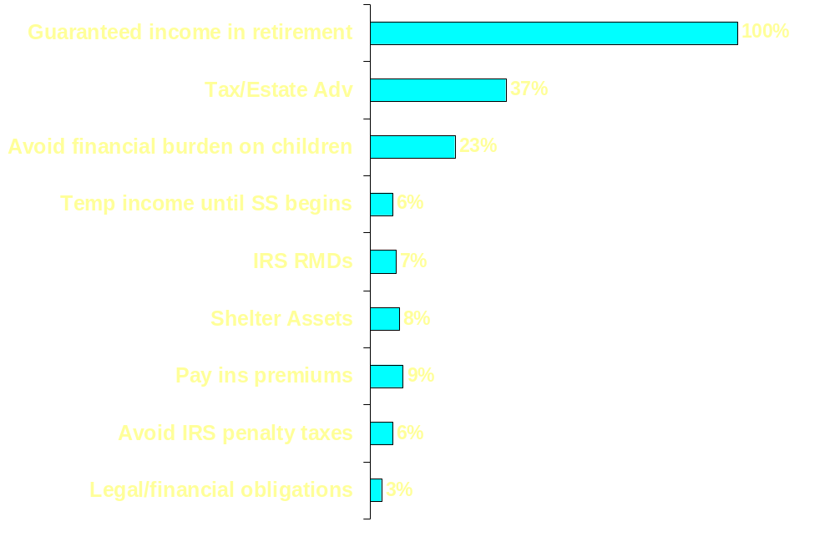
SPIA Consumer Profile
Sources: LIMRA 2000 SPIA Buyer Attitudes Study

Slide 6
Sales Ideas
Funding Vehicle:
Client Purchases an Immediate Annuity & Uses the Income to Pay Premiums, Etc.
Life Insurance
Long Term Care
Divorce Settlement
Child Support
Client Wants to
Pay Recurring Expense

Slide 7
Sales Ideas
Estate Planning
Estate is reduced by the SPIA premium amount
and heirs receive death benefit tax free.
Client buys SPIA to pay life insurance premiums
Notes:
Client buys life-only SPIA to pay premiums on a life insurance policy owned by a trust. The estate is reduced by the SPIA premium amount, thereby reducing potential estate tax liability, & beneficiaries of the life insurance policy receive life insurance proceeds income-tax free.

Slide 8
Sales Ideas
Wealth Transfer
Transfer the deferred annuity into a SPIA and channel the payments into a life policy that will pay an income-tax free death benefit.
Client owns a
deferred annuity that
is not needed
for income.

Slide 9
Impaired Risk Option
An Immediate Annuity with a Impaired Risk option is a medically underwritten immediate annuity that may provide individuals with serious medical conditions larger benefit payments or lower premium costs.
Notes:
First lets consider what an immediate annuity with an impaired risk option is….
An immediate annuity with an impaired risk option defined is
A medically underwritten…. (SPEAK TO THE SLIDE) …premium costs.

Slide 10
Impaired Risk Option
Impaired Risk Option Highlights
Impaired Risk option is only available on life contingent SPIA benefit options
Maximum age rate up is age 85
Typically, annuitant must have at least a 25% reduction in life expectancy in order to qualify for an age rate up.
Good rule of thumb- If client would be a table 2 or higher for Life Insurance Underwriting, they may be eligible for a rated SPIA.
Notes:
Some things/highlights to keep in mind about this/our option….. (SPEAK TO THE SLIDE)

Slide 11
Impaired Risk Option
Examples of the Minimum “Rated Age” for a 25% Reduction in Life Expectancy*
Female Male
Age Rated Age Age Rated Age
71 76 71 76
72 77 72 77
73 78 73 78
74 79 74 78
75 79 75 79
76 80 76 80
77 81 77 81
78 82 78 82
*Using Current Retirement Table QNSB00A
Notes:
In order for your client to qualify for a “rated age” with FCL, the client must have at least a 25% reduction in their life expectancy.
This chart provides examples of specific ages/genders & what a 25% reduction in life expectancy equates to in years or what “rated age” that client would have to qualify for in order to receive a rating.
(SPEAK TO THE SLIDE)

Slide 12
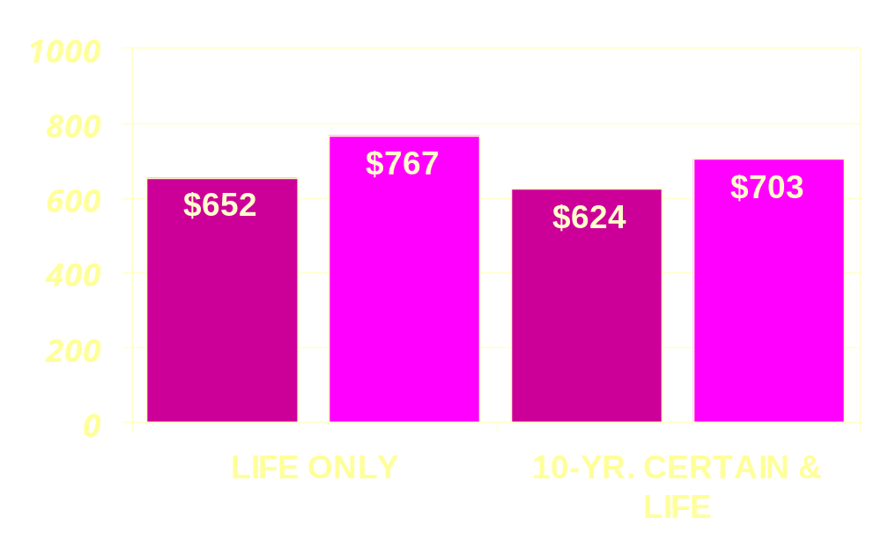
Impaired Risk Option
HIGHER MONTHLY BENEFIT PAYMENT Male $100,00 Premium
How much higher are the benefits with a “rated age”?
ACTUAL AGE 65
RATED AGE 71
RATED AGE 71
ACTUAL AGE 65
*Rate Scale effect 4.1.04. Rates are subject to change.
Notes:
(SPEAK TO THE SLIDE)
Now that we know what an Impaired Risk option on an immediate annuity is, Let’s look at why you should be offering/promoting this option to/with your clients
This graph shows how much higher a client’s benefit payments would be if they qualified for a rated age of 71.
On a life only option the client would receive $120 more a month
On a ten year certain & life option the client would receive about $90 more a month

Slide 13
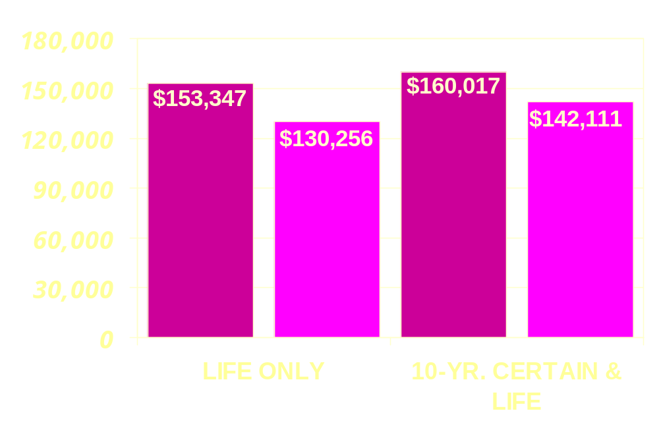
Impaired Risk Option
How much lower is the premium with a “rated age”?
LOWER PREMIUM Male $1,000 Monthly Benefit
ACTUAL AGE 65
RATED AGE 71
ACTUAL AGE 65
RATED AGE 71
*Rate Scale 3/15/02 FC2/BD. Rates are subject to change.
Notes:
(SPEAK TO THE SLIDE)

Slide 14
Impaired Risk Option
Impaired Risk Application Process
Submit the following information about the annuitant(s):
  Date of birth
  Name
  Gender
  Medical information about the applicant
Notes:
(SPEAK TO THE SLIDE)

Slide 15
Impaired Risk Option
Acceptable sources of medical information:
  Hospital discharge summaries, particularly within the past five years
  Report from a medical examination at the time of diagnosis, particularly within the past five years
  Report from the most recent medical examination by a physician
  Reports reflecting significant conditions preceding the primary condition
  Reports of significant hospitalizations, surgeries or rehabilitation
Notes:
We do not require you to submit an APS…here are several acceptable sources of medical information
(SPEAK TO THE SLIDE)

Slide 16
Impaired Risk Option
Submit information to:
  CPS Insurance Service
  9 Corporate Park Dr. Ste 100
  Irvine, Ca 92606
  Facsimile (800) 436-8255
  Email address: Annuity@cpsinsurance.com
Phone # (800)326-5433
Pete Buechler AAPA, ACS ext 148
Dean Walsh ext 143
Notes:
(SPEAK TO THE SLIDE)

Slide 17
(800) 326-5433
…Did you know
CPS has been in business for 30 years Has contracts w/ over 100 different carriers
Is one of the largest independently owned wholesalers in the U.S.
Has a full service Life, LTC and Annuity Dept.
Has 2 In-House Life Underwriters
Has an On-Staff Advanced Planning Attorney
Carries specialty contracts such as MoneyGuard Life/LTC policy, Wealth transfer contracts, ROP term, 412i planning, Guarantee issue life and much more…

