Slide 1
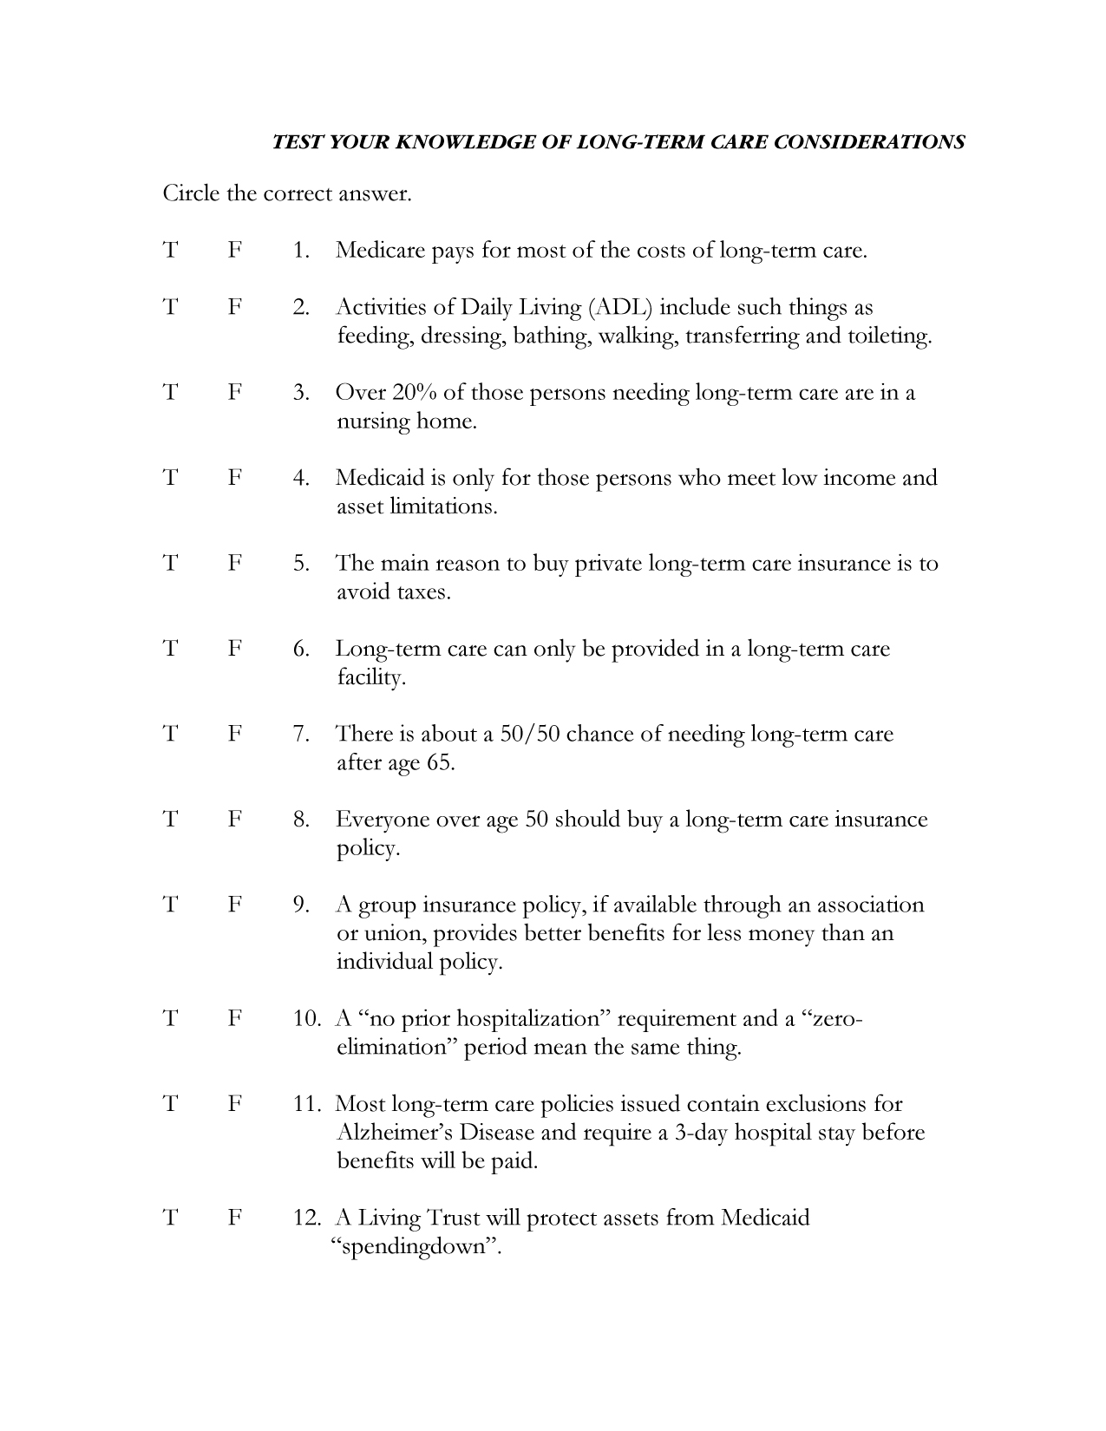
welcome
Please register and receive your reference information
Please complete your Pre-Test before we begin
Notes:
Talking points:
Display this slide as your guests are arriving to the seminar.

Slide 2

Life insurance products are not deposits, not FDIC insured, not insured by any federal government agency, not guaranteed by any bank or savings association, and may go down in value.
The Lincoln National Life Insurance Company
L02-0277-LL
Notes:
Talking points:
Introduction of speakers and organization hosting seminar.
Purpose: Not to try and cover the entire subject of long-term care, but to uncover the issues and concerns you have for yourself and your family. Please feel free to ask questions.
With that said, this public setting is probably not the most appropriate place to discuss your personal financial situation. For that reason, everyone will receive a complimentary, that means free, consultation.
In your material is a consultation request form. Please take it out, put your name and phone number on the front. Because there will be some questions you may have that there isn’t enough time here to answer, please list any unanswered questions on the back of this paper.
We’ll make sure we address your questions during your personal consultation.
So, let’s look at how we did on the pre-test!

Slide 3
answers
Pre-test . . .
How did you do?
1. Medicare pays for most of the costs of long-term care.
2. Activities of Daily Living (ADL) include such things as feeding, dressing, bathing, walking, transferring, and toileting.
3. Over 20% of those persons needing long-term care in a nursing home.
4. Medicaid is only for those persons who meet low income and asset limitations.
5. The main reason to buy long-term care insurance is to avoid taxes.
6. Long-term care can only be provided in a long-term care facility.
Notes:
Talking points:
1. False According to Health Care Financial Administration, 1999 statistics, Medicare only pays about 15% of LTC expenses. Welfare and personal savings are about 66% combined.
2. True
3. False Actually, nursing home care is less than 20% of the LTC expenses. (Spector, Fleishman, Perrin and Spillman, “The Characteristics of Long-Term Care Users”, Table 10, Agency for Health Care Research and Quality, Sept 2000.)
4. True
5. False Although there are some tax advantages to buying long-term care insurance, the main reason is NOT to avoid paying taxes.
6. False There are a variety of places long-term care can be given other than a long-term care facility. Most long-term care is given in the home.

Slide 4
7. There is about a 50/50 chance of needing long-term care after age 65.
8. Everyone over age 50 should buy a long-term care policy.
9. A group insurance policy, if available through an association or union, provides better benefits for less money than an individual policy.
10. A “no prior hospitalization” requirement and a “zero day elimination period mean the same thing.
11. Most long-term care policies issued contain exclusions for Alzheimer’s Disease and require a 3-day hospital stay before benefits will be paid.
12. A living Trust will protect assets from Medicaid “spendingdown”.
Notes:
Talking points:
7. True According to Health Insurance Assoc. of America, the odds of needing long-term care are actually greater than 50/50. (“Who buys LTC Insurance?” 1994-1995 Profiles and Innovations in a Dynamic Market”, confirmed by LifePlans, Inc., 2/01)
8. False LTC Insurance is not for everyone. People with small assets or income who are eligible for Medicaid, should not buy it.
9. False
10. False These are eligibility triggers of LTC policies and are very different.
11. False Most do not. Tax Qualified policies would not allow these exclusions.
12. False A Living Trust is a revocable trust and its corpus would be subject to “spendingdown”.

Slide 5

What is
long-term care?
“Long-term care consists of those services designed to provide diagnostic, preventative, therapeutic, rehabilitative, supportive, and maintenance services for individuals who have chronic physical and/or mental impairments in a variety
of institutional and non-institutional health settings, including the home, with the goal of promoting the optimum level of physical, social and psychological functioning.”
Division of Long-Term Care, Health Resources Administration, Department of Health and Human Services
Notes:
Talking points:
Long-term care is about chronic conditions and their care.
Long-term care is not age specific - it can strike at any age.
But, the older we get the greater the chance

Slide 6
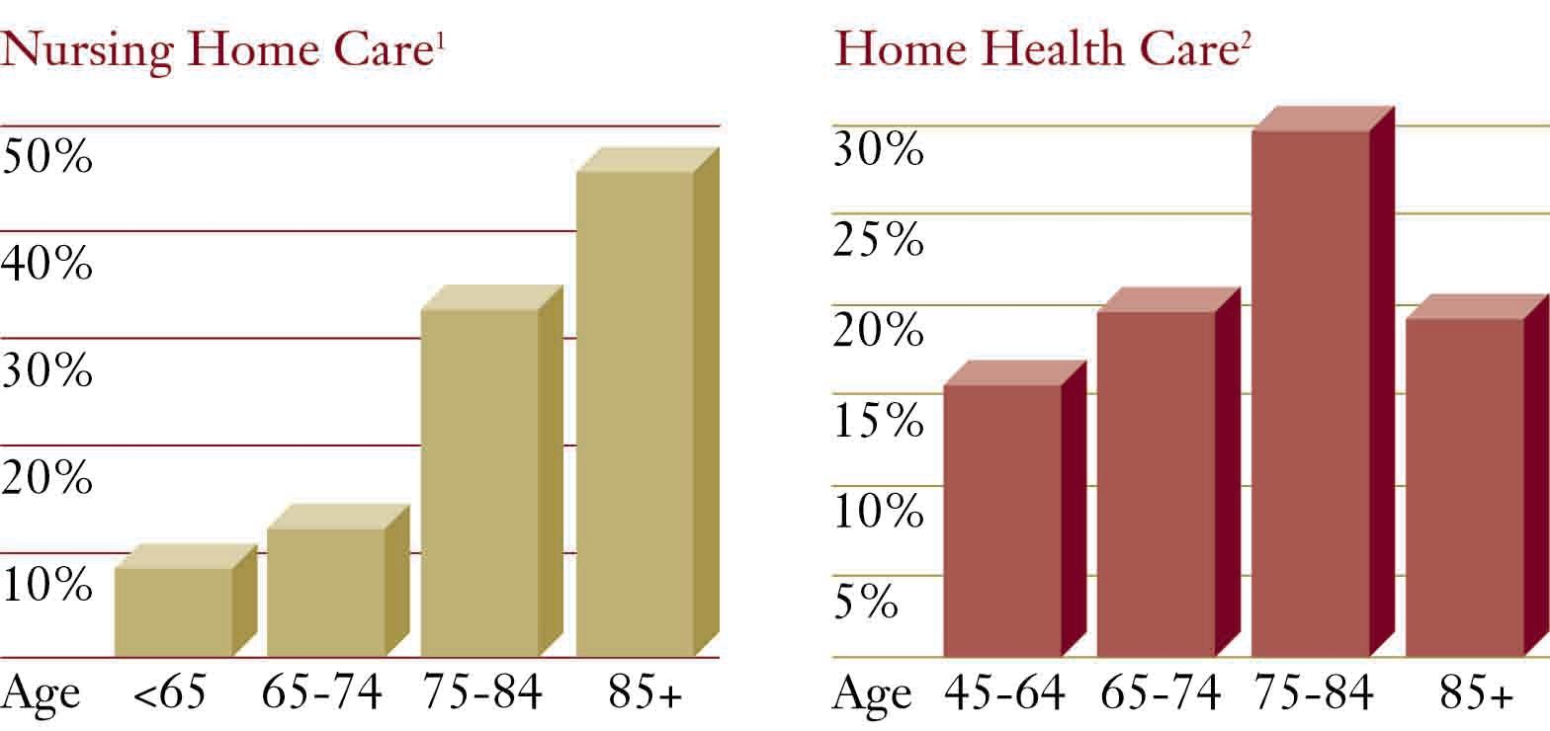
What’s the risk of needing
long-term care?
¹1997 Nursing Home Use, U.S. National Center for Health Care Statistics, Advance Data, No. 312, April 25, 2000.
²1998 Home Health Care Use, U.S. National Center for Health Care Statistics, unpublished data.
Age distributions of nursing home residents (1997) and home health care recipients (1998)
Notes:
Talking points:
Even though many retirees believe that they’ll never need it, the probability of requiring long-term care increases with each year of age.
Because the need for long-term care increases with age, it is important to plan for your long-term care needs while you are healthy.
While the general population perceives the risk of needing long-term care services to be less than 25%, the actual risk for needing long-term care (either home care or nursing care) is greater than 50% after age 65. (Who Buys Long-Term Care Insurance? 1994-1995 Profiles and innovations in a Dynamic Market, Health Insurance Association of America/LifePlans, Inc., p.2)(Confirmed with LifePlans, Inc. January 2001)

Slide 7
where
is long-term care given?
Institution
Skilled Nursing Facility
Intermediate Care Facility
  Group Home
  Personal Care Home
Residential Care Facility
Assisted Living
Community
Hospice
Respite Care
Geriatric Day Rehabilitation
Adult Day Care
Adult Foster Care
Congregate Meals
Community Mental Health
Senior Citizen Center
Legal Services
Protective Services
In-Home
Visiting Nurse
Homemaker
Home Health Aide
Chore Services
Home-Delivered Meals
Notes:
Talking points:
Long-term care is given in a variety of places and settings.
Do you know of someone, friend, relative, public figure that has received long-term care in one of these places?
What did it cost to receive these services?

Slide 8
What does
cost?
long-term care
Daily Costs: $90 - $200
Monthly Costs: $2,700 - $6,000
Yearly Costs: $32,400 - $72,000 Met Life Mature Market study as of April 26, 2002.
Notes:
Talking points:
Long-term care can be expensive. From 1970-1995, the national cost of LTC went from $11 Billion to over $100 Billion. The total nursing home expenditures are expected to reach $330 Billion by 2030 (ACLI, April,1998)
Current costs of long-term care. (MetLife Mature Market study as of April 26, 2002)
Average length of stay is 2.38 years. Women and single people are likely to spend significantly more time in a nursing home. The average stay also increases with age. (National Nursing Home Survey 1997, National Center for Health Statistics)
Future costs projected to be nearly $200,000/year by year 2030 - 5 times the current cost. (American Council of Life Insurance, October, 1998)

Slide 9

Who pays for
long-term care?
Private Insurance
11%
Out Of Pocket
27%
Medicare
15%
Other
7%
<2% VA
39%
Medicaid
L02-0277-LL
Notes:
Talking points:
Medicare has limited LTC benefits
Most long-term care benefits are paid from individual savings. (National Care Financing Administration, 1999 statistics, March 2001)
Welfare (Medicaid) pays a high percentage of long-term care costs after individual savings are spent down. (ibid)

Slide 10
What does
Medicare
cover?
Prior hospitalization required
Skilled Care only
100 days in a nursing home following a hospital confinement
Notes:
Talking points:
Medicare is designed to pay for “acute” care. Medicare has limited long-term care benefits.
Medicare only covers skilled care (the most advanced level of care), only if it is preceded by a minimum 3-day hospital stay.
Medicare pays 100% of eligible benefits for the first 20 days, and co-pays benefits for the next 80 days.

Slide 11
Medicaid?
What is
A Federal/State welfare program
State administered
Covers long-term care expenses once you qualify
State recovers costs from estate
Notes:
Talking points:
To qualify, you must reach “spendingdown” limits
Certain assets are excluded from eligibility requirements.
Income is also an eligibility factor.
Community spouse may keep a portion of assets and income.

Slide 12
Medicaid summary
Requires impoverishment
“Look-back” provisions for asset transfers
Eligibility may be denied or postponed if
“non-allowed” asset transfers are discovered
Limited choices
Notes:
Talking points:
To qualify for Medicaid, you must meet asset and income limitations.
Giving assets away doesn’t help either. If the gift is to someone else, there is a three-year “look-back” period before Medicaid will pay (a five-year “look-back” applies to gifts to trusts).
Eligibility may be denied or postponed if “non-allowed” asset transfers are discovered.
Limited choice of facilities.

Slide 13
Long-Term Care
options
funding
Long-Term Care Insurance (transfer the risk)
Self Insure
(keep the risk)
Notes:
Talking points:
I think we agree that relying on government programs isn’t for us.
Our two remaining options are “self-insuring” or purchasing long-term care insurance.
What is self- insuring? It’s crossing your fingers and hoping that the money that you’ve worked hard to save, will be enough in the unfortunate event that you need convalescent care.
But first, let’s talk more about “self-insuring”.

Slide 14

self-insuring
is an option
Many of us plan to use our own assets to pay for long-term care.
Notes:
Talking points:
Self-insurers will probably use readily available assets first to pay for long-term care.
Readily available assets are liquid assets in such things as savings accounts, money market accounts, or the cash value in a life insurance policy.

Slide 15

Which would you use first to pay for long-term care needs?
assets
L02-0277-LL
Notes:
Talking points:
Which assets would you liquidate first if you needed LTC today?
Instead of keeping the risk - TRANSFER THE RISK!

Slide 16

2
ways to
transfer the risk
Traditional long-term care insurance
&
Notes:
Talking points:
Read from slide

Slide 17
Traditional long-term care insurance
is an option
Advantages
Guaranteed benefits
Most policies cover all levels of care
Disadvantages
Recurring premium payments
Premiums are not guaranteed
Notes:
Talking points:
Read from slide.

Slide 18

don’t
What if I
use it?
Notes:
Talking points:
The purchase of a traditional long-term care policy transfers the risk to an insurance company, but . . .
Why pay ongoing premiums for something you may never need?
There are traditional long-term care policies on the market today that offer a return of premium option, but they are extremely expensive to purchase.

Slide 19
smart
“The way to insure”
Notes:
Talking points:
Transferring The Risk - Consider insurance as a tool to shift the risk of long-term care expenses from your portfolio. Just as you use it to shift the financial risks of losing a home or an automobile, you can also use insurance to transfer the more likely risk of long-term care expenses.
Insurance provides an additional pool of money to cover bills that you would otherwise have to pay by liquidating your investments. A few thousand dollars moved today could save a hundred thousand dollars spent tomorrow.
The MoneyGuard universal life insurance policy has a rider that accelerates the death benefit to pay for covered long-term care expenses.

Slide 20
Benefits, Exclusions and Limitations
Benefits
Lifetime money-back guarantee.
Lifetime minimum benefit guarantee.
Pre-existing conditions are covered.
Long-term care benefit payments reimburse expenses for care in a nursing home, assisted living facility*, adult day care center, including adult foster care in Oregon, respite care or at home.
Alzheimer’s Disease and similar irreversible loss of mental capacity is covered.
Exclusions/Limitations
Guarantees apply if you do not borrow or withdraw any money, and keep benefits at recommended levels.
You must truthfully answer all questions in the application.
Care must be provided in one of these facilities or by a licensed home care agency. Services from family or services which are normally free are not covered. Free treatment and benefits provided by
the government are not covered.
Treatment resulting from attempted suicide, or alcohol or drug addiction are not covered.
*Residential Care Facility in California and Oregon
For additional details concerning MoneyGuard’s benefits, exclusions and limitations, please ask for a personalized MoneyGuard illustration and Outline of Coverage. MoneyGuard is a universal life insurance policy with a rider that accelerates the death benefit to pay for covered long-term care expenses. This rider is guaranteed renewable. We may not cancel or reduce coverage provided by this rider. Unless you request termination of this rider, this rider will remain in force for as long as the policy remains in force.
Notes:
Talking points:
All insurance benefits are subject to exclusions and limitations. Here are MoneyGuard’s principal long-term care benefits, together with exclusions and limitations.
Read entire slide.

Slide 21
smart
“The way to insure®”
$187,776 Additional Long-Term Care (LTC) Benefit
$100,000
$150,000 Readily Available Assets
Freed-up Funds for Your Use
$93,888 Death Benefit or LTC Benefit
$50,000 Moved (Premium)
This example is based on a 65-year old, non-smoking female in good health. It includes the four-year extension of benefits rider available at an additional cost. Benefit amounts vary by age, gender (except in Montana where male premiums apply) and health status. Benefits are adjusted for loans and withdrawals. Based on guaranteed cost factors and the original benefit amounts, policy values will become exhausted prior to age 100. This would result in a termination of coverage. The minimum single premium is $10,000.
Notes:
Talking points:
Slide Build #1
Let’s look at an example of a 65-year old non-smoking woman, in good health.
She’s set aside $150,000 for an “emergency”.
If she needs long-term care, these funds would be liquidated first.
She’s fortunate - her “rainy-day” funds are more than adequate for the average long-term care need.
However, she would prefer to use some of those funds for other purposes.
Slide Build #2
If we were to move a portion of that asset into a product like MoneyGuard, what would happen?
Slide Build #3
By moving $50,000 of assets, MoneyGuard provides an immediate death benefit of $93,888, or if needed, a benefit of up to $281,664 for long-term care.
She actually has more than she had before for long-term care - up to $281,664 for a fraction of the dollars.
This now frees up $100,000 of assets for other uses.
Let’s look at how MoneyGuard works.

Slide 22
Is your win-win
solution
$281,664
Total Long-Term Care Benefit
$93,888 Death Benefit
$50,000 Premium
or
or
This example is based on a 65-year old, non-smoking female in good health. It includes the four-year extension of benefits rider available at an additional cost. Benefit amounts vary by age, gender (except in Montana where male premiums apply) and health status. Benefits are adjusted for loans and withdrawals. Based on guaranteed cost factors and the original benefit amounts, policy values will become exhausted prior to age 100. This would result in a termination of coverage. The minimum single premium is $10,000.
Notes:
Talking points:
Slide Build #1
The first bucket holds your single premium.
What’s so important is that your premium is guaranteed to be returned to you for as long as you own MoneyGuard. Guarantees are subject to policy terms and conditions and is in effect provided there have been no policy loans or withdrawals and coverage is maintained at recommended levels.
The money in the premium bucket is available any time you need cash that is not related to long-term care, such as a family emergency.
Slide Build #2
Not everyone requires long-term care, and if you fall into that category, the death benefit will be paid to your named beneficiaries, income tax-free under IRC Section 101 (a)(1), without probate delays.
Slide Build #3
Should you require long-term care, the long-term care bucket is available to you to help pay for your care whether it’s received in your own home, a nursing home, an adult day care center including adult foster care in Oregon or an assisted living facility (residential care facilities in California and Oregon). Any unused death benefit will be paid to your beneficiaries.
It’s as though we’ve created and linked three buckets. You can draw out of the bucket that meets your most urgent need. In this way, MoneyGuard links the benefits of life insurance and long-term care benefits in a single policy.

Slide 23

Which option fits your plan?
Government programs
Self-insuring
Traditional long-term care insurance
Notes:
Talking points:
Read from slide.

Slide 24

Review your options
Schedule a meeting with your Financial Representative.
Notes:
Talking points:
I can help you determine which option is best for you and your family!

Slide 25

Personal Consultation Request Form
Notes:
Talking points:
Please complete this form if you’d like to receive a complimentary consultation.
Be sure and write down any unanswered questions you may have so that we address them during your personal consultation.
When you’ve completed it, please give your form to __________.

Slide 26

The MoneyGuard universal life insurance policy has a rider that accelerates the death benefit to pay for covered long-term care expenses. An Extension of Benefits rider is available at an additional cost to continue long-term care benefit payments after the entire death benefit has been paid. Issued by The Lincoln National Life Insurance Company, Fort Wayne, IN. Administrative office Schaumburg, IL. Based on guaranteed cost factors, policy values will become exhausted prior to age 100. This would result in a termination of coverage. Products and features are subject to state availability. This policy has exclusions and/or limitations. For costs and complete details of the coverage call your insurance agent. Service marks are the property of The Lincoln National Life Insurance Company.
MoneyGuard Policy Form LL-2020 Series and Rider Form LL-2800 Series.
Lincoln Financial Group is the marketing name for Lincoln National Corporation and its affiliates.

Slide 27
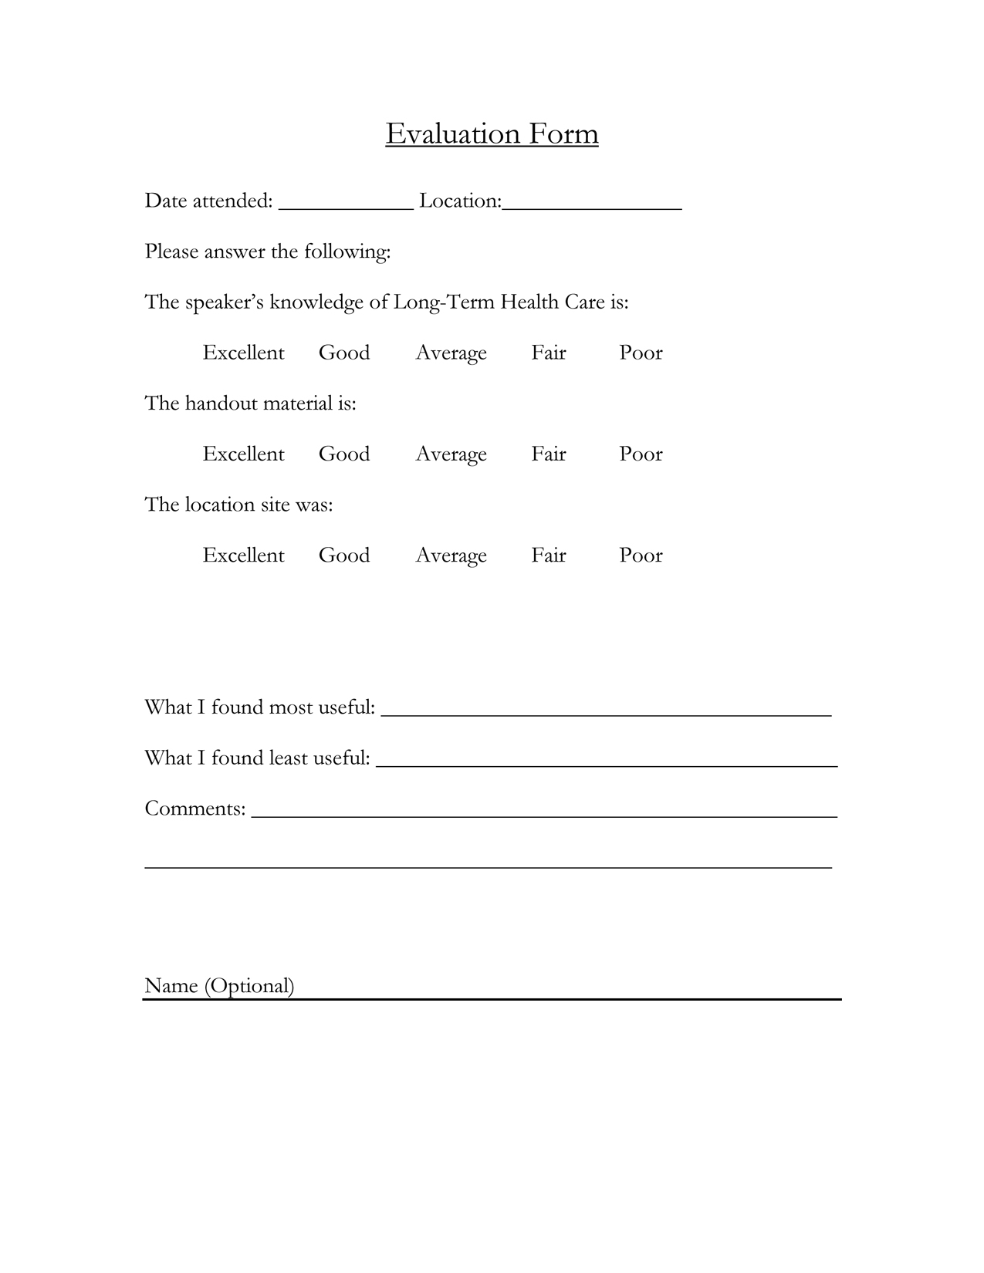
Evaluation Form
Notes:
Talking points:
It’s been our pleasure to provide this important information to you today. In an ongoing effort to improve our seminar, we’d like for you to take just a couple of minutes to complete the evaluation form. We greatly appreciate your feedback!

