Slide 1
Secrets of Selling LTC Successfully
PART 2
How to Prepare, Present, and Close in One Call
Web Conference
2/8/06
Rose Clayton, CLTC
Manager, Long Term Care Sales & Marketing
CPS Insurance Services

Slide 2
Agenda
  Review Part 1
  The 3 Essential Elements of the Sale
  LTC Fact-Finder Form
  Open-Ended Questions
  Best Closing Technique

Slide 3
Review Part 1
Your Beliefs
Health Qualifying
Preparation

Slide 4
You believe that living a long life is a near certainty…and planning for it is a necessity
Medical advances have succeeded in stopping disease and illnesses from killing us.
Without planning, the well-being of your client’s family and best thought-out retirement plans are at risk.

Slide 5
  You believe in the product you’re selling
You have the solution to the largest
health care crisis facing us today
and in the future.

Slide 6
You believe that the REAL reason most people don’t buy is
D E N I A L

Slide 7
You believe in yourself and what you’re doing
We protect people from their greatest risk.
Being alive and broke.
We protect the innocent—it’s about the FAMILY

Slide 8
When LTC discussion begins, start this
Health Pre-Qualifying Script:
“You don’t have to be in perfect health to get long term care insurance,
but you do have to be in reasonably good health.”
Have you been in the hospital in the past 5 years?
In the past have either of you ever had anything serious, like a stroke?
Have you ever had any cancers or any heart diseases?
Any diabetes? Any high blood pressure?
What is your approx. height/weight? Do you smoke?
Do you take any prescription medications?
Do you have any other health issues affecting your life that I haven’t asked about?

Slide 9
Preparation is Everything
Pre-qualify for Wealth
Make sure your client has assets to protect and that the premium is comfortably affordable.
Send appointment confirmation letter with health questionnaire (this can be a copy of the medical questions on the app for policy you’re going to recommend)
Ask them to have questionnaire completed when you sit down together.
Be the Expert
Know which plan you’re going to recommend and why.

Slide 10
Part 2
Begin with a Fact-Finder
(Asking Questions = Control)

Slide 11
LTC Fact-Finder Form
(One is available at www.cpsinsurance.com under
Long Term Care / Sales & Marketing Toolkit / Fact Finders)
Using the Fact-Finder has 2 main purposes:
      It’s the framework for the conversation
      It allows you to stay in control of the sales process
      by being the person who asks the questions.

Slide 12
LTC Fact-Finder Form
(pdf available in LTC section of www.cpsinsurance.com)
The Fact-Finder contains:
Personal Information
Prior Personal Experience with LTC
Health History (a completed Health Questionnaire will substitute)
Health Insurance Information
Family History
Needs and Concerns
Children’s Information
Legal Information on Wills, Trusts, Power of Attorney
Financial Information

Slide 13
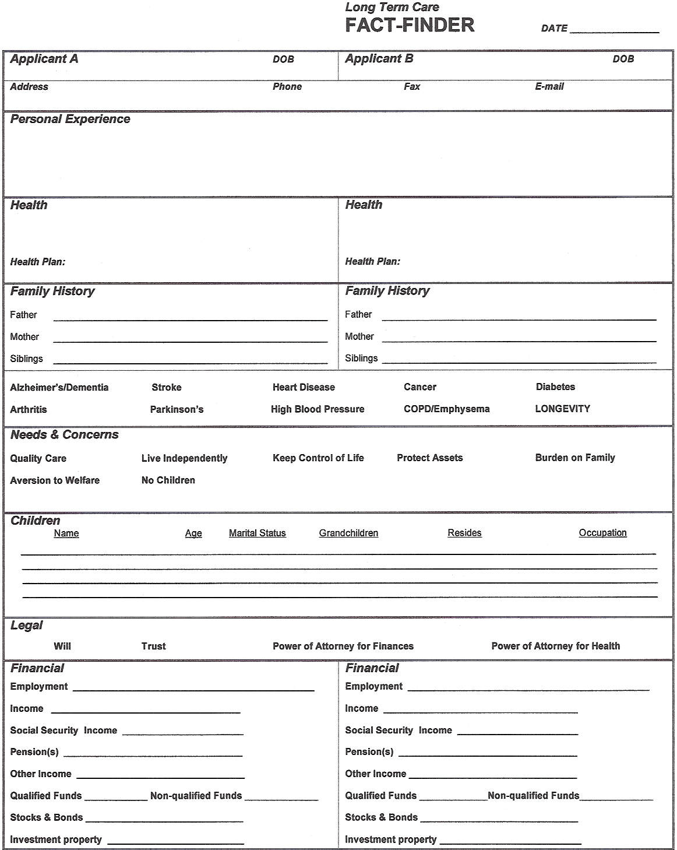
LTC Fact-Finder Form

Slide 14
LTC Fact-Finder Form
Each agent has their own style and approach. If you are the client’s Financial Planner, you will already know much of this information.
For many agents, it works best to begin by politely asking, “do you mind if I take some notes?”
Personal Information:
  Name, date of birth, and contact information
  Fax and E-mail very useful for follow-up

Slide 15
LTC Fact-Finder Form
Personal Experience:
Have you had an experience with long term care?
What happened? Who provided the care?
How long did it last? Who paid for the care?
Did the person have enough funds to pay for care?
If they have experience and you have too, share it by saying, “I went through the same thing. I understand what you went through.” Spend time developing the impact LTC had on your family.
If they’ve had no personal experience, share your story—”I’ve had an experience and I want to take a moment to share with you the impact it had on my family.” Or you can share the true story of someone you know and what happened to them.
STORYTELLING IS POWERFUL ONLY WHEN IT’S A TRUE STORY

Slide 16
LTC Fact-Finder Form
Health History:
“Let’s look at your health today.” Always get medical conditions and Rx’s taken. Look for red flags. Look for stability. Remember: No health, no deal.
Have Underwriting Hotlines programmed in your cell phone so you can call an underwriter. They’ll give you questions to ask to determine if you can submit an application. Doing this creates a positive feeling in your client as they watch you going to bat for them.
ALWAYS explain, “everything depends of your health today …”and your health doesn’t have to change to the point where you actually need long term care either, because if you look at many people today—they look fine and certainly don’t need long term care, but they’ve lost their INSURABILITY for this. And that’s the key with long term care insurance, (name), it’s getting it while you’re still INSURABLE. “

Slide 17
LTC Fact-Finder Form
Health Insurance:
It’s very useful for you to know what kind of health insurance they have. This gives you the opportunity to develop 3 important points:
The level of coverage they have indicates how much they are willing to spend for quality coverage of their medical care.
You will explain how their medical coverage does NOT cover LTC. Only a long term care policy covers custodial care—the kind of care people need when they can’t take care of themselves anymore.
And most importantly, talking about their medical coverage diffuses the objection of “it won’t happen to me” and creates urgency. You say, “actually (name), don’t you have your medical insurance because you realize you could have a health change today, right now? How would you feel if you had a health change and couldn’t buy the insurance, no matter what you were willing to pay?

Slide 18
LTC Fact-Finder Form
Family History:
“Apart from your own health, another thing that factors into
this is your family history. Because really the only evidence
we have to go on is what we know about your family history
and what we know statistically about how people need care.”
Here you are looking for both history and what your client is worried about so that you can design the correct policy. Histories of Alzheimer’s or old-age Dementia, or Parkinson’s will mean Lifetime benefit period may be appropriate if it’s affordable.

Slide 19
LTC Fact-Finder Form
Needs and Concerns:
By now your client should feel comfortable enough to open up about what they’re worried about and what they want from this policy.
The information you develop here will be used when you explain the benefits in simple terms, always tying the benefits to the need and concerns they have shared.

Slide 20
LTC Fact-Finder Form
Children:
Ask names, ages, marital status, # of grandchildren, where they live, and what their occupation is for each one.
“Do you expect one of your children to take care of you?”
“I just want to be sure that they fully understand what taking care of you really means. It’s not ‘stopping over and making sure that there’s food in the house.’
What taking care of you means is—which of your children is willing and able to quit work, come over here every day, get you out of bed, bring you to the bathroom, bathe you, dress you, cook for you and feed you. What this means is which of your children is able to give up their life to take care of you?
And which of your children are you willing to have do these things for you? How would your dignity feel if they had to do those things for you?”

Slide 21
LTC Fact-Finder Form
Information on Wills, Power of Attorney, Trusts
A client who does these things plans for the future and wants to do what’s best for their family.
Those are the clients who buy long term care insurance.

Slide 22
LTC Fact-Finder Form
Financial Information:
To design the appropriate policy for you client, you have to know affordability and assets. Always ask for “rough numbers.”
In this part, the client can see that their retirement plan is in jeopardy if they don’t transfer the risk to an insurance company.
If it turns out they have a lot of assets, say, “in my experience, wealthy individuals understand the value of spending pennies to protect dollars. And the generally will agree that long term care insurance is the best way to fund their long term care needs, allowing them to invest their assets and reap higher returns.”

Slide 23
The 3 Essential Elements of the Sale

Slide 24
The reasonable opportunity to sell long term care insurance is based on three essential elements.
These elements or steps are sequential.
You should not attempt to establish Step 2 unless you are convinced that your client has agreed with Step 1, and so on.
These elements are interdependent.
When all 3 elements are established independently, they end up operating interdependently—they continually reinforce themselves and establish a strong foundation for the sale.

Slide 25
1. Establishing the need for long term care beyond a reasonable doubt. That living a long life may substantially increase the risk of needing long term care.
Most reasonable people believe they may live a long life, and when they do, their chances of needing care increase.
If your client doesn’t agree with this, there’s no point to continue the discussion.

Slide 26
2. Establishing beyond a reasonable doubt that providing care may have serious consequences for the individual’s family and finances.
Long term care is not about your client. It’s about his family.
“The question is not who will take care of you when you need care. Rather it is what providing that care may do to your family and your best thought out retirement plan.”
It is important that your client agrees that LTC is a family, not an individual, issue.

Slide 27
Establishing beyond a reasonable doubt that generally nothing may pay for the plan of care other than assets and income, otherwise allocated for retirement, thus possibly placing the client’s best thought-out retirement plan in jeopardy.
The portfolio has been allocated for retirement, not paying for long term care. Without long term care insurance, long term care expenses may only be paid from retirement assets and income.
It is important that your client agrees that in principle LTC is paid for by cash. “You start writing checks every month.”

Slide 28
“Who you gonna call?”
DENIAL BUSTERS

Slide 29
You can ask any difficult question
by prefacing
“With all due respect,…”
“I understand…”

Slide 30
Are you concerned about risks to your retirement plan?
Which risks cause the greatest concern—financial risks due to market conditions or unanticipated health care or housing costs due to old age, poor health or disability?
What have you done to help protect against the cost of long term care?
How secure do you feel about your source of income in your retirement?
Are you aware of the impact of inflation on your potential health care needs?
Do you know what the current costs are in your area for quality long term care in either assisted care or a nursing home?

Slide 31
Do you know anyone who has needed long term care either at home or in a facility?
Have you ever visited a nursing home?
Given a choice, would you prefer to receive care in your home or in a quality assisted care or nursing home facility?
Have you ever tried to bring care into the home?
What do you expect long term care to cost when you are likely to need it?
How do you plan to pay for your long term care needs? With cash assets, or will you have to liquidate stocks, bonds, or mutual funds to pay these costs?

Slide 32
  Can you think of any reason you would choose to self-insure a potential risk to your retirement assets?
  Have you thought about the impact long term care needs will have on your spouse’s future retirement income and financial security?
  Have you thought about the consequences living a long life and needing care will have on your family and retirement portfolio?
  If you need care tomorrow, what would you do?
  Do you have a strategy?

Slide 33
Two best closings:
If the 3 essential elements of the sale have been established, the conversation flows naturally to a simple close:
“Let me show you how this works (go to brochure and/or illustration) and we’ll get you signed up.”
“This is what I recommend you do.”

Slide 34
For more information, contact:
Rose Clayton
Manager, Long Term Care Sales
CPS Insurance
(800) 326-5433 x 159 rclayton@cpsinsurance.com

