Slide 1
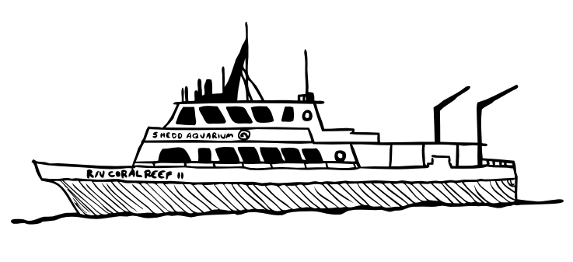
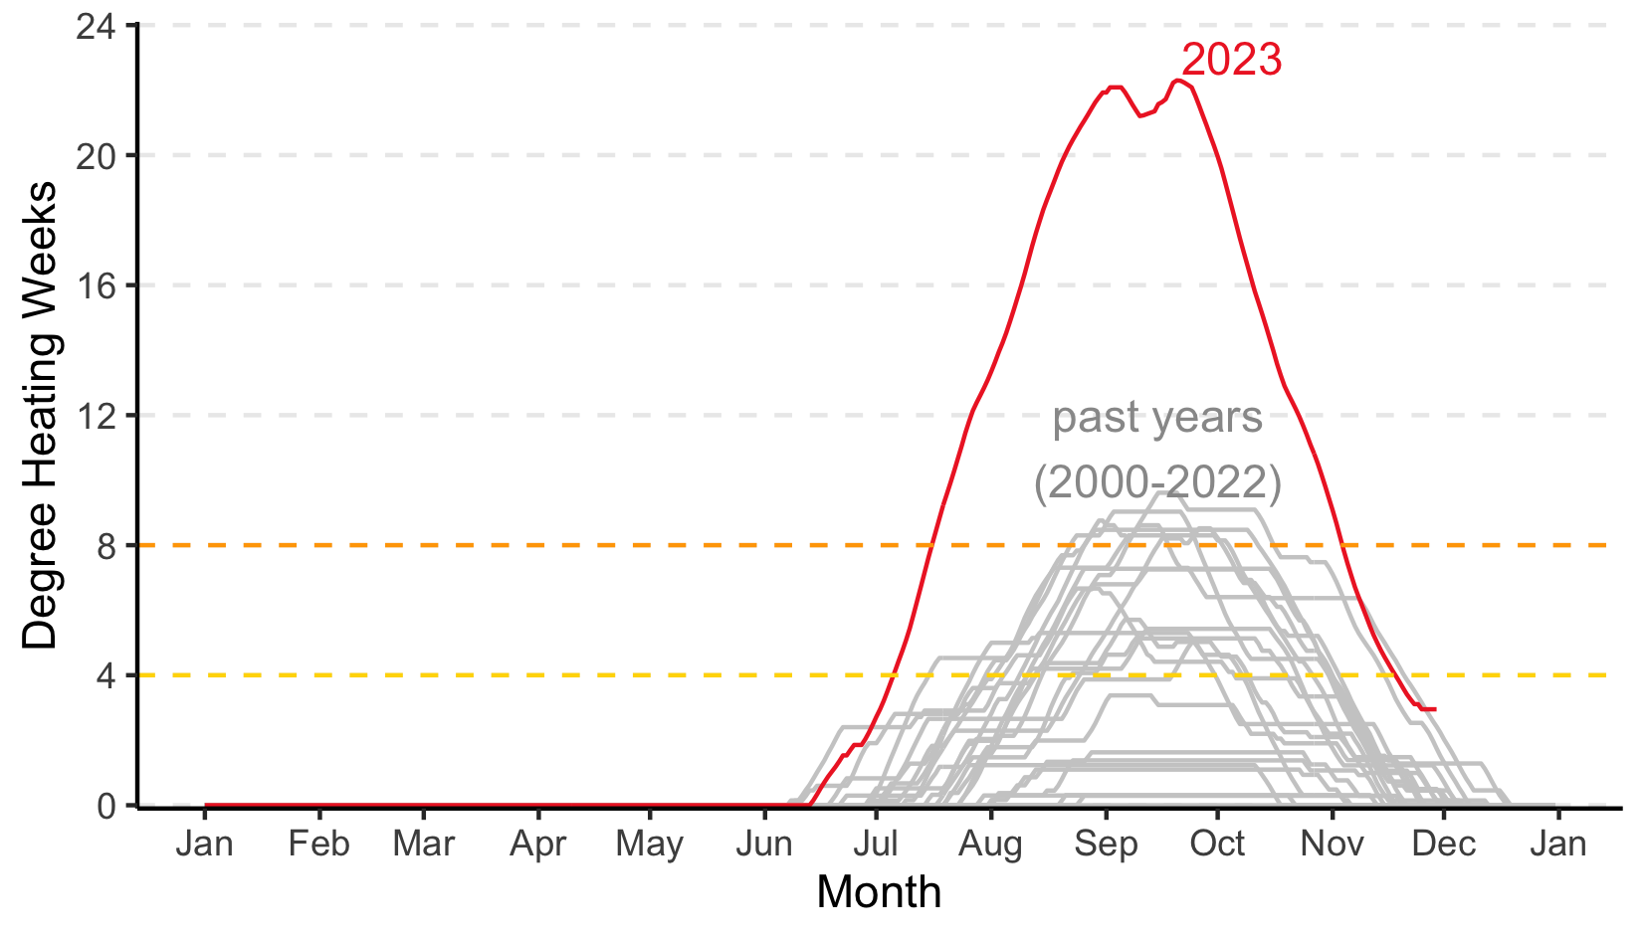
severe, widespread bleaching and mortality
significant bleaching

Slide 2
Disturbance Response Monitoring (DRM)
Florida Fish and Wildlife Conservation Commission (FWC)
2005-present
Collaborative effort to survey Florida’s Coral Reef every summer
4 x 10 m² belt transects per site
2023: 40,355 corals surveyed across 608 sites
Shedd team:
12% of all surveys
20% of surveys @ DHW > 12

Slide 3
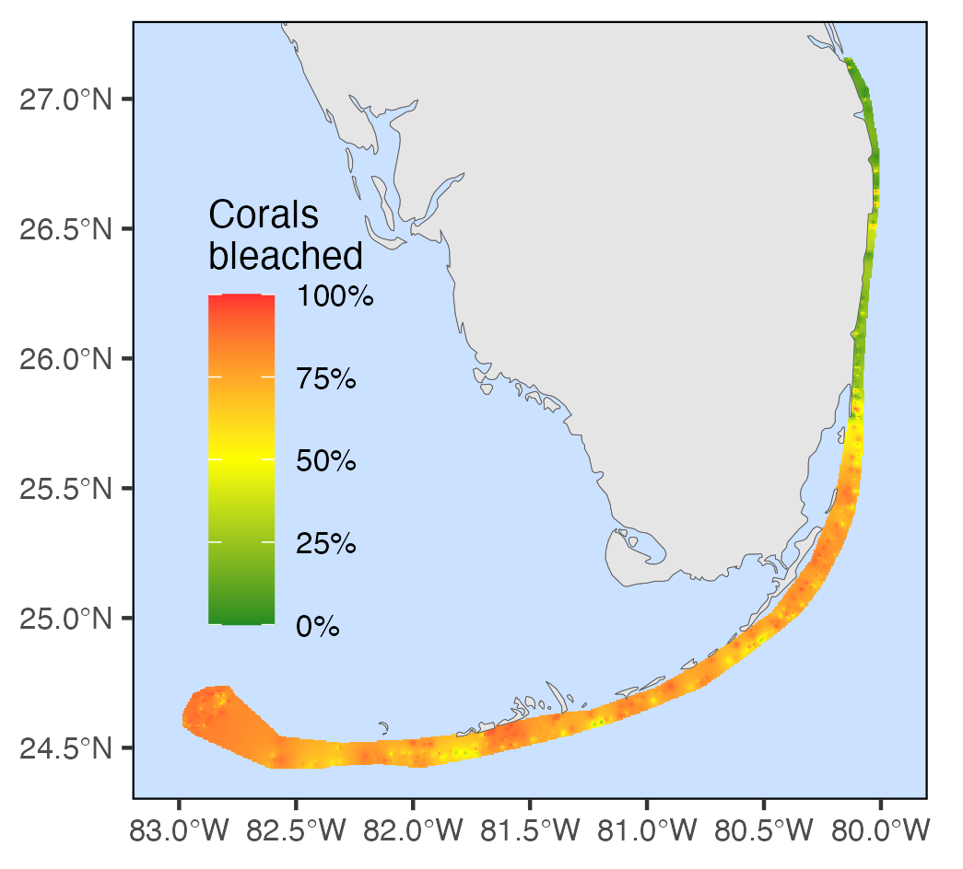

Slide 4
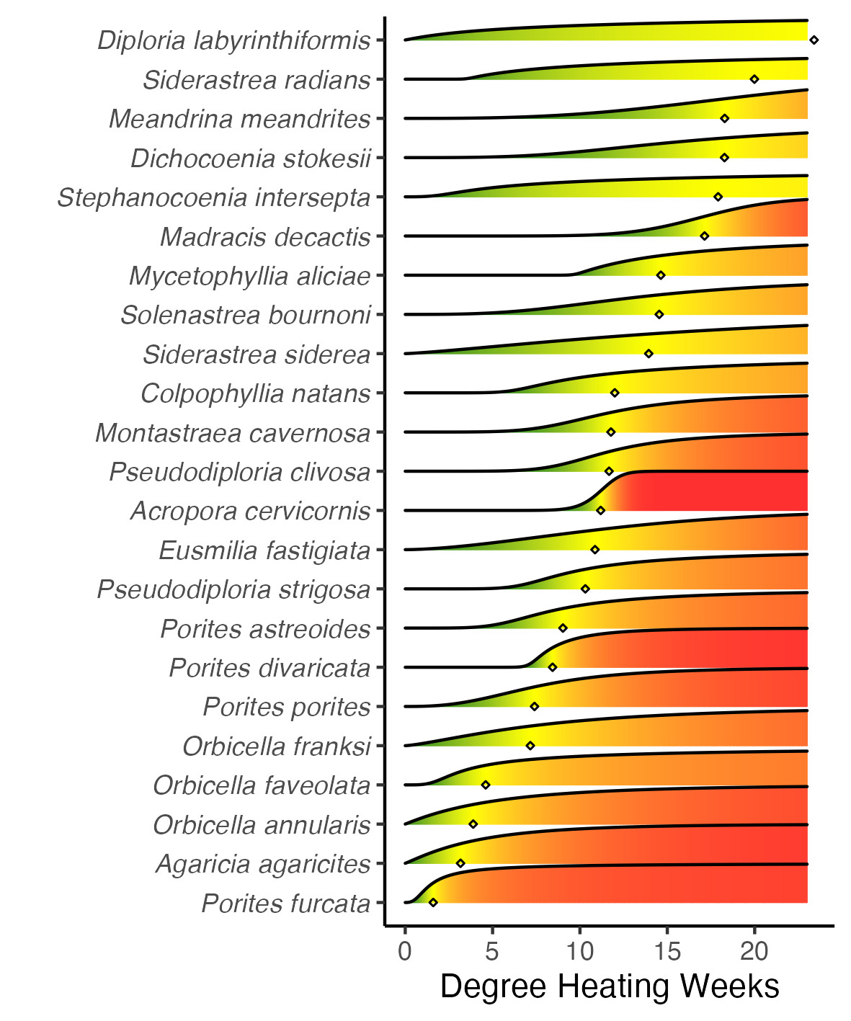
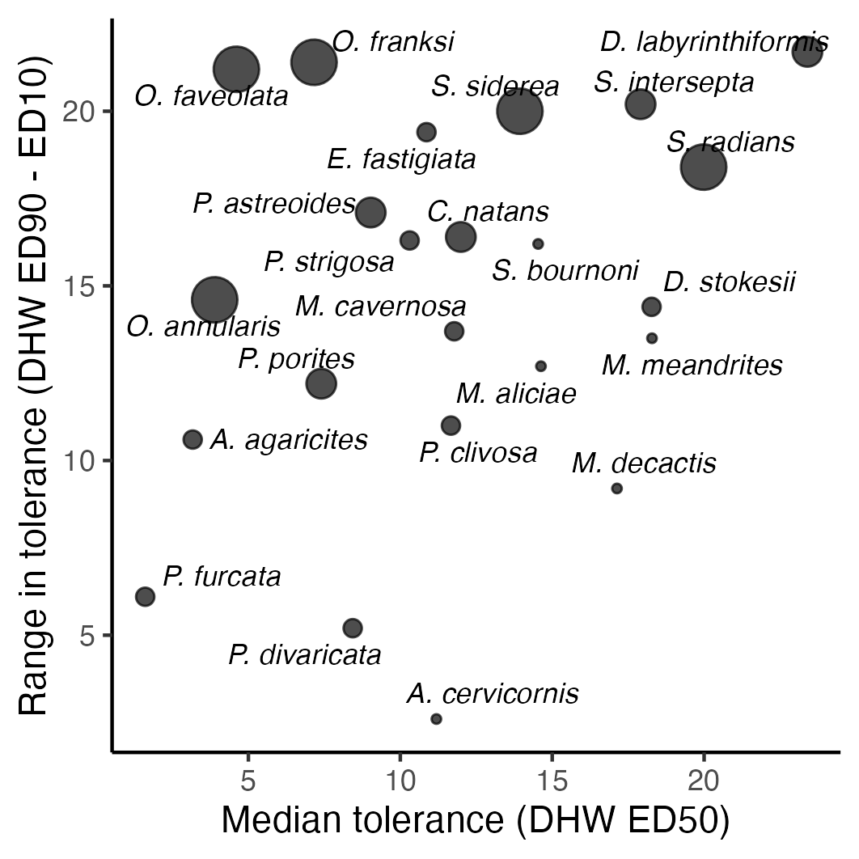

Slide 5
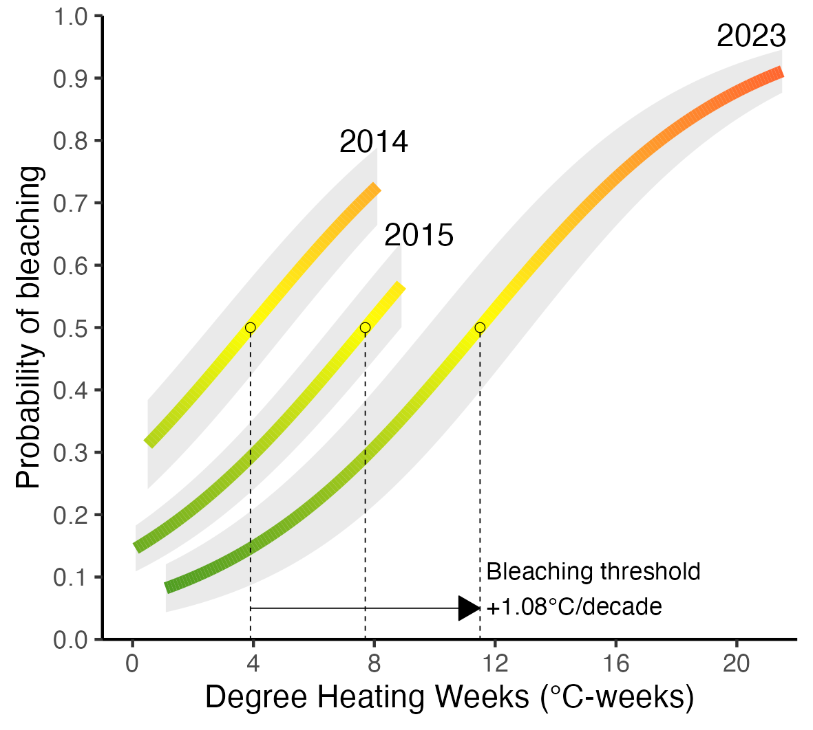

Slide 6
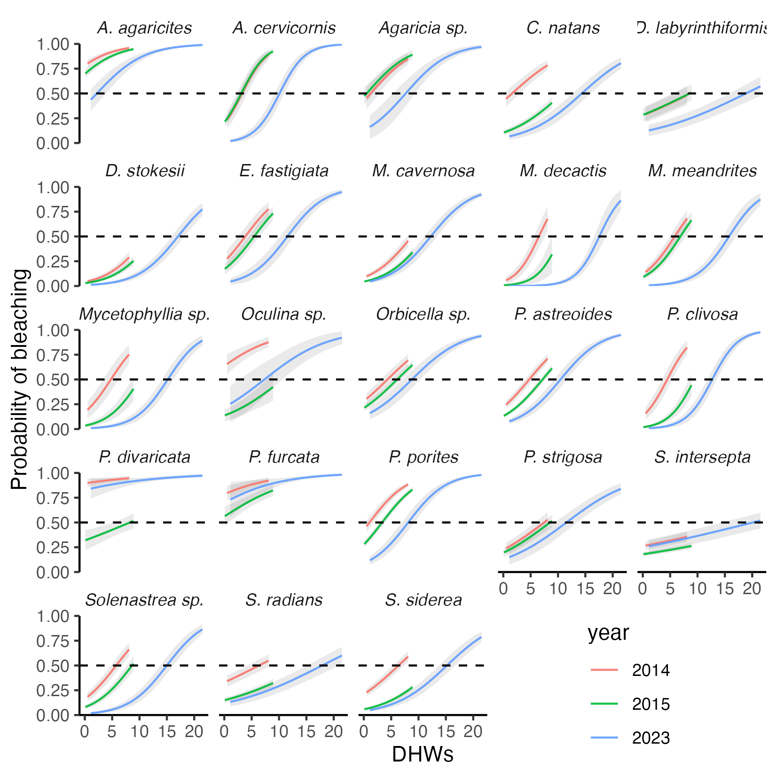

Slide 7
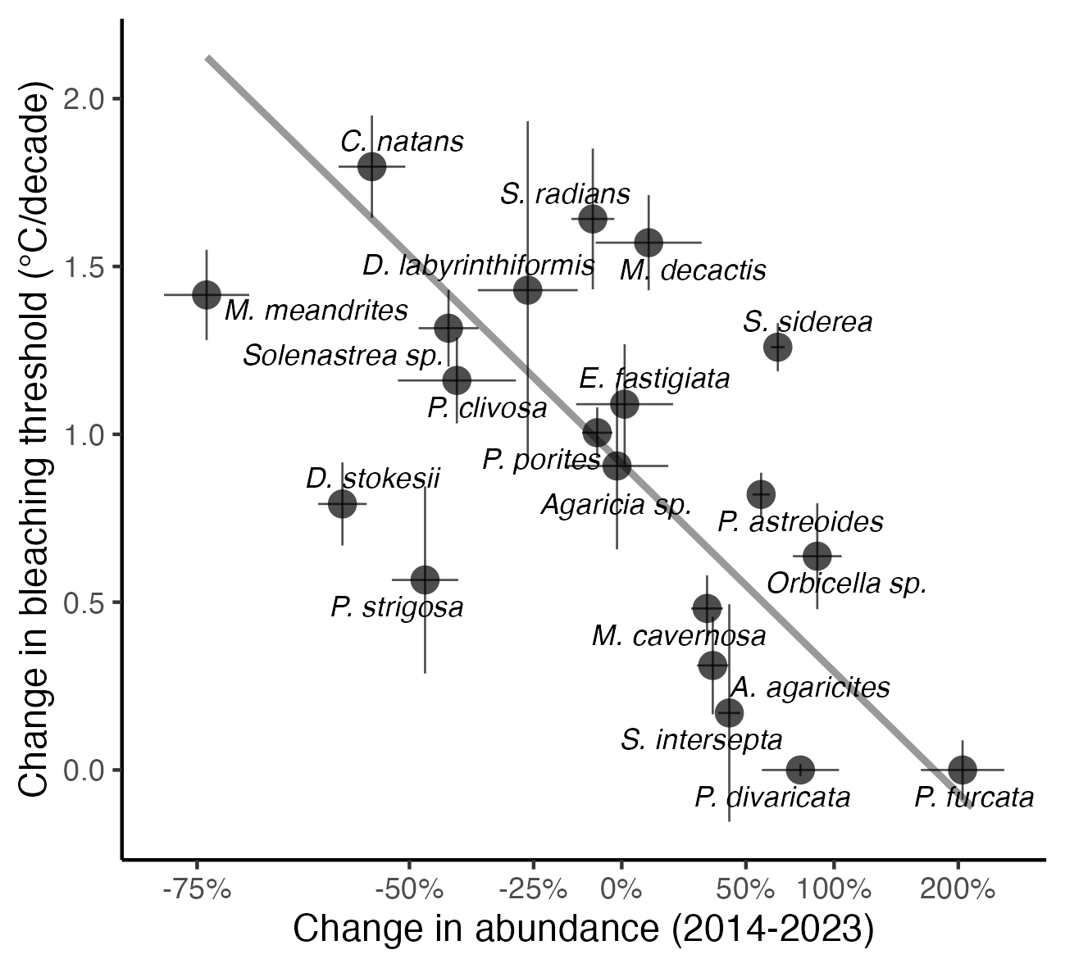

Slide 8
