Slide 1
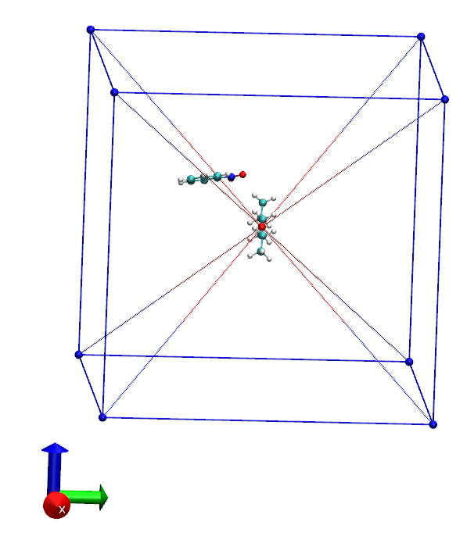
B (p2)
C (p3)
A (p1)
D(p4)
Pyramid 1
Pyramid 6
Pyramid 5
F (p6)
Pyramid 2
G (p7)
E (p5)
z
H (p8)
Pyramid 3: Along the positive x axis
Pyramid 4: Along the negative y axis
x
y

Slide 2
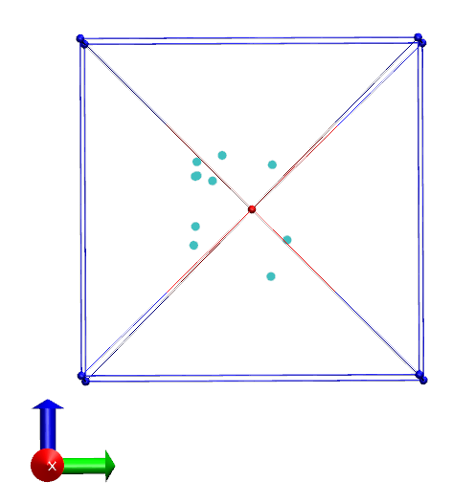
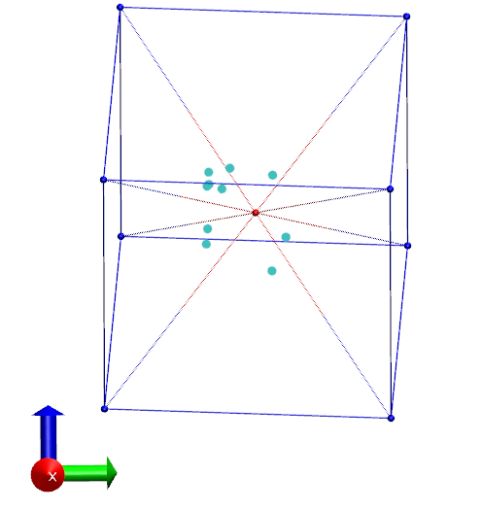
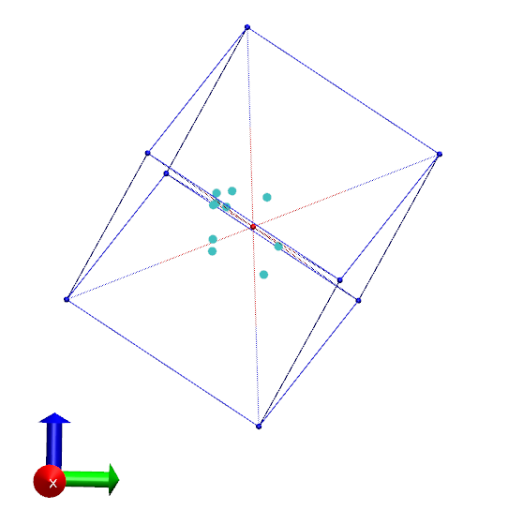
A (p1)
1
= 36.5º
= 87.6º
γ = 271.7º
= 210.4º
= 90.3º
γ = 186.2º
1
1
6
5
A (p1)
2
A (p1)
4
Pointing forward along the positive x-axis
5
Pointing backward along the negative y-axis
Number of points in a region:
d = [2, 1, 0, 1, 0, 6]
S = 0.278
Number of points in a region:
d = [6, 0, 2, 1, 0, 1]
S = 0.278
Number of points in a region:
d = [5, 1, 3, 0, 1, 0]
S = 0.333

Slide 3
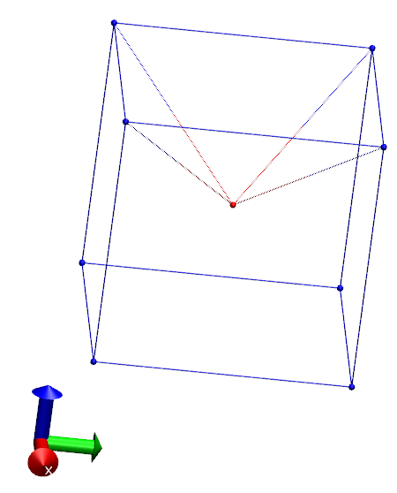
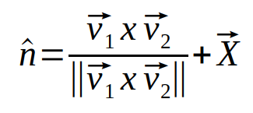


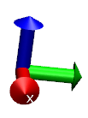
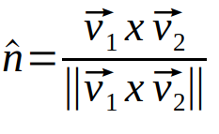
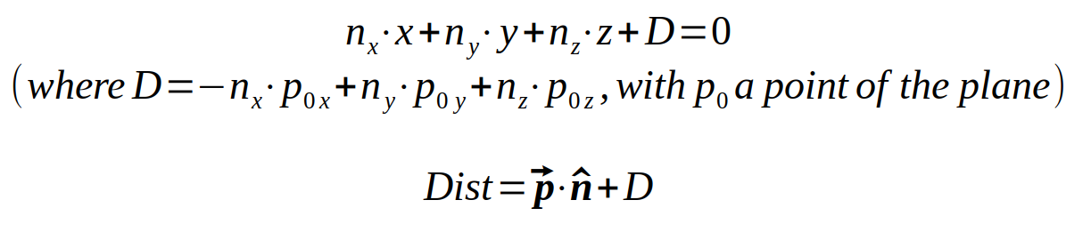
B (p2)
C (p3)
A (p1)
D(p4)
B (p2)
X
C (p3)
O
A (p1)
O
Three points on the plane are chosen.
The operations must be performed in such a way that the normal vector is outward pointing. X is a point on the plane.
Point (p) is outside half space (Dist>0)
A plane of the region
B (p2)
C (p3)
A (p1)
O
Point (p) is inside half space (Dist<0)

