Slide 1
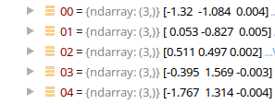
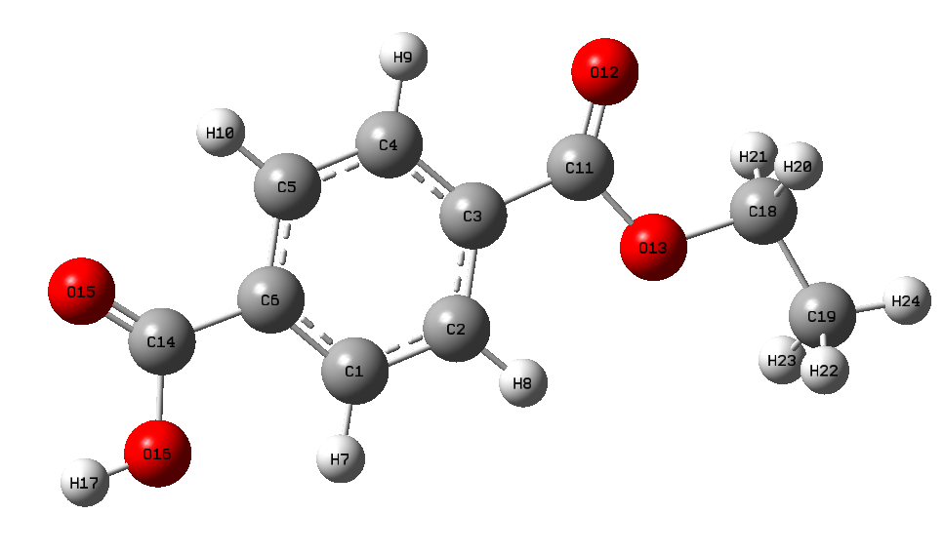

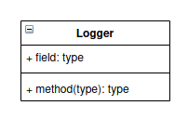
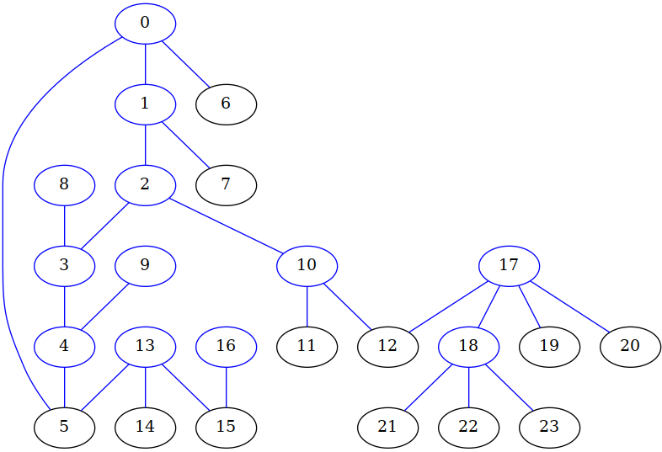
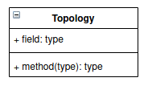
_coords
PET monomer
(...)
_dummy_tail_atom = 24
_dummy_head_atom = 16
_filecoord="pet_monomer.pdb"
_filetop= None
_filetypeatoms=None
_natoms=24
_typelements=None
_elements=['C', 'C', ...., 'H', 'H']
_charge=0
_isBOassigned=False
Output (_logger)
_topology

