Slide 1
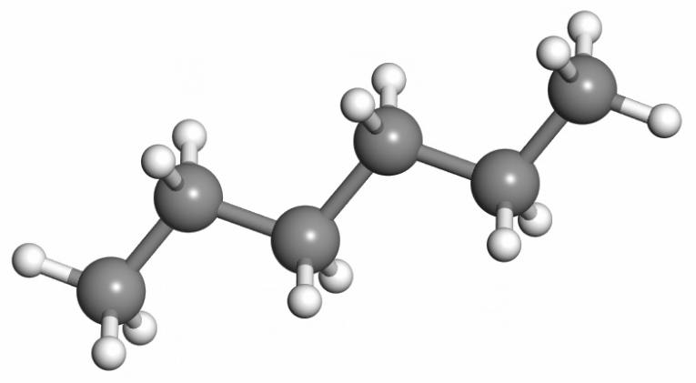
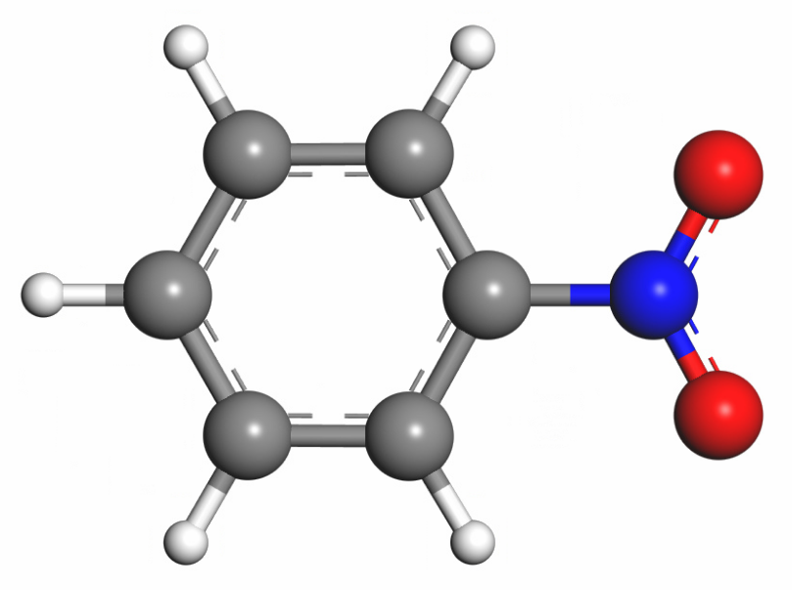
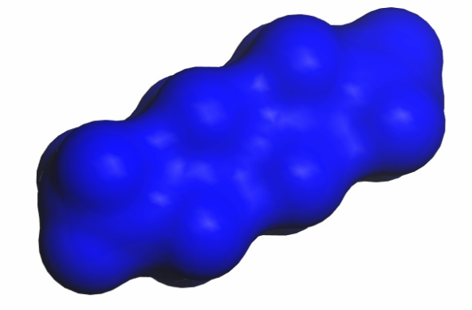
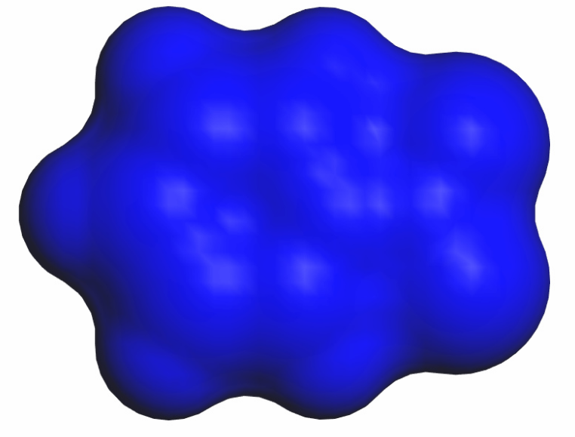
a)
b)
n-hexane
nitrobenzene

Slide 2
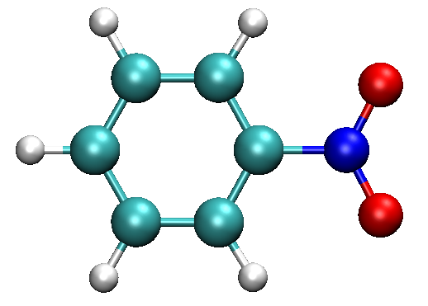
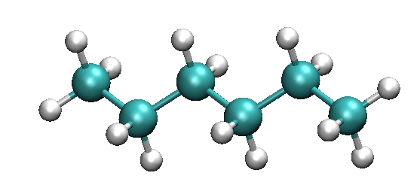
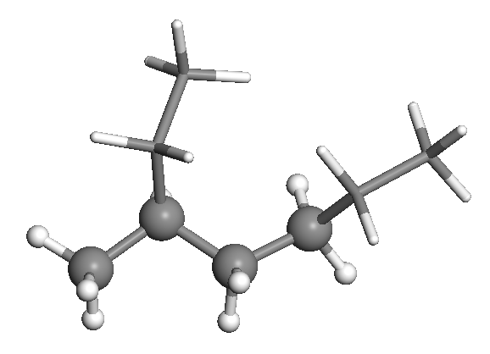
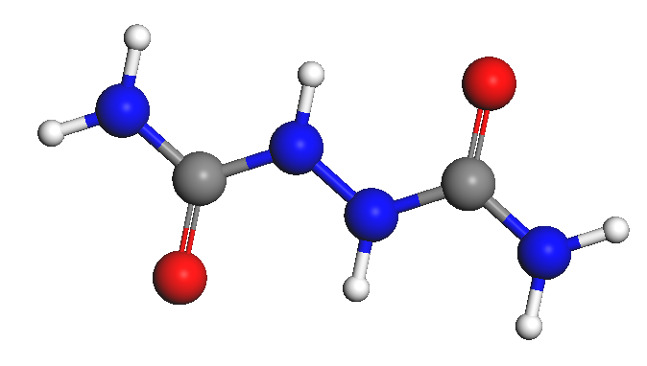
n-hexane
nitrobenzene
polybutene
polyurea

Slide 3
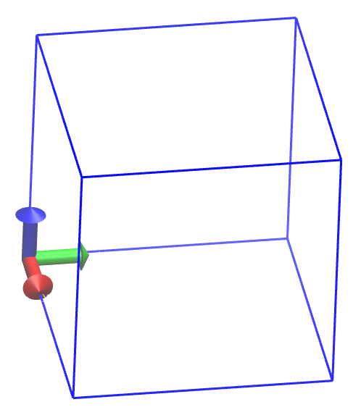
c
z
{x_{hi}, y_{hi}, z_{hi}}
z
b
y
{x_{lo}, y_{lo}, z_{lo}}
x
y
a
x

Slide 4

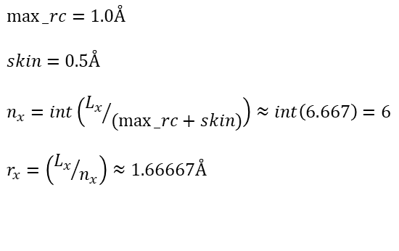

Grid for a cubic cell 6x6x6
Layer = 5
Layer = 0
Layer = 1
180 | 181 | 182 | 183 | 184 | 185
186 | 187 | 188 | 189 | 190 | 191
192 | 193 | 194 | 195 | 196 | 197
198 | 199 | 200 | 201 | 202 | 203
204 | 205 | 206 | 207 | 208 | 209
210 | 211 | 212 | 213 | 214 | 215
0 | 1 | 2 | 3 | 4 | 5
6 | 7 | 8 | 9 | 10 | 11
12 | 13 | 14 | 15 | 16 | 17
18 | 19 | 20 | 21 | 22 | 23
24 | 25 | 26 | 27 | 28 | 29
30 | 31 | 32 | 33 | 34 | 35
36 | 37 | 38 | 39 | 40 | 41
42 | 43 | 44 | 45 | 46 | 47
48 | 49 | 50 | 51 | 52 | 53
54 | 55 | 56 | 57 | 58 | 59
60 | 61 | 62 | 63 | 64 | 65
66 | 67 | 68 | 69 | 70 | 71
10 Å
$$r_{x}$$
0 | 1 | 2 | 3 | 4 | 5
6 | 7 | 8 | 9 | 10 | 11
12 | 13 | 14 | 15 | 16 | 17
18 | 19 | 20 | 21 | 22 | 23
24 | 25 | 26 | 27 | 28 | 29
30 | 31 | 32 | 33 | 34 | 35
$$max⁡_rc=1.0Å$$
$$skin=0.5Å$$
$$n_{x}=int\left({L_{x}}/{(max⁡_rc+skin)}\right)≈int\left(6.667\right)=6$$
$$r_{x}=\left({L_{x}}/{n_{x}}\right)≈1.66667Å$$
$$r_{y}$$
10 Å

