Slide 1
Performance Dashboard

Slide 2
Content
Problem
Solution
Dashboard
Insights and Recommendations

Slide 3

Problem
Increase market share
Provide tools to monitor performance & insights
Unified and dynamic dashboard

Slide 4
Solution

Slide 5
Challenges Executing
Ambiguous data
Duplicated data
Incomplete data
Establishing data connections
Timeline information
Market data

Slide 6
Starting the Project
Clean and structure data
Created a connection through date and product
Create new data dimensions to show more detailed KPI
Create new measures in Power BI

Slide 7
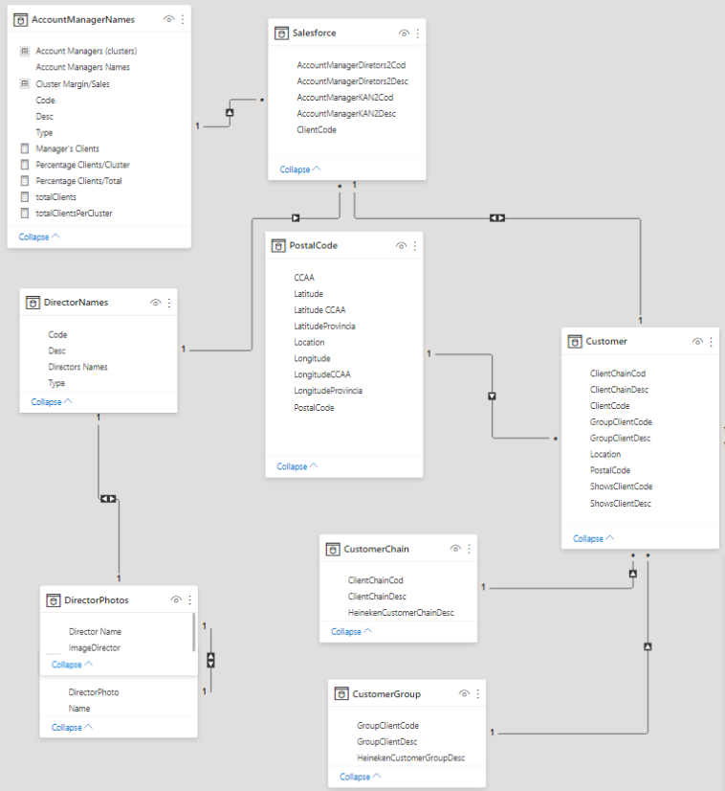
Customer

Slide 8
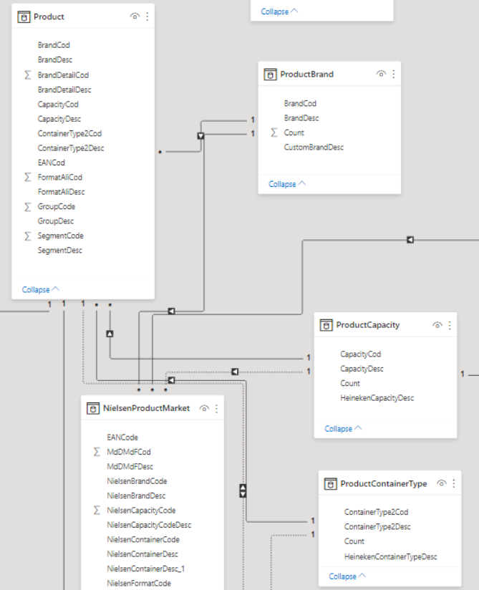
Product

Slide 9
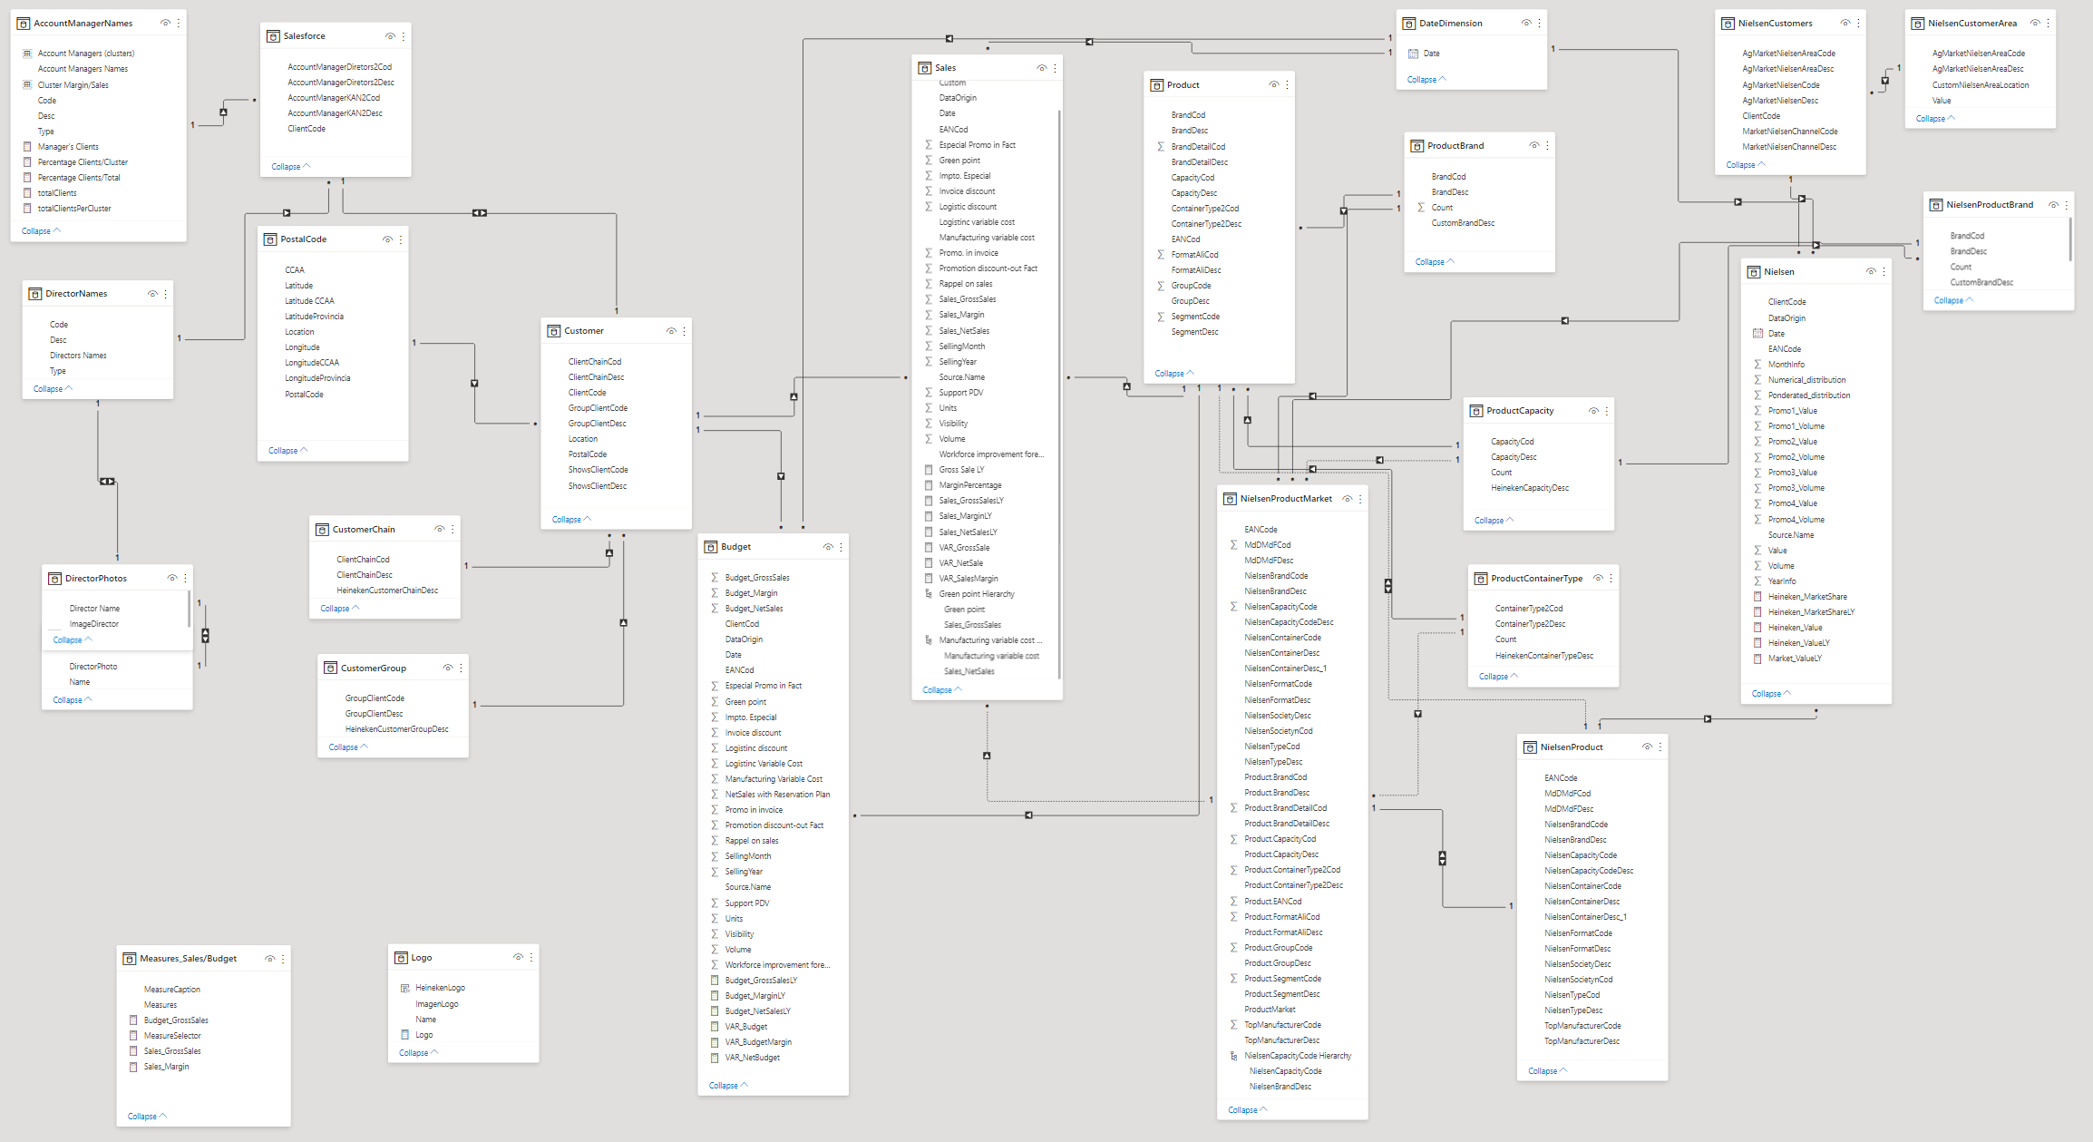

Slide 10
Dashboard

Slide 11
Recommendations

Slide 12
Insights
Recommendations
Budget Goal
Not Increasing Market Share
Main competitors losing Market Share
Small competitors penetrating the market with Premium and Craft Beers
Poor Market share in North and South of Spain
More Aggressive Budget Goal
Promote Best Selling Products
Target losing markets by offering Premium and Craft Beer as it represents a growing market
Focused Marketing Campaigns in North and South of Spain

Slide 13
Questions?

