Slide 1
GlucoTwin
A two-hour glucose event
research workspace
Team dev
J R Deva Dattan
Army Institute of Technology, Pune
Synthetic demo. Not for clinical decisions.
GlucoTwin / Research prototype
01

Slide 2
The review question
What changed, and can this
forecast be trusted?
Proposed user
Working interaction
A clinician reviewing a simulated Type 2 diabetes worklist.
Inspect the data available at a moment, advance replay, and compare the later outcome.
GlucoTwin / Research prototype
02
Notes:
Project scope: docs/approved-plan.md. No clinician interview or usability study has been performed.

Slide 3
The event definition
120 minutes
Two consecutive future readings above 180 mg/dL, sampled every 15 minutes.
Both readings must lie inside the future window.
A current value above 180 suppresses a new-event estimate.
Missing future observations mean the outcome is unknown.
Two readings span 15 minutes, not 30 minutes.
GlucoTwin / Research prototype
03
Notes:
Project-specific event protocol; threshold context: Battelino et al., International Consensus on Time in Range (2019), https://pubmed.ncbi.nlm.nih.gov/31177185/. The episode protocol is not an emergency definition or a treatment trigger.

Slide 4
Synthetic demonstration and real evidence
Browser demonstration
Retrospective benchmark
240 fictional people in training/evaluation. Four selected held-out illustrations in the interface. The generator deliberately uses static context.
100 adults, 109 sessions from ShanghaiT2DM. Separate models and aggregate results. No real records in the public app.
Real-data context: age and recorded gender only. Availability at baseline is assumed. All undated labs are excluded.
GlucoTwin / Research prototype
04
Notes:
Sources: model/README.md, model/REAL_BENCHMARK.md, public/model-evidence.json, model/real-benchmark-evidence.json. Zhao et al. (2023), https://doi.org/10.1038/s41597-023-01940-7.

Slide 5
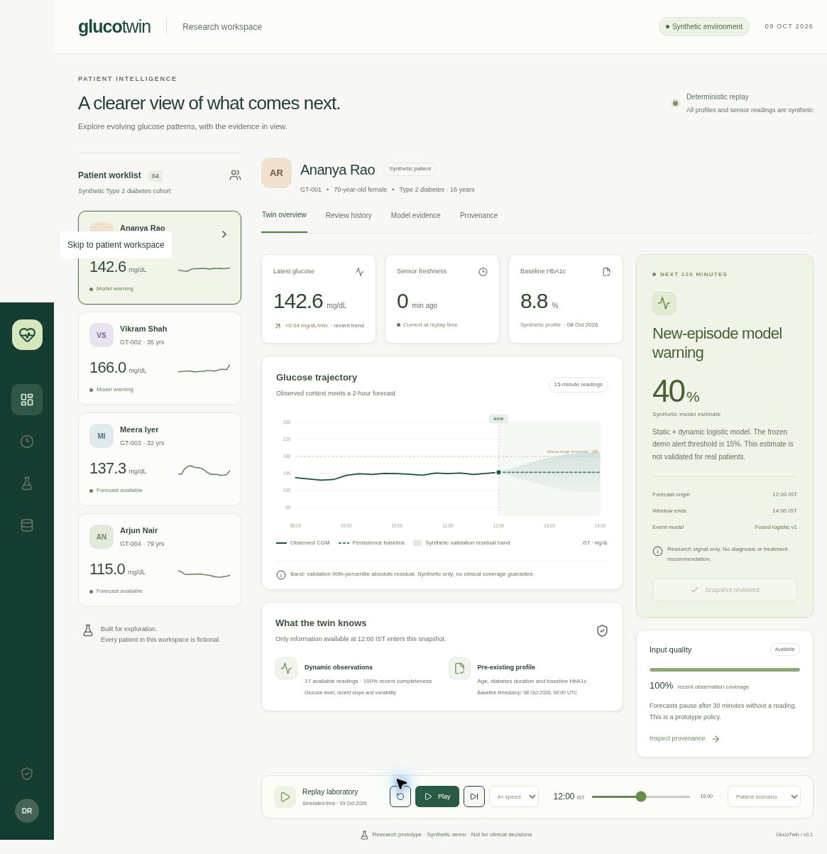
The working review loop
Actual app detail
Select a fictional patient.
Advance the replay.
Inspect the available inputs and evidence.
Synthetic profile and observations. Review actions stay in the current session.
GlucoTwin / Research prototype
05
Notes:
Implementation: src/App.tsx and src/lib/engine.ts. Session-only notes and acknowledgments never contact a clinical system. No live EHR or sensor connection.

Slide 6
Implemented architecture
Synthetic profile
and replay
Quality checks
and rolling state
Past-only
features
Replay reveals
observed outcome
Evidence and
review workspace
Event estimate +
separate trajectory
Offline Python training exports synthetic model JSON. A separate local pipeline produces real aggregate evidence.
GlucoTwin / Research prototype
06
Notes:
Implementation: src/lib/engine.ts, src/App.tsx, model/train.py, model/benchmark_real.py. Browser runs synthetic JSON coefficients; the real benchmark exports aggregates only.

Slide 7
The two model outputs have different jobs
Event estimate
Glucose chart
Logistic regression combines the last hour of glucose with synthetic age, diabetes duration, and pre-existing HbA1c.
Persistence holds the current glucose constant. Its descriptive bands come from validation residuals.
The chart and event estimate can disagree. The bands are not patient-specific clinical confidence intervals.
At 120 minutes, synthetic persistence MAE is 19.55 mg/dL versus 33.85 for the clipped trend.
GlucoTwin / Research prototype
07
Notes:
Sources: model/README.md and public/model-evidence.json. Synthetic persistence 120-minute MAE 19.55 mg/dL; clipped linear trend 33.85 mg/dL. The bands use validation 90th percentile absolute residuals; marginal coverage is measured per horizon.

Slide 8
Synthetic held-out results
48 test people / 30,248 eligible windows
PR-AUC
2.81
false alerts / patient-day
293 / 334 episodes warned
Median lead: 30 minutes
Window precision: 27.2%
Synthetic results demonstrate the implementation. The generator builds in a role for static context.
GlucoTwin / Research prototype
08
Notes:
Source: public/model-evidence.json; seed 20261009; split 144/48/48 people. Average precision is labeled PR-AUC. Threshold 0.15 selected on validation. Patient bootstrap uses 300 resamples; fused PR-AUC 95% interval 0.2731 to 0.3581. Generator-driven evidence only.

Slide 9
Real fusion gain remains uncertain
20 held-out people / 20,687 eligible windows
PR-AUC
+0.0024
Fused minus dynamic PR-AUC
Paired 95% interval
-0.00248 to +0.00758
Includes zero
This small retrospective study does not establish a meaningful benefit from fusion.
GlucoTwin / Research prototype
09
Notes:
Source: model/real-benchmark-evidence.json. ShanghaiT2DM v5, https://doi.org/10.6084/m9.figshare.21600933.v5, CC BY 4.0. 60/20/20 patient split; 20,687 eligible test windows. Average precision is labeled PR-AUC. Paired cluster bootstrap: 300 resamples of 20 test people.

Slide 10
Alert workload limits the real benchmark
2.97 false alerts
per recorded patient-day
302 / 326 forecastable episodes warned
Median lead: 45 minutes
754 false alerts
~254 recorded patient-days
28.9% window precision
Alerts use a 120-minute cooldown. Recorded-span time includes gaps and current-high periods.
GlucoTwin / Research prototype
10
Notes:
Source: model/real-benchmark-evidence.json, model/REAL_BENCHMARK.md. At threshold 0.20 chosen on validation: precision 0.289, recall 0.505, Brier 0.0787. 120-minute alert cooldown per recording. Episodes and alerts separately deduplicated; one alert may warn multiple episodes. Denominator is recorded-span time, including gaps and current-high periods.

Slide 11
Failure cases and boundaries
Visible failures
Limits before clinical use
Selected synthetic false positive and missed episode. Sensor dropout, cold start, invalid units, and disconnected feed withhold forecasts.
No prospective study, Indian-population validation, clinician usability study, live EHR integration, or treatment workflow.
Next research step: external validation with verified feature timing and clinician review of alert burden.
GlucoTwin / Research prototype
11
Notes:
Sources: public/model-demo.json, src/lib/engine.ts, model/test_model.py, model/test_real.py. UI requires nine samples; synthetic training requires at least five. Real benchmark requires 24 contiguous past/current samples. UI 30-minute stale limit is an engineering policy.

Slide 12
Reproducibility and contribution disclosure
Pinned dependencies, deterministic synthetic training, and browser parity tests.
Real source records stay outside the repository, video, and hosted app.
AI assistance covers design, implementation, evaluation, and documentation.
MIT code. CC BY 4.0 data, modified into features and aggregate results.
Zhao et al. (2023): doi:10.1038/s41597-023-01940-7
Dataset v5: doi:10.6084/m9.figshare.21600933.v5 / CC BY 4.0
Team dev / J R Deva Dattan / Army Institute of Technology, Pune
GlucoTwin / Research prototype
12
Notes:
Sources: README.md, model/README.md, model/REAL_BENCHMARK.md, docs/CONTRIBUTIONS.md, docs/THIRD_PARTY_NOTICES.md. Dataset: Zhao et al. (2023), https://doi.org/10.1038/s41597-023-01940-7; release https://doi.org/10.6084/m9.figshare.21600933.v5, CC BY 4.0 https://creativecommons.org/licenses/by/4.0/. Derived trailing features and aggregate evaluation are modifications.

