Slide 1
High-Frequency Trade Sign Classification
Deep Learning - Final Project
Jared Hansen, Matt Isaac, Kegan Penovich
23 April, 2019
Notes:
MATT

Slide 2
Outline
Problem & Motivation
Data
Baseline Models (forests and k-NN)
Neural Network Models (feedforward, LSTMs)
Conclusions & Future Work
Notes:
MATT

Slide 3
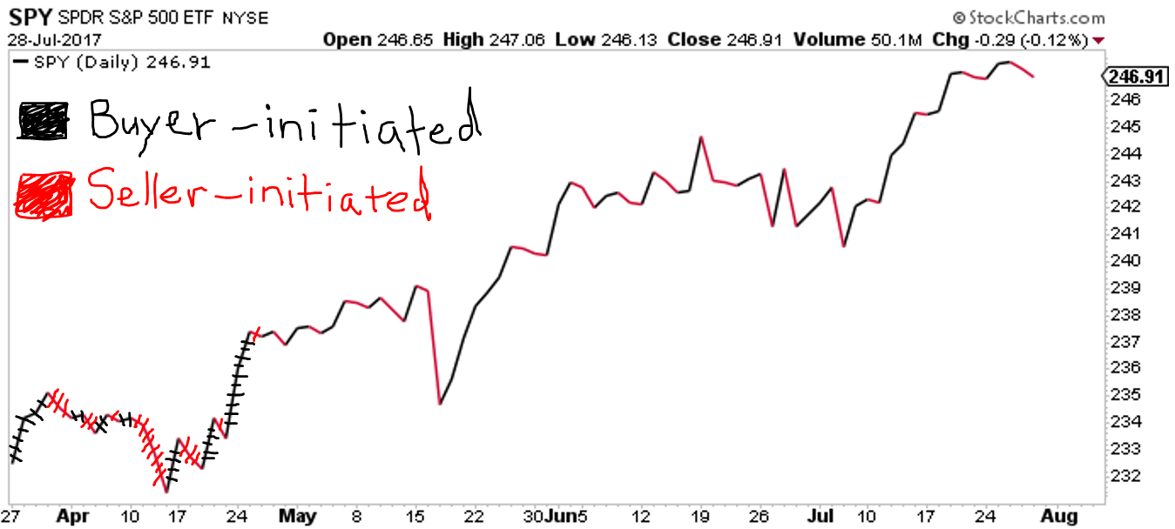
Problem and Motivation
PROBLEM: classify high-frequency trade (HFT) initiation
Notes:
JARED

Slide 4
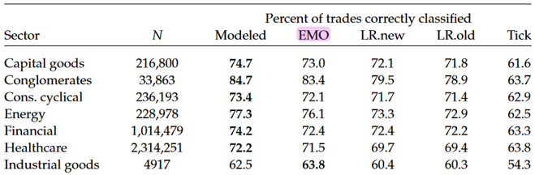
Problem and Motivation
MOTIVATION: Finance researchers often don’t have ITCH access, but need to know trade signs (liquidity measures, price-estimation models)
Target accuracy: surpass accuracies in Rosenthal’s 2012 “Modeling Trade Direction”

Slide 5
Data
ITCH data feed (Nasdaq product)
Dataset includes all 21 trading days in March 2018
10 Tickers (stocks)
AAOI (Applied Optoelectronics Inc.)
BABY (Natus Medical Inc.)
CA (CA Technologies)
DAIO (Data I/O Corporation)
EA (Electronic Arts Inc.)
FANG (Diamondback Energy Inc.)
GABC (German American Bancorp Inc.)
HA (Hawaiian Holding Inc.)
IAC (InterActiveCorp)
JACK (Jack in the Box Inc.)

Slide 6
Features
Feature | Size | Type | Description
Nanoseconds | 10^13 | int | Timestamp: nanoseconds since midnight of that trading day
Date | 10^7 | int | Given as “YYYYMMDD”
Match Num, Order Num | 10^5 10^7 | int int | Unique identifier, proxy for timestamp(?)
Tracking Num | 10^1 | int | Nasdaq-specific, generally values of 2, 4, 6, or 8
Price | 10^2 | float (.4f) | The limit order price (can differ from execution price)
Exec_Price | 10^2 | float (.4f) | The price at which execution occurred
Shares | 10^3 | int | The limit order number of shares (can differ from ex_shares)
Exec_Shares | 10^3 | int | The number of shares executed for the trade
Message Type P | 10^0 | binary | Indicates that trade executed against a hidden order
Message Type E | 10^0 | binary | Generic ‘order executed’ message
Notes:
JARED

Slide 7
Data - Preparation and Cleaning
10 stocks x 21 days = 210 text files
For each text file:
Remove all bids, asks, cancels, etc., leaving only executed trades
Convert to .csv file
Result: total of about 700,000 observations
Standardized within each variable (except the binary msg_type features) across each dataset, e.g.

Slide 8
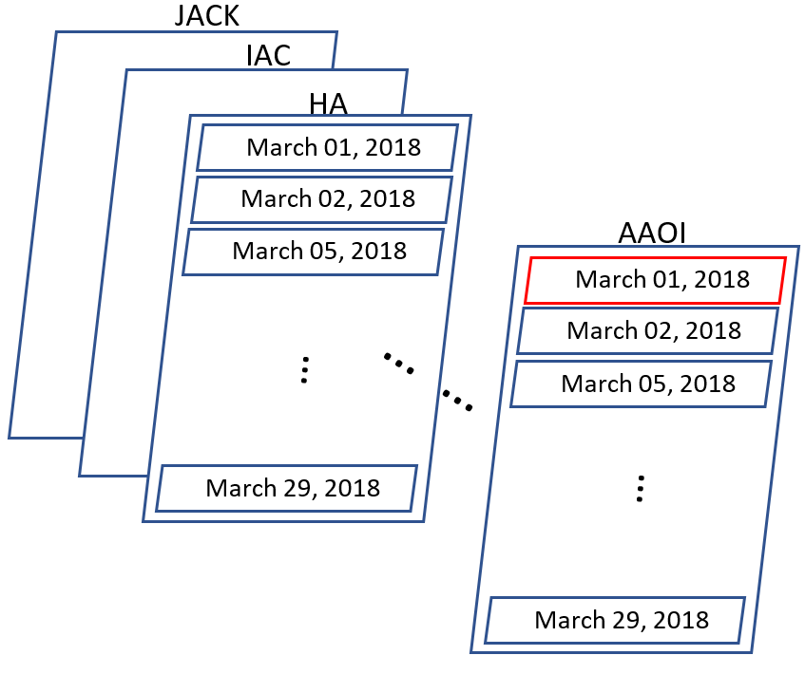
Data Aggregation
Two ways we aggregated the data for training:
One ticker, one day
One ticker, all days
Notes:
MATT

Slide 9
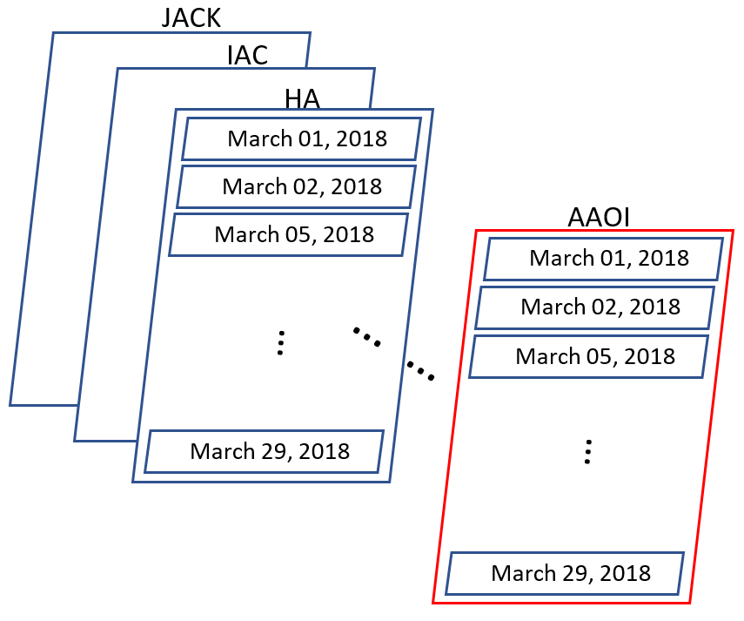
Data Aggregation
Two ways we aggregated the data for training:
One ticker, one day
One ticker, all days

Slide 10
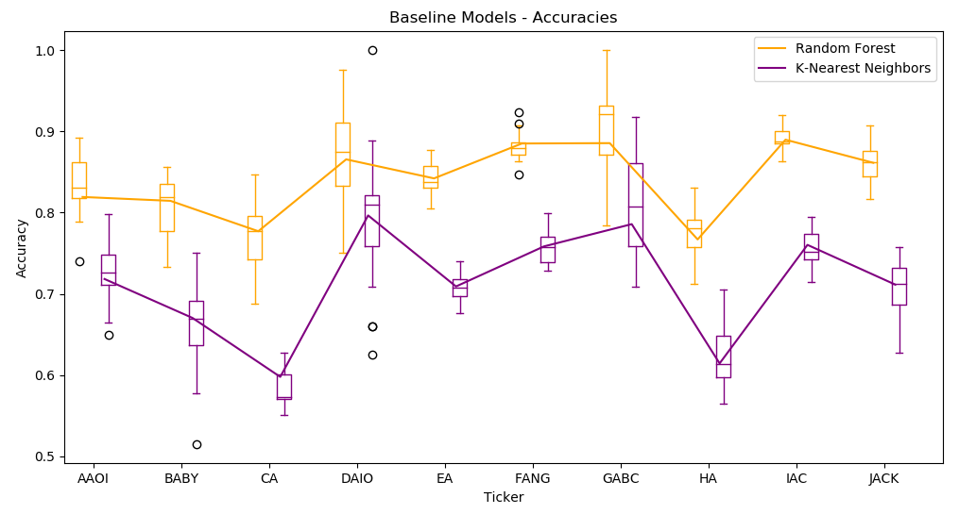
Baseline Models: k-NN & Random Forests
Notes:
Boxplots show ‘distribution’ of accuracies for 1 ticker/1 day trained RFs/KNN classifiers.
Lines show accuracies for one ticker/all days trained RFs/KNN classifiers
Noteable observations:
Aggregating seemed to give a relativley ‘middle of the road’ accuracy across the days.
RFs clearlydid better than Knn across the board.
Some tickers seem to just have more difficult signals to learn (lines seem to move together).

Slide 11
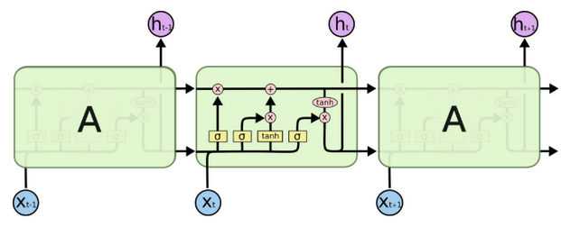
Bidirectional LSTM: Keras
Since there is a time series aspect to the data, we could consider a RNN. LSTM’s are the canonical choice for this kind of problem.
We do not need to take this into account for our stated purpose, but we can try it to see if it can assist.
Notes:
KEGAN

Slide 12
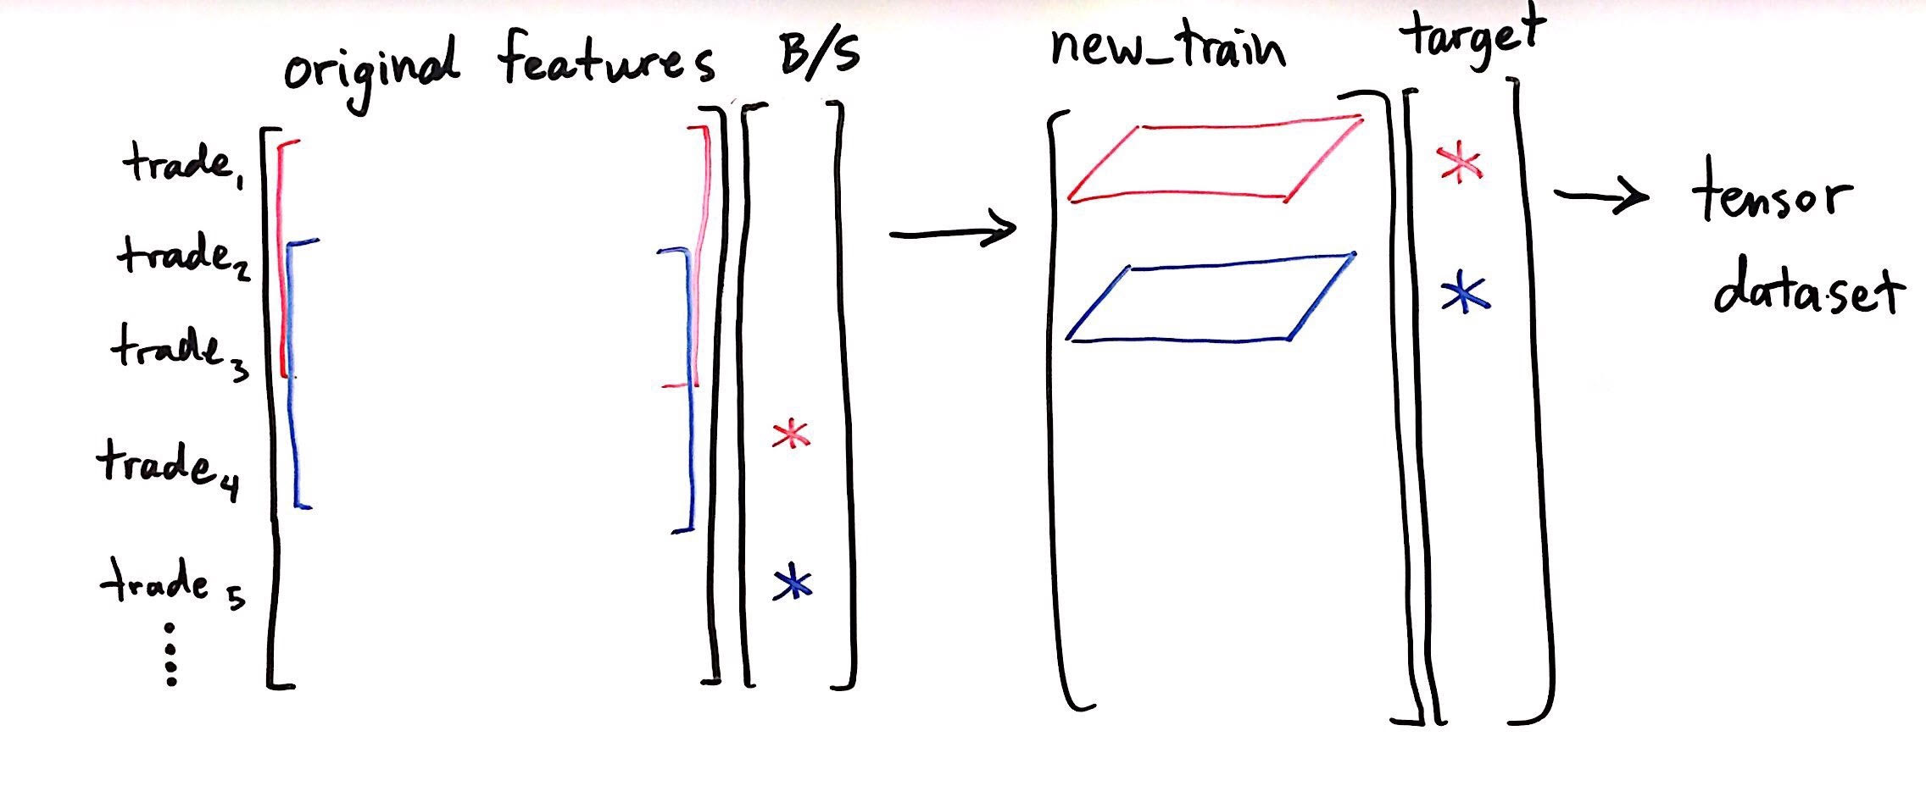
Better Leveraging B-LSTM
Data pre-processing: more predictive sequence inputs
Notes:
For efficiency purposes we need to break the series into subseries. Our input is then a batch of these sub series. We control the length of the subseries, and the overlap of the subseries. If you choose these correctly there is no need for padding in our case. The data is normalized and then split up as stated above.

Slide 13
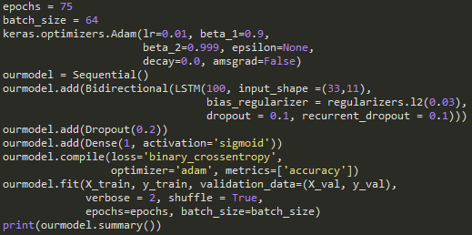
Bidirectional LSTM Architecture
We kept this very basic.
Single LSTM layer
Dropout = 0.2
Single dense layer = 100 neurons
Sigmoid output
BCE loss function
Adam optimizer (defaults)

Slide 14
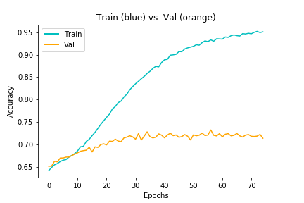
B-LSTM Results (w/out regularization)
A typical result (regardless of parameters) is in the low to mid 70’s.
There was a serious issue of over fitting that would happen.
Initial efforts to address this did reduce overfitting, but did not increase validation accuracy.

Slide 15
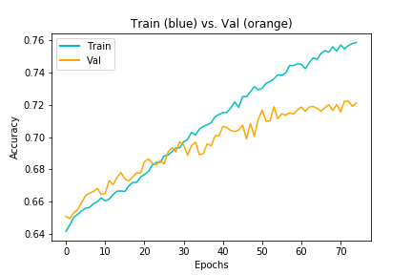
B-LSTM Results (w/regularization)
To deal with the overfitting we implemented some regularization techniques.
L2 Regularization (0.03)
Drop Out (0.1, 0.1, 0.2)
These drastically reduced overfitting, though it did not improve the validation accuracy.
Notes:
KEGAN

Slide 16

Bidirectional LSTM (PyTorch)
Amazing results! So good that they broke mathematical law
Unfortunately this wasn’t the case
Notes:
JARED

Slide 17
B-LSTM Architecture
Window_length = 10 (10 sequences of features data per buy/sell target)
Shift_by = 1 (maximizing utility of LSTM hidden & cell states)
2 hidden layers per cell, 128 neurons
1 output neuron, Sigmoid activation, round value to get 0 or 1
Cost = BCE
Learning rate = 0.001
Optimizer = Adam
Num_epochs = 4
Batch_size = 20
Notes:
JARED

Slide 18
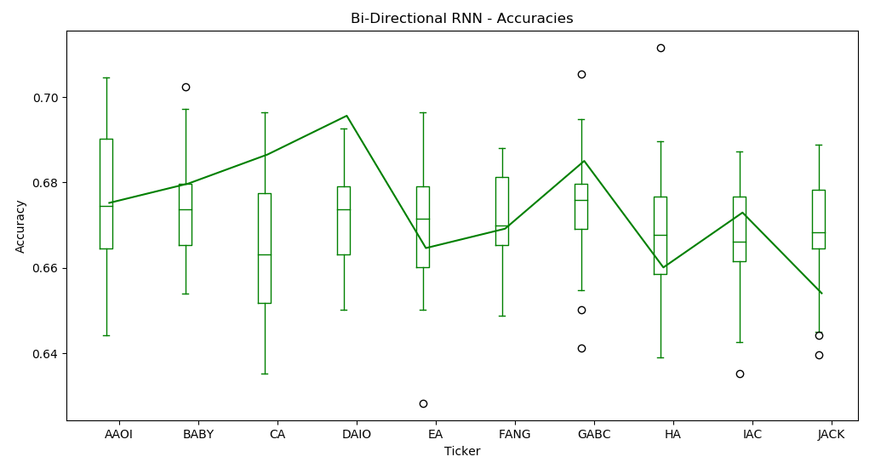
B-LSTM Test Accuracies (PyTorch)
Notes:
JARED

Slide 19
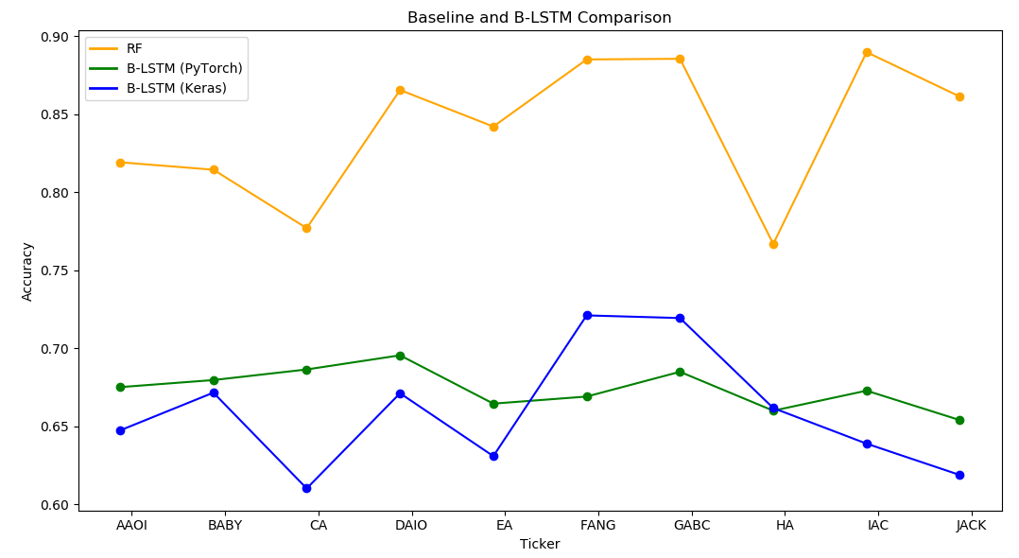
Model Accuracy Comparison
Notes:
KEGAN

Slide 20
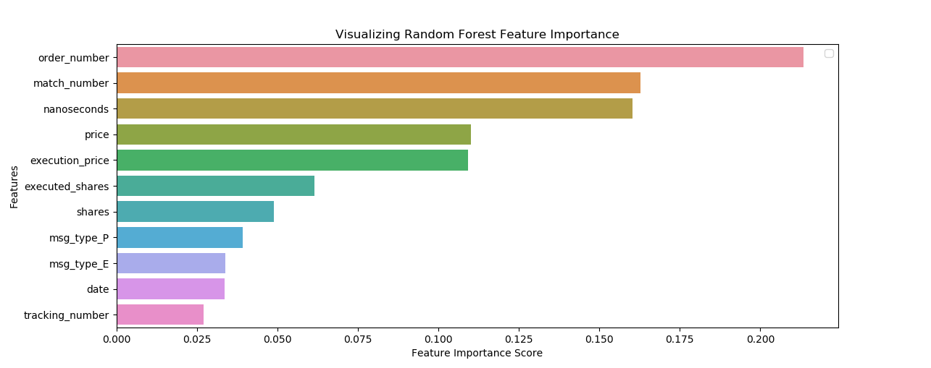
Conclusions
Forests: low investment, high return
Beat Rosenthal -- and previous methods’ -- accuracies !
B-LSTM implementation?
How do we know? → timestamp/proxy-for-timestamp features in RF feature importance vec
Notes:
MATT

Slide 21
Future Work
More exploration with B-LSTM model, modifying implementation, parameters
Transfer learning: predict onto TAQ data
Match Quotes data with Trades data (better features?)
Hierarchical B-LSTM to maximize info in Quotes data (multiple quotes per trade)
Notes:
JARED

