Slide 1

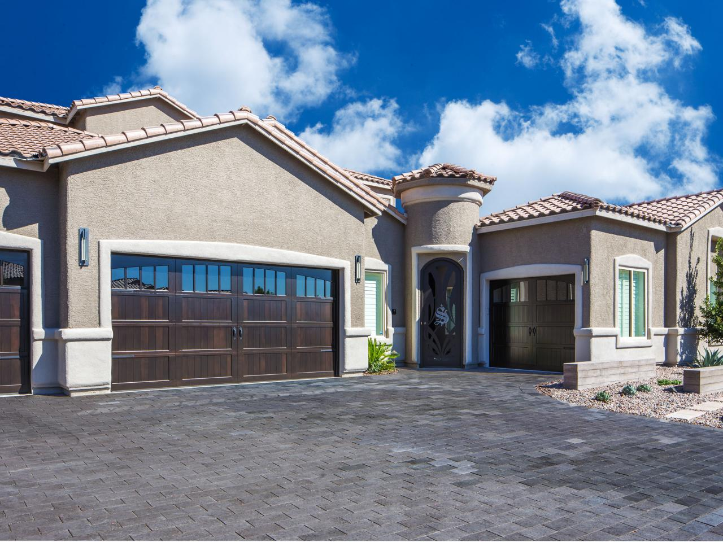


Sample Property, Baguio IL 2600
Jordan Cachero CCW Company 09261000883
This is the Front View of the House, isn't it very beautiful?
jrdncchr@gmail.com

Slide 2
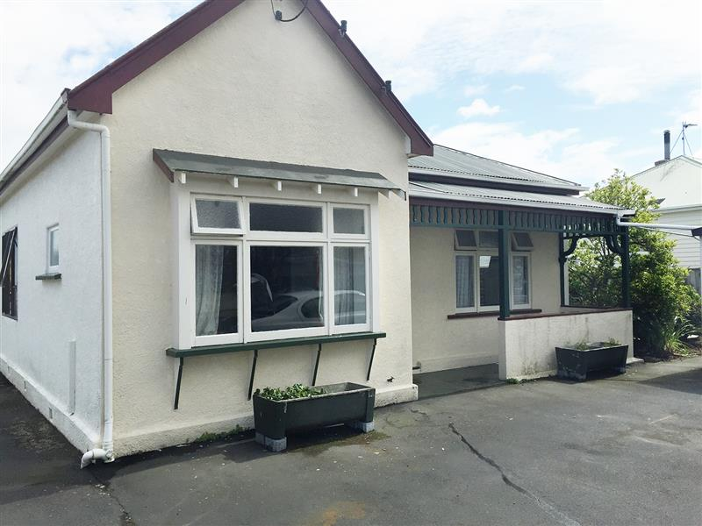
Sample Property, Baguio IL 2600
Jordan Cachero CCW Company 09261000883
This is the Back View of the House, isn't it very beautiful?
jrdncchr@gmail.com

Slide 3
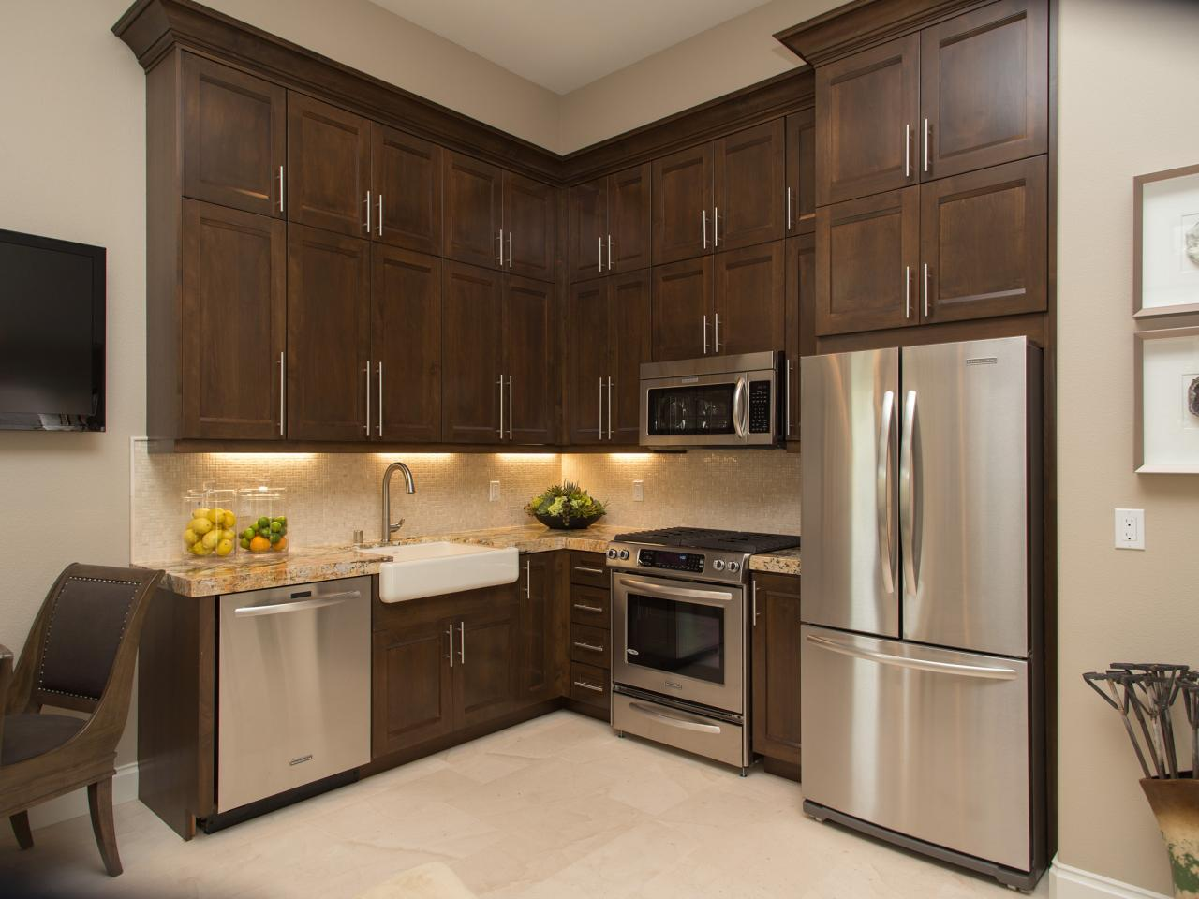
Sample Property, Baguio IL 2600
Jordan Cachero CCW Company 09261000883
This is the Kitchen of the House, isn't it very beautiful?
jrdncchr@gmail.com

Slide 4
Contact Jordan TODAY...
09261000883 jrdncchr@gmail.com

