Slide 1


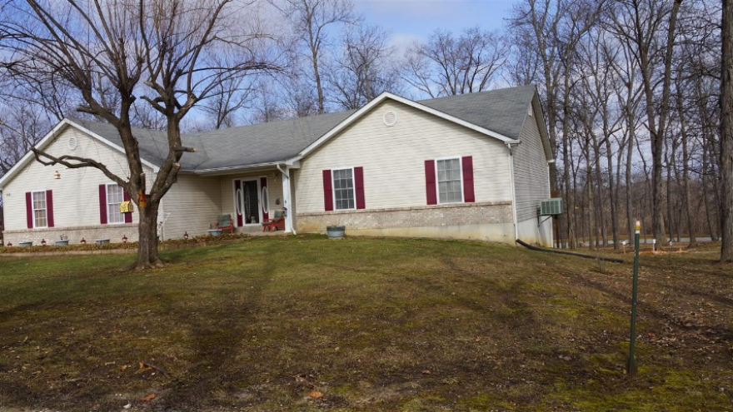



Sample Property, Baguio IL 2600
Jordan Cachero CCW Company 09261000883 jrdncchr@gmail.com
Front View of our Beautiful Home

Slide 2
Contact Jordan TODAY... 09261000883 jrdncchr@gmail.com
Jordan Cachero CCW Company 09261000883 jrdncchr@gmail.com

