Slide 1
Exploring the Heat Hypothesis: Temperature and Crime Rates in Manhattan
Investigating the Relationship Between Temperature and Crime (2013-2023)
(January 2025)
Dalton Schmidt
Jordan Thomas
Geovanni Rubio

Slide 2
Introduction
Background:
- The 'Heat Hypothesis' suggests that hotter temperatures increase the likelihood of more aggressive behavior.
- Previous studies demonstrate links between weather and crime rates.
Objective:
- Analyze the correlation between temperature and crime in Manhattan.
- Identify patterns in specific types of crime and temperature.

Slide 3
Research Questions
1. Is there a relationship between crime and temperature in Manhattan?
2. Does temperature increase the likelihood of certain kinds of crime?
3. How might current events (e.g., pandemic, policy changes) act as confounding variables?
4. Do observed patterns remain consistent across different years?

Slide 4
Datasets
Temperature Data: OpenMeteo API
- Data range: 01/01/2013 - 12/31/2023
- Coverage: Five distinct neighborhoods in Manhattan
Crime Data: City of New York Complaint Data API
- Crime records from 2013 to 2023
- Types of crimes: violent crimes, property crimes, theft, etc.

Slide 5
Methodology
1. Data Collection:
- Fetch temperature data using OpenMeteo API.
- Extract crime data from the NYPD Complaint Data API.
2. Data Transformation:
- Clean and organize data using Python and Pandas.
- Ensure alignment of datasets by date and location.
3. Analysis Techniques:
- Generate Line & Scatter Plot visualizations using Plotly.
- Create interactive maps with GeoJSON and Leaflet.
- Conduct statistical analyses to explore correlations.

Slide 6
Data Visualization Tools
Plotly: For creating interactive charts (line graphs, scatter plots).
GeoJSON + Leaflet: For interactive mapping.
Examples:
- Crime density by neighborhood.
- Seasonal crime trends overlayed with temperature data.

Slide 7
Statistical Analysis Plan
Correlation Analysis:
- Measure the linear relationship between temperature and crime rates.
- Identify threshold temperatures associated with increased crime.
Hypothesis Testing:
- Null Hypothesis: No correlation exists between temperature and crime.
- Alternative Hypothesis: Higher temperatures correlate with increased crime rates.

Slide 8
Preliminary Findings
Crime Types:
- Initial data suggests higher rates of violent crimes on hotter days.
Seasonality:
- Crime trends peak during summer months.
Neighborhood Patterns:
- Variation in crime-temperature relationship across neighborhoods.

Slide 9
Challenges & Considerations
Confounding Variables:
- Economic factors, public policies, major events.
Data Transformation:
- Ensuring consistency between datasets (e.g., date formats).

Slide 10
Results & Analysis
Correlation Analysis:
- Crime and Data show an independent upward trend overtime.
- Initial data analysis shows a correlation of some form but a lack of strong relationship.

Slide 11
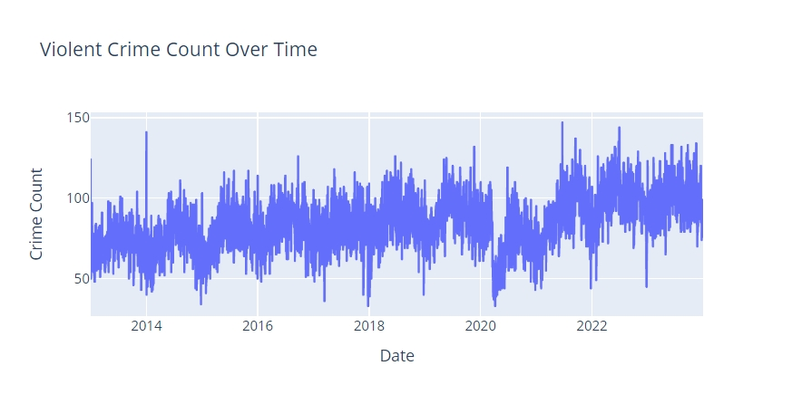

Slide 12
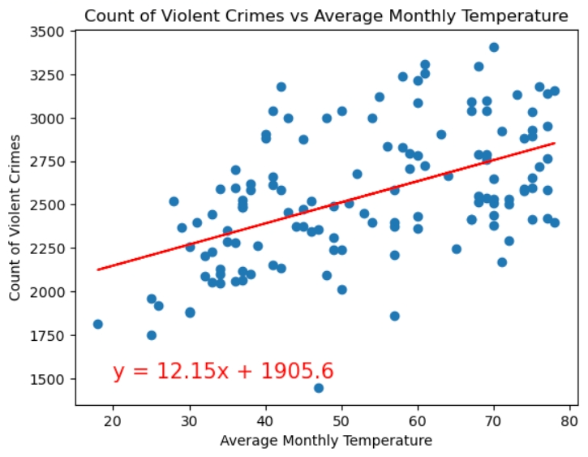

Slide 13
Conclusion
Key Takeaways:
- Preliminary analysis supports the Heat Hypothesis.
- Crime patterns vary significantly by neighborhood and crime type.
- Relationship is not statistically significant but results suggest further study is needed.
-

Slide 14
Q&A
Thank you!
Please feel free to ask any questions.

