Slide 1

Brief Overview of LLMs, and RAG, Plus Optional Content on AI Agents
April 23, 2025
Scalable Computational Intelligence
Texas Advanced Computing Center (TACC)

Slide 2
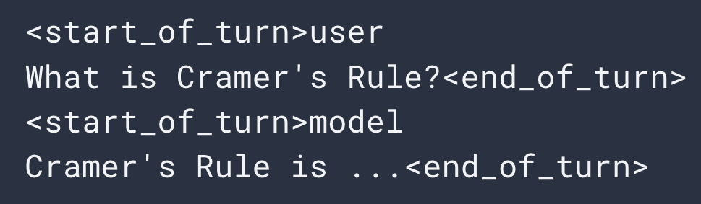
LLM is just text in and text out
Prompt
Background Information: My name is Dr. Orange Instructions: Write a poem that exactly rhymes with my name
As I sat 000000000000000000 000000000000000000000000
Background Information: My name is Dr. Orange Instructions: Write a poem that exactly rhymes with my name
As I sat under0000000000000 000000000000000000000000
Background Information: My name is Dr. Orange Instructions: Write a poem that exactly rhymes with my name
00000000000000000000000000000000000000000000000000
Background Information: My name is Dr. Orange Instructions: Write a poem that exactly rhymes with my name
As00000000000000000000000000000000000000000000000
Gemma 2 - Instruct
Background Information: My name is Dr. Orange Instructions: Write a poem that exactly rhymes with my name
As I000000000000000000000 000000000000000000000000
LLMs convert words or partial words to ids called tokens
Context window or context length is the maximum number of tokens an LLM will accept as input
LLM generation is recursive, so your output token amount is limited to:
Input tokens
Context window
(e.g. 8k tokens)
Mutli-turn conversations are just recorded as one long prompt with special tokens demarcating user and agent messages
The “Instruct” versions of models have been fine-tuned to understand this convention
LLM
$$\max{output tokens= }context window −input tokens$$
under
sat
As
I

Slide 3
Retrieval Augmented Generation (RAG)
Prompt
What is the typical dust mass density distribution start systems with only one planet?
Prompt
What is the typical…
Relevant Papers
{paper 1 text}
{paper 2 text}
Embedding Vector [.5, .36,…]
Find most similar vectors
Abstract 1 Vector [.02, .60,…]
Paper Database
Abstract 2 Vector [.23, .44,…]
Abstract N Vector [.72, .97,…]

Slide 4
Capabilities and Limitations of LLMs and RAG
Large Language Models (LLMs) excel at generating human-like text for creative or general tasks, like storytelling or summarization, but they're limited by static training data that can become outdated
Retrieval-Augmented Generation (RAG) enhances LLMs by pulling real-time external data, solving accuracy issues in knowledge-intensive queries such as medical advice or current events.
RAG improves factual grounding via retrieval but falters on aggregate analysis across large corpora —e.g., counting how many of 1,000 papers cite a specific author requires parsing, and aggregating metadata, which static retrieval can't handle.

Slide 5
Extra Slides

Slide 6
How fast can I run my model?
A little faster than you can read!
 |  | iPhone 16 Pro Max | Macbook Pro | Vista GPU node | Tejas
Model Family | # of Parameters | tokens/s | tokens/s | tokens/s | tokens/s
Qwen3 | 1.7 billion | 13 | 73 | 313 | -
Llama3.1 | 8 billion | - | 25 | 173 | 1001
Qwen3 | 30 billion | - | 36 | 130 | -
DeepSeek-R1 | 70 billion | - | - | 36 | -
DeepSeek-R1 | 671 billion | - | - | - | 135
Time to generate 100,000 tokens for agentic workloads:
4 hours
40 minutes
10 minutes
2 minutes
Laptop is ~6x faster than phone
1 Vista GPU is ~4x faster than laptop
Tejas is ~5x faster than 1 Vista GPU

Slide 7
What are AI agents?
AI Agent Definition: “An artificial entity capable of perceiving its surroundings using sensors, making decisions, and then taking actions in response using actuators.”
The decision-making core of modern AI agents is either a reinforcement learning (RL) algorithm, or a LLM
RL-based agents can struggle with complex tasks and their decision making can be inscrutable
e. g. in long-horizon tasks where the rewards during policy search are rare, the training times become extreme
LLM-based agents utilize goal decomposition to break down goals into smaller subgoals
LLM can act as a planner
decides what action to take for a given subgoal
actions can be simple LLM tasks or external API calls to other software
Z. Xi et al. “The Rise and Potential of Large Language Model Based Agents: A Survey” arXiv (2023)

Slide 8
Key functionalities an agent needs
Planning and/or Reasoning through goal decomposition
Goal decomposition: LLM writes a todo list
ReAct: LLM iteratively decided next best step
Acting through “tool” use
LLM writes a command to trigger another piece of software
Sensing current state of surroundings
automatic snapshot of agent working area using software
Memory retrieval
Vector store/search
Retrieval augmented generation (RAG)

Slide 9
LLM agent - goal decomposition and tool use example
LLM Planner
Goal
Relevant Memory
List of available tools
[{‘Tool name’, ‘tool description’}, …]
List of past actions and results
[{‘Action summary’, ‘result summary’}, …]
User input text:
Look up the current weather at the Keck Observatory
Memories

Slide 10
LLM agent - goal decomposition and tool use example
LLM Planner
Goal
Relevant Memory
LLM prompt:
Your goal is: {goal}
Relevant memories: {memories}
Break up your goal into smaller subgoals
Memories

Slide 11
LLM agent - goal decomposition and tool use example
LLM Planner
Goal
Action Plan:
Use Tool: Search Engine to find information Keck Observatory location
Use Tool: Weather API to find weather at location
Relevant Memory
Memories

Slide 12
LLM agent - goal decomposition and tool use example
LLM Planner
Goal
Relevant Memory
LLM prompt:
Your goal is: {goal}
Relevant memories: {memories}
Action plan: {action plan}
Perform step 1
LLM prompt:
Your goal is: {goal}
Relevant memories: {memories}
Break up your goal into smaller subgoals
Memories

Slide 13
LLM agent - goal decomposition and tool use example
LLM Planner
Tool
Goal
API call to search engine with input “Keck Observatory”
Relevant Memory
Memories
Continue through whole action plan…

Slide 14
LLM agent - goal decomposition and tool use example
LLM Planner
Final output text:
Keck Observatory is located on the summit of Mauna Kea where the current weather is 16°C
Goal
Relevant Memory
Memories

Slide 15
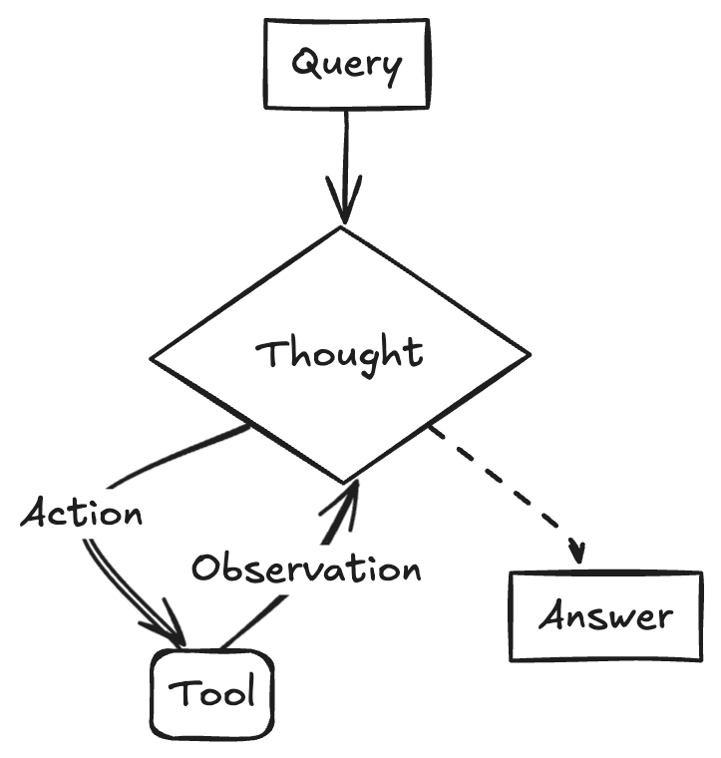
ReAct
ReAct agents are AI systems that combine reasoning and action to solve problems by analyzing tasks and interacting with their environment.
They operate in a loop of reasoning, acting, and observing, allowing for dynamic decision-making and real-time adjustments based on feedback.
Contrasting ReAct agents with goal decomposition, ReAct agents only think 1 step ahead when reasoning. If they choose to execute an action they next ingest those results and reason on the next best step.

Slide 16
LLM agent – ReAct and tool use example
LLM Brain
Goal
Relevant Memory
List of available tools
[{‘Tool name’, ‘tool description’}, …]
List of past actions and results
[{‘Action summary’, ‘result summary’}, …]
User input text:
Look up the current weather at the Keck Observatory
Memories

Slide 17
LLM agent – ReAct and tool use example
LLM Brain
Goal
Relevant Memory
LLM prompt:
Your goal is: {goal}
Relevant memories: {memories}
Indicate what you should do next to solve this problem
Memories

Slide 18
LLM agent – ReAct and tool use example
LLM Brain
Goal
Next Step:
Use Tool: Search Engine to find information Keck Observatory location
Relevant Memory
Memories

Slide 19
LLM agent – ReAct and tool use example
LLM Brain
Goal
Relevant Memory
LLM prompt:
Your goal is: {goal}
Relevant memories: {memories}
Next step: {Next tool call}
Perform requested tool call.
LLM prompt:
Your goal is: {goal}
Relevant memories: {memories}
Break up your goal into smaller subgoals
Memories

Slide 20
LLM agent – ReAct and tool use example
LLM Brain
Tool
Goal
API call to search engine with input “Keck Observatory”
Relevant Memory
Memories

Slide 21
LLM agent – ReAct and tool use example
LLM Brain
Goal
Relevant Memory
LLM prompt:
Your goal is: {goal}
Relevant memories: {memories… including keck observatory is located in Maunaki, Hawaii}
Indicate what you should do next to solve this problem
Memories

Slide 22
LLM agent – ReAct and tool use example
LLM Brain
Goal
Next Step:
2. Use Tool: Weather API to find weather at location
Relevant Memory
Memories

Slide 23
LLM agent – ReAct and tool use example
LLM brain
Tool
Goal
API call to get weather in Hawaii
Relevant Memory
Memories
Continue until LLM brain decides to send message back to user.

Slide 24
LLM agent – ReAct and tool use example
LLM Brain
Final output text:
Keck Observatory is located on the summit of Mauna Kea where the current weather is 16°C
Goal
Relevant Memory
Memories

Slide 25
Capabilities of LLM-based agentic systems
LLMs can only directly provide solutions to word problems
knowledge retrieval
structure unstructured text
generate code
classify text/images
solve logic puzzles (given X what should I do next?)
Most of what agents do is autonomously execute existing software
How to build an agent checklist
How do I organize the information that I send to the LLM so that it can solve my problem?
How much text can I input and generate at once?
How fast can I run my model?
What software do I need to write for my agent to use?

